Slide 1
Fundamentals of Programming (part2)
Introduction to HTML

Slide 2
Learning Objectives
What is HTML?
History of HTML
Basic HTML Code Structure
Basic tags of HTML

Slide 3
What is HTML?
Hyper Text Markup Language
HTML stands for __________________________
HTML is a markup language
A markup language is a set of markup _____
The tags describe document content
HTML documents contain HTML tags and plain text
HTML documents are also called __________
tags
web pages
Notes:
So now you all know about html and http. What are the diff?
HTTP is the TCP/IP protocol used to deliver webpages from servers to clients, whereas HTML is the formatting language used to design webpages.

Slide 4
History of HTML
Since the early days of the web, there have been many versions of HTML:
Version | Year
HTML | 1991
HTML+ | 1993
HTML 2.0 | 1995
HTML 3.2 | 1997
HTML 4.01 | 1999
XHTML 1.0 | 2000
HTML 5.0 | 2012
XHTML 5.0 | 2013

Slide 5
History of HTML
XHTML
stands for EXtensible Hyper Text Markup Language
almost identical to HTML 4.01
a stricter and cleaner version of HTML 4.01
tags must be lower case
HTML 5.0
advanced version of HTML
offline data storage, ability for visitors to edit sections of web pages.
<video> and <audio> tags for media playback
support for local storage
new content-specific elements, like <article>, <footer>, <header>, <nav>, <section>
new form controls, like calendar, date, time, email, url, search

Slide 6

Basic HTML Structure
<!DOCTYPE html PUBLIC "-//W3C//DTD XHTML 1.0 Transitional//EN" "http://www.w3.org/TR/xhtml1/DTD/xhtml1-transitional.dtd">
<html>
<head>
<title>HTML Basics for Fun and Profit</title>
</head>
<body>
<h1>Welcome to my first webpage</h1>
<hr/>
<p>This is a paragraph.</p>
</body>
</html>
Declaration (optional)
Head
Root
Body
EXAMPLE

Slide 7
<!DocType> Declaration
Must be the very first line of your file
Tells the browser what version of HTML to expect
HTML 5.0
<!DOCTYPE html>
XHTML 1.0
<!DOCTYPE html PUBLIC "-//W3C//DTD XHTML 1.0 Transitional//EN" "http://www.w3.org/TR/xhtml1/DTD/xhtml1-transitional.dtd">
HTML 4.01
<!DOCTYPE HTML PUBLIC "-//W3C//DTD HTML 4.01 Transitional//EN" "http://www.w3.org/TR/html4/loose.dtd">
Notes:
HTML Elements Valid DOCTYPES (w3schools.com)

Slide 8

Which of these are correct?
<!doctype html>
<!DOCTYPE HTML>
Notes:
Both are correct as HTML 5 is case insensitive

Slide 9
HTML – Required Tags
<html> … </html> (Required)
identify portion of file that contains HTML
<html> is an opening tag
</html> is a closing tag (note the direction of the slash!)
text between the opening and closing tag is called the “content”
<head> … </head> (Required)
placed at the top of document immediately after the <html> tag
tags information about the document, e.g. author, style, etc.
contains the required document <title>...</title> tag

Slide 10
HTML – Required Tags
<title> … </title>
included as an element inside the <head>…</head> section
element of this tag is the title displayed in title bar of the browser
may also be used as title of page when page is bookmarked
<body> … </body> (Required)
included as the second element inside the <html>…</html> tags.
follows the <head>…</head> portion of the document
contains the information to be displayed in the browser window
any attributes set on this tag will apply to the entire page
Notes:
For title, even w

Slide 11

Whenever you create a webpage, always type in the basic structure first!
<html>
<head><title></title></head>
<body>
</body>
</html>

Slide 12
Which of these is not a HTML tag
<head>
<title>
<body>
<foot>

Slide 13
HTML Elements
Starts with a start tag / opening tag
Ends with an end tag / closing tag
The element content is everything between the start and the end tag
Elements may have empty content
Elements can have attributes
Most HTML elements can be nested (can contain other HTML elements).

Slide 14

Opening tag
<body>
….
</body>
Content
Closing tag
(Note the /)
There are some elements without closing tags, example:
New line <br/>
Horizontal line <hr/>

Slide 15

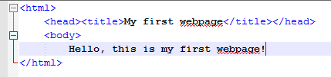
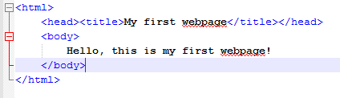
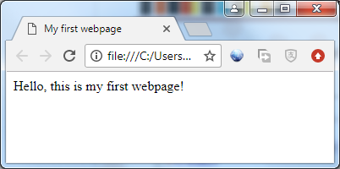
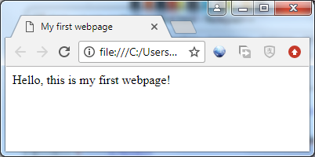
Hands On Time!
What is the difference between the left and right side?
Notes:
Let students know that the browser is very forgiving on syntax, even if sometimes the ending tag is omitted, the page may still display accordingly. But it does not mean the code is correct. Emphasize to students that marks WILL BE DEDUCTED during quizzes if the syntax is wrong (ie missing end tag) even if it is still displayed correctly on the browser.

Slide 16
HTML Elements
HTML Block elements
Block level elements normally start (and end) with a new line when displayed in a browser.
Examples: <h1>, <p>, <ul>, <table>
HTML Inline elements
Inline elements are normally displayed without starting a new line.
Examples: <b>, <td>, <a>, <img>
EXAMPLE
Notes:
The <span> tag is another type of inline element used to mark up a part of a text, or a part of a document.

Slide 17
HTML Attributes
Attributes provide additional information about the element
Attributes are always specified in the start tag
In a well-formed HTML document, the value of attribute should be quoted.
Attributes come in name/value pairs like: id=“para1”
Name
Value
Notes:
Html attribute of the additional info put in the tag. Like <h1 id=“firstpara”> </h1> <span style=“color:blue”></span>

Slide 18
Attribute NAME
Note the opening & closing quotes
<body id=“main”>
….
</body>
Attribute VALUE

Slide 19
HTML Attributes
MOST of HTML elements can have:
id | Unique identifier for that element (on a page)
name | Identifier for that element (on a page)
class | A classname for an element (more shortly)
title | Tooltip text
style | Inline CSS (more shortly)

Slide 20
Id is like your admin no
(must be different among everyone)
Name is your name
(you can have the same name as your friend)

Slide 21
HTML <div> Element
Block level element that defines a generic container in HTML
Allows us to group other HTML elements
Example, a section in a document that will be displayed in blue:
When we learn CSS, styles can be applied to div
<div style="color:#0000FF"> <h3>This is a heading</h3> <p>This is a paragraph.</p> </div>
EXAMPLE

Slide 22
HTML <span> Tag
The <span> tag is used to group inline-elements in a document.
The <span> tag provides no visual change by itself.
The <span> tag provides a way to add a hook to a part of a text or a part of a document.
Example, a <span> element used to color a part of a text:
<p>My mother has <span style="color:blue">blue</span> eyes.</p>
EXAMPLE
Notes:
Inform students that CSS will be covered later, no need to be stressed if they do not understand it now. It is just to illustrated the use of span tag.

Slide 23
Hands On Time!
The tags <h1> to <h6> are used to create heading text
Discuss!
Which heading is the largest and which is the smallest?
Notes:
H1 biggest

Slide 24
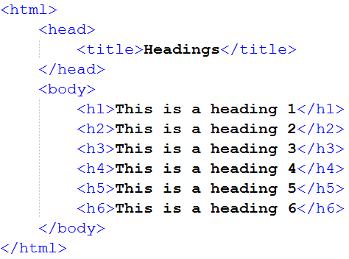
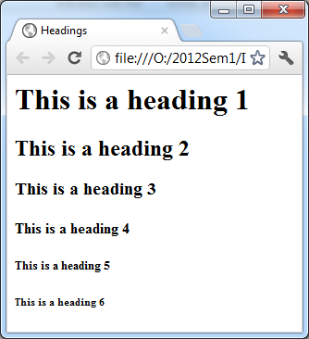
Heading
The tags <h1> to <h6> are used to create heading text

Slide 25
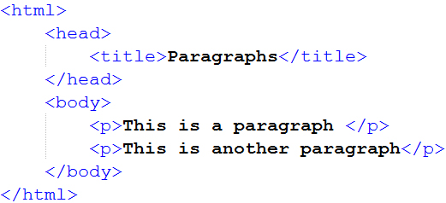
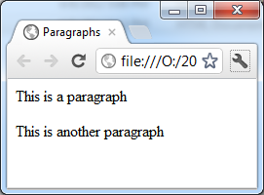
Paragraph
The <p> tag is used to group text together
Allows attributes and formatting styles to be applied to entire sections of text

Slide 26
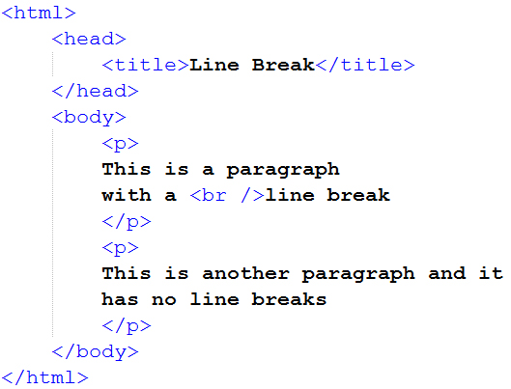
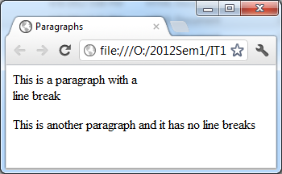
HTML Line Breaks
Use the <br /> tag if you want a line break (a new line) without starting a new paragraph

Slide 27
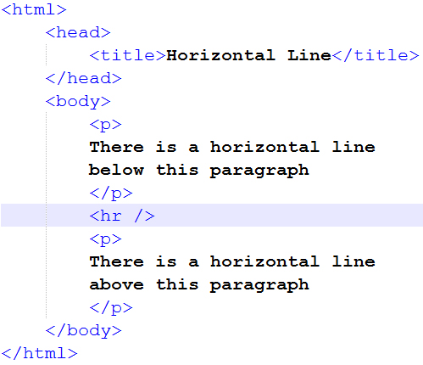
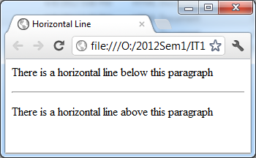
Horizontal Rule
To add a horizontal line to the Web page (for dividing sections, etc.), we use the <hr/> tag

Slide 28
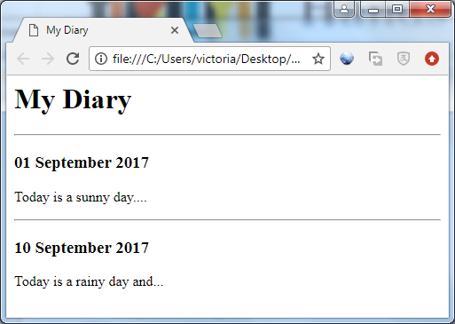
Hands On Time!
Discuss which HTML element is used to create the following content:
Heading - h1
Heading - h3
Horizontal rule - hr
Paragraph - p
Heading - h3
Paragraph - p

Slide 29
Name one of the HTML tag you have learnt today!
Notes:
Both are correct as HTML 5 is case insensitive

Slide 30

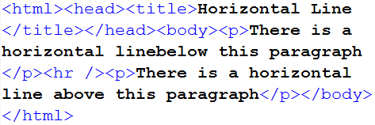
Please indent your codes…
Although you can write all your codes in one big chunk and it will still look the same in browser…
PLEASE DON’T…
No Indent
Indent
Notes:
Emphasize to students the importance of indenting the codes for ease of reading and understanding. Make it a habit now.

Slide 31
Summary
HTML is the universal markup language for the Web.
HTML lets you format text, add graphics, create links, input forms, frames and tables, etc., and save it all in a text file that any browser can read and display.
The key to HTML is the tags, which indicates what content is coming up.

Slide 32

Learning Objectives
What is HTML?
History of HTML
Basic HTML Code Structure
Basic tags of HTML

Slide 33
Discussion
What can HTML be used for everybody?
How can the understanding of HTML tags help in my daily lives?

