Slide 1
Fundamentals of Programming (part3) Web page Construction

Slide 2
Learning Objective
Able to format text
Understand directory structure in order to access files
Adding images to the web page
Adding hyperlinks

Slide 3
Text Formatting
HTML Tag | Purpose
<b>…</b> | Defines bold text
<strong>…</strong> | Defines strong text (similar to bold)
<i>…</i> | Defines italic text
<em>…</em> | Defines emphasized text
<u>…</u> | Defines underlined text
<big>…</big> | Defines big text
<small>…</small> | Defines small text
<sub>…</sub> | Defines subscripted text
<sup>…</sup> | Defines superscripted text
<ins>…</ins> | Defines inserted text
<del>…</del> | Defines deleted text

Slide 4

HTML tags are usually very descriptive of what their function is
italic = <i>
bold = <b>
subscript = <sub>

Slide 5
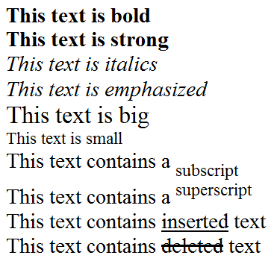
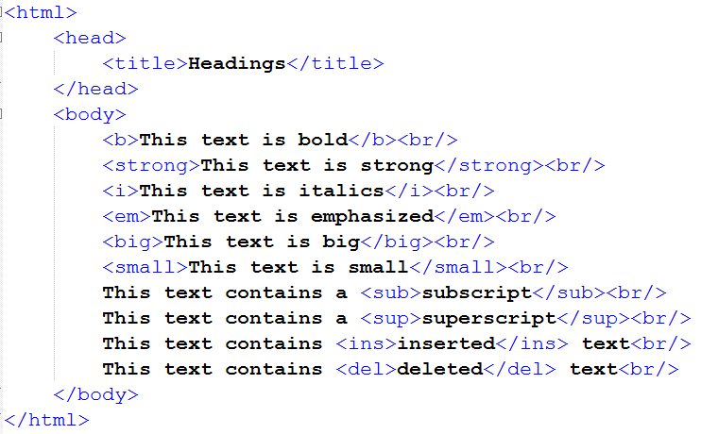
Text Formatting

Slide 6

Hands On Time
Google
What is the difference between <b> and <strong>, <i> and <em>?
Notes:
The <strong> element is for content that is of greater importance, while the <b> element is used to draw attention to text without indicating that it's more important.
They have the same effect on normal web browser rendering engines, but there is a fundamental difference between them.
As the author writes in a discussion list post:
Think of three different situations:
web browsers
blind people
mobile phones
"Bold" is a style - when you say "bold a word", people basically know that it means to add more, let's say "ink", around the letters until they stand out more amongst the rest of the letters.
That, unfortunately, means nothing to a blind person. On mobile phones and other PDAs, text is already bold because screen resolution is very small. You can't bold a bold without screwing something up.
<b> is a style - we know what "bold" is supposed to look like.
<strong> however is an indication of how something should be understood. "Strong" could (and often does) mean "bold" in a browser, but it could also mean a lower tone for a speaking program like Jaws (for blind people) or be represented by an underline (since you can't bold a bold) on a Palm Pilot.
HTML was never meant to be about styles. Do some searches for "Tim Berners-Lee" and "the semantic web." <strong> is semantic—it describes the text it surrounds (e.g., "this text should be stronger than the rest of the text you've displayed") as opposed to describing how the text it surrounds should be displayed (e.g., "this text should be bold").

Slide 7
Character Entities
Some characters or sequence of characters (e.g. < or <b>, <i>) have special meaning in HTML
If we want the browser to actually display these special characters, we must insert character entities in the HTML source
A character entity has three parts:
an ampersand (&)
an entity name or a # and an entity number
a semicolon (;)
Notes:
HTML Entities (w3schools.com)

Slide 8
Common Character Entities
Character | Description | Entity Name | Entity No.
 | non-breaking space | &nbsp; | &#160;
< | less than | &lt; | &#60;
> | greater than | &gt; | &#62;
& | Ampersand | &amp; | &#38;
" | quotation mark | &quot; | &#34;
' | apostrophe |  | &#39;
Notes:
HTML Entities (w3schools.com)
So we can either call out the

Slide 9
Common Character Entities
Character | Description | Entity Name | Entity No.
¢ | cent | &cent; | &#162;
£ | Pound | &pound; | &#163;
¥ | Yen | &yen; | &#165;
§ | Section | &sect; | &#167;
© | Copyright | &copy; | &#169;
® | Registered trademark | &reg; | &#174;
× | multiplication | &times; | &#215;
÷ | Division | &divide; | &#247;

Slide 10
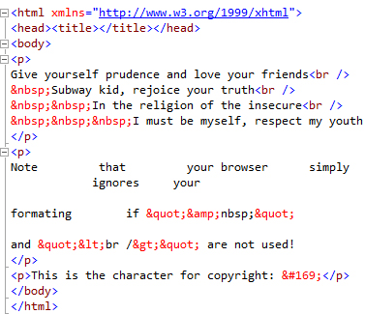

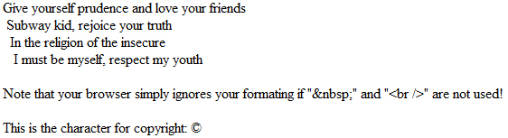
Character Entities Example
HTML Source Code
EXAMPLE
Browser Display

Slide 11
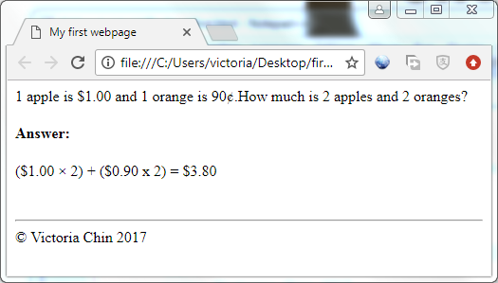
Hands On Time
Which are character entities and how to create them?
Notes:
Answers: There are 3 character entities: &cent; AND &times; AND &copy;
<!doctype html>
<html>
<head><title>My Hands-On on Character Entities</title></head>
<body>
<p>1 apple is $1.00 and 1 orange is 90&cent;.How much is 2 apples and 2 oranges?</p>
<p><b>Answer:</b></p>
<p>($1.00 &times; 2) + ($0.90 &times; 2) = $3.80</p>
<br/>
<hr/>
<p>&copy; Victoria Chin 2017</p>
</body>
</html>

Slide 12
Adding an Image
<img src="image.jpg" alt="an image" align="left" border="0" width="748" height="347" />
Some common attributes:
src: URL or pathname of the image file (REQUIRED!)
alt/title: specifies alternative text to display if the user has turned off images in their browser (for performance). Also creates a tooltip popup on mouseover
align: specifies the alignment of the image
border: sets the thickness of the border around the image (“0” for no border)
width/height: will stretch/shrink the image to fit a desired area
EXAMPLE

Slide 13
Directory Structure
Absolute path refers to a file on the Internet using its full URL
Relative path assumes that the file is on the current server
http://www.yoursite.com/business/trends/laptop.jpg
business/trends/laptop.jpg

Slide 14

Absolute path starts with drive letter (e.g. C:\) or protocol (e.g. http://)
Relative path starts from the web folder where the files and folders are found

Slide 15

Directory Structure
Web
folder
index.htm
Accessing a file in the current folder
page1.htm
<img src=“logo.gif” />
page2.htm
logo.gif
picture.jpg

Slide 16
Directory Structure
Web
Folder
index.htm
Accessing a file in a sub folder that is in the current folder
page1.htm
page2.htm
<img src=“images/logo.gif” />
images
logo.gif

Slide 17
Directory Structure
Web
Folder
html
Accessing a file in a sub folder that is in the parent folder
Notice the .. in the
beginning of the path
index.htm
page1.htm
<img src=“../images/logo.gif” />
images
logo.gif
Notes:
After explaining, draw a few samples and test the students on their understanding

Slide 18
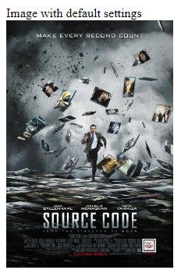

Insert an Image on a Web Page

Slide 19
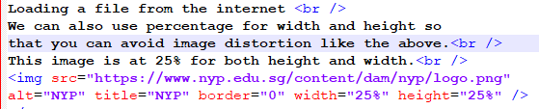
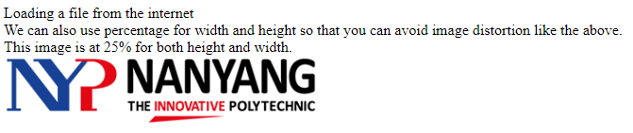
Insert an Image from Another Location

Slide 20
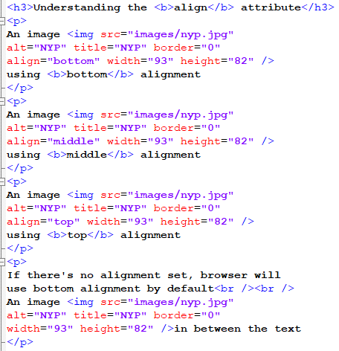
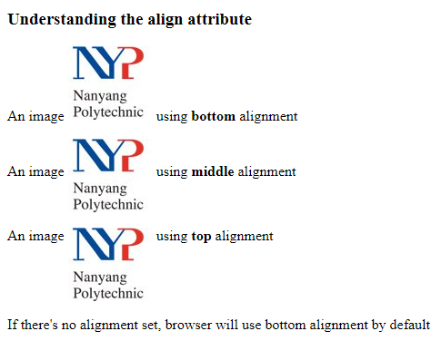
Aligning Image with Text

Slide 21
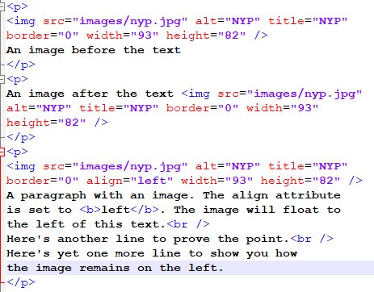
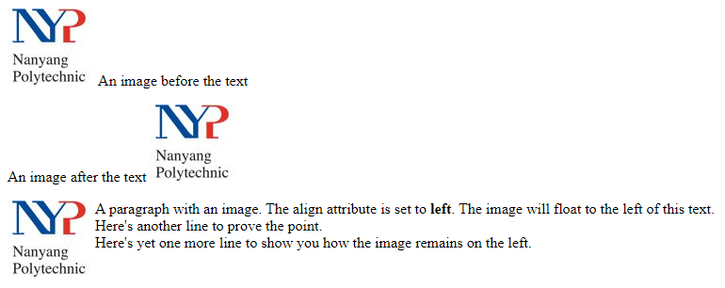
Floating Image

Slide 22
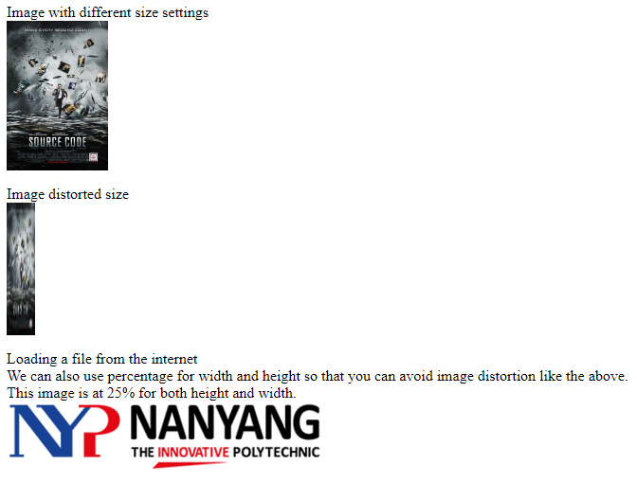
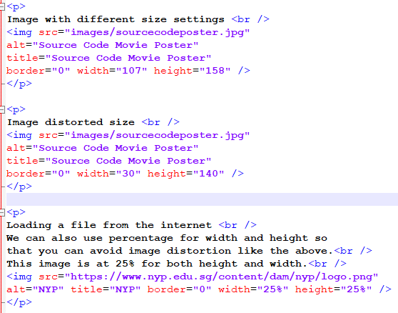
Adjusting Image Size

Slide 23
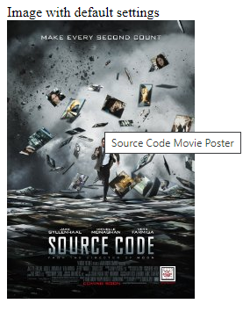

Display Alternate Text for Image

Slide 24
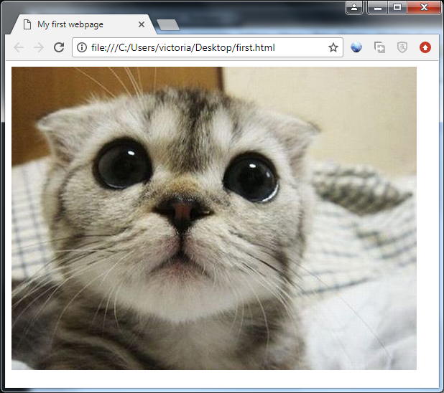
Hands On Time
Create a webpage and write HTML codes to display an image!
EXAMPLE

Slide 25
Adding a Hyperlink
Linking to other pages is the point of the Internet
Anchor tag: <a>
Common attributes:
href – destination page
target – Where to open page (e.g. target="_blank" opens a new browser window)
name – Anchor on this page
Examples:
<a href="http://www.nyp.edu.sg" target="_blank">Go to our school!</a>
<a name="start"/>
<a href="mypage.htm#start">Go to start</a>
EXAMPLE

Slide 26
Adding a Hyperlink
With the target attribute, you can define where the linked document will be opened:
New browser window
Same browser window
Example, to open www.nyp.edu.sg in a new browser window when the link is clicked:
<a href="http://www.nyp.edu.sg" target = "_blank">Visit NYP! </a>

Slide 27
Hyperlink to another Web Page
Web page within the same web site
<a href=“hobbies/football.html”>about football</a>
Web page at the other web sites
<a href=“http://www.abc.com/football.html”>about football</a>

Slide 28
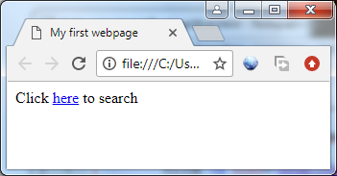
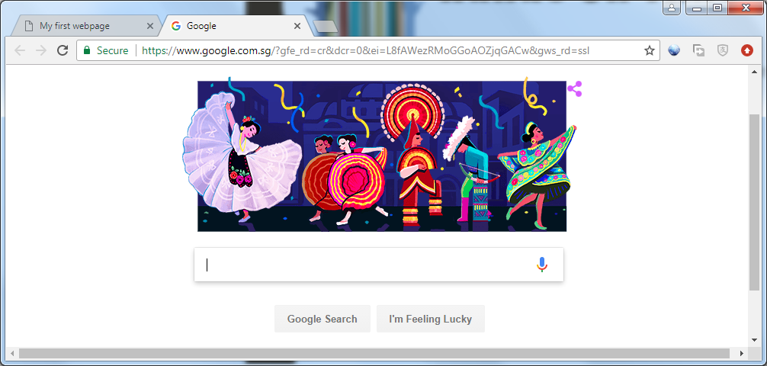
Hands On Time
Create a webpage and write HTML codes to display a hyper link that direct user to another website.
EXAMPLE
Notes:
<!doctype html>
<html>
<head><title>My Hands-On on Hyperlink</title></head>
<body>
<p>Click <a href="http://www.google.com" target="_blank">here</a> to search</p>
</body>
</html>

Slide 29
Hyperlink within the same Web Page
Step 1: Create a bookmark (named anchor) at the destination:
<a name="tips"></a> or
<a name="tips"/>
EXAMPLE
Step 2: Create the link to the bookmark
<a href="#tips">Useful Exam Tips! </a>

Slide 30
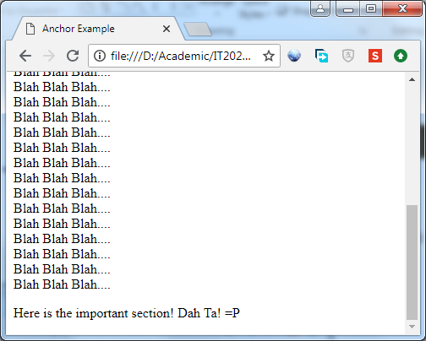
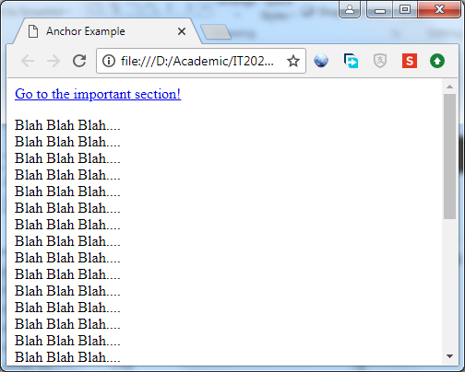
Hands On Time
Create a webpage with a hyperlink that acts as a bookmark to other sections in the page

Slide 31
Hyperlink to a Specific Location
<a href=“hobbies/football.html#shooting”>about football</a>
Current viewing page
Football.html
<a href=“hobbies/football.html#shooting”>about football</a>
....
<a name=“shooting”/>
....

Slide 32
An Email Link
Hyperlinks may also be used to send email
When an email hyperlink is clicked, the email program will be launched.
Example:
<a href="mailto:alan_chow@nyp.edu.sg">
Send email to Mr Chow</a>
A more complicated email hyperlink can be found at:
http://www.w3schools.com/html/tryit.asp?filename=tryhtml_mailto2
Notes:
Let student know that this is not commonly used as the client computer requires the email client software to be setup which many of us now uses web based email. Besides, there is also a risk of the email address being exposed to public and be a target of spam emails.

Slide 33

Learning Objective
Able to format text
Understand directory structure in order to access files
Adding images to the web page
Adding hyperlinks

