Slide 1
Fundamentals of Programming (part4)
JavaScript

Slide 2
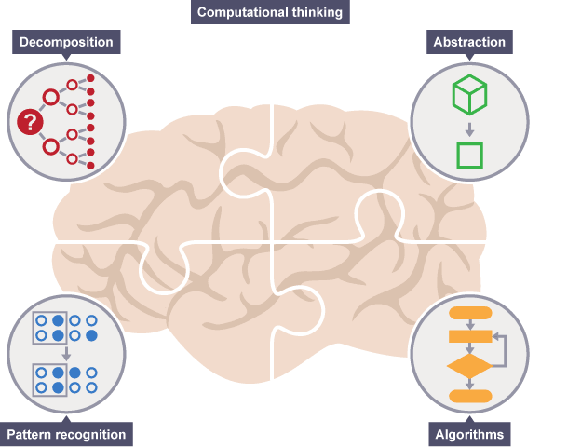
Computational thinking is a set of problem-solving methods that involve expressing problems and their solutions in ways that a computer could execute.
Source : https://www.bbc.co.uk/education/guides/zp92mp3/revision

Slide 3
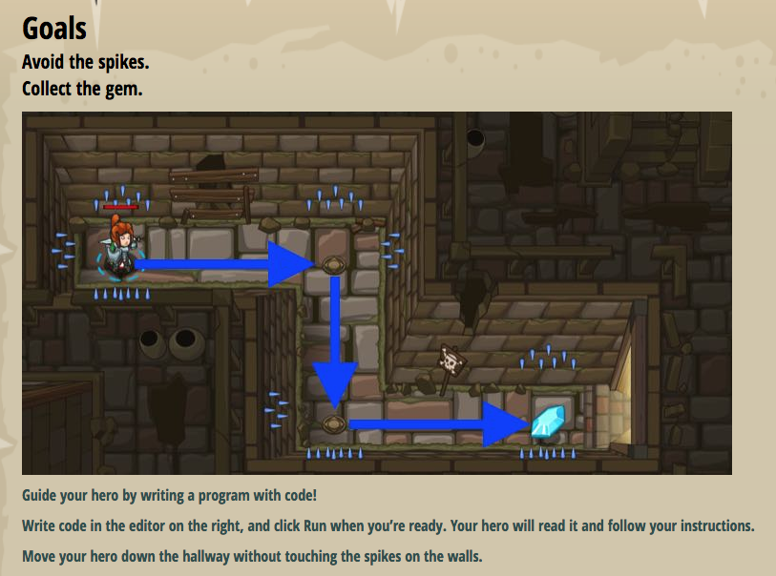
Constructing a sequence of instruction to get things done
Conditions
If, Else
Loops
For loop, While loop, do while loops
Functions
Add(a,b)
a=5
b = 4
c = add(a,b)
c= 9
Credit : Codecombat

Slide 4
Learning Objectives
What is JavaScript in HTML website?
How to add JavaScript to a WebPage?
Applying Computational Thinking in HTML websites
Notes:
JavaScript created in 1995, was originally named LiveScript, but Netscape associate the language with then-hot Java…
Microsoft introduce jScript…
The official name for JavaScript is ECMAScript which is developed and maintained by an international standards organization called Ecma International: http://www.ecmascript.org/

Slide 5
What is JavaScript ?
It is a programming language that enables you to interact with users such as dynamically updating content, control multimedia and animate images.
It has some similarity in syntax with Java, but it is not related to Java.
It is a scripting language which do not need to be fully compiled before execution.
It was created in the year of 1995 and it is still evolving. It’s standard is ECMAScript. Currently ECMAScript 2018.
In this module, we mainly focused at its basics and usage in Web API and DOM (usage in browser environment)

Slide 6
How to use JavaScript ?
How do we let the browser know in advance that it is not normal text but JavaScript ?
Example:
<!DOCTYPE HTML>
<html> <head> <title>My JavaScript Page</title> </head> <body> <script type="text/javascript"> alert("Welcome to my world!!!"); </script> </body> </html>
Using the <script> tag
For HTML5, this is optional

Slide 7
How to use JavaScript ?
You can enter JavaScript directly in both the <head> and <body> sections of the document. JavaScript code can also be stored in a separate file and be included to the document.
As a general rule, place as much of your JavaScript
(function definition) in the document head
Why ?
JavaScript is interpreted in the order in which it appears in the document. It is especially important when your document body need to perform tasks that depend on the scripts.

Slide 8
How to use JavaScript
Sometime JavaScript codes are meant to be executed while web page is loaded. This codes should be ready and interpreted up front.
For most of the JavaScript codes which is about manipulating the contents of a web page, you need to wait until the page is loaded.

Slide 9
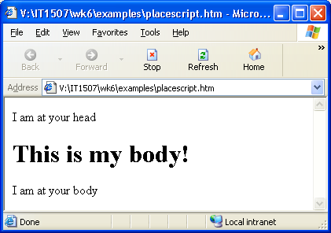
Where to place JavaScript ?
<!DOCTYPE HTML>
<html>
<head>
<script>
document.write("I am at your head");
</script>
</head>
<body>
<h1>This is my body!</h1>
<script>
document.write("I am at your body");
</script>
</body>
</html>

Slide 10
JavaScript as an external file
<html>
<head>
<script type="text/javascript" src="hello.js">
</script>
</head>
<body>
<script>
sayhello();
</script>
</body>
</html>
function sayhello() {
alert("Hello, what’s up?");
document.write("Hey, don’t ignore me !");
}
hello.js
show

Slide 11
Comments
Single and multi-line comments:
// This is a single-line comment
/* This is a
multi-line
comment. */

Slide 12
Syntax of JavaScript
JavaScript lines end with a semicolon.
Always put the text within " ".
Capital letters are different from lowercase letters.
There are keywords that carry special meaning for JavaScript. Programmers are not allowed to use them for different purpose.
document.write(“Hello World!”);
Document.write(Hello World!)

Slide 13
What does JavaScript have?
Variable – a place to hold information
Statement
Assign value to a variable
Checking conditions for decision making
If….else
switch case
Repeating a task (loop)
do … while
for , for.. In
Control statements

Slide 14
What does JavaScript have?
Operators – for example: + - * / % = == ===
Function – statements can be grouped to accomplished certain task(s)
Event Handlers – will be triggered when certain events happen. For example:
onclick, onmouseover, onmouseout
Notes:
=== is strict equal, object should of same type and same value

Slide 15
What does JavaScript have?
Built-in Objects – there some objects which have been defined and can be used readily. For example:
window, document, form, history, image, location, math, string, array, date ……

Slide 16
Variables and Data Types
What is variable ?
name
Hold data/information
numbers ?
String ?
Boolean (true / false) ?
Undefined ?
Objects ? (e.g. Array, or self defined objects)
Data types

Slide 17
Variable Name
Rules and conventions when naming a variable:
Identifiers must begin with an uppercase or lowercase ASCII letter, dollar sign ($), or underscore ( _ )
You can use numbers in an identifier, but not as the first character
You cannot include spaces in an identifier
You cannot use reserved words for identifiers

Slide 18
Declaring Variables
To use a variable, you have to declare it first.
var variable_name;
Global variable
it is known and available to all parts of your program.
it should be declared outside a function.
Local variable
it is known within a function.
it is declared inside a function.
Variable scope

Slide 19
Declaring Variables (Cont.)
Examples: (declare and assign value to it)
var myVar="Hello World";
var myVar=8;
var myVar=4.56;
var myVar=true;
var myVar=null;

Slide 20
Modifying Variables
You can change the variable’s value at any point in a script:
Use a statement that includes variable’s name, followed by an equal sign, followed by the value to assign to the variable
e.g. myNumber=8;

Slide 21
What is data Type ?
Specific category of information that a variable contains
Helps determine how much memory the computer allocates for data stored in the variable
Data type also governs the kinds of operations that can be performed on a variable
JavaScript is a loosely typed scripting language
Variable declarations do not declare the type of data
Type is determined dynamically as necessary

Slide 22
What is data Type ?
JavaScript is a loosely typed scripting language
Variables can have the same value == (to compare if same value)
But are of different types === (to compare if same type and same value)
show

Slide 23
Data Types (Cont.)
String
Example: var str="happy birthday";
Number
Example: var n=23.5;
var n1=12e-3; // 0.012
Boolean
Example: var answer=true;
var guess=false;

Slide 24
Data Types (Cont.)
Array
Example:
var marks=[70, 83, 64, 55, 96]
var names=["ah mei", "ah john", "ah meng"]
Object
Example:
var student={ name:"Ah Meng", adminNo:"153434T", gender:"Male"};

Slide 25
Data Types (Cont.)
Undefined
A variable that has not been assigned a value is of type undefined.
var nothing;
if ( typeof nothing === typeof undefined){
alert("It is undefined");
}
else {
alert("nothing is ="+nothing);
}
show
Notes:
null is a value. When an object is not assigned a value, its value is undefined not null.

Slide 26
Functions
Function is a block of reusable code for a particular purpose.
Example of defining a function:
function name
parameters
keyword
function add(num1, num2) {
var total;
total=num1+num2;
return total;
}
return a value (optional)

Slide 27
Functions
Once a function is defined, it can be executed many times as required by calling the function.
Variable to hold return value
2
3
var sum=add(2, 3);
argument
function name
function add(num1, num2) {
var total;
total=num1+num2;
return total;
}
5

Slide 28
Functions
User defined functions
Defined by users
Built-in functions
For example:
eval() – evaluate the value
parseInt() – convert to integer
isNaN() – is not a number ?

Slide 29
User Defined Function – Another Example
The name of the function: _______________
Number of parameter expected: ____
Purpose of the function: ______________
What does the function return? __________
Define Function
function getSquareArea(side) {
var area=side*side;
return area;
}

Slide 30
User Defined Function – Another Example
The name of the function: ___getSquareArea______
Number of parameter expected: _1_
Purpose of the function: _calculate area of square_______
What does the function return? _area of square______
Define Function
function getSquareArea(side) {
var area=side*side;
return area;
}
Notes:
Javascript can have variable number of arguments. Test arguments.length. arguments is the keyword.

Slide 31
User Defined Function – Another Example
Call Function
var side=2;
var areaOfSquare=getSquareArea(side);
Name of function called: _____________
Number of argument passing in: ___
Value of argument: ___
Value returned by the function _____
Where the value is being stored? ___________
Example

Slide 32
User Defined Function – Another Example
Call Function
var side=2;
var areaOfSquare=getSquareArea(side);
Name of function called: _getSquareArea____
Number of argument passing in: _1_
Value of argument: _2_
Value returned by the function __4__
Where the value is being stored? _areaOfSquare___
Example

Slide 33
Built-in Functions
Functions which are already defined. Examples:
alert(“Yeah!”);
var name=prompt(“What is your name”,””);
var isSure=confirm(“Are you sure?”);
var number=parseInt(“123”); // 123
var isNotNumber=isNaN(“88”); // false

Slide 34
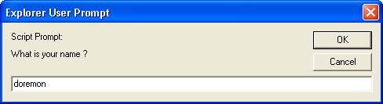
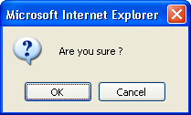
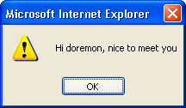
Built-in Function (Examples)
The 3 different kinds of popup dialog boxes.
prompt
confirm
alert

Slide 35
Built-in Function (Examples)
Example 1:
Experience with 3 different kinds of popup dialog boxes.
<html>
<body>
<script type="text/javascript">
<!--
var name=prompt("What is your name ?");
var answer=confirm("Are you sure ?");
if (answer==true) {
alert("Hi "+name+", nice to meet you");
} else {
alert("Can't remember your name?! That's ok! Relax");
}
window.close();
-->
</script>
</body>
</html>
Example

Slide 36
Built-in Function of JavaScript defined Objects
There are some useful JavaScript defined objects which come with useful functions: Examples:
document.write(“Hello World!!”); // print Hello World
var randomNumber=Math.random(); // A Number from 0 to < 1
var now=new Date();
var thisYear=now.getFullYear();
var myNumber=8;
var numberBinary=myNumber.toString(2) // 1000
Example

Slide 37
The JavaScript Object: String
To assign a string to a variable
myFeeling=“sleepy”
degree=“extremely”
To join (concatenate) two strings
mode = degree +” “+ myFeeling
(the value of mode is “extremely sleepy”)

