Slide 1

Computational Thinking
And Programming

Slide 2
Fundamentals of Programming (part5)
JavaScript

Slide 3

Control Statements (making decision)
if I have more than $100,000
Buy a car
if ( money>100000 ) {
buyCar=true;
}

Slide 4
Control Statements (making decision)
if I have more than $100,000
Buy a car
if ( money>100000 ) {
buyCar=true;
}
else {
buyToy=true;
}
else
get a toy

Slide 5
Control Statements (making decision)
if ( marks >= 50) {
pass=true;
if (marks>=90)
grade=“distinction”;
else if (marks>=80) {
grade=“A”;
}
else if (marks>=70) {
grade=“B”;
}
……
}
else {
pass=false;
}
There are other decision making statements such as,
nested if
switch .. Case
switch (day) {
case “Sunday”:
seeMovie();
break;
case “Saturday”:
sleeplah();
break;
default:
study();
}

Slide 6

Control Statements (repeat)
hungry !! EAT!
Still hungry ?! EAT!
while ( hungry==true) {
food=food+1;
}
Still hungry ?! EAT!

Slide 7

Control Statements (repeat)
Counter initialization
Counter update
for ( noOfhours=0; noOfhours < 8; noOfhours++) {
working=true;
}
Condition checking

Slide 8

Control Statements (repeat)
dancers is an array of dancer objects
i=0
i=1
i=2
for ( i=0; i < dancers.length; i++) {
dancers[i].dance();
}
No of dancers

Slide 9
Control Statements (repeat)
Total marks for a student
marks is an array of float
var marks = [60.5,100,78];
var total=0;
for ( i=0; i < marks.length; i++) {
total=total+marks[i];
}
alert(“total =“+total);

Slide 10
Control Statements (repeat)
There are other iteration/loop statements such as,
do.. while
do {
statement(s)
}while(conditional expression);

Slide 11
Summary
What is JavaScript ?
Scripting language
Add interactivity to Web Page
How to include JavaScript in a Web Page
<script> </script>
Head, body or a separate file
Syntax of JavaScript
end with semicolon
Case sensitive
“text”
keywords

Slide 12
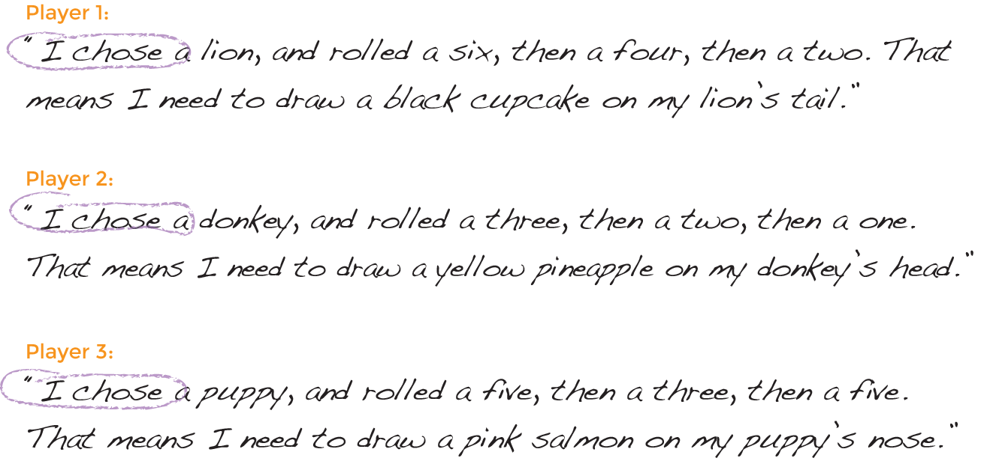
Hands on TimE! (part 1)
Try to create a display using the concatenating technique to form the string of words, making the animal as a variable, “animal”. You may use the attached template to make changes to it.

Slide 13
Hands on TimE! (part 2)
Using the same set of code you created in part 1 and add another 3 more variables for the “firstNumber”, “secondNumber” and “thirdNumber”. If you didn’t manage to complete the first exercise, use the attached to complete part2.

Slide 14
Hands on TimE! (part 3)
Using the same set of code you created in part 2 and add a Loop to create the following 3 lines dynamically. If you didn’t manage to complete the first exercise, use the attached to complete part3.

Slide 15
WelL Done!
We have applied computational Thinking to create a dynamic solution for the following challenge. You may use the attached possible solution as reference.

Slide 16
Summary
Variables and data types
Declare a variable (using keyword var)
number, string, boolean, array, object, undefined …
No need to specify type in Javascript. But required for other platform like C++ and even RPA (UiPath)
Operators
+ - * / = == === > <
Control Statements/structures (eLearning)
if, if-else, while, for ….

Slide 17
Summary (cont..)
Functions
User-defined function
Built-in function
Built-in pop up boxes in browser
Example of built-in object
String
Usage of the document.write()
document refers to the web page

