Slide 1
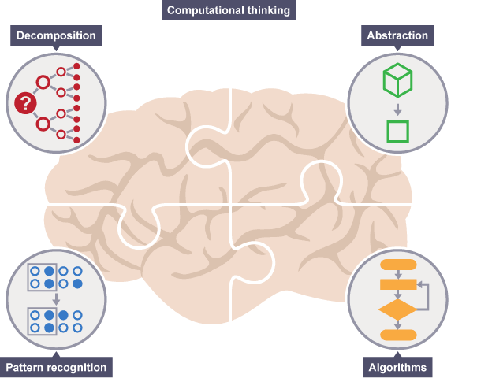
Key Concepts of Computational Thinking
Notes:
Resources:
https://www.bbc.com/education/guides/zp92mp3/revision/1
https://computationalthinkingcourse.withgoogle.com/unit

Slide 2




Learning Outcomes
Know the 4 key concepts of Computational Thinking
Define decomposition, pattern recognition, abstraction and algorithm
Learn 15 mins
Activity 45 mins
Quiz 10 mins
Lunch

Slide 3
1 Decomposition
Break a problem down into smaller problems

Slide 4
Decomposition
Breaking a task or problem into steps or parts
Decomposing a problem frequently leads to pattern recognition and generalization
Examples:
When we taste an unfamiliar dish and identify several ingredients based on the flavour, we are decomposing that dish into its individual ingredients

Slide 5
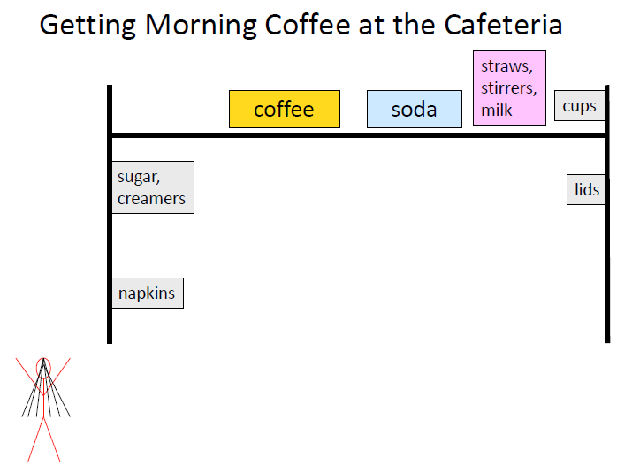
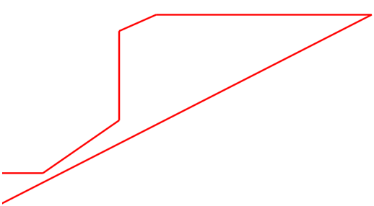
Decomposition
We’re doing decomposition
Remember the scenario
Considerations
Shortest path
Sequence
Must get cup before coffee and milk
Exclude unimportant details

Slide 6
2 Pattern Recognition
Find similarities between things

Slide 7
Pattern Recognition
The ability to notice similarities or common differences that will help us make predictions or lead us to shortcuts
Examples:
People look for patterns in stock prices to decide when to buy and sell.
In mathematics, when calculating the largest area possible for a rectangle of a given perimeter, we can see patterns in the length, width, and area such as:
As the length and width approach each other in value, the area increases
As the difference between the length and width increases, the area decreases

Slide 8
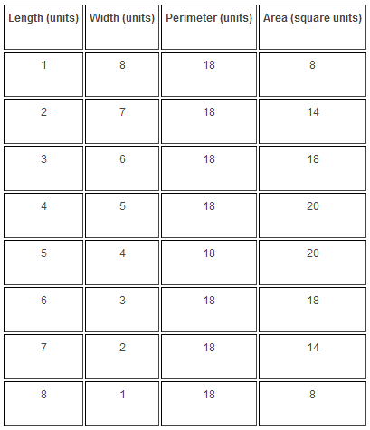
Pattern Recognition
As the length and width approaches each other in value, the area increases

Slide 9
3 Abstraction
Find similarities between things

Slide 10
Abstraction is also referred to as Pattern Generalization

Slide 11
Pattern Generalisation
Pattern generalization allows us to represent an idea or a process in general terms so that we can use it to solve other problems that are similar in nature.
Example:
In mathematics, we write generalized formulas in terms of variables instead of numbers so that we can use them to solve problems involving different values
The slope of any straight line can be described as a function of y = mx + b

Slide 12
Pattern Generalisation
Example: Design is made up of 4 circles

Slide 13
Pattern Generalisation
Design
Draw circle
Rotate 90°, draw circle

Slide 14
Pattern Generalisation
Design
Draw circle
Rotate 90°, draw circle
Rotate 90°, draw circle

Slide 15
Pattern Generalisation
Design
Draw circle
Rotate 90°, draw circle
Rotate 90°, draw circle
Rotate 90°, draw circle

Slide 16
Pattern Generalisation
Design
Draw circle
Repeat 3 times
Rotate 90°, draw circle

Slide 17
Abstraction
Focus on the details (essential characteristics) that matter
Used to simplify problems & make things easier to do by hiding some of the less important details
Example
The culture of a country can be capture in its national costume

Slide 18
Pattern Generalisation
Pattern generalization allows us to represent an idea or a process in general terms so that we can use it to solve other problems that are similar in nature.
Remember the scenario to sum 1 - 200
Is pattern generalisation applicable for the above case to solve other problems?

Slide 19

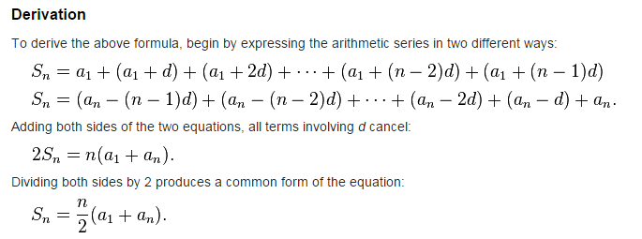
Pattern Generalisation
Arithmetic Series
http://en.wikipedia.org/wiki/Arithmetic_progression

Slide 20

Pattern Generalisation
Arithmetic Series
Sum of 1 - 200
n = 200
a₁ = 1
a₂₀₀ = 200
Sn = 20,100
Sum odd no of 1 - 200
n = 100
a₁ = 1
a₁₉₉ = 199
Sn = 10,000

Slide 21
4 Algorithm
A list of steps that you can follow to finish a task

Slide 22
Algorithm
Algorithm: a series of steps to follow in a given order that achieves some goal
The steps can be followed without those involved having any understanding of what they are doing, i.e. given an algorithmic solution, other people (or computers) can then follow the instructions mechanically.
E.g. When a chef writes a recipe for a dish, she is creating an algorithm that others can follow to replicate the dish.
We will learn more about Algorithm in the next lesson

Slide 23
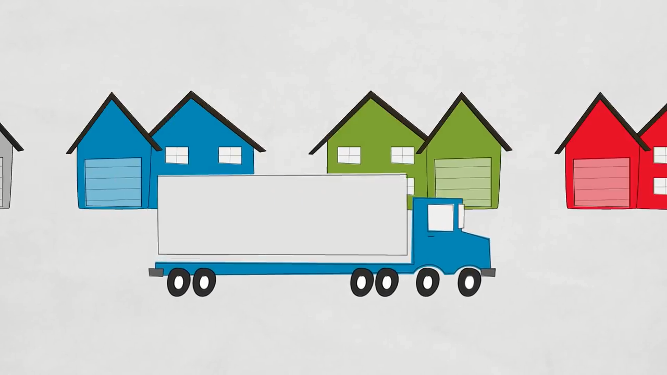
Solving Problems at Google Using Computational Thinking
https://www.youtube.com/watch?v=SVVB5RQfYxk

Slide 24

Summary - 4 Key Concepts of Computational Thinking
Decomposition
Break a problem down into smaller problems
Pattern Recognition
Find similarities between things
Abstraction (Pattern Generalization)
Pull out specific differences to make one solution work for multiple problems
Algorithm
A list of steps that you can follow to finish a task

Slide 25


Activity
Task 1 Decomposition
Break a problem down into smaller problems
[ Optional ]

Slide 26
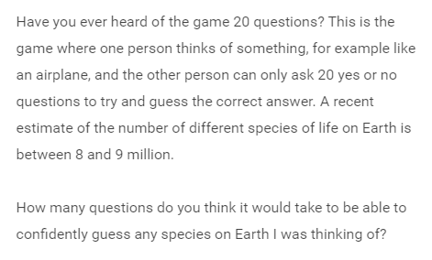
Individual
Classification
Mystery Animal
Class

Slide 27
Class
Activity
Task 2 Pattern Recognition
Find similarities between things
[ Optional]

Slide 28
Activity: Sum of 1-200
Without using computers/calculator/ mobile phones
Find a fast way to calculate sum of 1-200

Slide 29
Activity: Sum of 1-200
Easiest method
Just sum up manually
1 + 2 = 3
1 +2 +3 = 6
…
1 + 2 + … + 200 = 20100
Tedious
Time consuming

Slide 30
Activity: Sum of 1-200
How can we use decomposition to break the problems to identify any patterns
1 + 2 + … + 100 + 101 + … + 199 + 200

Slide 31
Activity: Sum of 1-200
1 + 2 + … + 100 + 101 + … + 199 + 200
100 + 101 = 201
. . .
2 + 199 = 201
1 + 200 = 201

Slide 32
Activity: Sum of 1-200
Patterns Recognition
Each pair of matching numbers sum up to 201
1 – 200 is made up of 100 pairs of these numbers
Therefore sum of 1 – 200
201 x 100 = 20100

Slide 33
Individual
Activity
Task 3 Abstraction
Pattern Generalization

Slide 34
Activity: Word Pattern
What is the pattern?
I have two orange dogs
I have three orange cats
I have two orange chairs
Can you give the next sentence that fits in the pattern?

Slide 35
Activity: Word Pattern
Abstraction:
Hide some of the less important details
I have two orange dogs
I have three orange cats
I have two orange chairs

Slide 36
Activity: Word Pattern
Abstraction:
Identify primary pattern (ignoring others)
I have xxx orange xxx
I have two orange dogs
I have three orange cats
I have two orange chairs

Slide 37
Activity: Word Pattern
Abstraction:
Identify any other patterns
xxx two xxx
xxx three xxx
repeats
I have two orange dogs
I have three orange cats
I have two orange chairs

Slide 38
Activity: Word Pattern
Abstraction:
Identify any other patterns
Non – repeating objects
I have two orange dogs
I have three orange cats
I have two orange chairs

Slide 39
Activity: Word Pattern
Putting them together
I have two orange dogs
I have three orange cats
I have two orange chairs
I have three orange rabbits

Slide 40

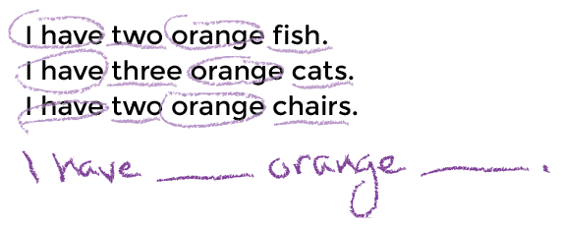
Worksheet
Complete the worksheet
Circle identical words
Underline differences
Write the sentence with ______ using Abstraction

Slide 41

Thank you

