Slide 1
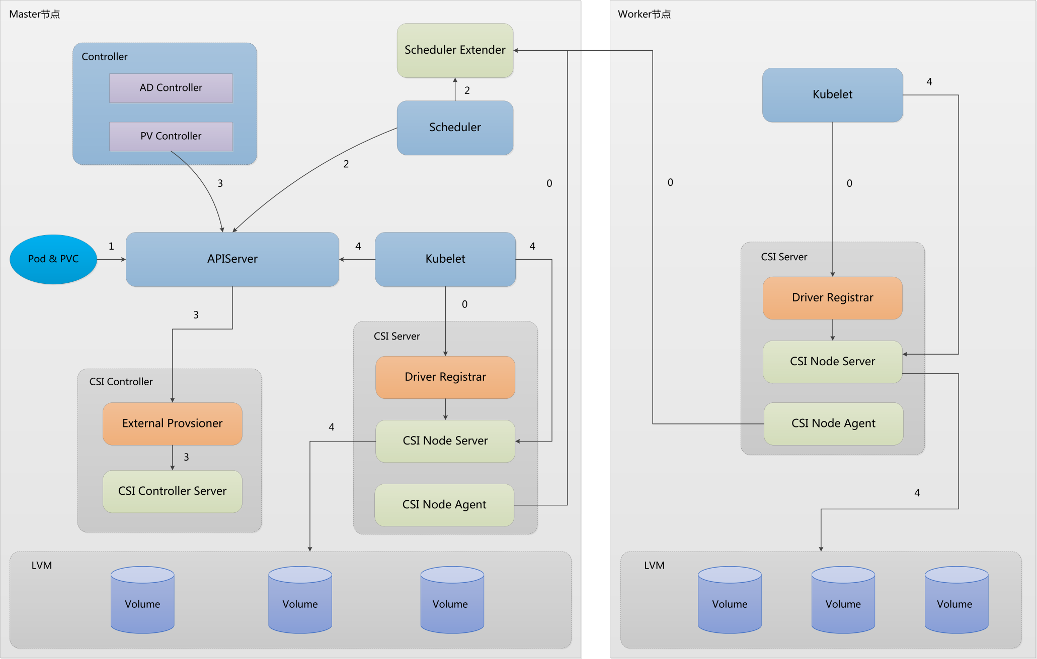
Kubernetes本地存储插件架构设计

Slide 2
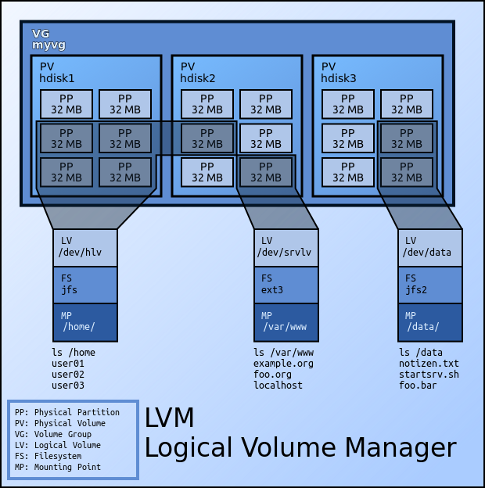
LVM 架构设计

Slide 3
Pod&PVC&PV 内部创建详细流程
平台运维人员创建
apiVersion: storage.k8s.io/v1
kind: StorageClass
metadata:
name: local-volume-csi
provisioner: local.volume.csi.kubernetes.io
parameters:
fsType: ext4
reclaimPolicy: Delete
volumeBindingMode: WaitForFirstConsumer

Slide 4
Pod&PVC&PV 内部创建详细流程
业务方创建
apiVersion: v1
kind: Pod
metadata:
name: test
spec:
containers:
- image: nginx
name: demo
volumeMounts:
- name: local-volume-csi-pvc
mountPath: “/data”
volumes:
- name: local-volume-csi-pvc
persistentVolumeClaim:
claimName: local-volume-csi-pvc

Slide 5
Pod&PVC&PV 内部创建详细流程
业务方创建
apiVersion: v1
kind: PersistentVolumeClaim
metadata:
name: local-volume-csi-pvc
spec:
accessModes:
- ReadWriteOnce
resources:
requests:
storage: 1Gi
storageClassName: local-volume-csi

Slide 6
Pod&PVC&PV 内部创建详细流程
Scheduler通知 PV Controller
apiVersion: v1
kind: PersistentVolumeClaim
metadata:
name: local-volume-csi-pvc
annotations:
volume.kubernetes.io/selected-node: 10.0.0.5
spec:
accessModes:
- ReadWriteOnce
resources:
requests:
storage: 1Gi
storageClassName: local-volume-csi
Notes:
代码地址：https://github.com/kubernetes/kubernetes/blob/master/pkg/controller/volume/scheduling/scheduler_binder.go

Slide 7
Pod&PVC&PV 内部创建详细流程
PV Controller 通知 External Provisioner
apiVersion: v1
kind: PersistentVolumeClaim
metadata:
name: local-volume-csi-pvc
annotations:
volume.kubernetes.io/selected-node: 10.0.0.5
volume.beta.kubernetes.io/storage-provisioner: local.volume.kubernetes.io
spec:
accessModes:
- ReadWriteOnce
resources:
requests:
storage: 1Gi
storageClassName: local-volume-csi
Notes:
代码地址：https://github.com/kubernetes/kubernetes/blob/master/pkg/controller/volume/persistentvolume/pv_controller.go

Slide 8
Pod&PVC&PV 内部创建详细流程
External Provisioner 创建 PV
apiVersion: v1
kind: PersistentVolume
metadata:
annotations:
local.volume.csi.kubernetes.io/publish: "true"
pv.kubernetes.io/provisioned-by: local.volume.csi.kubernetes.io
spec:
nodeAffinity:
required:
nodeSelectorTerms:
- matchExpressions:
- key: topology.local.volume.csi / hostname
operator: In
values:
- 10.0.0.5
Notes:
代码地址：https://github.com/kubernetes-csi/external-provisioner/blob/master/pkg/controller/controller.go

Slide 9
Pod&PVC&PV 内部创建详细流程
PV Controller 绑定 PV PVC 成功
apiVersion: v1
kind: PersistentVolumeClaim
metadata:
name: local-volume-csi-pvc
annotations:
volume.kubernetes.io/selected-node: 10.0.0.5
volume.beta.kubernetes.io/storage-provisioner: local.volume.kubernetes.io
pv.kubernetes.io/bind-completed: "yes“
pv.kubernetes.io/bound-by-controller: "yes"
spec:
accessModes:
- ReadWriteOnce
resources:
requests:
storage: 1Gi
storageClassName: local-volume-csi

Slide 10
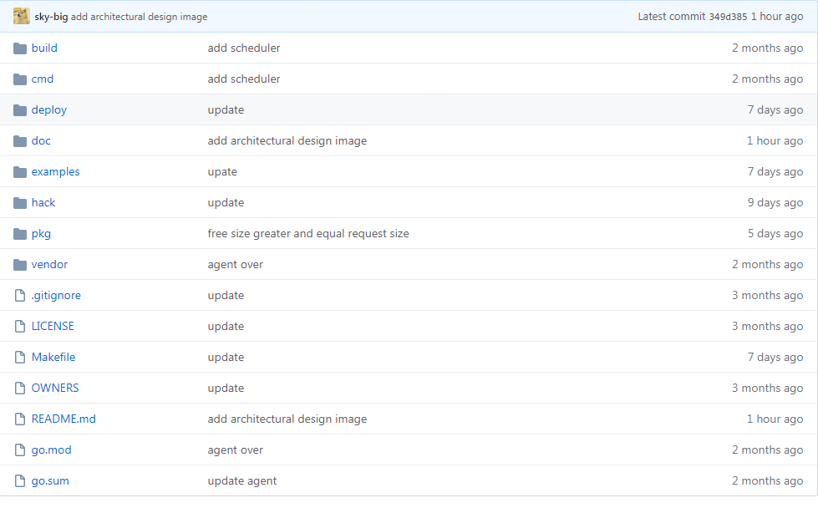
Kubernetes本地存储插件源代码
Notes:
代码地址：https://github.com/kubernetes-local-volume/kubernetes-local-volume

Slide 11
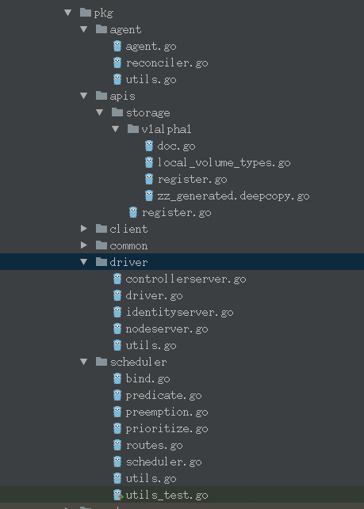
Kubernetes本地存储插件源代码
Notes:
代码地址：https://github.com/kubernetes-local-volume/kubernetes-local-volume

Slide 12
THANKS

