Slide 1

Attacks in Neural Networks from Hardware Perspective
By: Alan Devkota
Advisor: Dr. Xin Fu
ECE 6011_25383
February 10, 2023
Department of ECE, University of Houston
Houston, TX, USA

Slide 2
Outline
Overview of Neural Networks.
Overview of attacks.
Adversarial scenarios in cloud and edge.
Hardware Trojan Attack on Neural Networks.
Illustration in memory.
Conclusion and future direction.

Slide 3
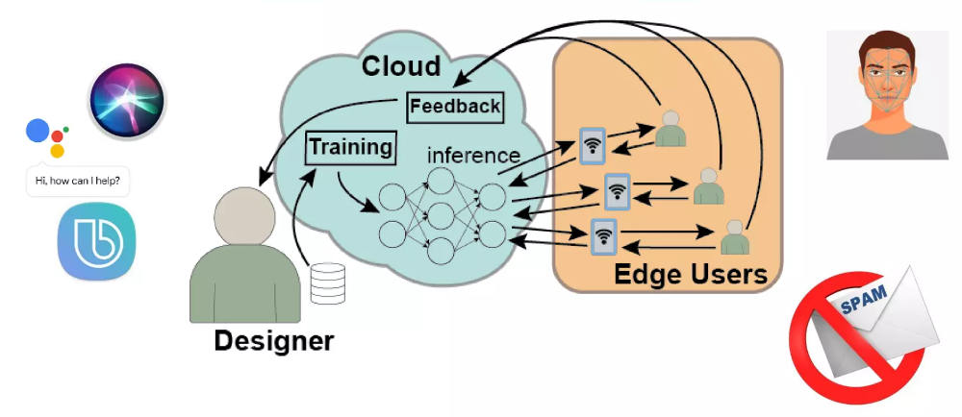
Overview of Neural Networks
Cloud Based ML Paradigms

Slide 4
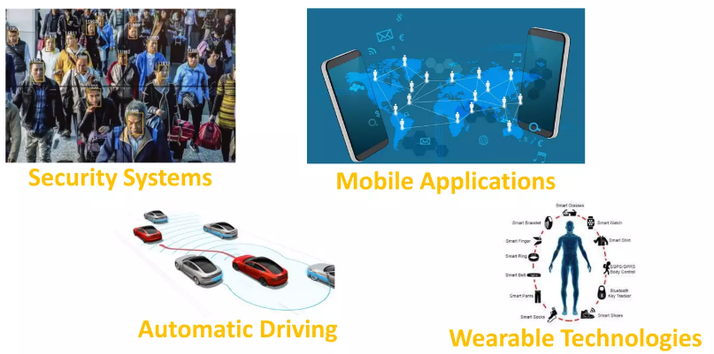
Overview of Neural Networks
Constrained Applications

Slide 5
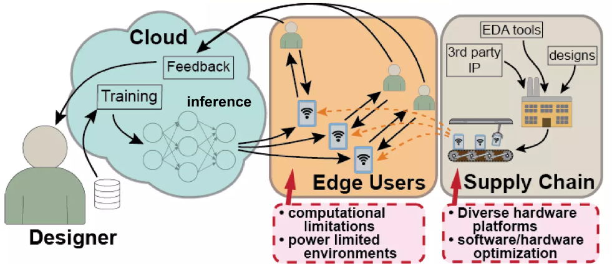

Overview of Neural Networks
Moving inference to the edge
Inference

Slide 6
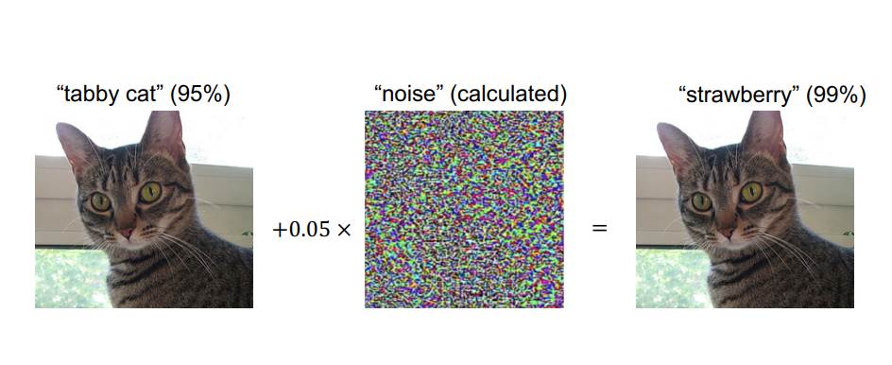
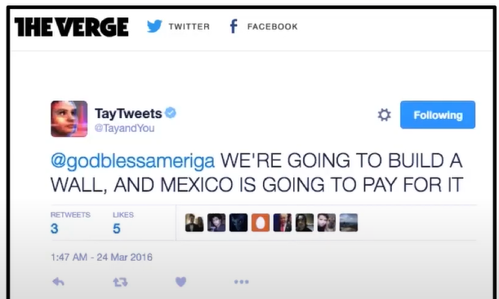
Overview of Attacks on Neural Networks
Prediction (Adversarial example)
labels: dog, cat, mango, strawberry and so on.
Solution: Adversarial training
Training Data (Poisoning)
Tay – a twitter bot developed by Microsoft seemed to learn some bad behavior on its own
Solution: Data sanitization/ Robust statistics

Slide 7

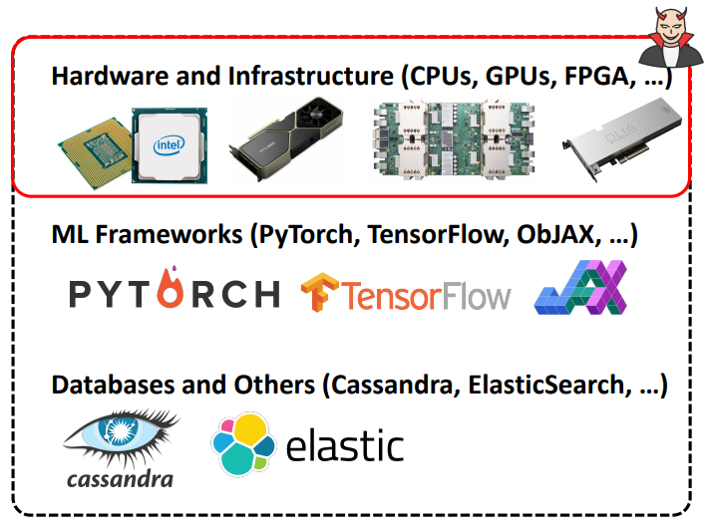
Have we placed sound mind in a sound body??
DNN Robustness
Prior works considered Machine Learning models as a standalone, mathematical concept.
We need to consider hardware level vulnerabilities as well.
Prior works considered: Hardware attack as weak attack and software attack as strong attack.
Not always
Security in Neural Network need both safe hardware and safe software

Slide 8
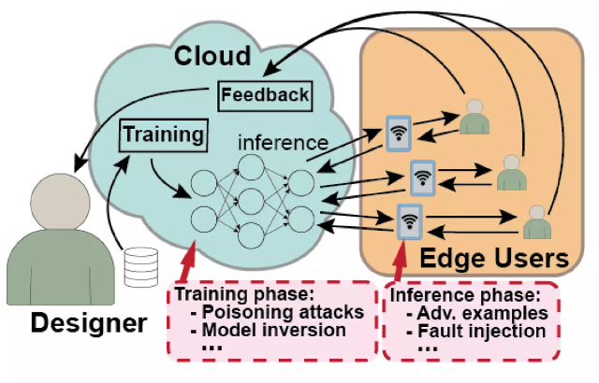
Adversarial Scenario in the Cloud

Slide 9
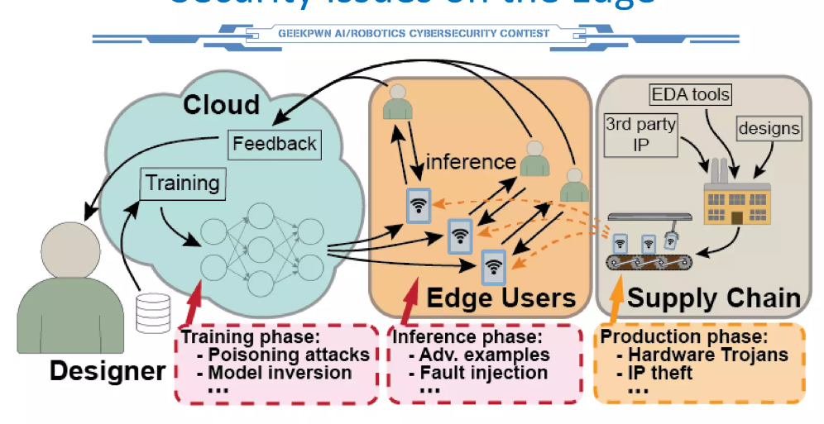
Adversarial Scenario on the Edge

Slide 10
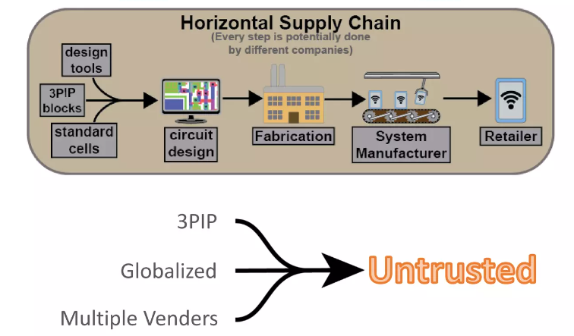
Hardware supply chain

Slide 11
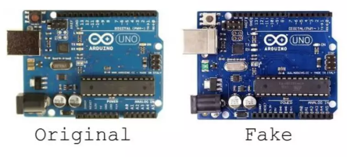
Attacks in hardware domain
IP Piracy: Produce IPs (or secretly more copies) without approval from original owner and provide them at low cost
Counterfeiting: Generating a fake one. (Especially ICs)

Slide 12
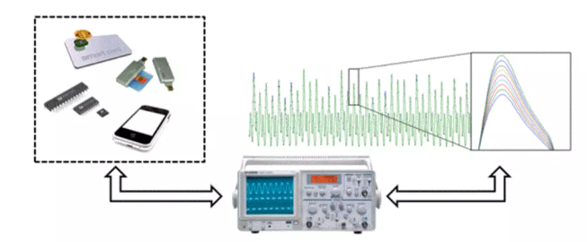
Attacks in hardware domain (contd.)
Side-channel attacks: Exploit information from computer such as electromagnetic radiation.

Slide 13
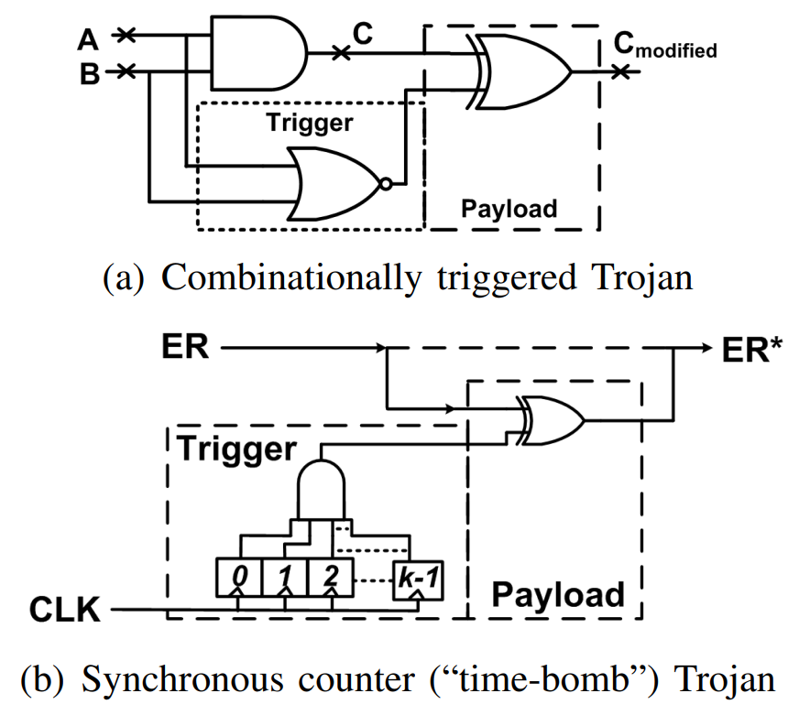
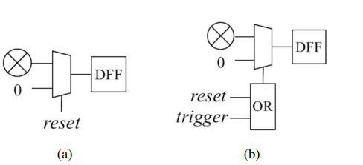
Attacks in hardware domain (contd.)
Hardware trojans: Attacker attempts to maliciously modify a circuit design such that the functionality changes.
(Especially, if attacker have access to supply chain)
original
Trojaned

Slide 14
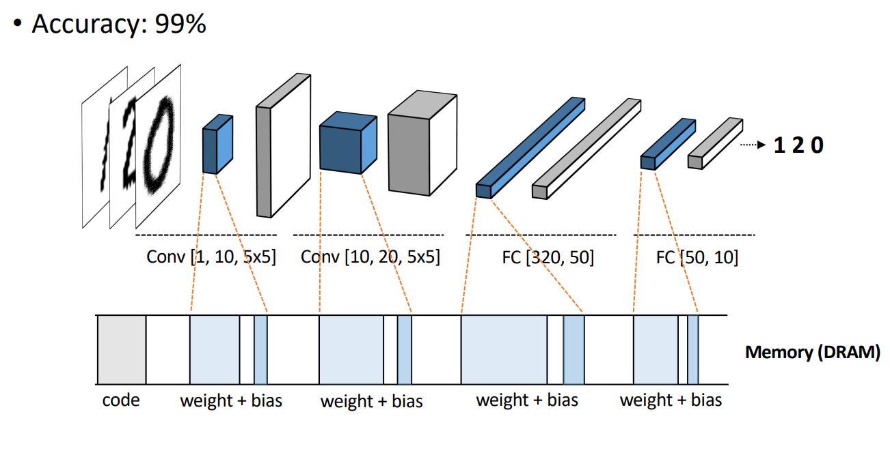
Illustration of DNN (In memory Representation)

Slide 15
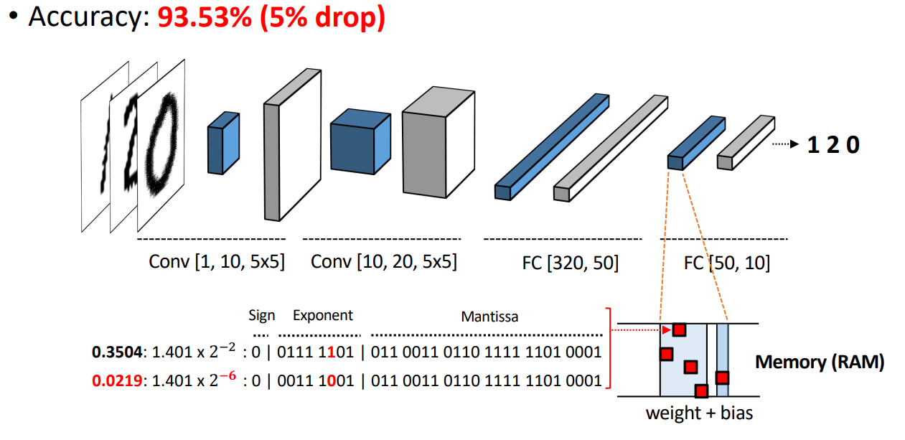
Illustration of DNN (In memory Representation)

Slide 16
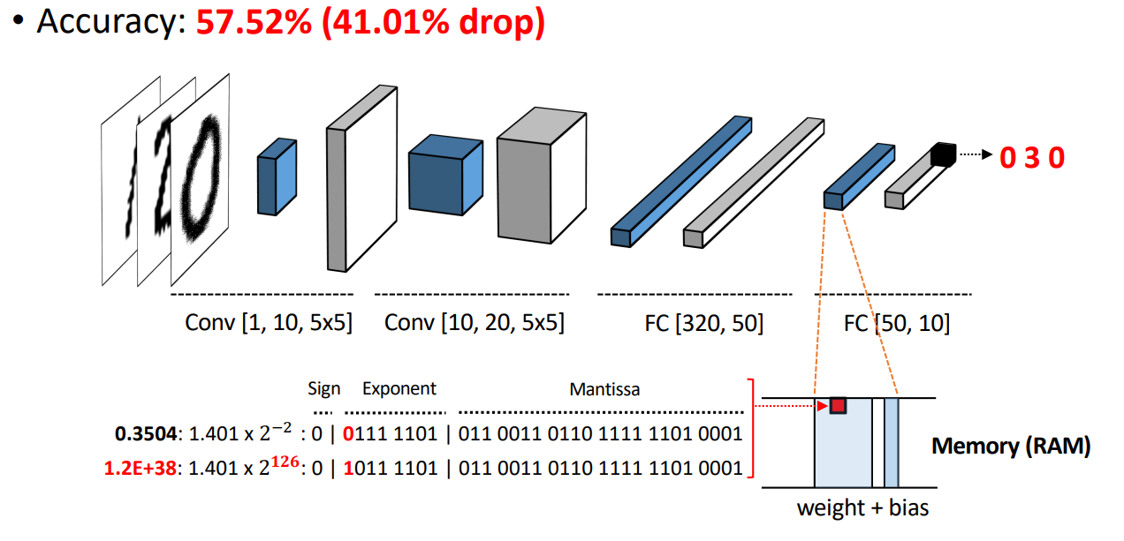
Illustration of DNN (In memory Representation)

Slide 17
Conclusion
Hardware attack can break mathematically proven guarantees.
Stealthy form of attack.
Other attacks on machine learning models are possible through hardware implementations.
Single-bit flip can inflict maximum damage if it’s the most significant bit. (Achilles bit)

Slide 18
References
Hong, Sanghyun, et al. "Terminal Brain Damage: Exposing the Graceless Degradation in Deep Neural Networks Under Hardware Fault Attacks." USENIX Security Symposium. 2019.
Clements, Joseph, and Yingjie Lao. "Hardware trojan design on neural networks." 2019 IEEE International Symposium on Circuits and Systems (ISCAS). IEEE, 2019.
Clements, Joseph, and Yingjie Lao. "Hardware trojan attacks on neural networks." arXiv preprint arXiv:1806.05768 (2018).
Hong, Sanghyun, and Maryland Cybersecurity Center MC. "A Sound Mind in A Vulnerable Body: Practical Hardware Attacks on Deep Learning."

Slide 19
Thank you for your attention!
Questions ??
adevkot2@cougarnet.uh.edu

