Slide 1

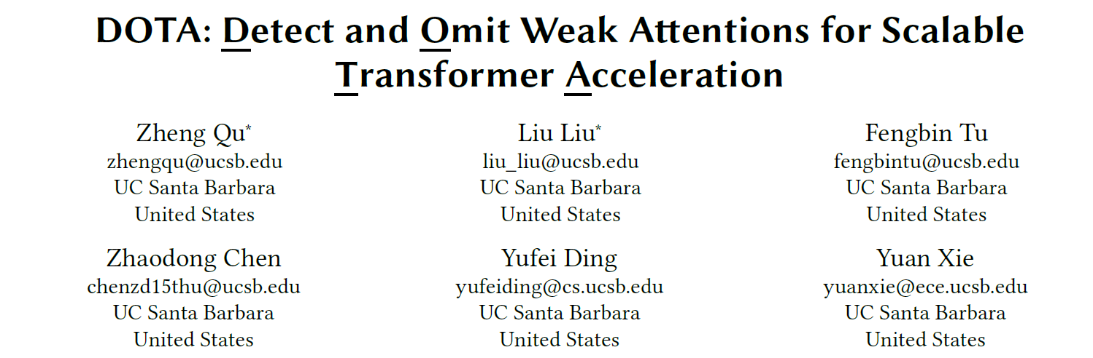
Presented By: Alan Devkota
ECE 601
Feb 15, 2023
Department of ECE, University of Houston
Houston, TX, USA

Slide 2
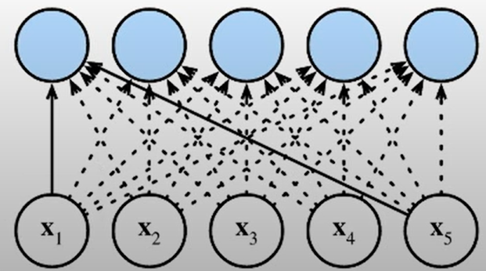
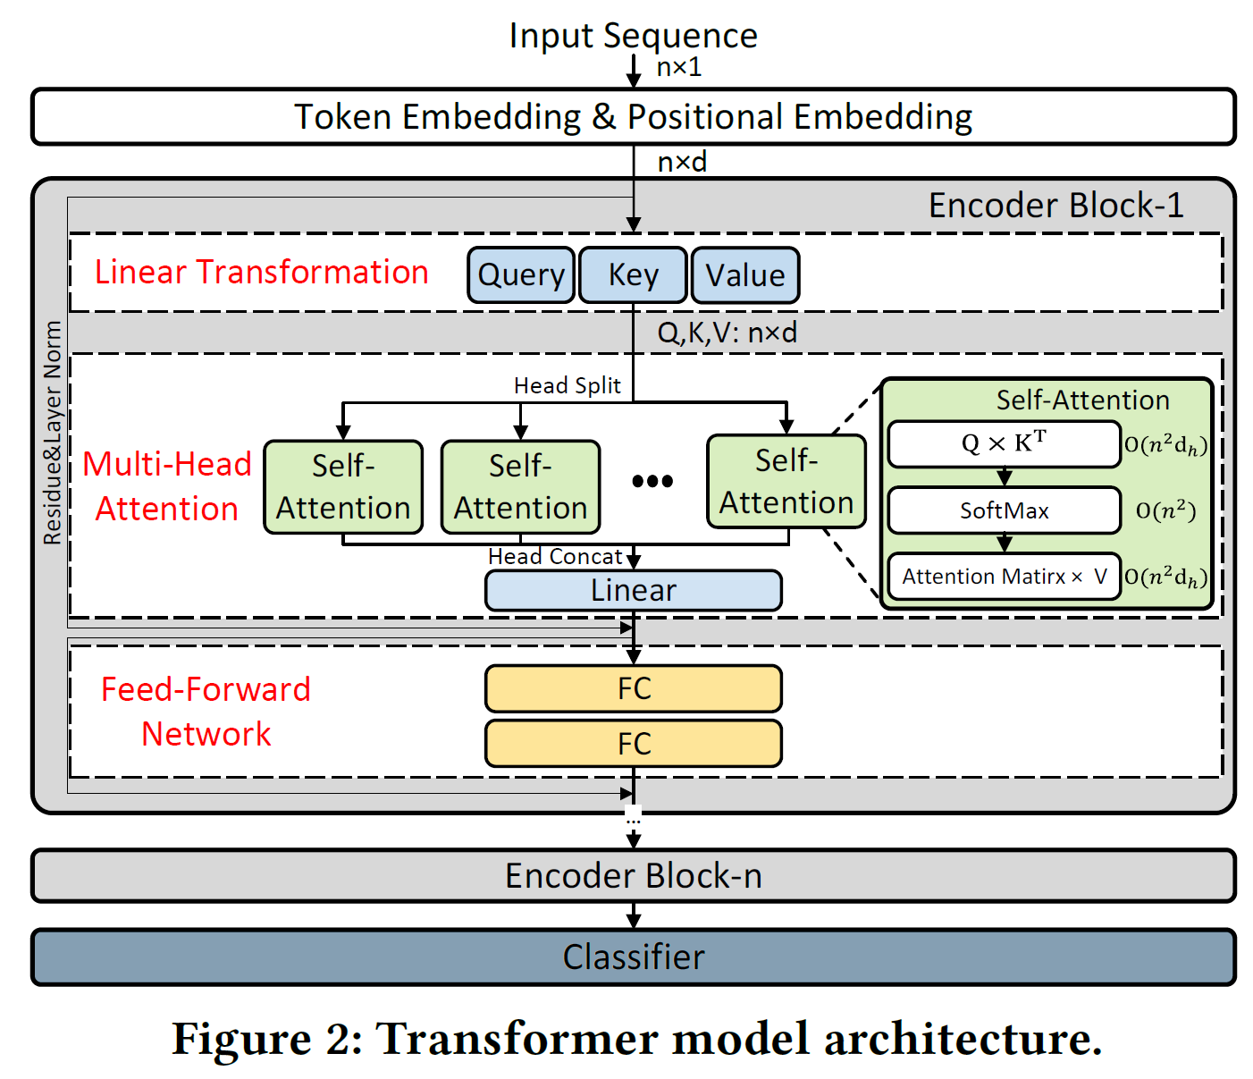
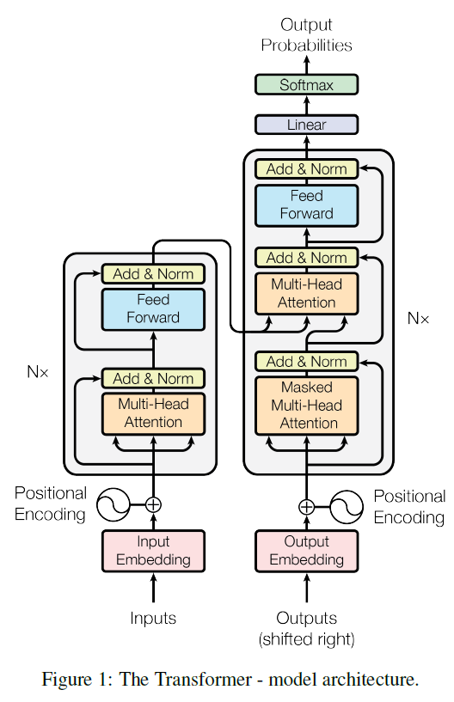
Transformer Neural Network
Cross-Attention
Self-Attention
Self-Attention
Model: Stack of encoder/ decoder blocks
Usually 3-Stage processing procedure: Linear transformation, Multi-head Attention and Feed Forward
Key Structure: Self-attention

Slide 3
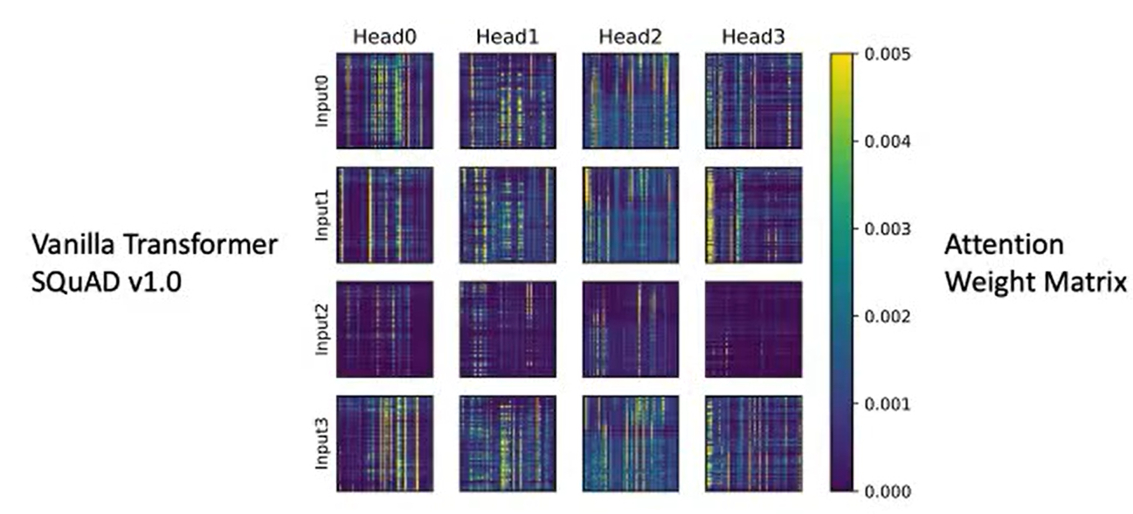
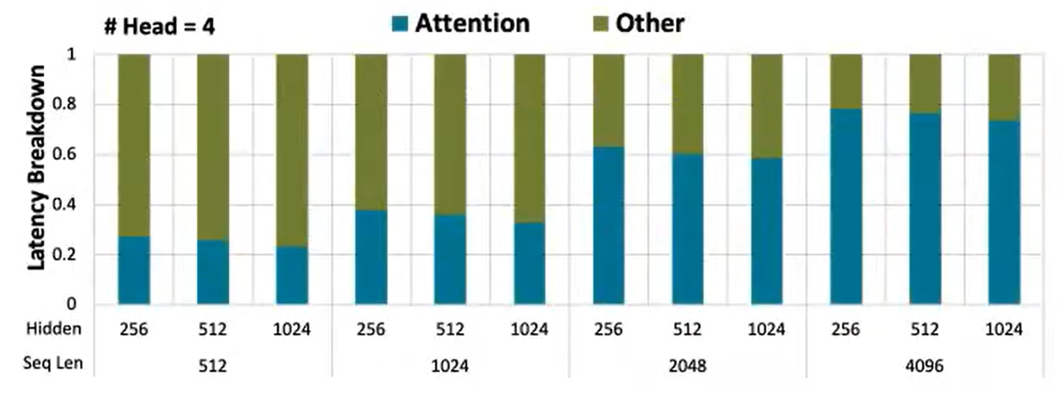
Motivation
Dynamic Sparsity
Repetition of the value “0” in weight or activations allows elimination of unnecessary computations.
Self-Attention have many weak connections that contributes very little to the final output of the feature aggregation!!
I like ECE Seminar
Notes:
Self-attention cost

Slide 4
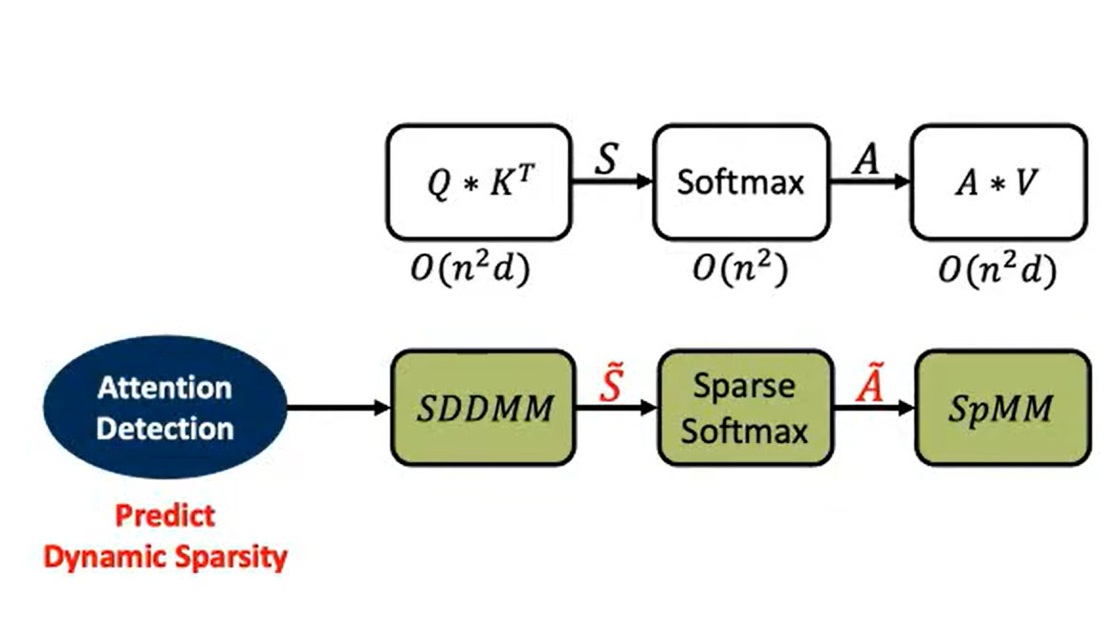
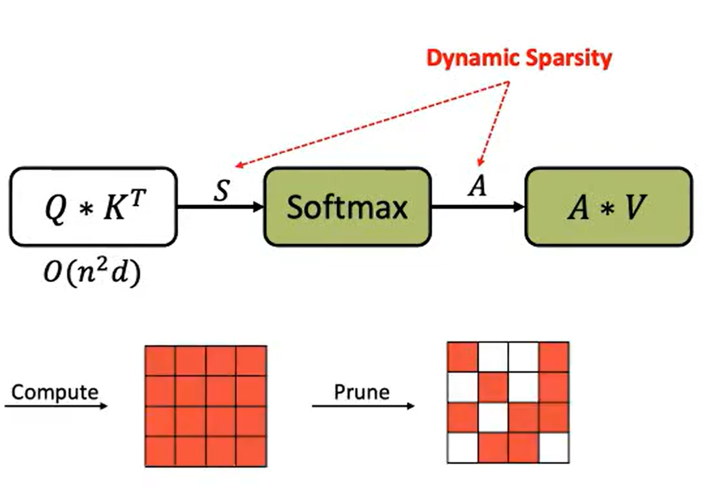
Challenges
How to locate weak attention connection?
(Compute A, Take A as a reference → compare and select only important ones.)
How about introducing the sparsity before Q * K’ to obtain most computation/ memory reduction?
Compute and Prune
Solution : (Detect and Omit)

Slide 5
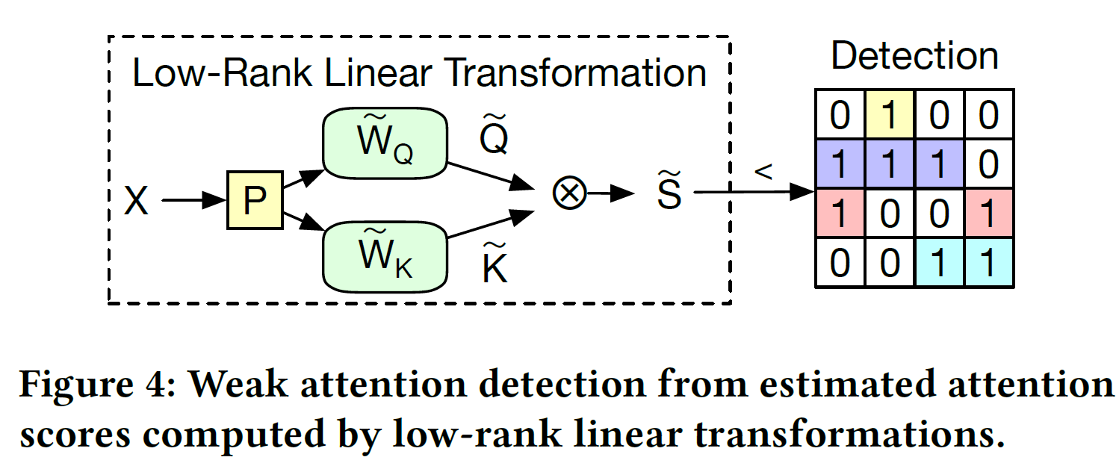
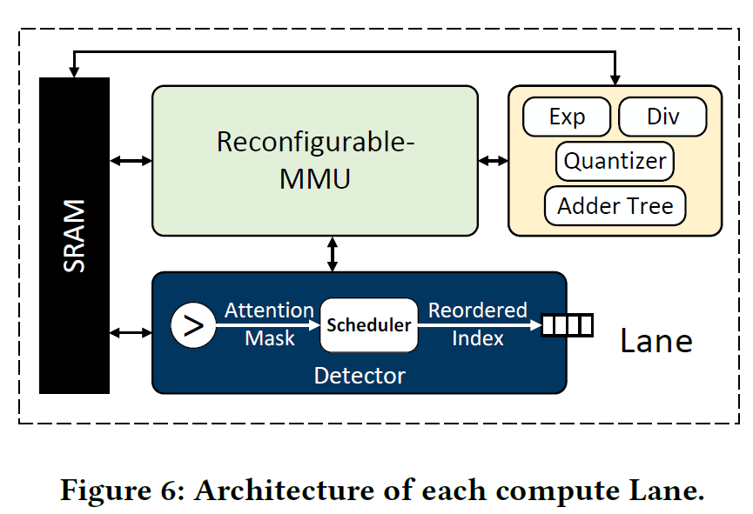
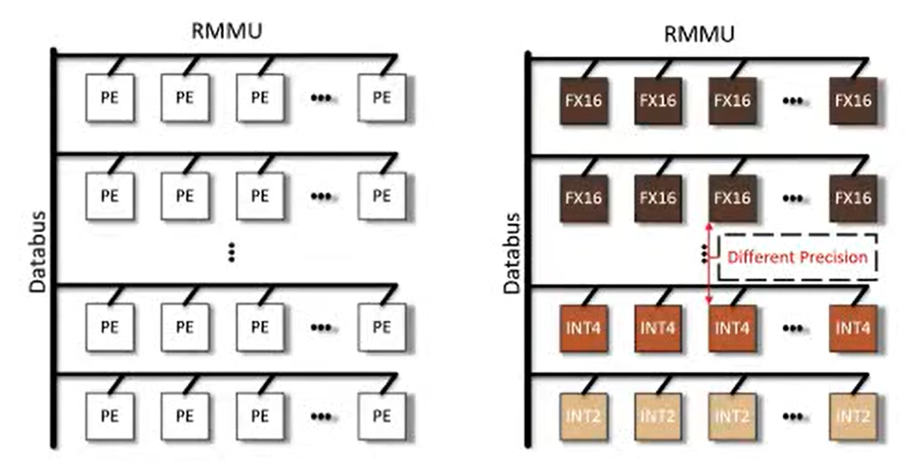
DOTA: Dynamic Sparse Attention Algorithm
Train a lightweight detection n/w to help detect the weak/important connection
Low precision and low dimension
Reconfigurable MMU
Notes:
Random projection, to reduce feature implement light weight detection network to obtain estimated attention scores.

Slide 6
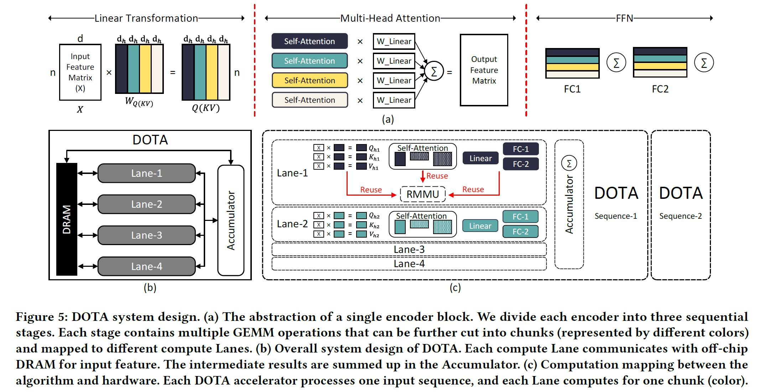
DOTA Accelerator Architecture

Slide 7
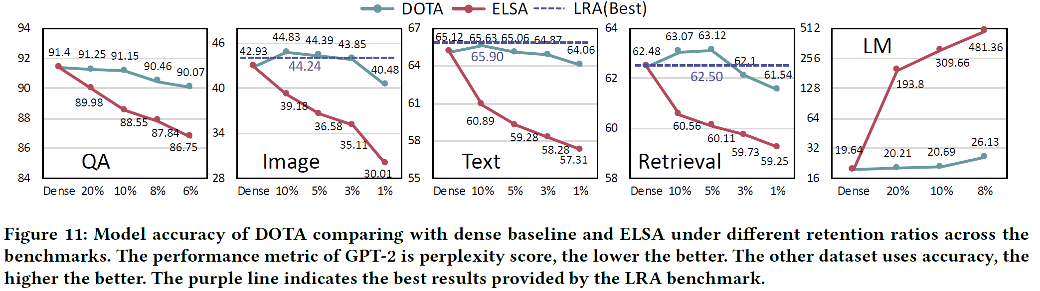
Evaluation: Model Accuracy
Comparable accuracy with dense models under 90-95% sparsity
Much better accuracy-sparsity trade-off than prior art (ELSA)
Notes:
NVIDIA V100 GPU

Slide 8
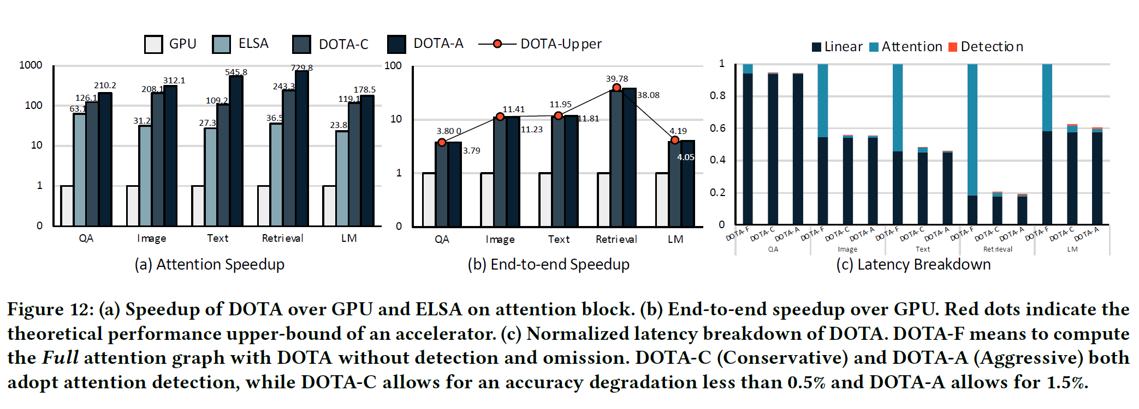
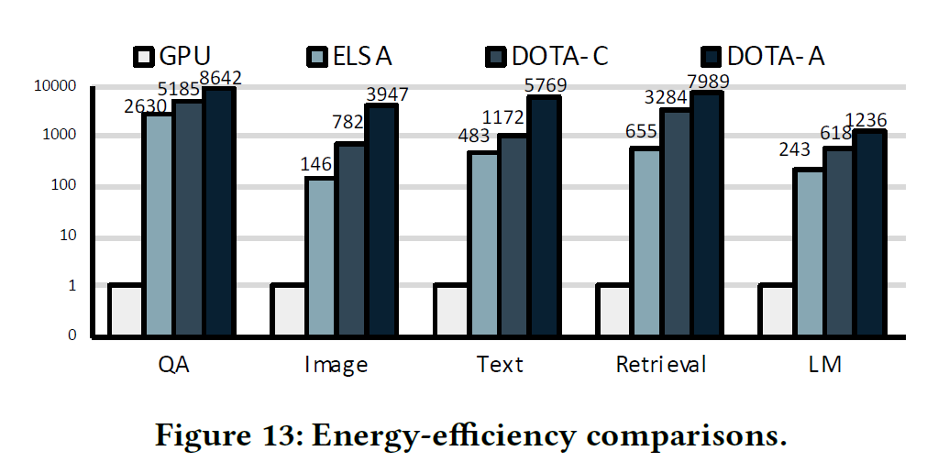
Evaluation
Notes:
NVIDIA V100 GPU

Slide 9
Conclusion
Proposed way to leverage weak attention connection to reduce cost of self-attention mechanism
Light weight detection network and joint optimization
Unified hardware-software co-design
Speedup, energy-efficient with negligible accuracy degradation

