Slide 2
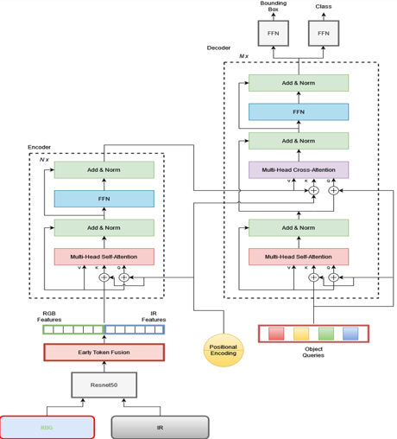
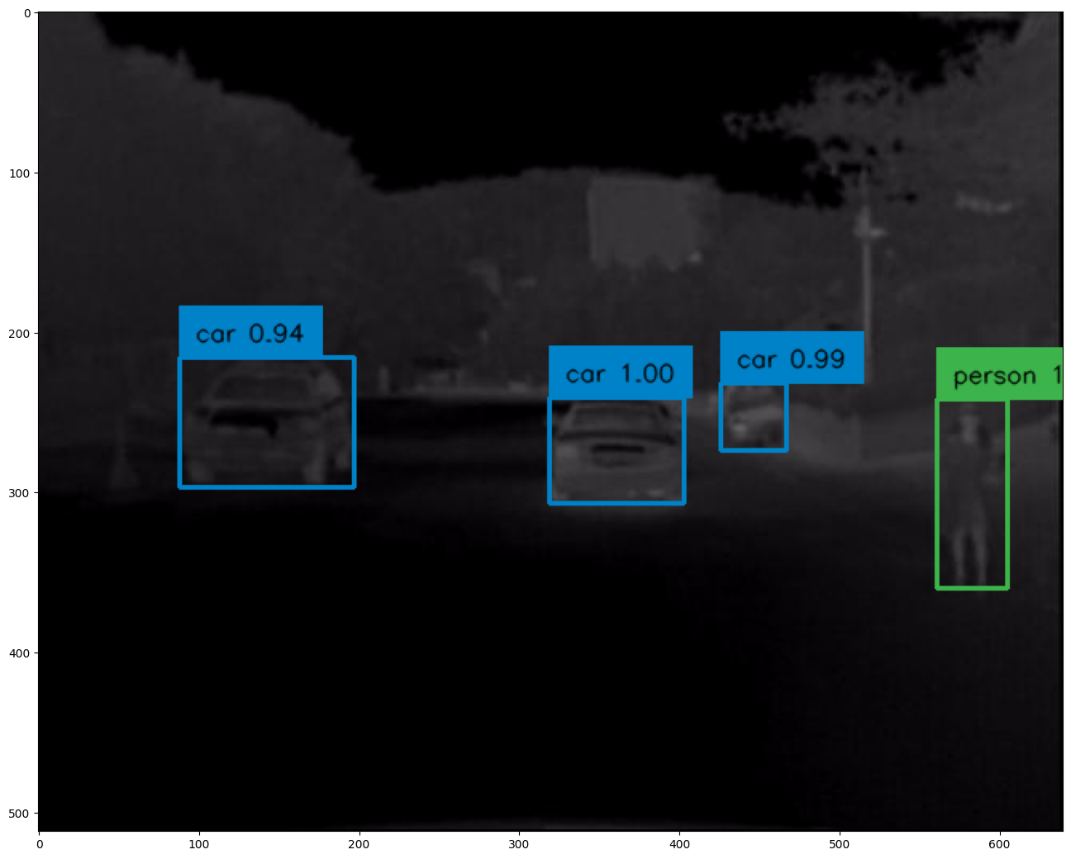
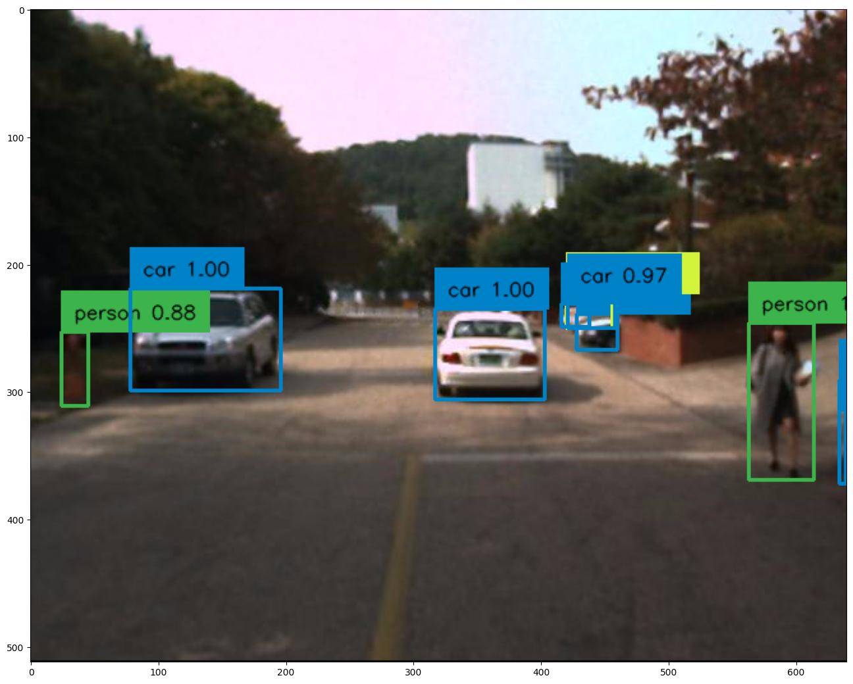
Fig: Thermal (IR)
Fig: RGB (visible)
DETR Architecture
Object Detection Result

