Slide 1
Comp 479
Name: Alan Fok
ID : 26816797

Slide 2
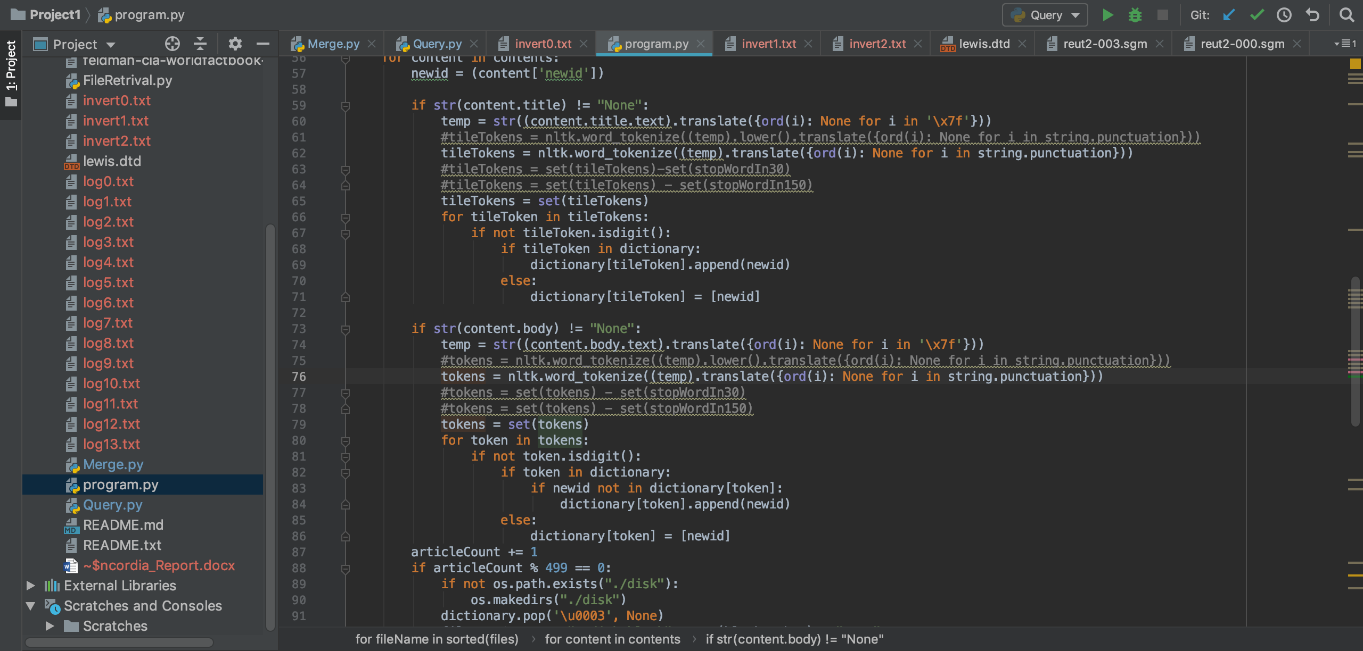
Tokenize

Slide 3
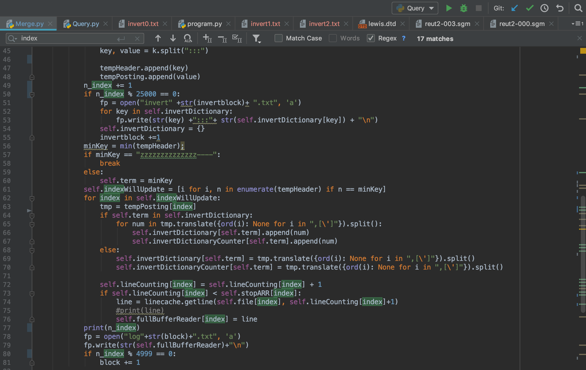

Merge

Slide 4

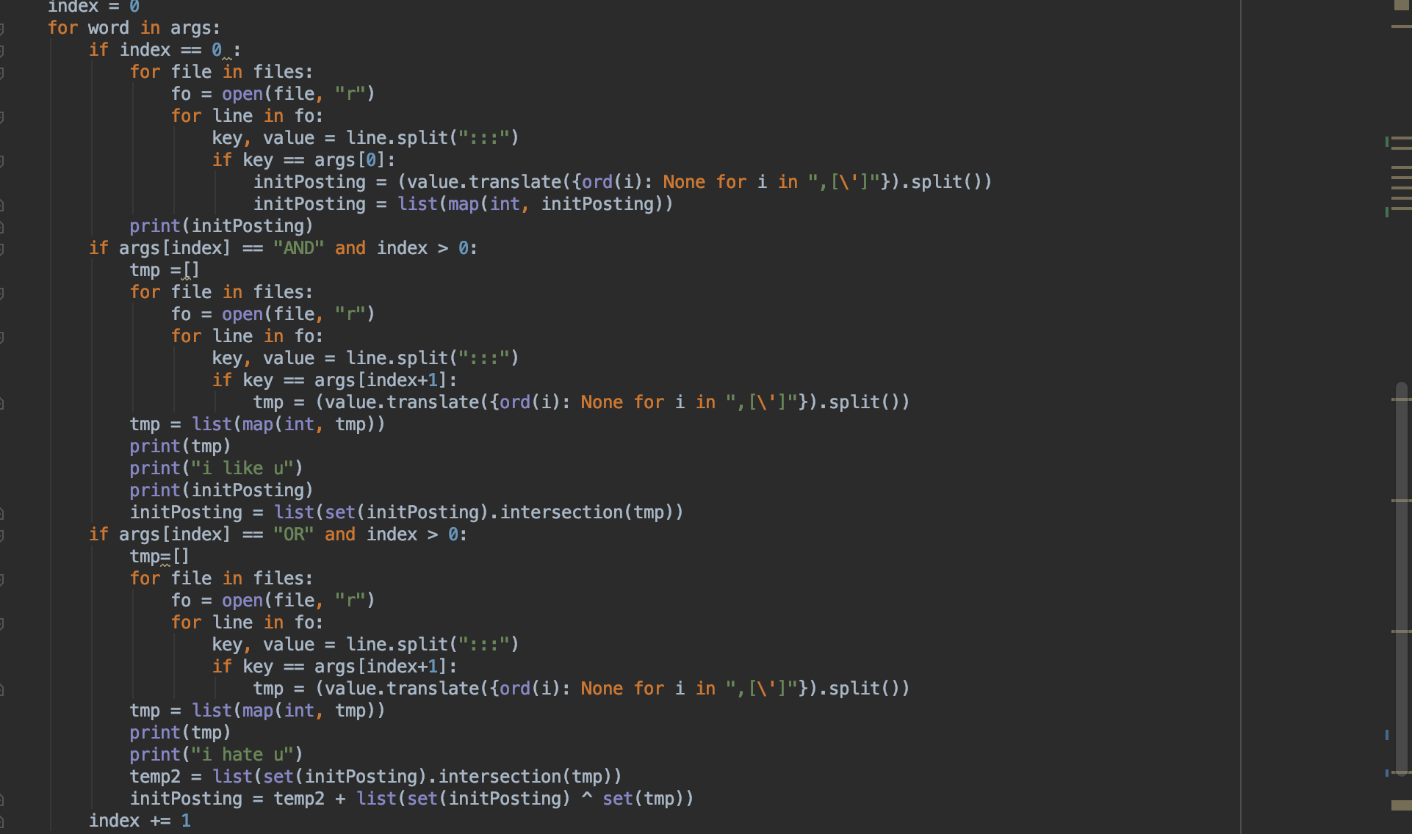
Query
Merging by loop the string query

