Slide 1
Klotho Gene
Effects on Aging
Allison Langhetee
BIOL 4097

Slide 2
Overview
Intro & Background
01
04
Current Research
Current Status
02
05
Conclusion
03
Effects on Aging
Sources
06
What is Klotho gene?
Discovery/History
Klotho gene structure & function

Slide 3
01
Introduction and Background

Slide 4
What is Klotho Gene?
Klotho (KL) gene makes Klotho protein which is very important in phosphate, vitamin D, and calcium regulation within the body
Klotho is found mostly in kidney cells since the kidneys are responsible for modulating these minerals
Klotho gene is located on chromosome 13, and the gene itself is around 5.2 kilobase pairs
Notes:
https://medlineplus.gov/genetics/gene/kl/
https://www.sciencedirect.com/topics/medicine-and-dentistry/klotho-protein https://www.sciencedirect.com/science/article/pii/S0085253815524605
https://pmc.ncbi.nlm.nih.gov/articles/PMC2637560/

Slide 5

Discovery of Klotho Gene
Klotho Gene was discovered by Dr. Makoto Kuro-o in 1997
The discovery of the Klotho gene was made accidentally after noticing decreased lifespan and organ failure after silencing this gene in mice models
They determined that this gene when present would inhibit aging, and when absent would accelerate aging
Notes:
https://pmc.ncbi.nlm.nih.gov/articles/PMC4531025/
https://www.openaccessgovernment.org/ageing-chronic-kidney-disease-biomedical-science/61319/

Slide 6
Discovery of Klotho Gene
Kuro-o was interested in studying hypertension, and created a study using transgenic mice to study his hypothesis that increasing Na⁺-proton transport causes hypertension
The transgene accidentally disrupted an existing gene, designating this mouse as useless for this study
However, Kuro-o and his team observed that the mouse began demonstrating signs of accelerated aging
They determined that the Klotho gene had been disrupted, and the deficiency in Klotho is what had caused the symptoms of aging in the mice
Notes:
https://pmc.ncbi.nlm.nih.gov/articles/PMC2743784/#S13
https://www.ahajournals.org/doi/full/10.1161/01.RES.76.1.148

Slide 7
Discovery of Klotho Gene
After discovering the Klotho gene from his hypertension study, Kuro-o performed experiments in which he overexpressed Klotho protein
He found that these mice had a lifespan around 20-30% longer than wild-type mice
These findings is why Klotho has been coined the “anti-aging gene”
Notes:
https://pmc.ncbi.nlm.nih.gov/articles/PMC2743784/#S13

Slide 8
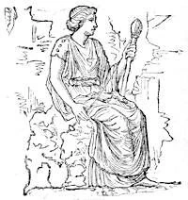
History of Klotho Gene
Klotho Gene was named after the goddess Clotho in Greek mythology
Clotho was the controller of life and was said to decide who lives or dies
For this reason, when the Klotho gene was discovered to be a determinant in ageing and lifespan, it was given its name in reference to the Greek goddess Clotho
Notes:
https://pmc.ncbi.nlm.nih.gov/articles/PMC7496967/
https://mythus.fandom.com/wiki/Clotho

Slide 9
02
Current Status

Slide 10
Klotho Structure
Klotho gene makes Klotho proteins, including α-Klotho, β-Klotho, and γ-Klotho
Klotho proteins are involved in the fibroblast growth factor (FGF) pathway, which is an important pathway for “embryonic development, tissue homeostasis, angiogenesis, tissue repair,” and other biological process related to growth
α-Klotho is involved in FGF23 signaling, β-Klotho is involved with FGF19 and FGF21 signaling, and γ-Klotho interacts with FGFR receptors, including FGFR 1b, 2c, and 4
Our main focus will be on α-Klotho
Notes:
https://pmc.ncbi.nlm.nih.gov/articles/PMC6611749/
https://lifesciences.danaher.com/us/en/library/fgf-pathway.html

Slide 11
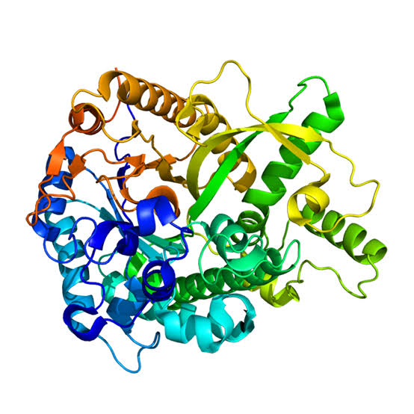
Klotho Structure
Membrane-bound and soluble forms of 𝛼-Klotho exist
The membrane-bound form primarily functions as a FGF23 binding site; this regulates phosphate and vitamin D levels
The soluble form is involved in calcium and potassium regulation through the TRPV5, TRPV6, and ROMK1 channels

Slide 12
Klotho Gene Function
𝛼-Klotho functions in several different ways:
  Role in insulin/IGF-1 pathways
  Role in Wnt signaling
  Regulates Ca2+ homeostasis
  Regulates Phosphate homeostasis
  Counteracts oxidative stress
Notes:
https://pmc.ncbi.nlm.nih.gov/articles/PMC4399270/

Slide 13
Klotho Gene Function
Role in insulin/IGF-1 pathways
  𝛼-Klotho plays a role in the IGF-1 pathway by decreasing the production of insulin and also increasing the body’s sensitivity to insulin
  Although unclear, some research has also indicated that Klotho is involved with indirectly regulating the insulin receptor substrate (IRS) and IGF-1 receptor
  It has been proposed that Klotho interacts with forkhead box proteins (FOXOs), increasing their activity and allowing cells to better handle stress and combat aging

Slide 14
Klotho Gene Function
Role in Wnt signaling
  It has been shown that Klotho decreases Wnt signaling, which is a pathway that regulates cell growth and development
  𝛼-Klotho acts as a Wnt antagonist, which can prevent excessive Wnt signaling and abnormal cell growth
Regulates Ca2+ homeostasis
  Presence of soluble 𝛼-Klotho can increase the presence of the calcium channel TRPV5 on the cellular membrane, which increases the activity of the channel and allowing the kidneys to reabsorb more calcium before it is excreted through the urine

Slide 15
Klotho Gene Function
Regulates phosphate homeostasis
  𝛼-Klotho interacts with the receptor on FGF23, which signals a protein kinase cascade, which ultimately prevents the reabsorption of phosphate in the kidneys, and allows excess phosphate to be excreted in the urine
Counteracts oxidative stress
  Very pertinent to our study of aging because oxidative stress can damage DNA and accelerate aging
  𝛼-Klotho plays a role in the phosphorylation of FOXO3a, which limits generation of reactive oxygen species (ROS) in the mitochondria
  Increased expression of Klotho also has shown to increase the presence of MnSOD, which is an antioxidant that can neutralize radical byproducts of ROS

Slide 16
03
Effects on Aging

Slide 17
Effects on Aging
Mutations in the Klotho gene can result in several different conditions consistent with accelerated aging:
  Chronic kidney disease
  Hypoactivity
  Sterility
  Skin thinning
  Muscle atrophy
  Osteoporosis
  Vascular calcifications
  Soft-tissue calcifications
  Defective hearing
  Thymus atrophy
  Pulmonary emphysema
  Ataxia
  Pituitary gland abnormalities
  Hypoglycemia
  Hyperphosphatemia
  High-plasma calcitriol levels
Notes:
https://www.sciencedirect.com/science/article/pii/S0085253815524605

Slide 18
04
Current Research

Slide 19
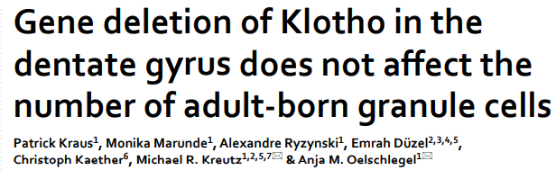
Current Research
Notes:
https://www.nature.com/articles/s41598-026-54703-w
https://pubmed.ncbi.nlm.nih.gov/25977081/

Slide 20
Current Research
This study by Kraus, et al. looked at how Klotho gene is implicated in adult hippocampal neurogenesis (AHN)
AHN is the process by which “new functional neurons are generated from adult neural stem cells” in the region of the hippocampus called the dentate gyrus (DG)
Klotho had been determined to be present in the DG through previous research, but no reports were made as to its necessity in the process of AHN

Slide 21
Methods
The researchers created “Klotho DG specific knockout mice” through a POMC-Cre recombinase, which removed Klotho in the DG granule cells
Fluorescence in situ hybridization (FISH) was used to detect molecules of mRNA; they found a significant decrease in Klotho in DG cells compared to other hippocampal regions
The researchers then used bromodeoxyuridine (BrdU), a chemical used to help track cell division
Injections of BrdU were given every 8 hours to track potential neurogenesis
Mice were then euthanized for brain analysis

Slide 22
POMC-Cre
POMC refers the to POMC promoter, which will manage transcription of POMC (pro-opimelanocortin) gene
Cre-lox system is a method of altering the genome via the enzyme Cre recombinase
To create the knockout Klotho gene, the researchers edited the mice genomes to make a Klotho-flox lox/lox
  Flox indicates the gene being edited (in this case Klotho); A floxed gene is surrounded by lox sites which designate where to cut when Cre is present
Therefore, our WT mice were POMC-Cre negative (no Cre present so no knockout) and KO mice were POMC-Cre positive (Cre present so knockout gene)
Notes:
https://pmc.ncbi.nlm.nih.gov/articles/PMC8372657/
https://www.jax.org/news-and-insights/jax-blog/2011/september/cre-lox-breeding

Slide 23
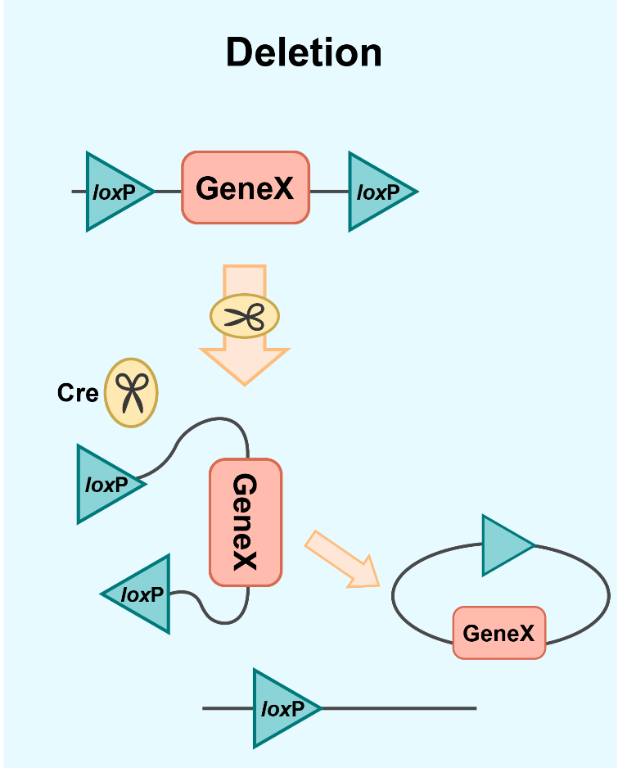
POMC-Cre

Slide 24
FISH
Fluorescence in situ hybridization (FISH) is a method of using dyes to visualize genetic material
The dye attaches to a specific marker and allows researchers to determine if a certain sequence of DNA is present, or in this case, not present
In this study, the researchers used FISH to confirm that Klotho mRNA had decreased in the DG as they expected it to, while Klotho mRNA in surrounding hippocampal areas were still present
Notes:
https://www.genome.gov/genetics-glossary/Fluorescence-In-Situ-Hybridization-FISH

Slide 25
Results
The researchers found that the Klotho knockout gene in the DG led to observed changes in AHN
Specifically, the mice with the Klotho-deletion gene had fewer BrdU-positive cells compared to controls for neurons that were 7-10 days old and 14-17 days old
However, between 21-28 days, there was no observable difference in the number of cells
The researchers concluded that Klotho in the DG is “required for AHN during a temporally restricted window”, and when removed, more cells are at risk of dying early
They also found no significant effect of Klotho on stem cells, neuronal progenitor cell proliferation, or gliogenesis

Slide 26
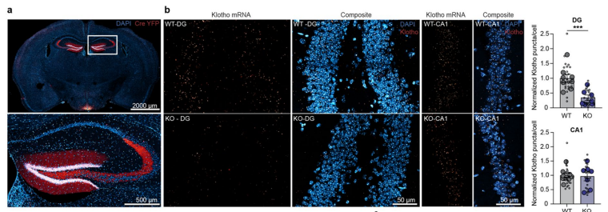
Results
Fig. 1a shows POMC-Cre in the DG, confirming the knockout gene would be isolated to the DG region
Fig. 1b shows FISH data that confirms low levels of Klotho mRNA within the DG while no changes in other regions

Slide 27
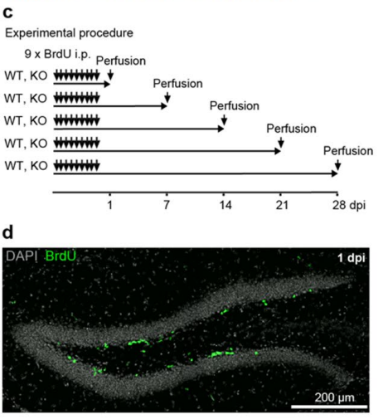
Results
Fig. 1c shows the timeline for BrdU injections and sacrificing the mice to track AHN in several stages
Fig. 1d shows BrdU-positive levels via immunohistocompatibility (IHC), 1 day post injection

Slide 28
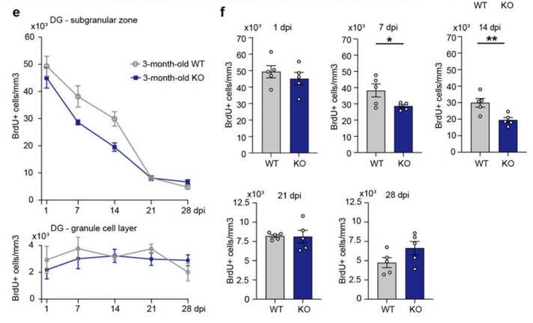
Results
Fig. 1e shows survival of neuronal cells over days post injection in subgranular zone and granule cell layer of DG; In KO mice, fewer neurons survived to maturation in early days post injection
Fig. 1f shows Days 7 and 14 dpi were significant but not significant at 21 or 28 dpi

Slide 29
Interpretation
The research by Kraus, et al. tells us in which region and during what time frame the Klotho gene is most important
Previous studies have referred to Klotho gene as the “anti-aging protein”, but this study shows that Klotho works differently:
  Aging is tied to a decrease in neural stem cells and progenitor cells, whereas decreased Klotho specifically decreases survival of developing neurons, suggesting a related but not direct tie of Klotho gene to aging
Because Klotho naturally decreases with age and is associated with cognitive decline, future directions look to how Klotho deficiency could contribute to decreased quality of neurons that survive to maturation

Slide 30
05
Conclusion

Slide 31
Conclusion
We started with an introduction of Klotho gene, its discovery, and the story behind its name
We then discussed the different Klotho protein structures produced by the Klotho gene and the different roles they perform
We also talked about the different functions of 𝛼-Klotho and its involvement in different pathways, especially its implications for aging
Next we discussed how mutations in the Klotho gene may lead to symptoms and conditions associating with aging

Slide 32
Conclusion
Our discussion continued with current research on the Klotho gene and how it may serve a purpose in adult hippocampal neurogenesis
From this study we looked at methods, analysis, and results
Finally, we used the scientific results to interpret Klotho’s role in aging and predict where future research may be focused

Slide 33
06
Sources

Slide 34
Sources
https://www.ahajournals.org/doi/full/10.1161/01.RES.76.1.148
https://en.vectorbuilder.com/resources/vector-academy/lessons/cre-lox.html
https://lifesciences.danaher.com/us/en/library/fgf-pathway.html
https://medlineplus.gov/genetics/gene/kl/
https://mythus.fandom.com/wiki/Clotho
https://phys.org/news/2018-03-anti-aging-protein-alpha-klotho-molecular.html
https://pmc.ncbi.nlm.nih.gov/articles/PMC2637560/
https://pmc.ncbi.nlm.nih.gov/articles/PMC2743784/#S13
https://pmc.ncbi.nlm.nih.gov/articles/PMC4399270/
https://pmc.ncbi.nlm.nih.gov/articles/PMC4531025/
https://pmc.ncbi.nlm.nih.gov/articles/PMC6611749/
https://pmc.ncbi.nlm.nih.gov/articles/PMC7496967/

Slide 35
Sources
https://pmc.ncbi.nlm.nih.gov/articles/PMC8372657/
https://pubmed.ncbi.nlm.nih.gov/25977081/
https://www.genome.gov/genetics-glossary/Fluorescence-In-Situ-Hybridization-FISH
https://www.jax.org/news-and-insights/jax-blog/2011/september/cre-lox-breeding
https://www.nature.com/articles/s41598-026-54703-w
https://www.openaccessgovernment.org/ageing-chronic-kidney-disease-biomedical-science/61319/
https://www.sciencedirect.com/science/article/pii/S0085253815301277
https://www.sciencedirect.com/science/article/pii/S0085253815524605
https://www.sciencedirect.com/topics/medicine-and-dentistry/klotho-protein

Slide 36
Questions/
Comments?

