Slide 2
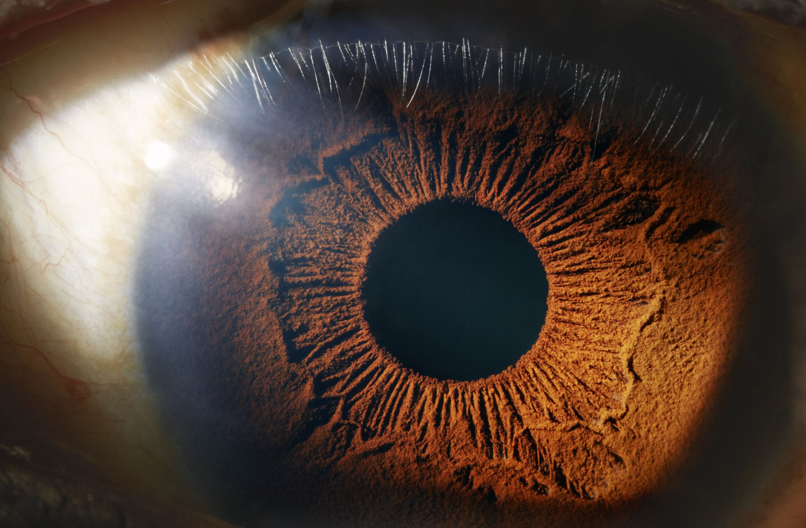
Other parts of the body take time to warm up not the eyes
Babies don’t produce tears when they cry till 4-13 weeks old
Eyes stay the same size but your nose and ears continue to grow
Half your brain is involved with seeing
Your eyes can distinguish 10million different colours
8% of vision problems world wide can be cured
Eyes are very quick healers
39 million people are blind

Slide 3
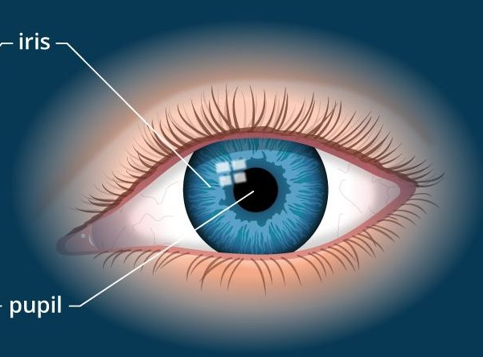

The eye is an amazing organ. It is complex and perfectly adapted for its function.
The iris is a muscle that we can’t consciously control.
It responds to light and narrows or expands the pupil.
“If you close your eye
and get your partner to
shine a phone light at an
angle into your eye. Then
open you eyes they will
see the iris contracting to
narrow the pupil.”
Notes:
Image: vision art eye care

Slide 4
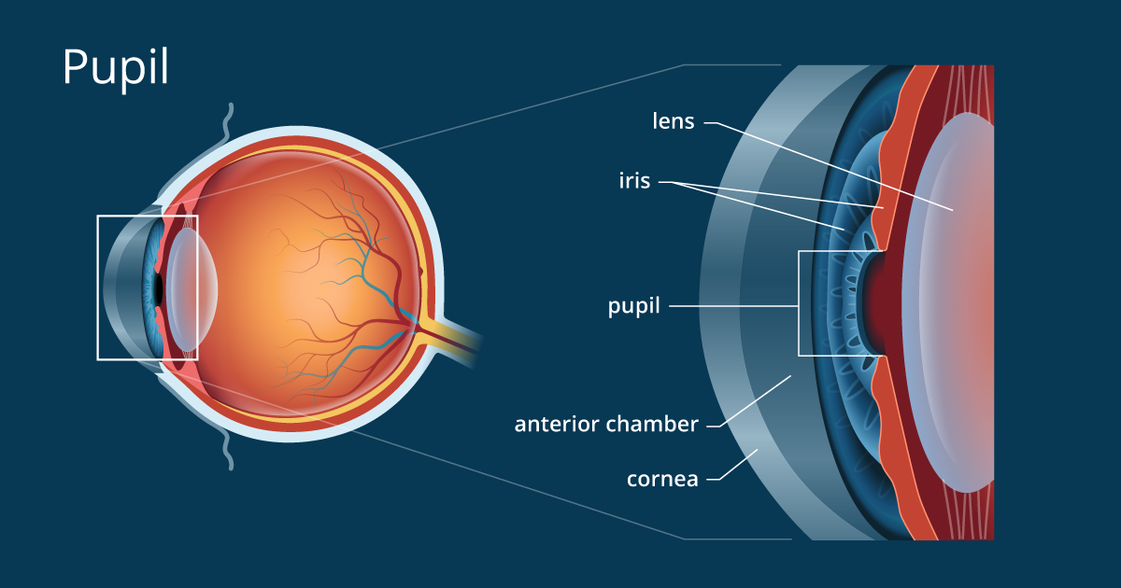
The cornea is a transparent tissue that covers the front of the eye. It is responsible for most of the refraction of light for focusing.
Cornea

Slide 5
Light travels through the pupil, which is a hole leading into the lens of the eye.

Slide 6
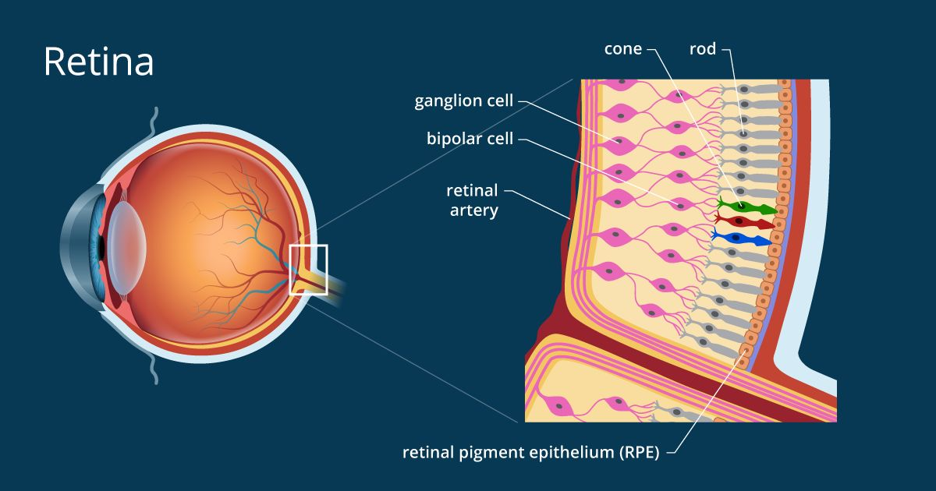
Light rays are focused by the lens onto the back of the eye called the retina. Specialised cells called photoreceptors respond to light.

Slide 7
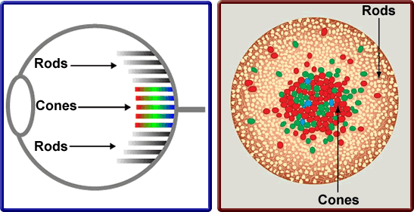
There are two types of photoreceptors ‘Rods’ and ‘Cones’.
Cones are sensitive to
Bright light and colours
Rods are sensitive to
movement and dim light

Slide 8
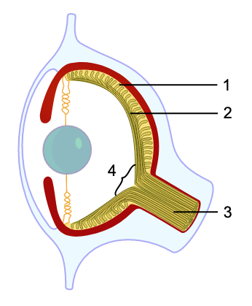
We have a blind spot. There are no rods or cones where the cells join to make the optical nerve. [part 4 on diagram]
Where is that place on the diagram?
“To find your blind spot draw
these two symbols 15cm apart
In your book.
Cover one eye with your hand
And focus on one symbol.
Move your head closer or
further till you can not see the
other symbol. When you can’t see
it that is because it is your
blind spot.”
☓

Slide 9
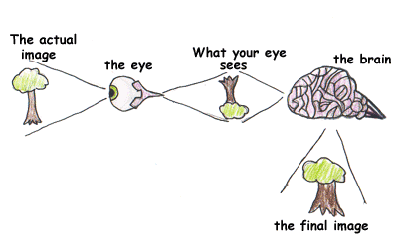
When light come from an object and passes into your eye to the retina the image is inverted (upside down). Your brain sorts the image to make it the right way up.

Slide 10
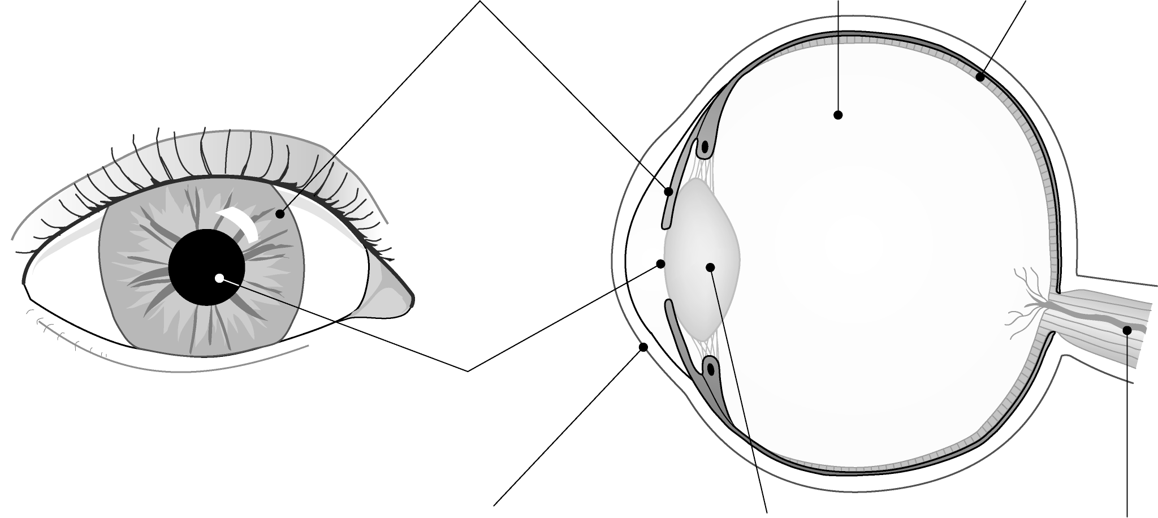
Review
Vitreous
humor
Iris
Retina
Pupil
Cornea
Lens
Optical
nerve

Slide 11
How is light focused on the retina?
The eye is a double lens consisting of the cornea, and the lens just behind it.
The focal length of the lens can be changed using the ciliary muscle. This allows the eye to focus on near or distant objects.
Ciliary muscle
Cornea
Lens
Retina
Iris
Optic nerve

Slide 12
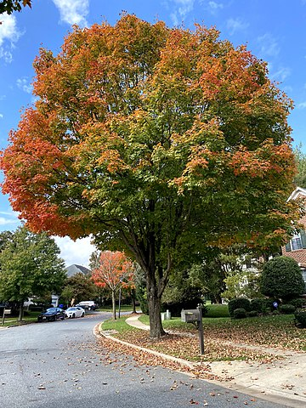
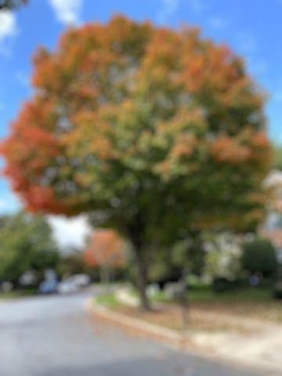
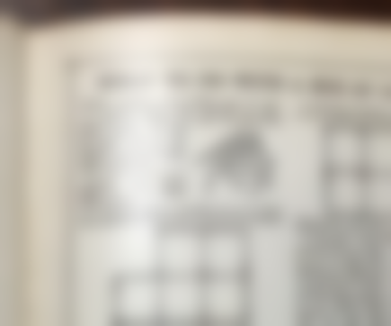
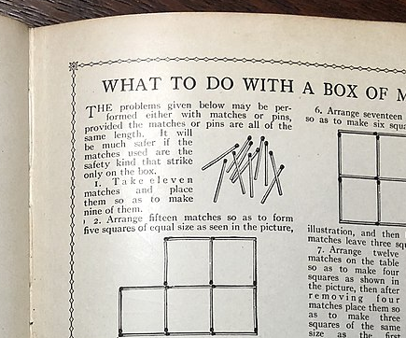
Long sighted Short sighted
CC0
CC0
CC0
CC0

Slide 13
What does short sighted mean?
A Short-Sighted person can focus on nearby objects but not distant objects.
CC0

Slide 14
What kind of lens can correct short-sightedness?
Short-Sight can be corrected with a Diverging Lens (concave)
Cannot focus on distant objects
A concave lens allows you to focus

Slide 15
What does long sighted mean
A Long-Sighted person cannot see nearby objects clearly.
Some (but not all) can see distant objects clearly.
CC0
CC0

Slide 16
What kind of lens can correct Long-sight?
Long-Sight can be corrected with a converging Lens (convex)
Long sight
Cannot focus on near objects
Focus corrected with convex lens

Slide 17
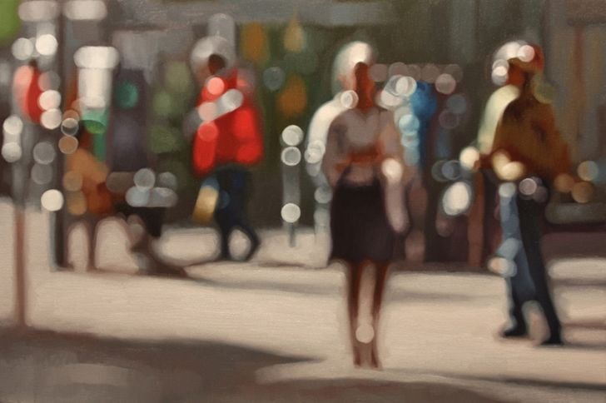
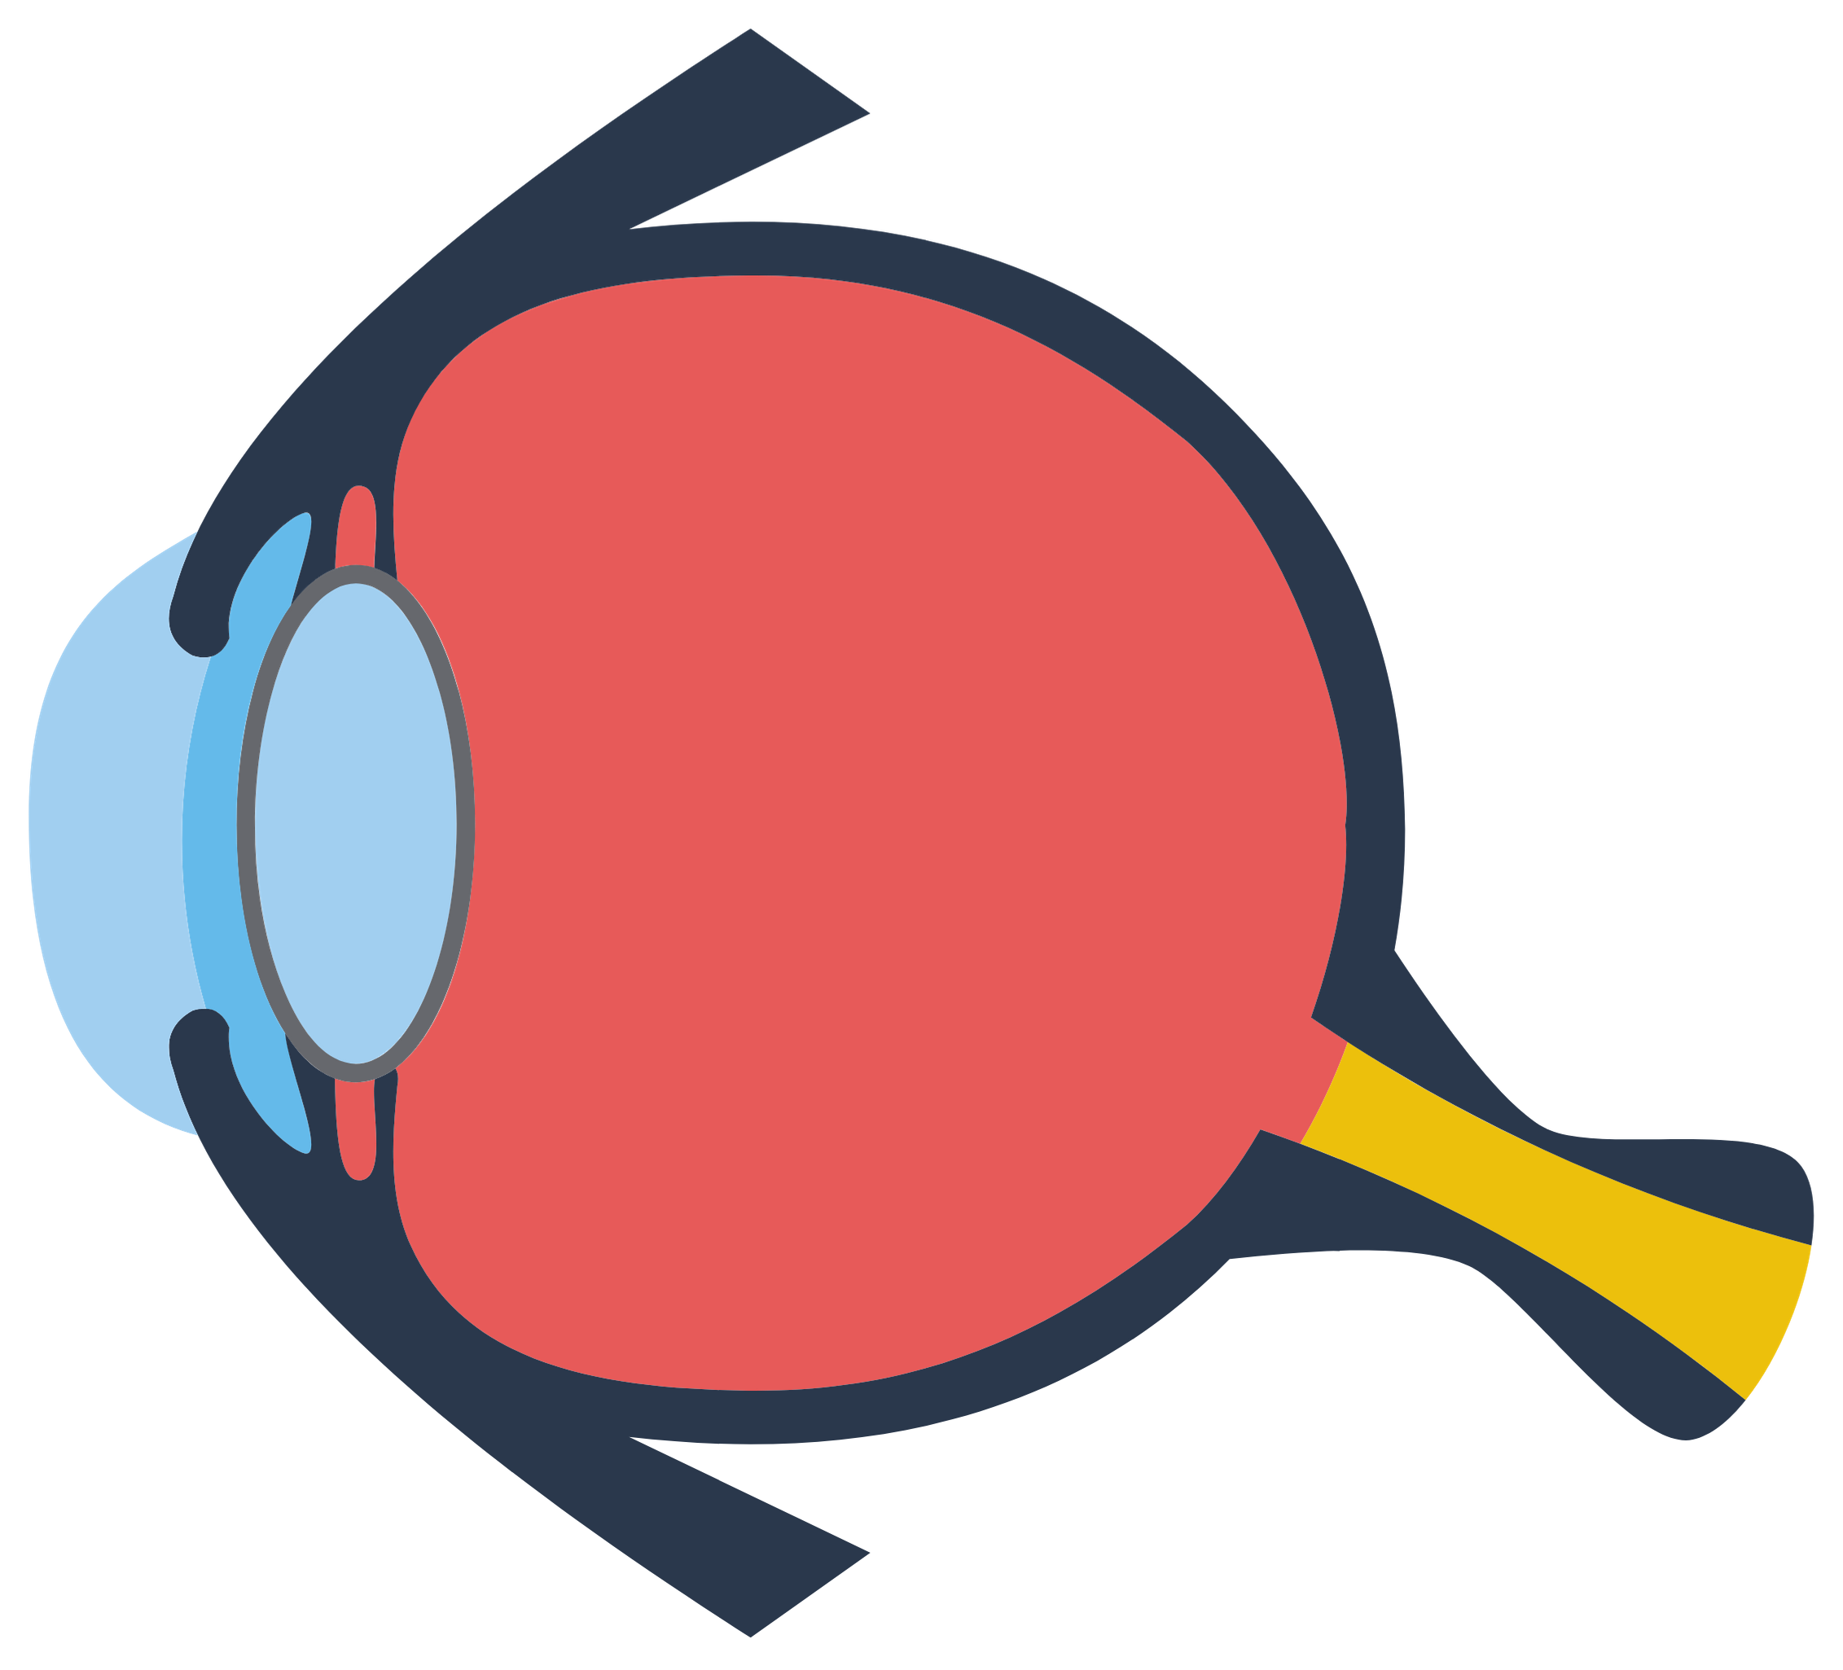
If you are short sighted you can’t see distance objects clearly
Reason: Image is in front
Of the retina
Eye ball is too long
Cornea or lens refracts
Light too much
Light rays not focused
in front of the retina.

Slide 18
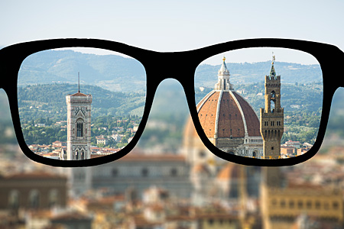
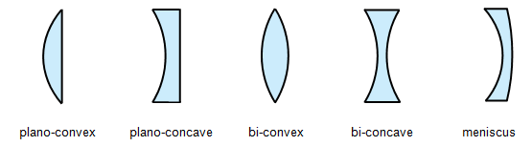
Light waves spread out from the concave lens before entering the eye lens.
Solution: Concave lens
Light is focused on
the retina giving a
sharp image.

Slide 19
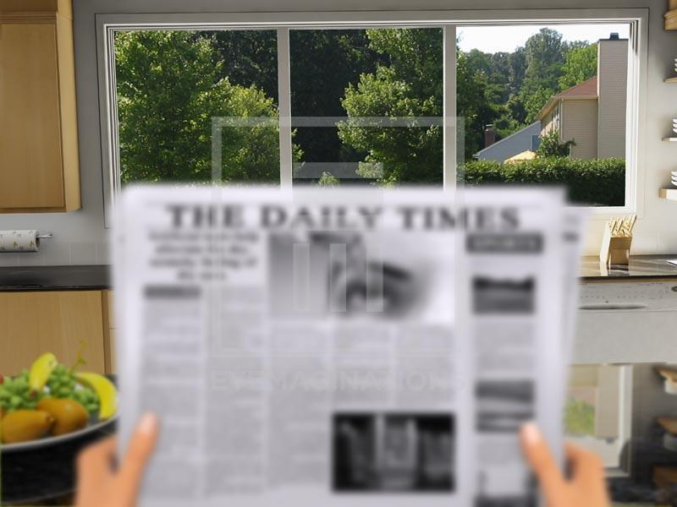
If you are long sighted you can’t see close by objects clearly.
Reason: Image is behind
the retina
Eye ball is too short
Cornea or lens can’t
Refract the light enough
Light rays focused
behind the retina

Slide 20

Light waves are pulled in by the convex lens before entering the eye lens.
Solution: Convex lens
Light is focused on
the retina giving a
sharp image.

