Slide 1
SUVAT EQUATIONS

Slide 2
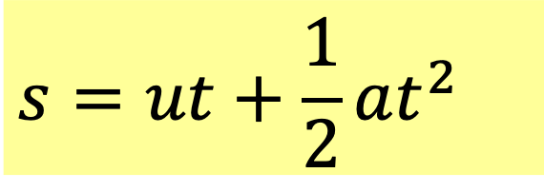
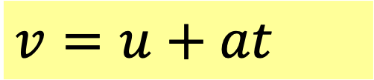
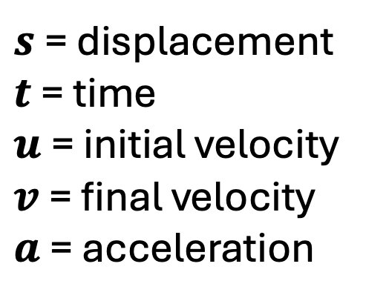
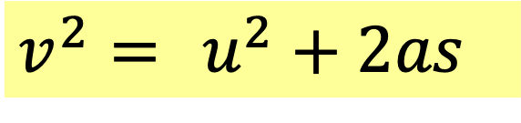
Write the 3 equations of motion
If acceleration is constant, then..
$$v=u+at$$
$s$ = displacement
$t$ = time
$u$= initial velocity
$v$= final velocity
$a$ = acceleration
$$s=ut+\frac{1}{2}at^{2}$$
$$v^{2}= u^{2}+2as$$
Also called kinematic equations
Also called “suvat” (from the symbols )

Slide 3
Derive the 3 equations of motion
(Higher Level)

Slide 4
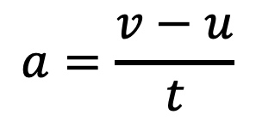
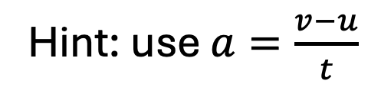
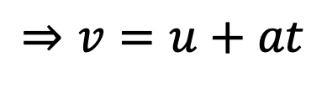

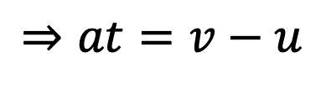
Derive $v=u+at$
Hint: use $a=\frac{v−u}{t}$
$$a=\frac{v−u}{t}$$
(definition of acceleration)
$$⇒at=v−u$$
$$⇒v=u+at$$

Slide 5

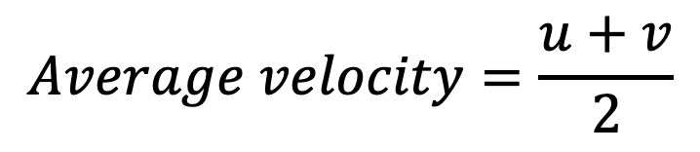
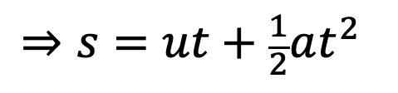
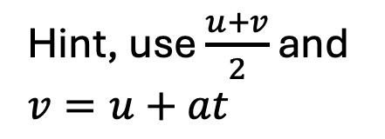
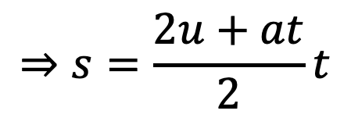
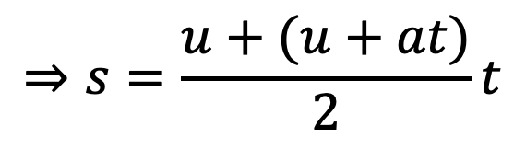
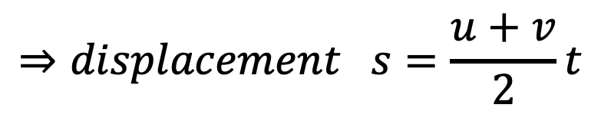
Derive $s=ut+\frac{1}{2}at^{2}$
Hint, use $\frac{u+v}{2}$ and $v=u+at$
$$Average velocity=\frac{u+v}{2}$$
For constant acceleration:
$$⇒displacement s=\frac{u+v}{2}t$$
(displacement = vt)
$$⇒s=\frac{u+(u+at)}{2}t$$
(because v= u+at)
$$⇒s=\frac{2u+at}{2}t$$
$$⇒s=ut+\frac{1}{2}at^{2}$$

Slide 6


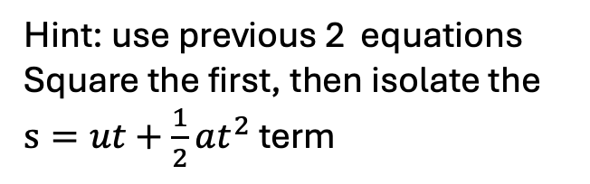


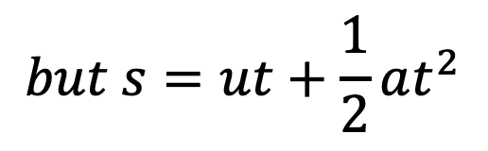
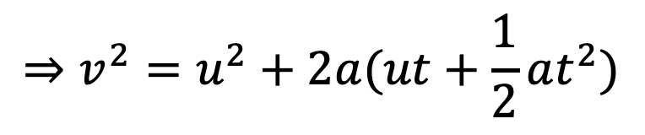
Derive $v^{2}=u^{2}+2as$
Hint: use previous 2 equations Square the first, then isolate the $s=ut+\frac{1}{2}at^{2}$ term
$$v=u+at$$
$$⇒v^{2}=u^{2}+2aut+a^{2}t^{2}$$
$$⇒v^{2}=u^{2}+2a(ut+\frac{1}{2}at^{2})$$
$$but s=ut+\frac{1}{2}at^{2}$$
$$⇒v^{2}=u^{2}+2as$$

