Slide 1
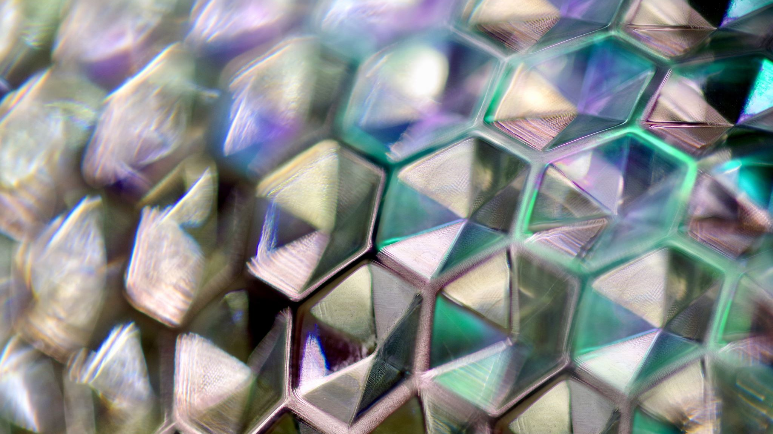
Total Internal Reflection

Slide 2
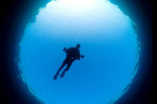
Snell’s Window
Light passing from water to air can only emerge through a cone with a circle of radius r at the surface.
All other rays outside of this cone cannot escape into the air due to total internal reflection.
If you are underwater and looking upwards,light from outside can only enter the water through a circle divers call Snell’s Window.

Slide 3
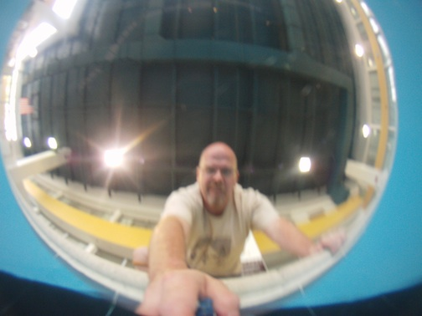
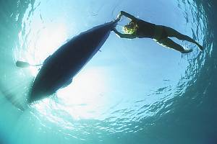
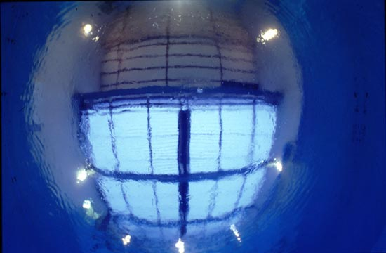
Snell’s Window

Slide 4
Prisms
PHET.COLORADO.EDU
Prism Simulation using red light

Slide 5
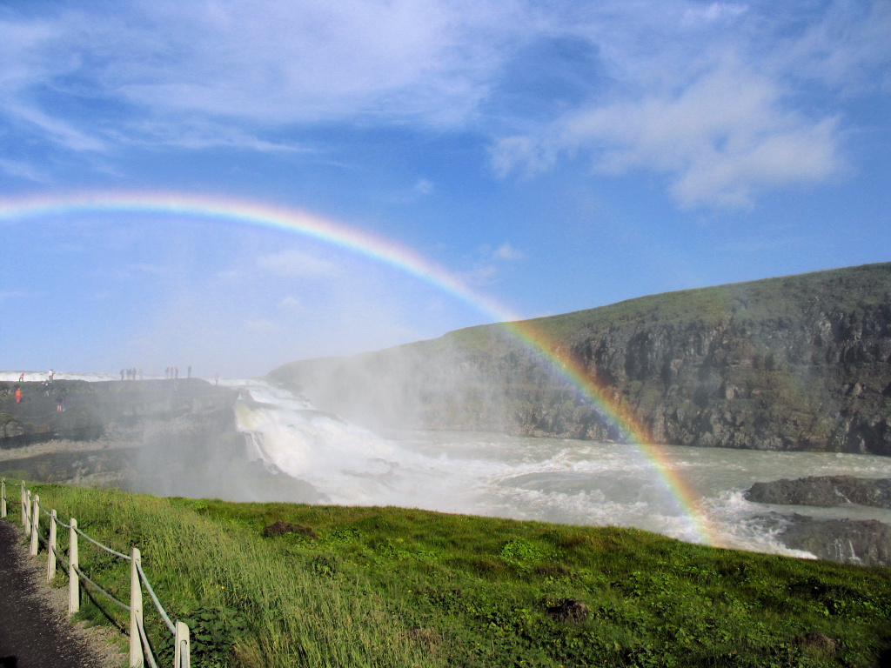
rainbow

Slide 6
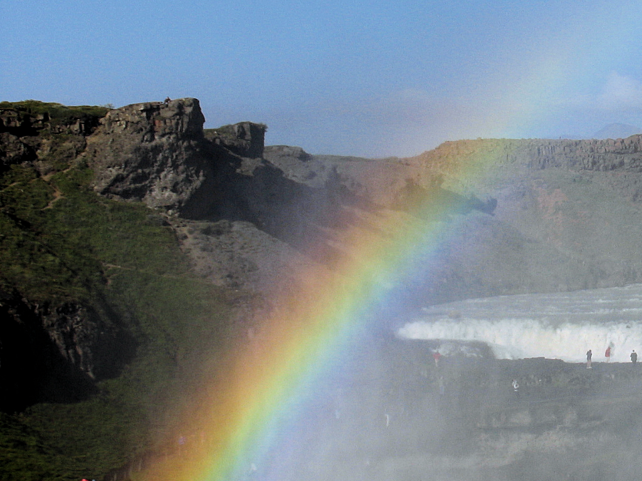
7 colours ?
Notes:
Newton divided the spectrum into seven named colors: Red, Orange, Yellow, Green, Blue, Indigo, and Violet; or ROYGBIV. He chose seven colors out of a belief, derived from the ancient Greek philosophers, that there was a connection between the colors, the musical notes, the known objects in the solar system, and the days of the week. (http://en.wikipedia.org/wiki/Optical_spectrum)

Slide 7
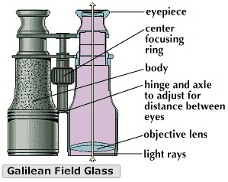
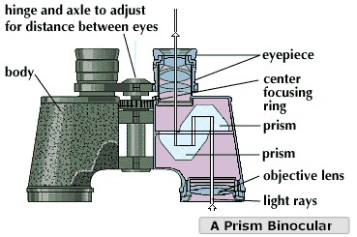
Uses of prisms

Slide 8
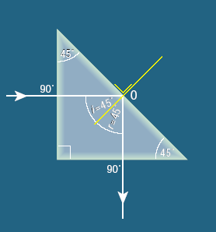
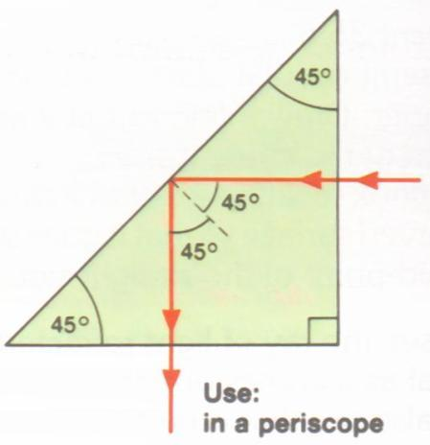
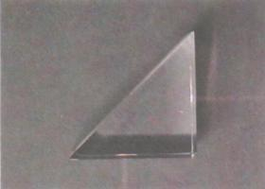
Using T.I.R. in a prism to deviate light through 90°

Slide 9

Critical angle of glass in prism 41.9º (approx)
Light from air to glass at 90º
No Refraction
Light attempting to go from glass to air but angle of incidence greater than critical angle.
45⁰
Total Internal Reflection
45⁰
Light from glass to air at 90º
No Refraction

Slide 10
Critical angle of glass in prism 41.9º (approx)
Light from air to glass at 90º
No Refraction
Light attempting to go from glass to air but angle of incidence greater than critical angle.
45⁰
Total Internal Reflection
45⁰
Light from glass to air at 90º
No Refraction

Slide 11
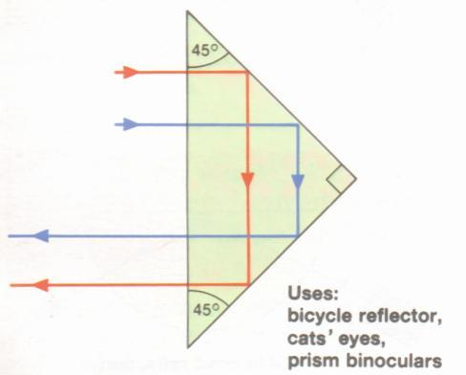
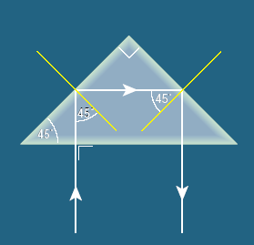
Using T.I.R. in a prism to deviate light through 180°

Slide 12

Critical angle of glass in prism 41.9º (approx)
Light from air to glass at 90º
No Refraction
45⁰
Light attempting to go from glass to air but angle of incidence greater than critical angle.
45⁰
45⁰
Total Internal Reflection
45⁰
Light from glass to air at 90º
No Refraction

Slide 13
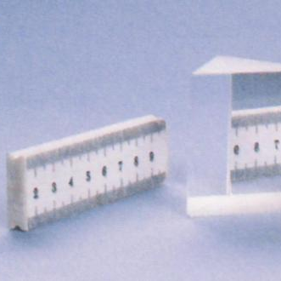
TIR –Prism & Ruler
When the angle of incidence exceeds the critical angle, light is totally internally reflected.
Here we see that the image of a ruler is totally reflected from the back surface of a triangular prism.

Slide 14
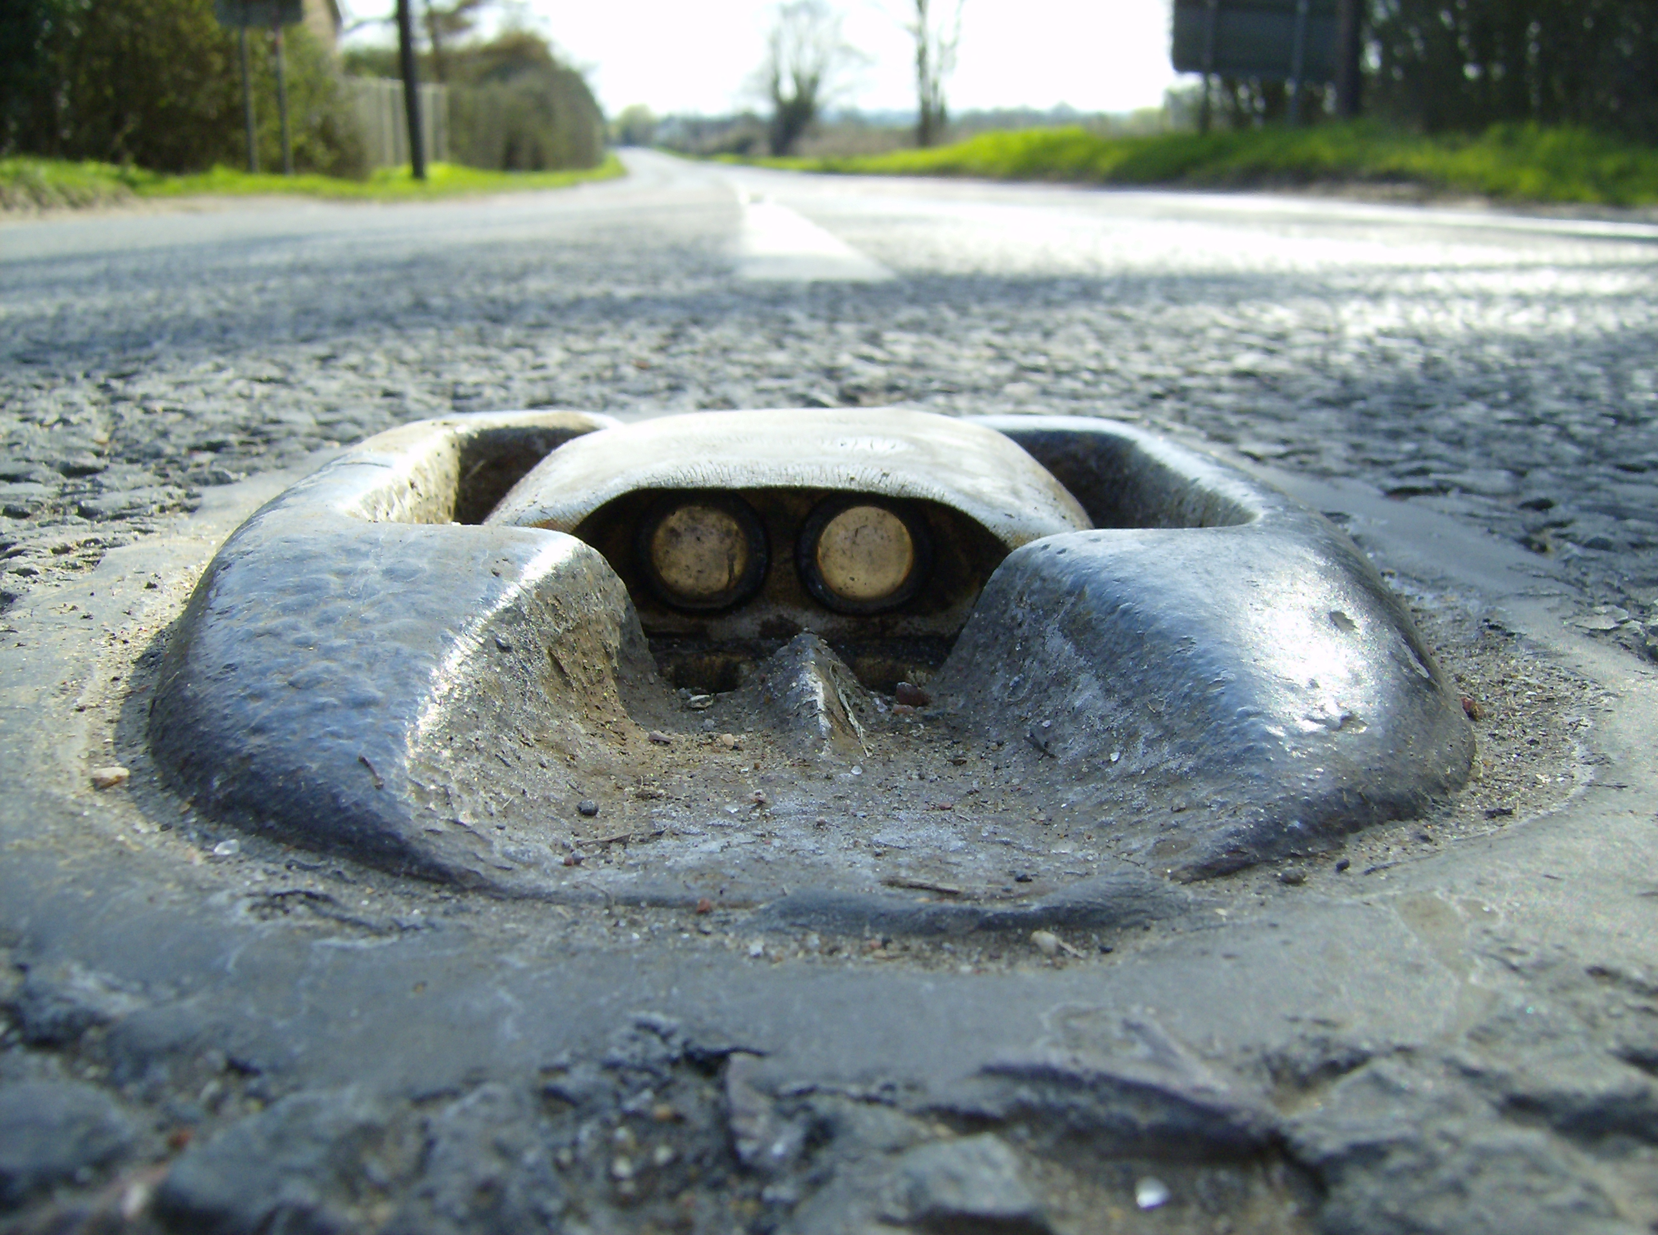
Applications of T.I.R.
“Cat’s eyes” on the road are made from tiny prisms that reflect light back to drivers by total internal reflection.

Slide 15
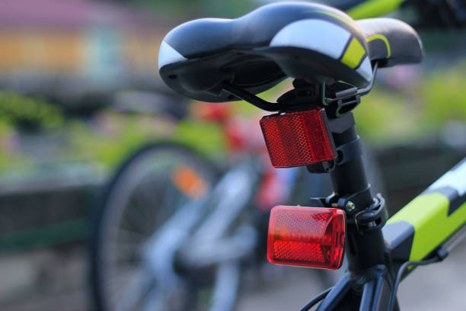
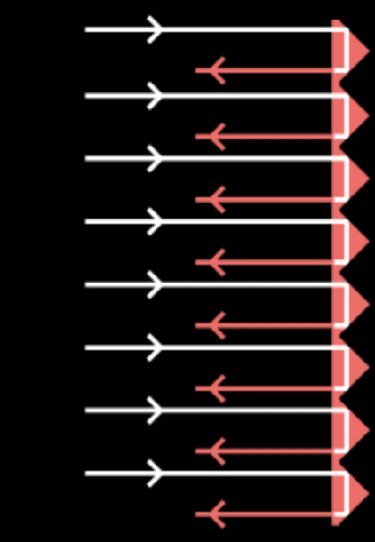
T.I.R. is Used in
Car/Bicycle Reflectors

Slide 16
Example: Prism reflectors
Light that is internally reflected in a 90⁰ prism will always reflect back to where it came from.
This principle is used in bicycle reflectors, in road signs and in reflective strips on clothing.
These prisms use a corner reflector arrangement so as to work in 3 dimensions. Hundreds or thousands of tiny prisms are used in road signs.
Prism based
retroreflectors

Slide 17
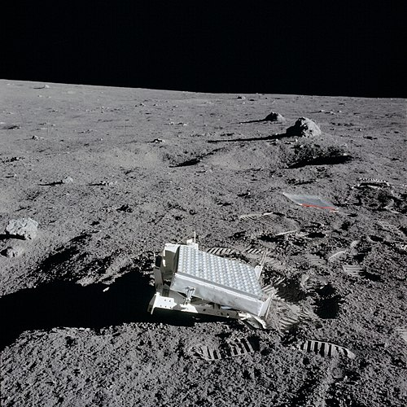
Retro reflectors on the moon
There are 7 retro-reflectors on the moon.
5 were placed there on the Apollo missions and have a prism design.
They allow very precise measurements to be made of the moon’s position relative to earth.
CC0

Slide 18
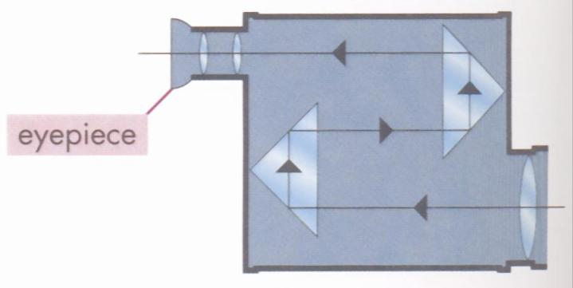
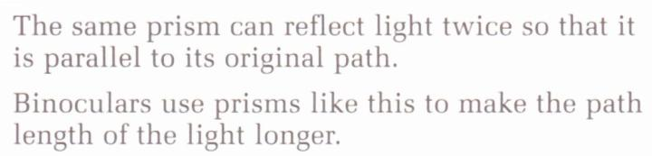
T.I.R. is used in prism binoculars

Slide 19
Uses of prisms

Slide 20
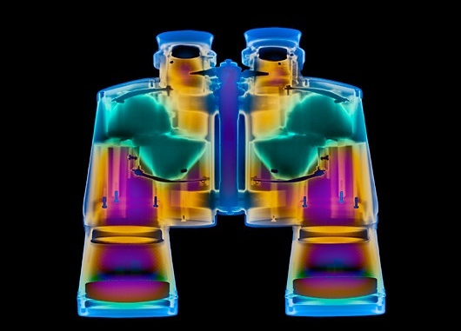

Slide 21
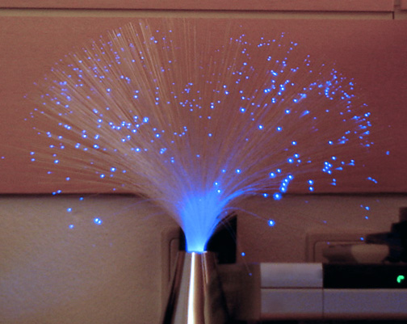

What is an Optical Fibre
A very thin transparent fibre of glass or plastic through which light can pass.

Slide 22
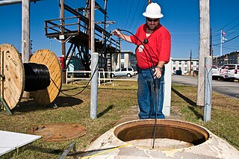
Use of Optical Fibres
Optic fibres are used in communication networks for transmitting data or video signals.

Slide 23
How do Optical Fibres transmit information?
The information is sent as a pulsating laser beam. The angle of incidence is always greater than the critical angle. Total internal reflection keeps the beam inside the fibre.

Slide 24
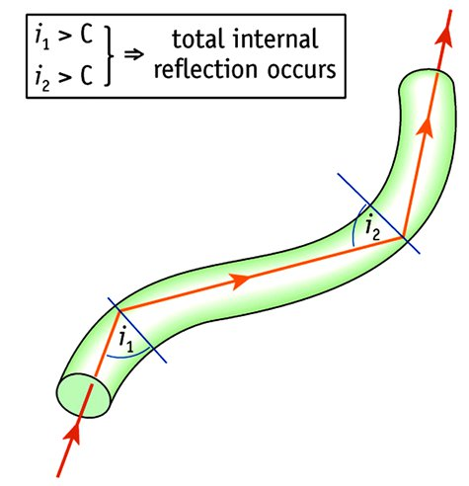

Optical Fibres
A very thin transparent rod (usually of glass) through which light can travel by total internal reflection is called an Optical Fibre.

Slide 25
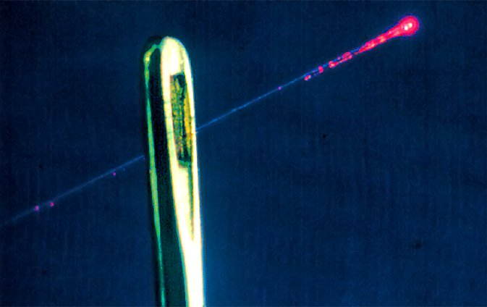
A very fine optical fibre passing through the eye of a needle

Slide 26
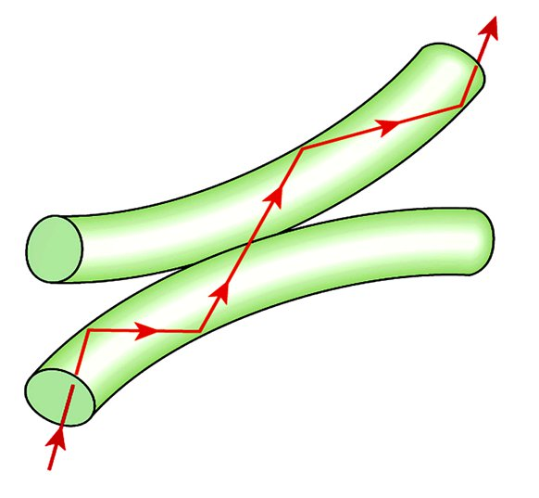
If two Optical Fibres touch, light may escape from one and pass into the other.

Slide 27
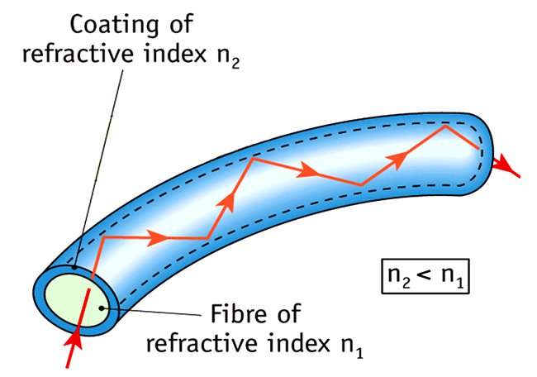
Optical fibres are usually coated with glass of lower refractive index.
This ensures that light always stays in the inner denser glass even if two fibres touch each other.
It also prevents damage to the surface of the denser inner fibre.

Slide 28
What is cladding on an optic fibre?
Inner core
Cladding
Many optic fibres are constructed with an inner core which carries the light signal and a thin outer “cladding” made of a similar material but with a lower refractive index.

Slide 29
Where does the total internal reflection occur?
Inner core
Cladding
Total internal reflection occurs at the boundary between the two materials

Slide 30
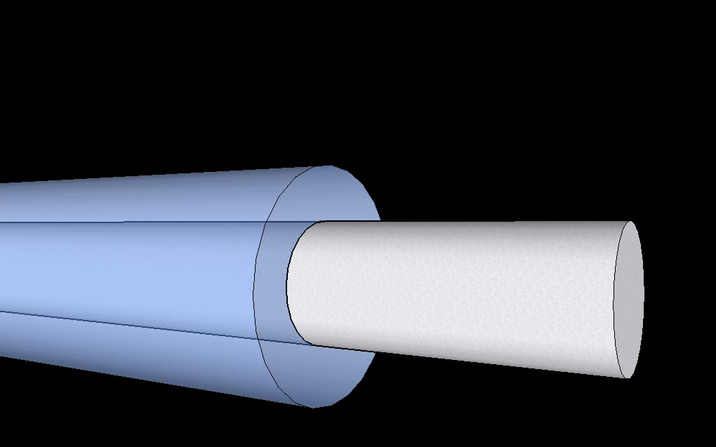
Optic Fibre
Glass cladding of low refractive index
Glass core of high refractive index

Slide 31
Exercise
The inner core and outer cladding of an optic fibre have refractive indices of 1.42 and 1.47 respectively. What is the Critical angle for light travelling in the core?
Inner core
Cladding
75.01º

Slide 32
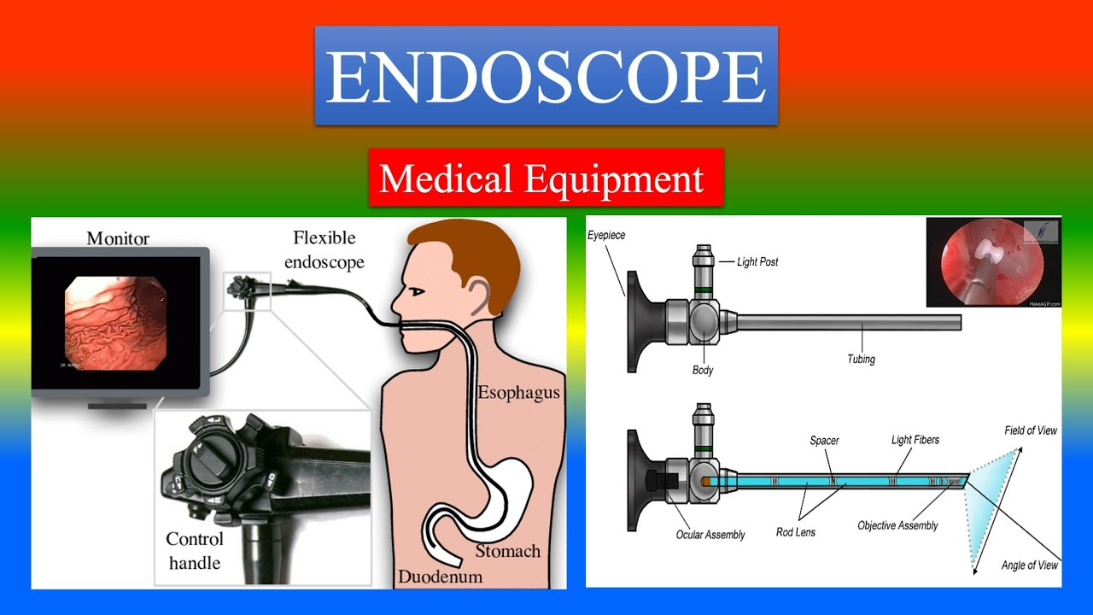

Slide 33
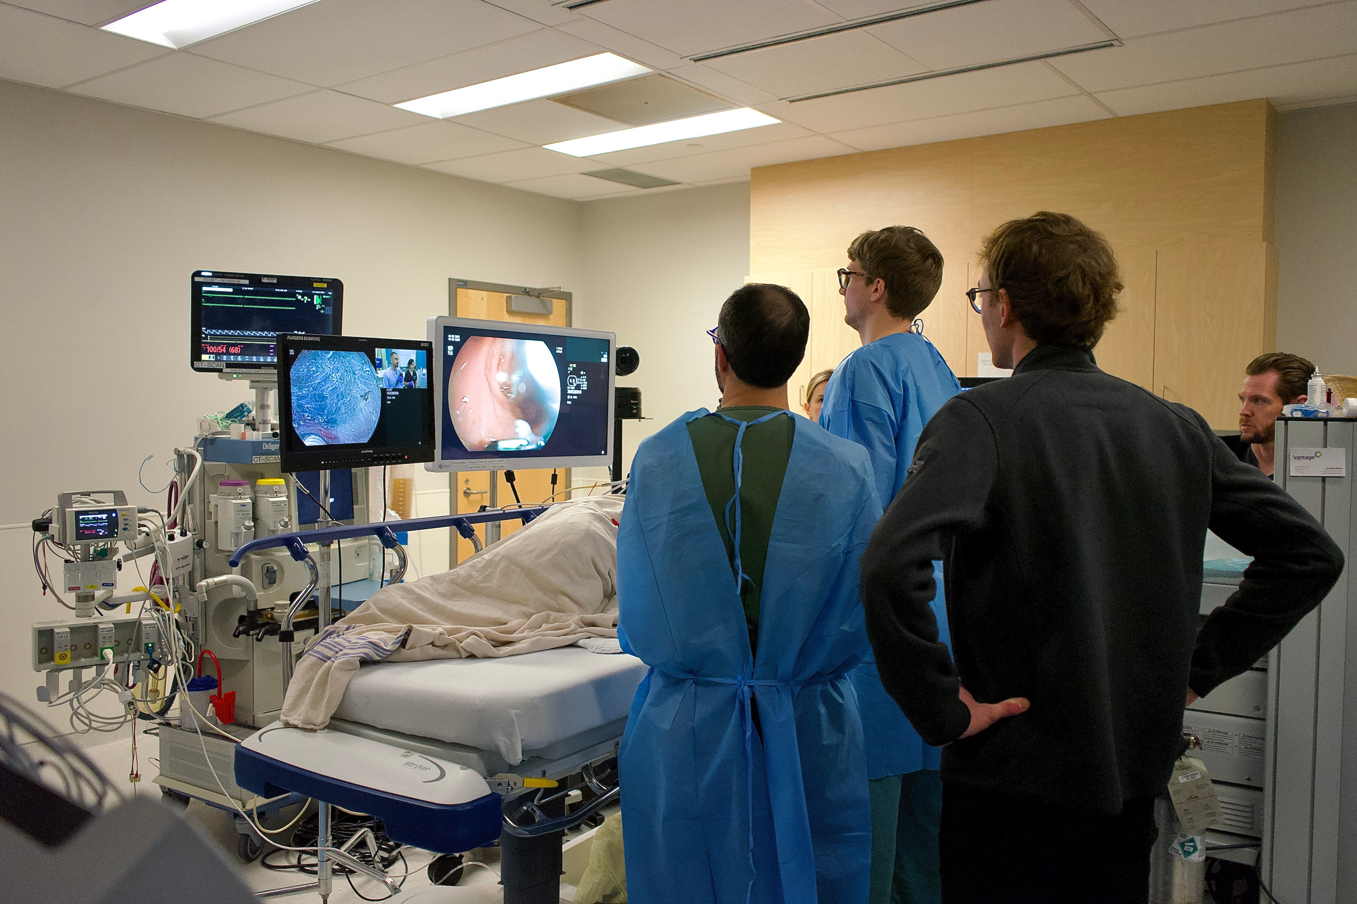

Slide 34
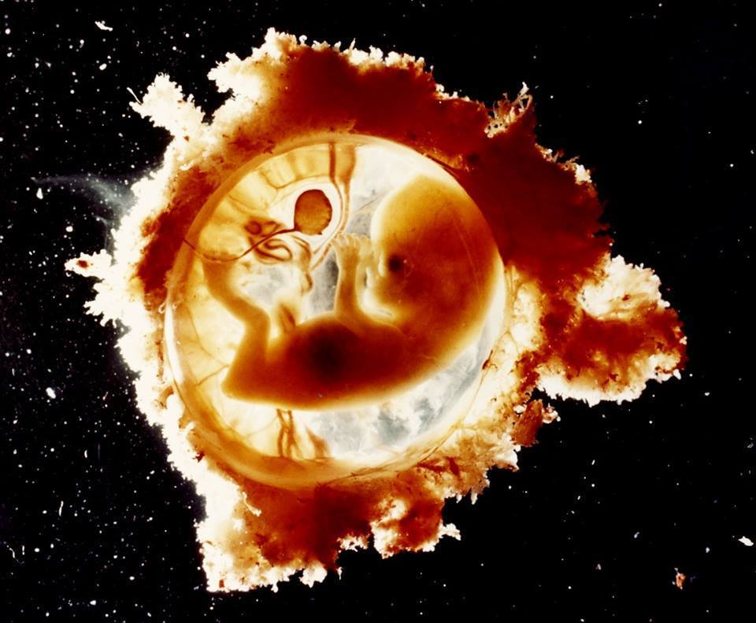
Endoscopic Image of a Human Foetus

Slide 35
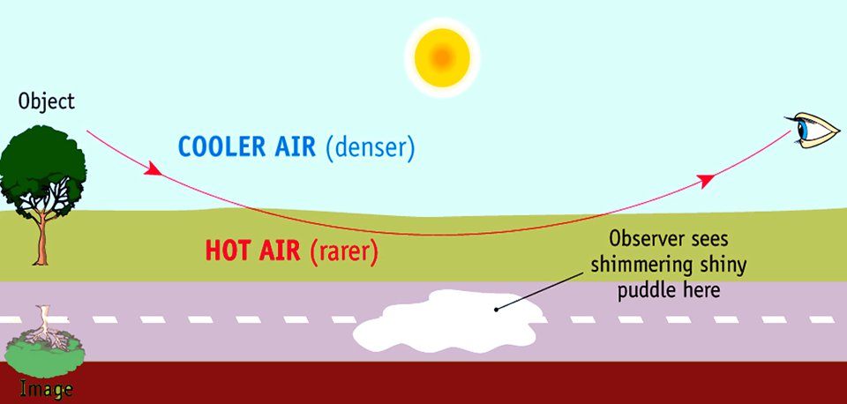
Hot air has a lower refractive index than cool air. A ray of light from the sky heading towards the road travels from a denser to a rarer medium and will be refracted away from the normal. It bends as shown. If, at some point, the angle of incidence is greater than the critical angle the ray will undergo total internal reflection and be reflected upwards. An observer will see an image of the sky in the ground. This is the shiny puddle, i.e., the mirage. An nearby object may be seen upside down in the puddle due to the same effect.

Slide 36
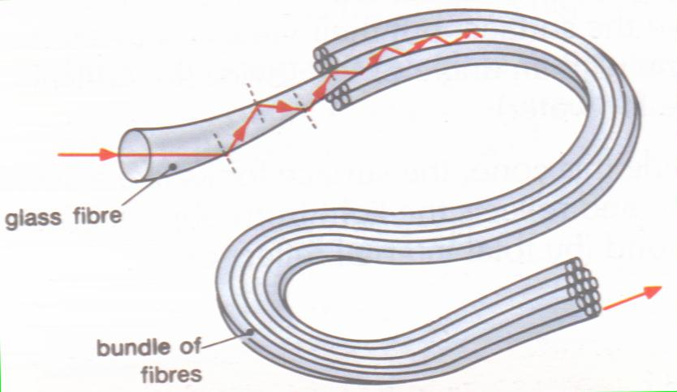
Structure of an Optic Fibre

Slide 37
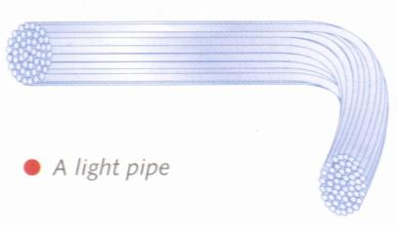
Optic Fibres: “light pipes”??
Some people refer to an optic fibre as a “light pipe.”
“Light pipe” is really a misnomer, since the glass through which the light is travellling is solid. It is normally made from silica glass which has a relatively high refractive index.
The outer cladding is made from a glass of lower refractive index.

Slide 38
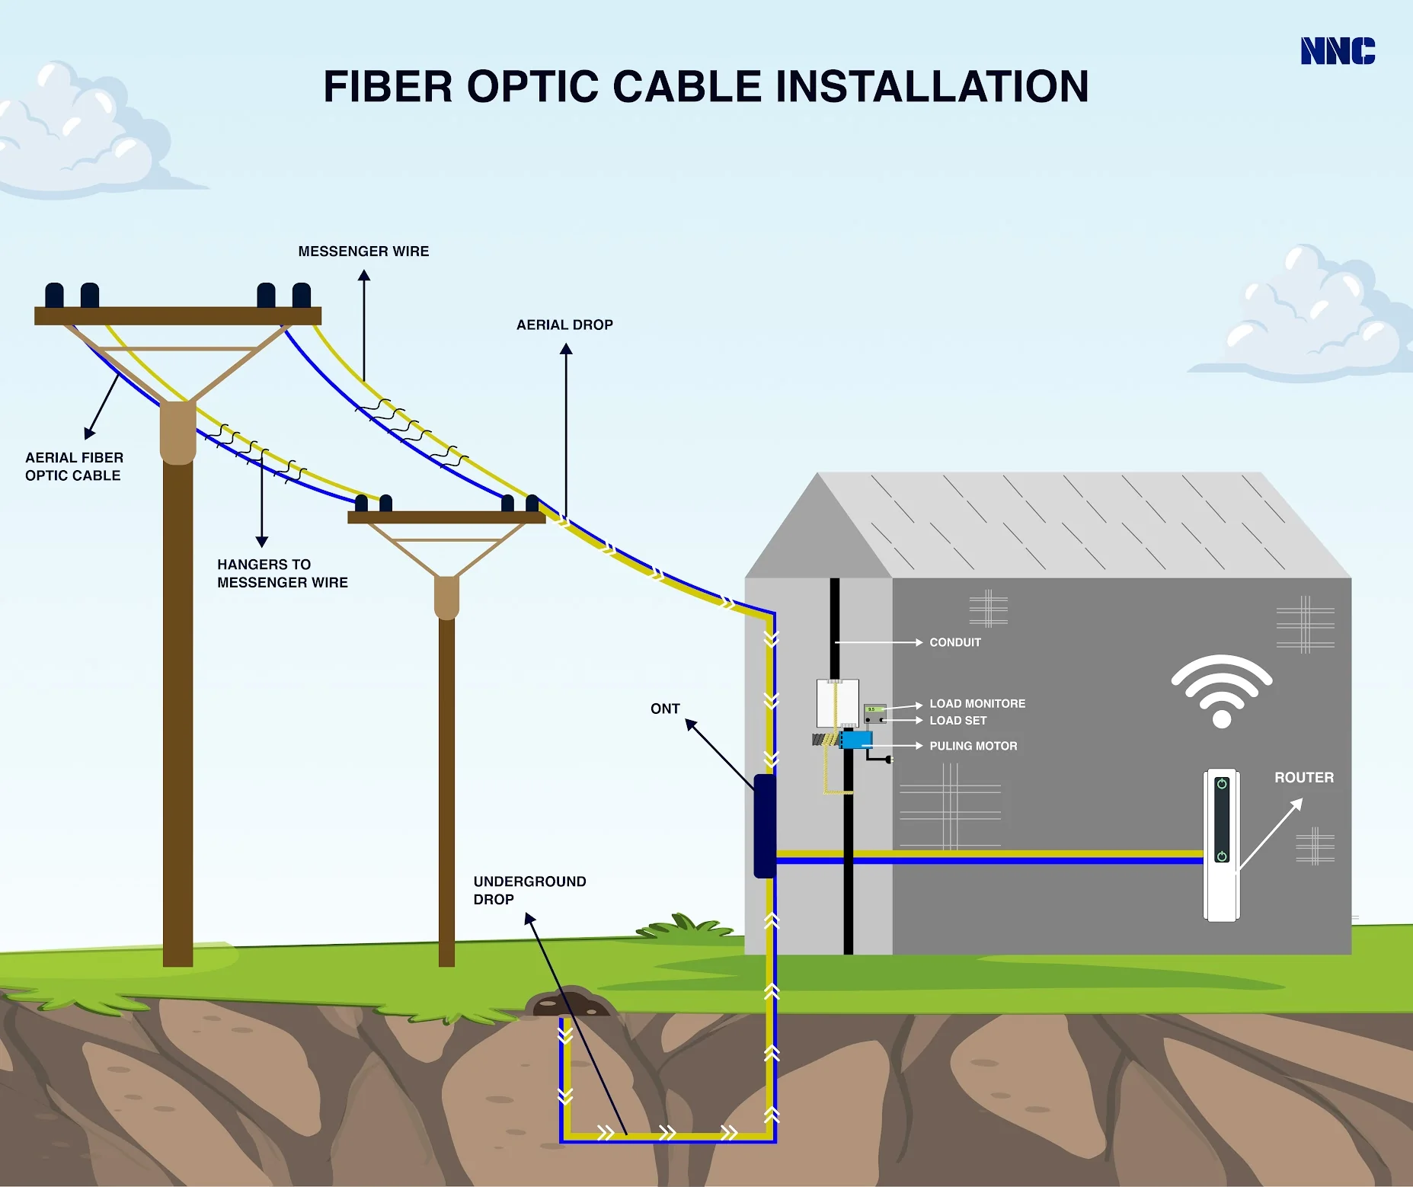
Optical Fibres in Telecommunications
Advantages of using optical fibres in telecommunication.
systems:
Up to 2,000 telephone calls per fibre.
Much less boosting required compared to an electrical signal.
Optical system ⇒ no “tapping”∴ more security.

Slide 39
TIR –Prism & Ruler
When the angle of incidence exceeds the critical angle, light is totally internally reflected.
Here we see that the image of a ruler is totally reflected from the back surface of a triangular prism.

Slide 40
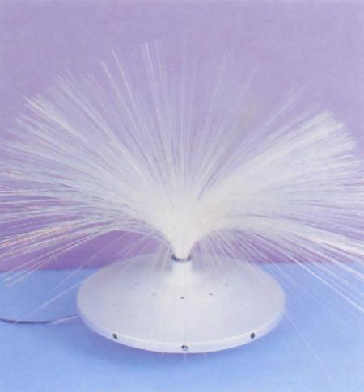
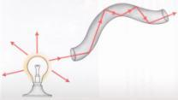
Another application of T.I.R.:
A fibre optic lamp

Slide 41
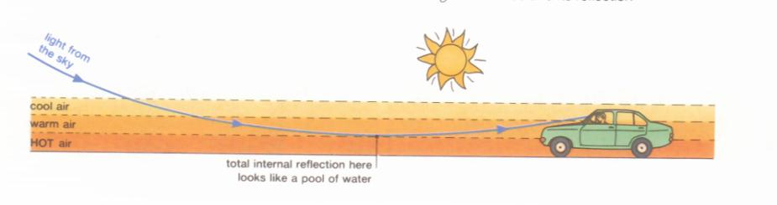
T.I.R. : The Mirage
(dense)
(rarer)

Slide 42

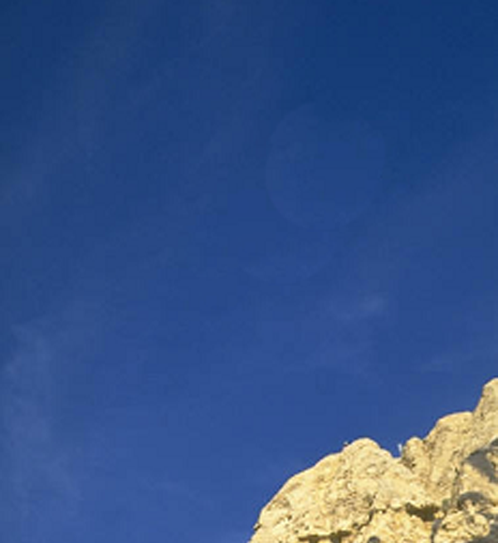
Mirage ---- Total Internal Reflection of light from sky
Light rays from sky
Cool air
High density
Warm air
Hot air
Low density
Hot ground

Slide 43
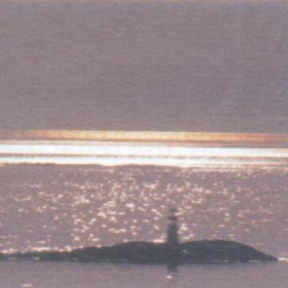
Total Internal Reflection:
A Mirage on Water
The shining surface of water seen as a mirage.
The mirage is slightly elevated above the horizon and appears more yellow than the real surface of water.

Slide 44
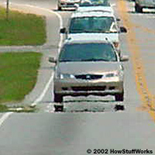
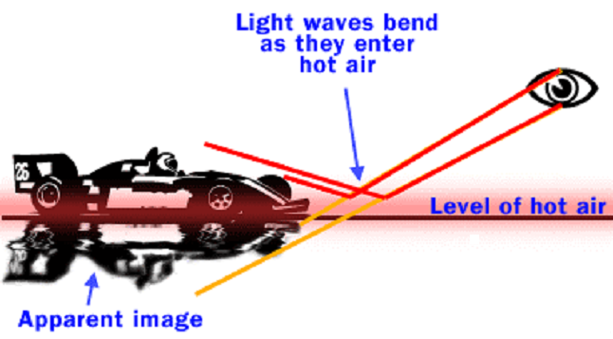
Mirages
Hot air has a lower density than cold air so refraction of the incident light occurs.

Slide 45

Does the “little star” actually twinkle?
When looking at a star you are looking through the earth’s entire atmosphere, made up of many layers of air
All moving
At various temperatures
Having various densities
Giving multiple refractions

Slide 46
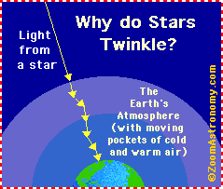

Slide 47


