Slide 1
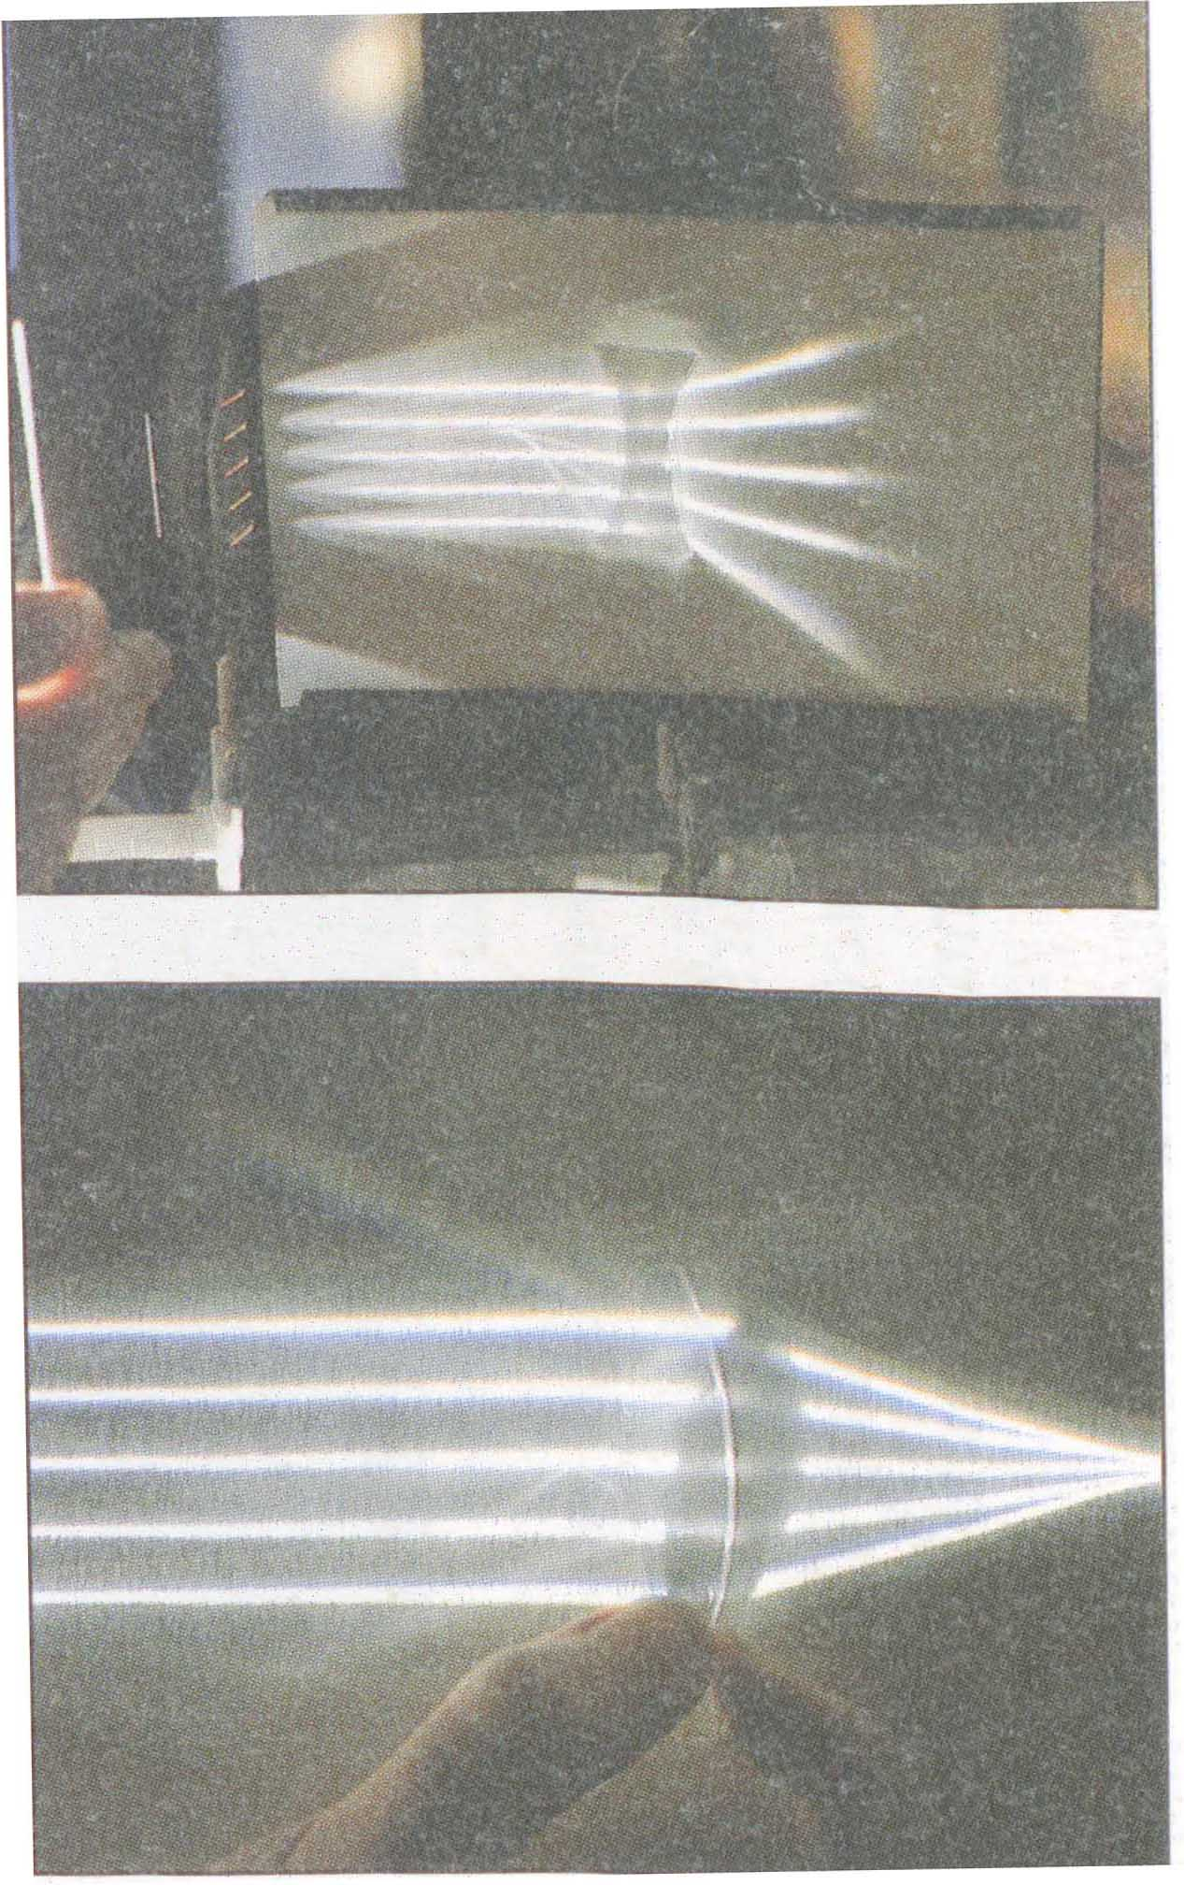
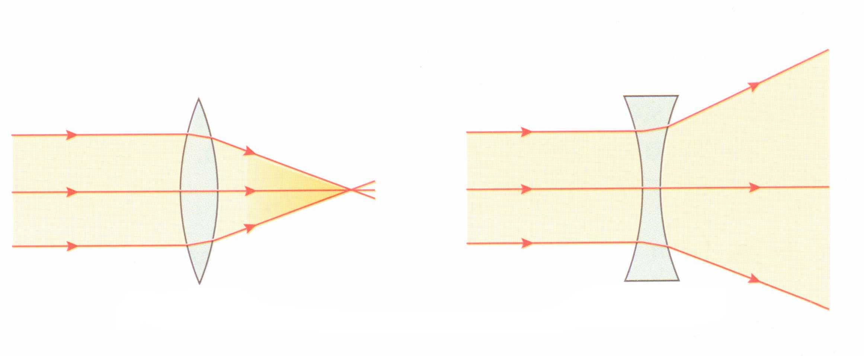
Diverging Lenses
“Diverging” means “ spreading out”. A diverging lens spreads out parallel rays of light.

Slide 2
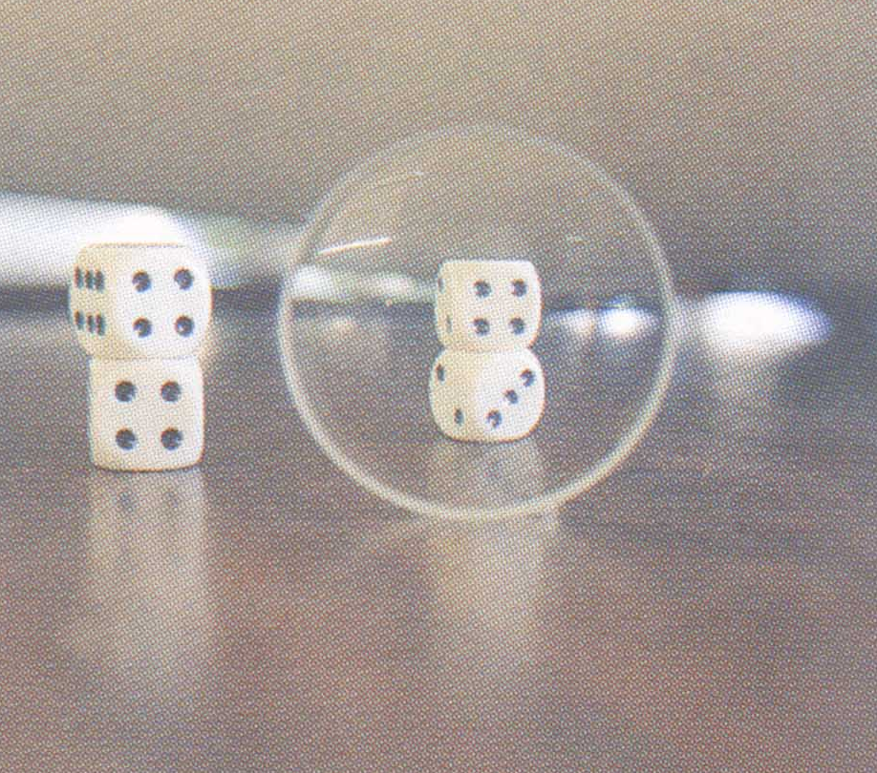
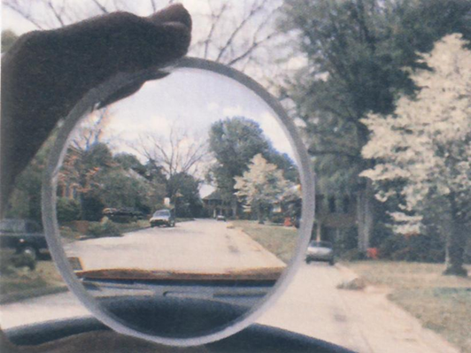
Looking through a Diverging Lens
Everything appears smaller when viewed through a diverging lens.

Slide 3
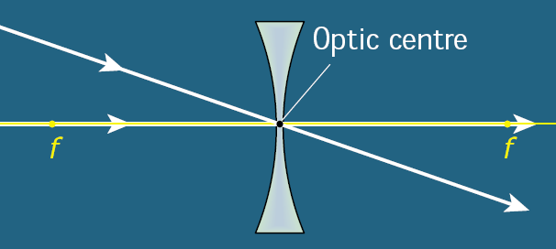
Important Rays for
Diverging Lenses

Slide 4
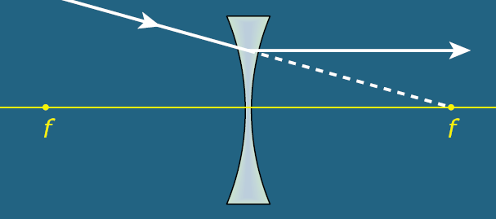
Important Rays for
Diverging Lenses

Slide 5
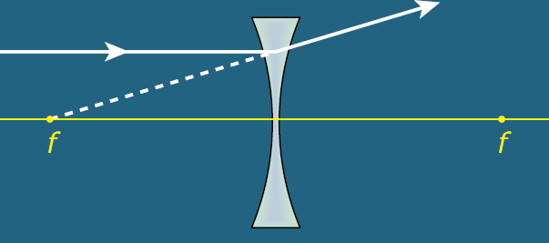
Important Rays for
Diverging Lenses

Slide 6
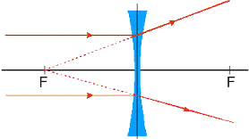
Important Rays for
Diverging Lenses

Slide 7
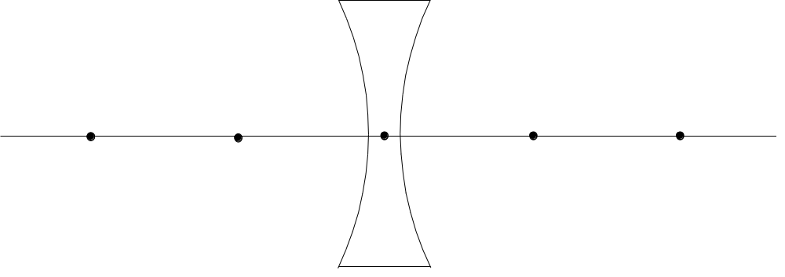

Diverging Lens :
Only 1 case
O
I
f
f
No matter where the object O is placed,
the image is always virtual, erect and diminished.

Slide 8
Diverging Lens :
Only 1 case
O
I
f
f
No matter where the object O is placed,
the image is always virtual, erect and diminished.

Slide 9


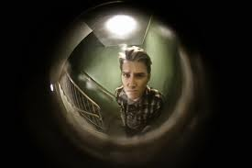
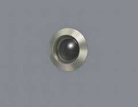
Uses for the Diverging Lens
Since the image is always diminished, a diverging lens gives a wide field of view. It can be used for security as a door peep-hole lens in a house. (This is also called a spy glass).
Spectacles.

