Slide 1
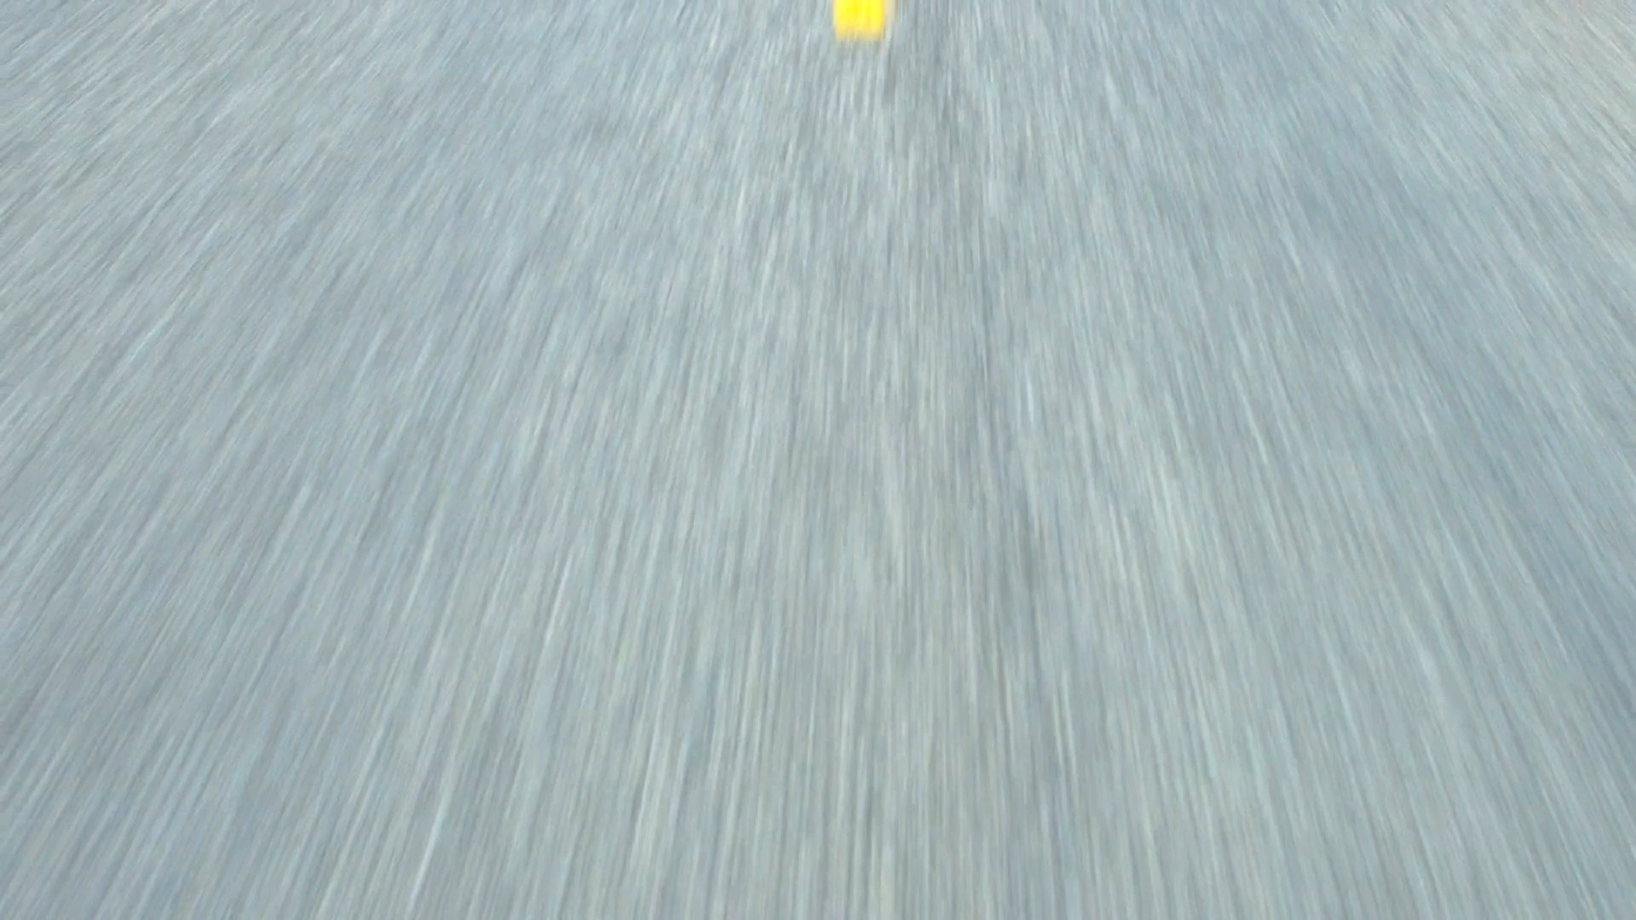
Acceleration

Slide 2
ACCELERATION
An object is said to be accelerating if its velocity is changing in any way.
So, an object is accelerating if it is:
  Speeding up
  Speeding up as it changes direction
  Slowing down
  Slowing down as it changes direction
  Changing direction
Acceleration is the rate of change of velocity with respect to time.
Acceleration is a vector quantity.

Slide 3
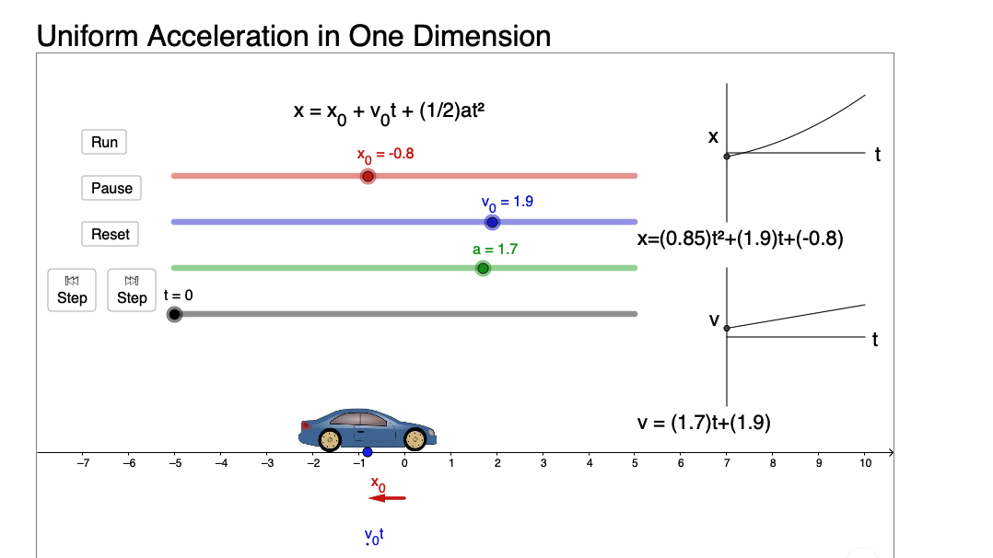

Slide 4
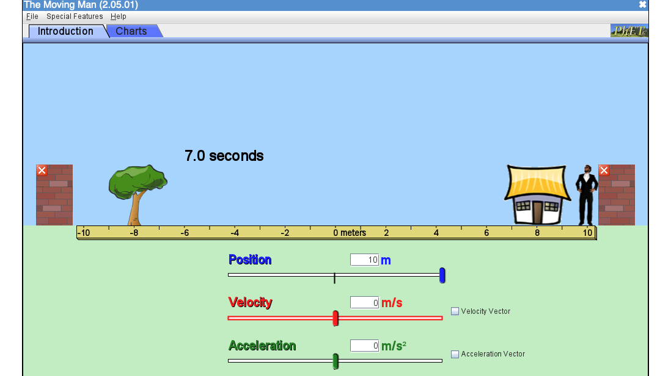

Slide 5
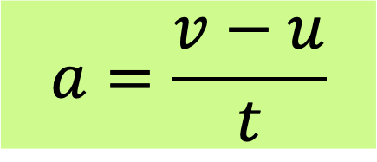
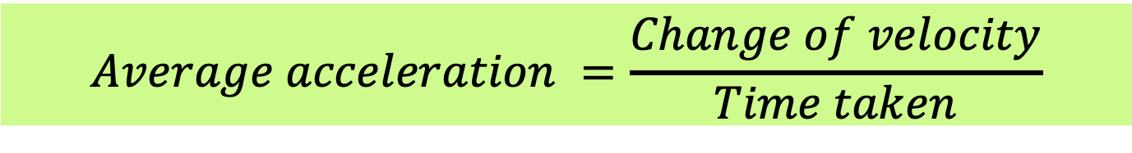
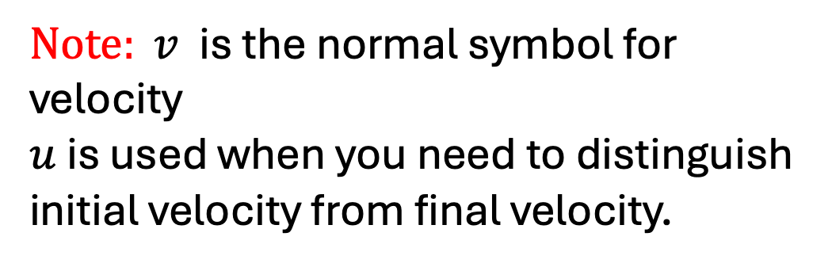
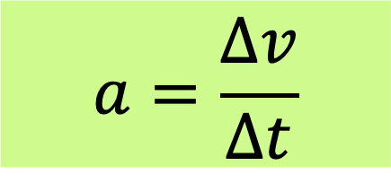
Formulae for acceleration
$$Average acceleration =\frac{Change of velocity}{Time taken}$$
$$a=\frac{v−u}{t}$$
$$a=\frac{Δv}{Δt}$$
$Note: v$ is the normal symbol for velocity
$u$ is used when you need to distinguish initial velocity from final velocity.

Slide 6
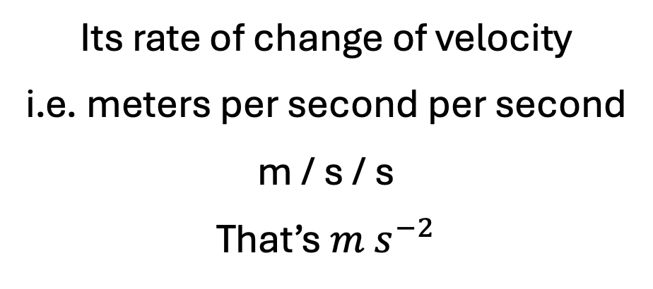
What is the SI unit of acceleration?
the metre per second squared ( m s⁻²).
Its rate of change of velocity
i.e. meters per second per second
m / s / s
That’s $m s^{−2}$

Slide 7
Example 1:
A cyclist changes velocity from +3 m/s to +15 m/s in 4 s. Calculate acceleration.

Slide 8
Example 2
A car moving east slows from +20 m/s to +8 m/s in 6 s. Calculate acceleration.

Slide 9
Example 3
A vehicle moving west changes velocity from −5 m/s to −17 m/s in 4 s. Find acceleration and state whether speed increases.

