Slide 1
Velocity

Slide 2
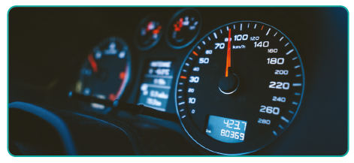
Instantaneous Speed
Instantaneous speed is the speed of an object at a specific moment in time, or the rate it would continue to travel if its speed stopped changing at that instant and stayed constant from then on.
Can you think of a devise used to measure instantaneous speed?
A car’s speedometer measures its speed at any instant.

Slide 3
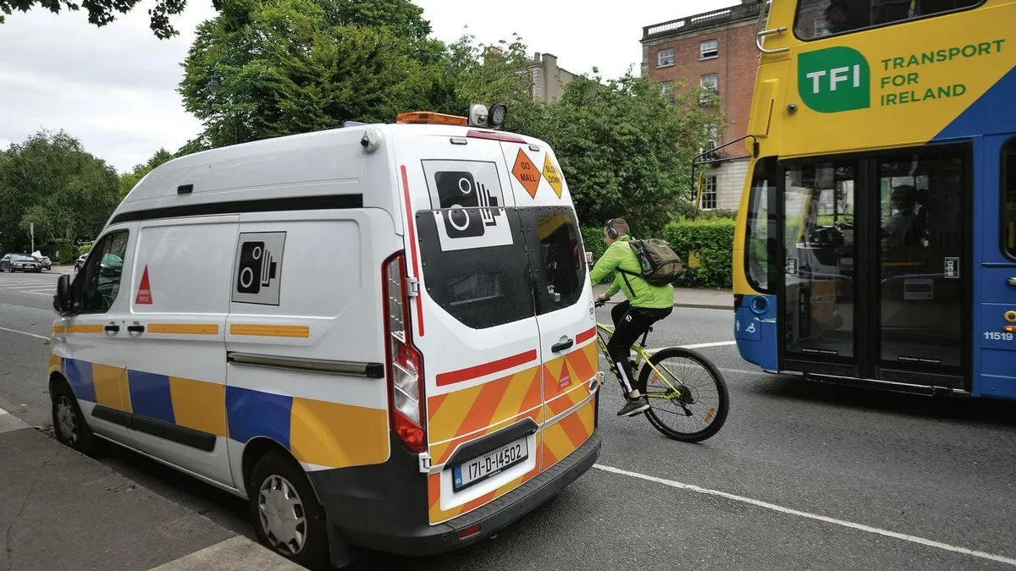
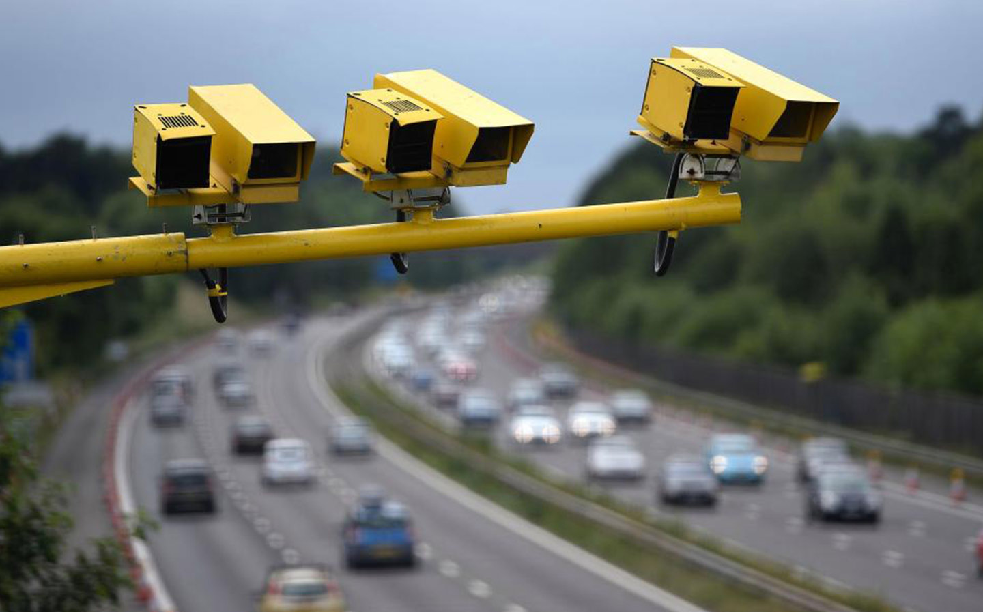
Use of Instantaneous speed
See Book pages 39-40

Slide 4
What is Velocity?
Velocity is the rate of change of displacement with respect to time..
Velocity is a vector quantity.
The SI unit of velocity is metre per second (m s⁻¹ ).

Slide 5
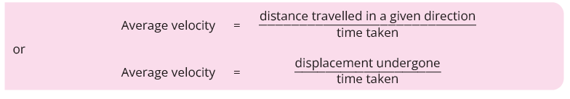

Slide 6

The Difference Between
Velocity and Speed!




Control tower? My velocity is 700 km h⁻¹ East!
Control tower? My velocity is 700 km h⁻¹ West!






These planes are both flying at the same speeds, but their velocities are different!

Slide 7
Is velocity a vector or scalar?
Vector.
Vector nature of velocity
Initial velocity
Final velocity

Slide 8
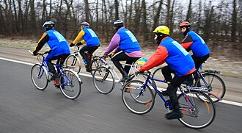
What is Constant Velocity?
When the speed and direction does not change
CC0

Slide 10
CONSTANT VELOCITY
If an object moves in a straight line and does not speed up or slow down it has a constant velocity.
Its average velocity is the same no matter what over time interval during the motion it is measured.
NOTE: Just Like For Speed: Average Velocity Equals Instantaneous Velocity (to high degree of accuracy) provided the average velocity is measured over a very small time interval or a very small distance.

Slide 11
Is this Constant Velocity?
No
The ball falls faster and faster.
therefore its not constant velocity.
Video Veritasium
https://www.youtube.com/watch?v=YJbKieEC49M

Slide 12
Is this Constant Velocity?
No
The direction of motion is changing.
Velocity is a vector
therefore it’s not constant velocity.

Slide 13
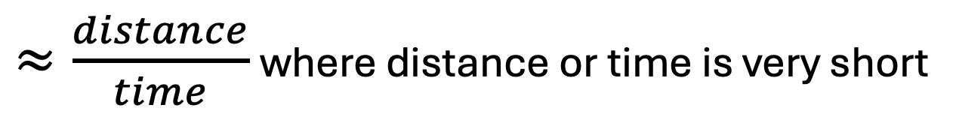
What is instantaneous velocity?
The velocity at an instant in time
$≈\frac{distance}{time}$ where distance or time is very short
The shorter the distance the closer to instantaneous
But… the shorter the distance the less accurate the measurement

Slide 14
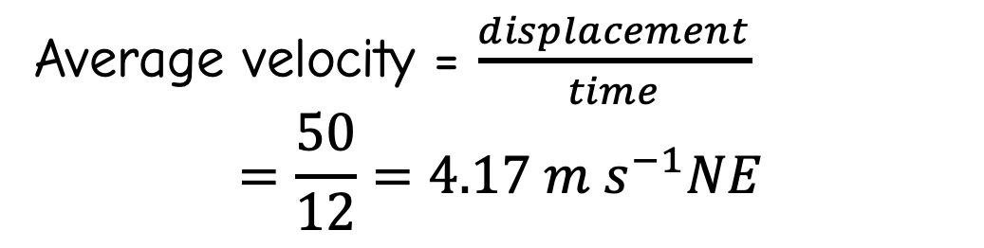
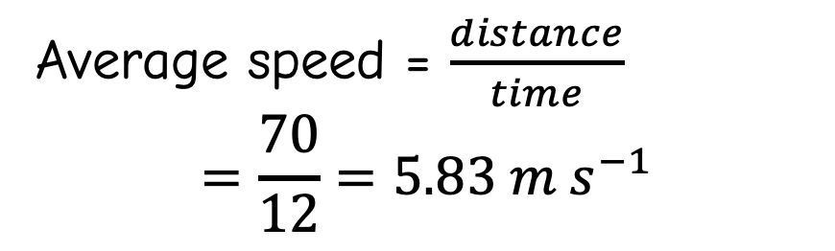
Example
A dog runs from A to B by the path in 12 seconds. Calculate his average speed and average velocity.
path
B
Average speed = $\frac{distance}{time}$
$$=\frac{70}{12}=5.83 m s^{−1}$$
70 m
50 m NE
A
Average velocity = $\frac{displacement}{time}$
$$=\frac{50}{12}=4.17 m s^{−1}NE$$

Slide 15
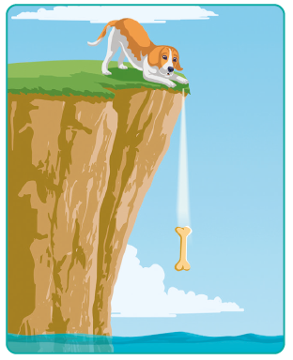
If a moving object does not have constant velocity, it is said to have varying velocity.
Explain why the bone has varying velocity.
As soon as it leaves the cliff edge its speed increases towards the water. So, its velocity is changing or varying.

Slide 16
How do we measure velocity in the lab?
Measure displacement and time and divide.
Time is measured with:
  Ticker tape
  or
  A light gate and timer
  or
  electrical contacts and timer

Slide 17
Measure velocity with gate and timer
Card to interrupt light gate
Light gate
Displacement: width of card
Time: time that card interrupts the light gate
Low friction track / Air track
Trolly
Velocity: width of card / time that card interrupts the light gate
Metre stick to measure card
Timer

Slide 18
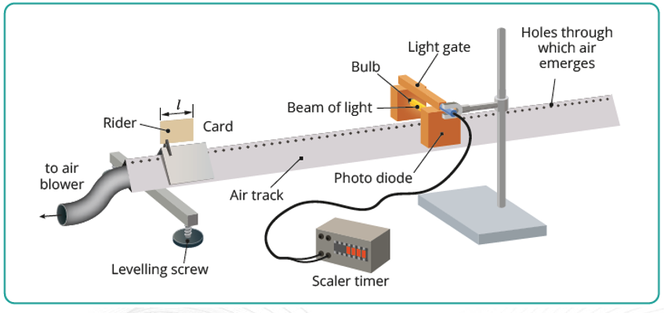

Slide 19
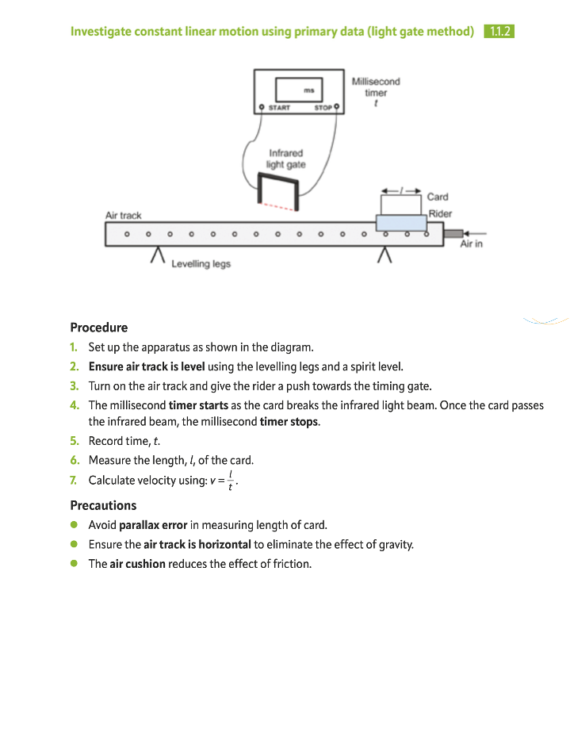

Slide 20
Variables
Independent variable: the position of the light gate along the track,
meaning its distance from where the rider is released.
To test whether the motion is constant, repeat the run with the gate at several positions
(for example 20 cm, 40 cm, 60 cm and 80 cm)
Dependent variable: the time, t, the card takes to break the beam, as read from the millisecond timer.
From this you calculate the velocity, v = l/t. The velocity is the main quantity you are examining.
If the motion is constant, v stays the same at every gate position.
Control variables :
The length of the card, l. A different length would change t, so use the same card throughout.
The initial push given to the rider. Try to push it the same way each time, or use a launcher if you have one.
The mass of the rider, which you keep by not adding or removing masses.
The air supply. The air cushion is on and at the same setting for every run.
The track angle. It is level, checked with the spirit level, so gravity has no effect along the track.
The light gate and timer, and the height of the beam on the card.

Slide 21
Measure time and distance with ticker timer
Distance: between N dots
Time: 20 ms x (N-1)
Paper tape
Trolly
Ticker timer
Low friction track
Metre stick
20 ms
20 ms

Slide 22
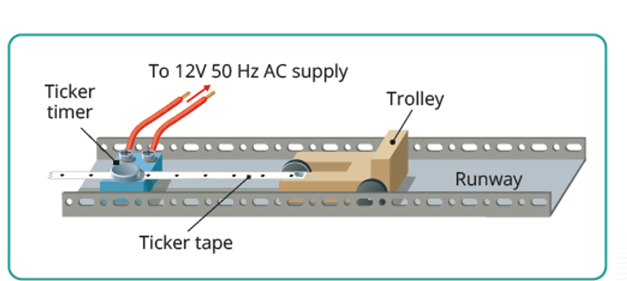

Slide 23
Ticker Timer
Vibrating hammer makes
50 dots per second
trolley
paper tape
Ticker Timer
paper tape
dots made by hammer
https://www.youtube.com/watch?v=-xjHLFTQvjo

Slide 24
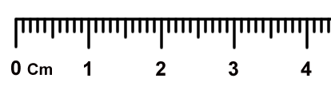
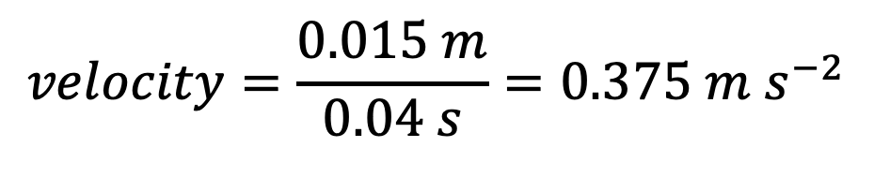
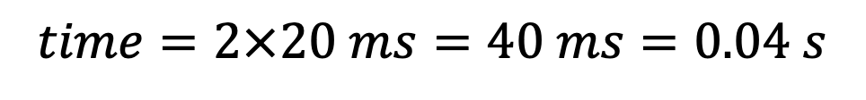
Reading the tape
Measure distance,
count spaces. Time for one space = 20 ms.
1.5 cm, 2 spaces
paper tape
$$time=2×20 ms=40 ms=0.04 s$$
$$velocity=\frac{0.015 m}{0.04 s}=0.375 m s^{−2}$$

