Slide 1
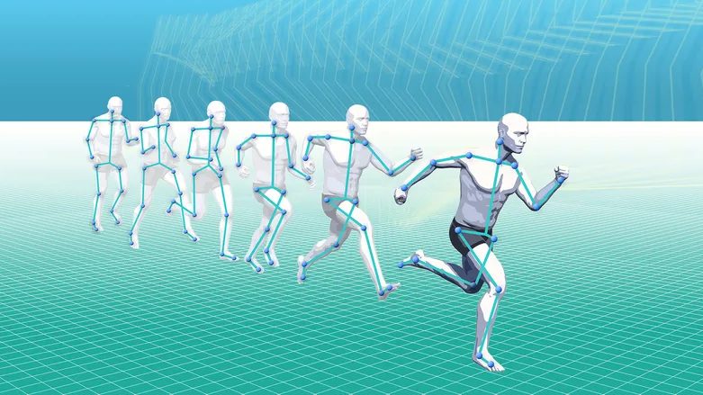
Kinematics
Chapter 3.
Lesson 1

Slide 2

Starter: On Whiteboards, calculate the following
A student walks 100 m in 20 s.
Distance?
Average speed?
SI unit?
$$Average Speed =\frac{Distance travelled}{Time taken}$$

Slide 3
HOW FAR DID I WALK ?
Distance =
Start
6 metre
Distance =
Where did I finish relative to where I started?

Slide 4
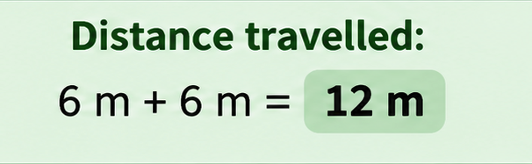
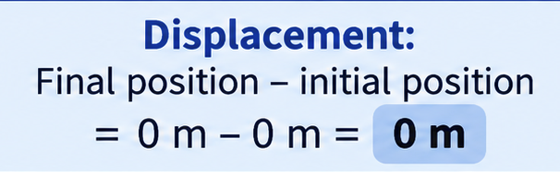
In Notes Copy, draw the following

Slide 5
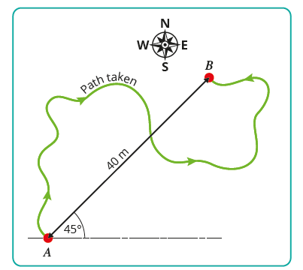
In Notes Copy, write the following
Distance describes the total path travelled
Displacement is the change in position of
an object in a specified direction..
Distance is a scalar quantity.
Displacement is a vector quantity.
Both are measured in Metres (m)

Slide 6
In Notes Copy, draw the following

Slide 7
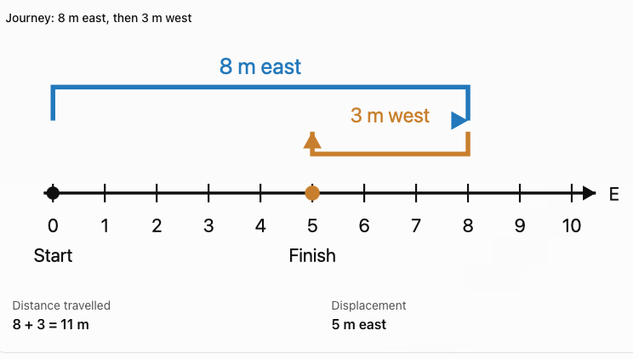



Slide 8
In Notes Copy, write the following
Speed is the rate of change of distance with time
Is speed a vector or scalar quantity?
Scalar

Slide 9
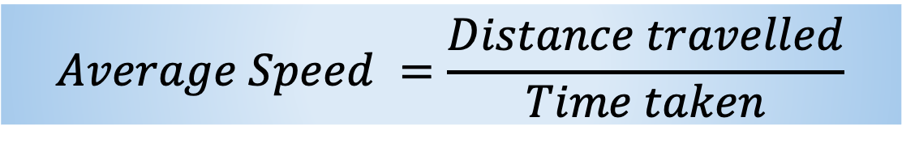
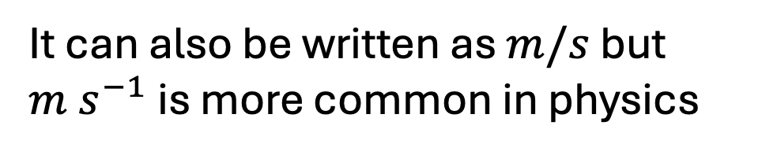
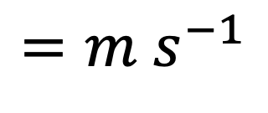
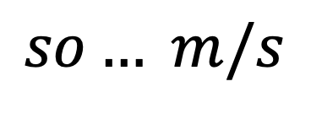
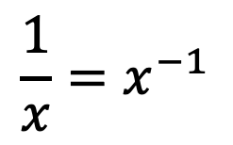
What is the SI unit for speed?
the metre per second (m s⁻¹).
It can also be written as $m/s$ but $m s^{−1}$ is more common in physics
Why m s⁻¹ ?
$$\frac{1}{x}=x^{−1}$$
$$so… m/s$$
$$=m s^{−1}$$
In Notes Copy, write the following
$$Average Speed =\frac{Distance travelled}{Time taken}$$

Slide 10
EXAMPLE 1: I DO
Walk 12 m east and 5 m west in 17 s.
Find distance, displacement and average speed.

Slide 11
EXAMPLE 2: WE DO
Cycle 200 m east then 80 m west in 40 s.
Find distance, displacement and average speed

Slide 12
EXAMPLE 3: YOU DO
Complete a 400 m lap in 80 s, finishing at the start.
Find distance, displacement and average speed.

Slide 13
ON WHITEBOARDS
Does zero displacement mean no movement?
Explain your answer

Slide 14
ON WHITEBOARDS
80 m east then 30 m west in 25 s
Find distance, displacement and average speed

Slide 15
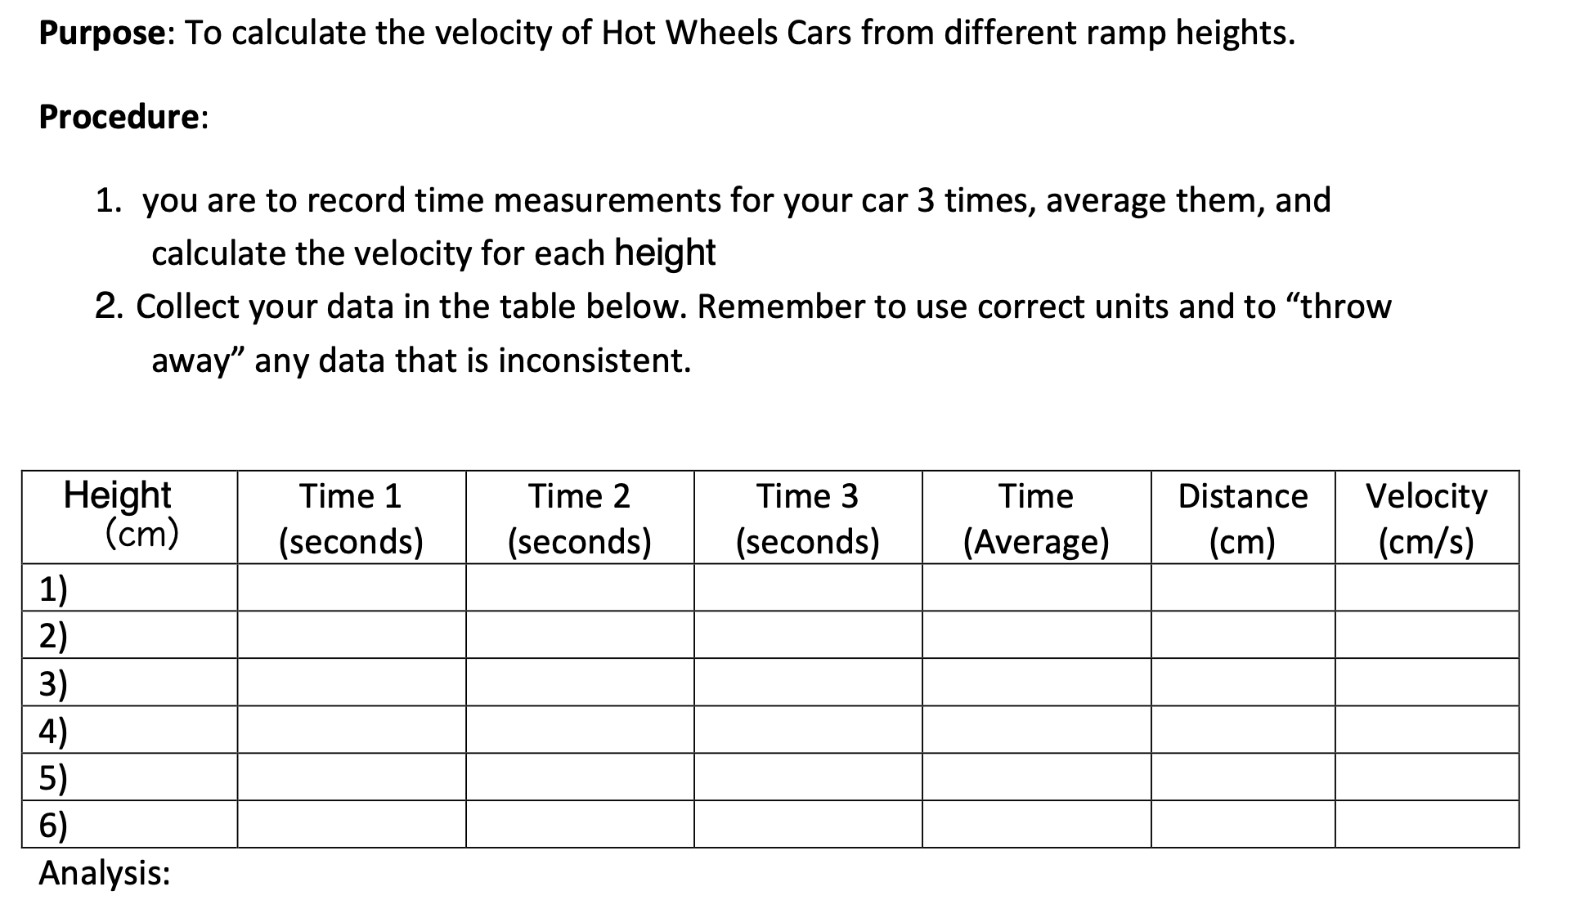
HOT WHEELS ACTIVITY

Slide 16
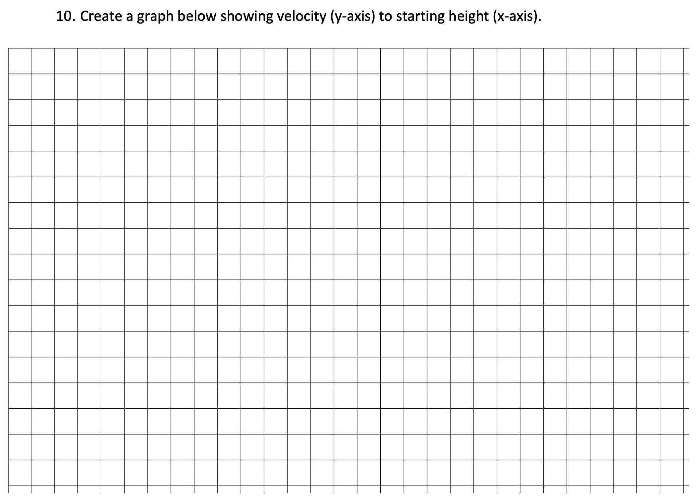

Slide 17
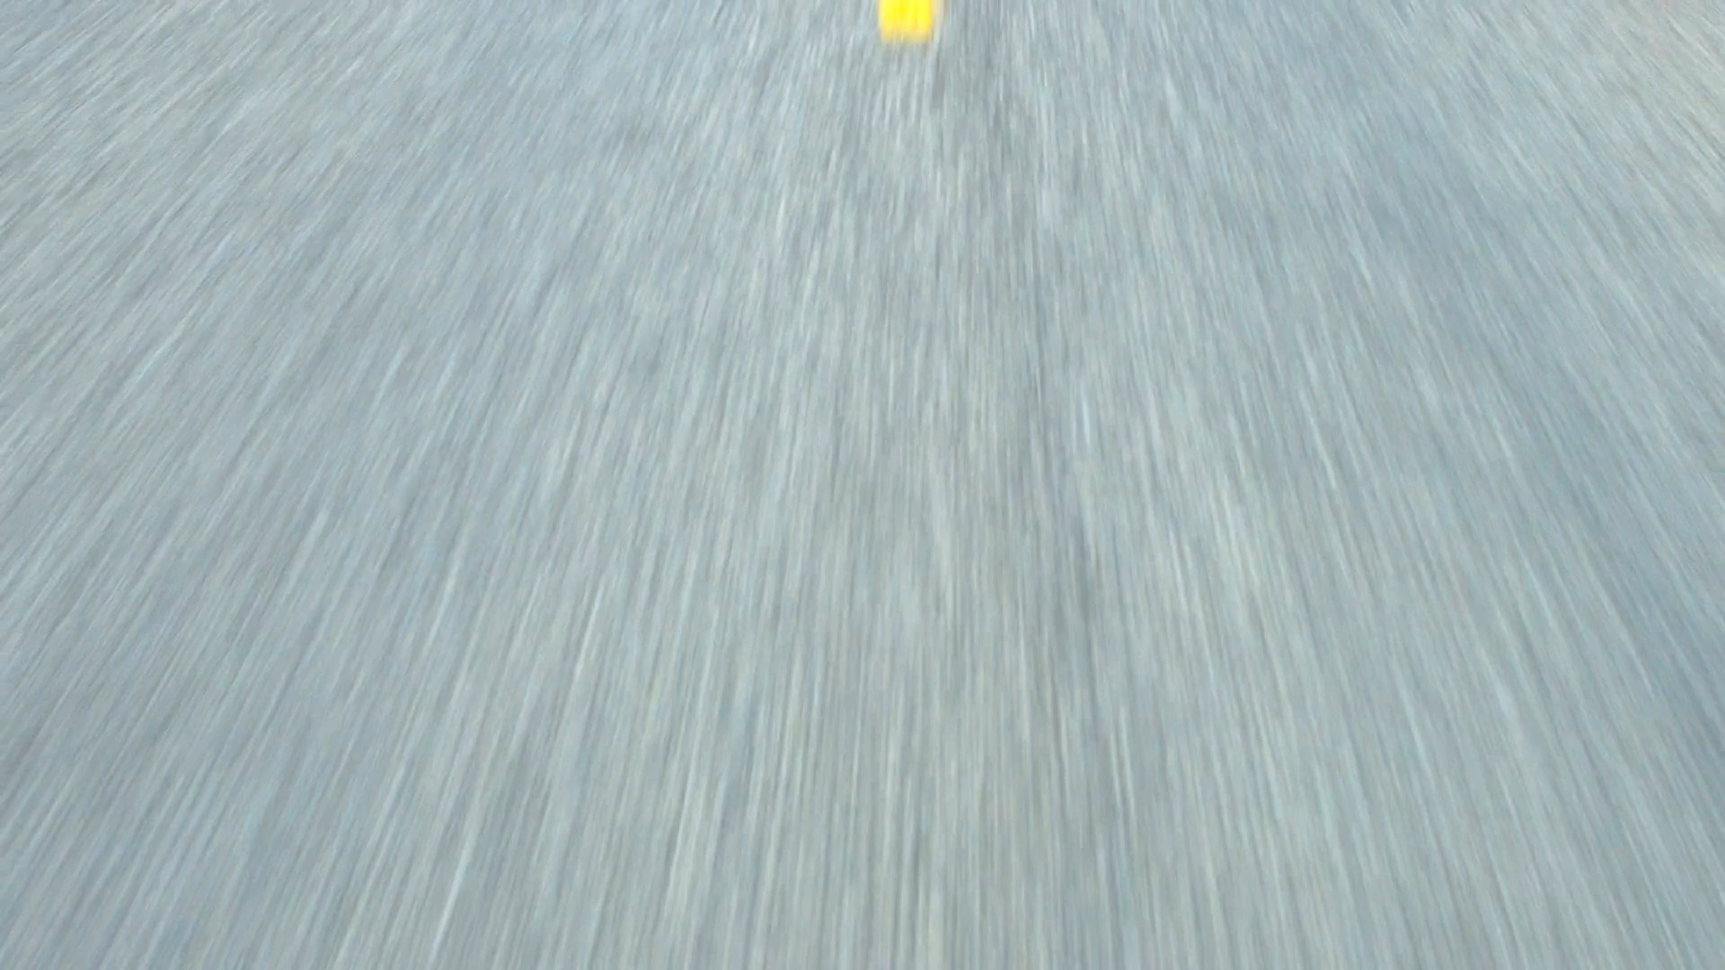
TO THINK ABOUT
Why can a straight line represent a real journey?

