Slide 1
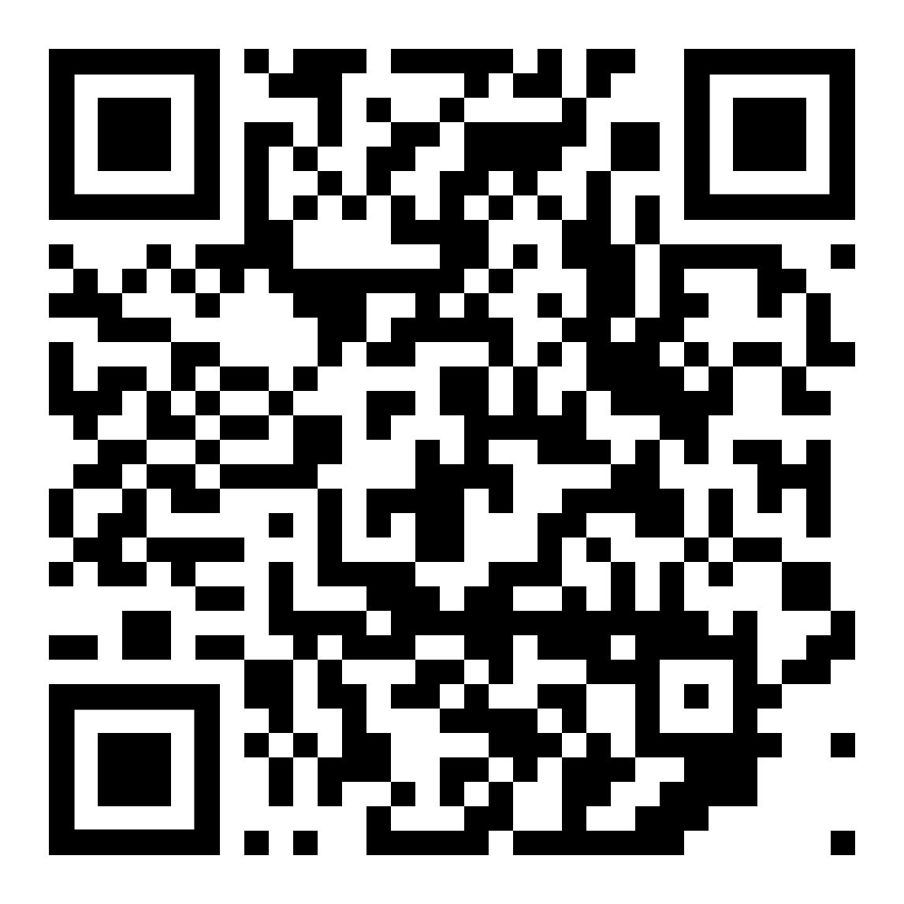

Slide 2
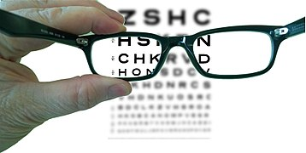

LENSES

Slide 3
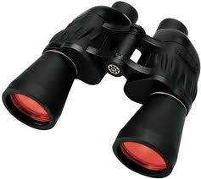
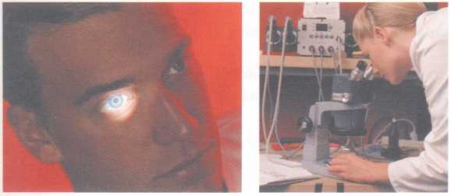
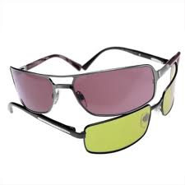
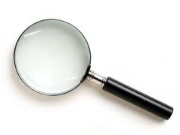
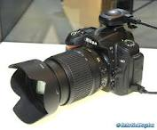
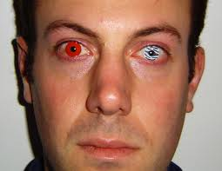
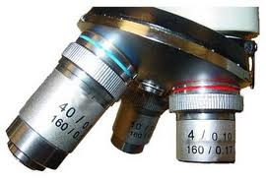
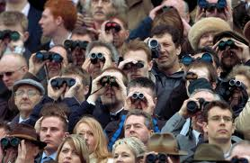

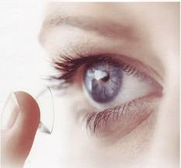
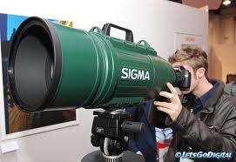
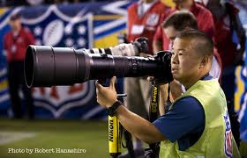
Lenses
A lens is a piece of glass which has at least one curved surface.
Light is refracted as it passes through the lens.

Slide 4
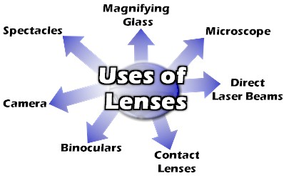
What are the uses of lenses?

Slide 5
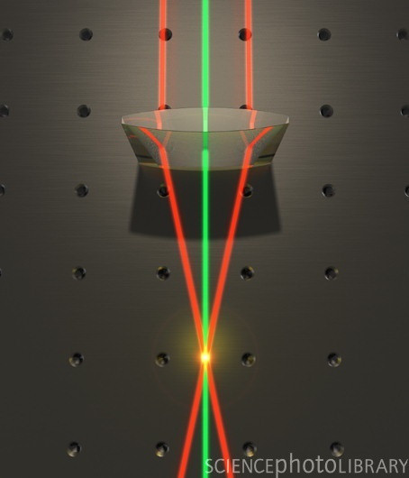
What is a converging lens?
“Converging” means “ coming together”. A converging lens brings parallel rays of light together.
converging beam.
Also called a Convex Lens

Slide 6
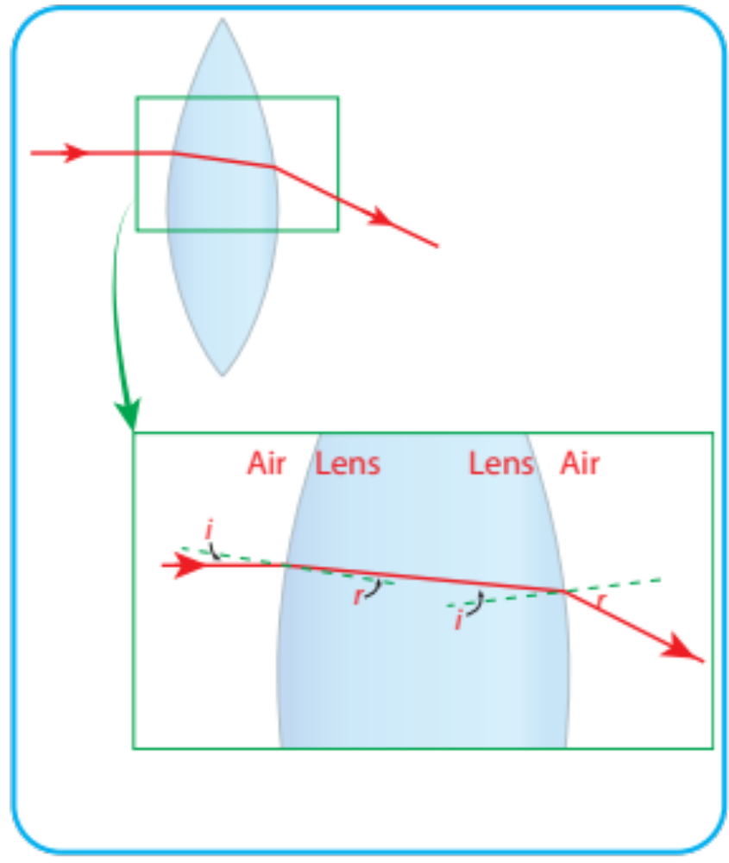
12.5 – Refraction and lenses
Convex
(converging lenses)

Slide 7
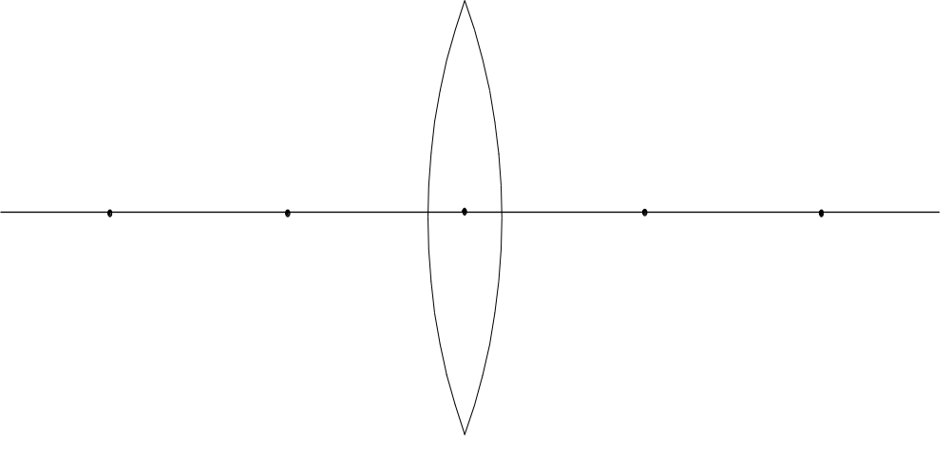
Converging Lens: Important Terms
Focus
or
focal point
Focus
or
focal point
Principal axis
2f
f
Focal length
f
2f
Optic centre

Slide 8
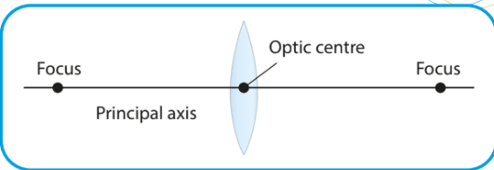
Points in a convex lens

Slide 9
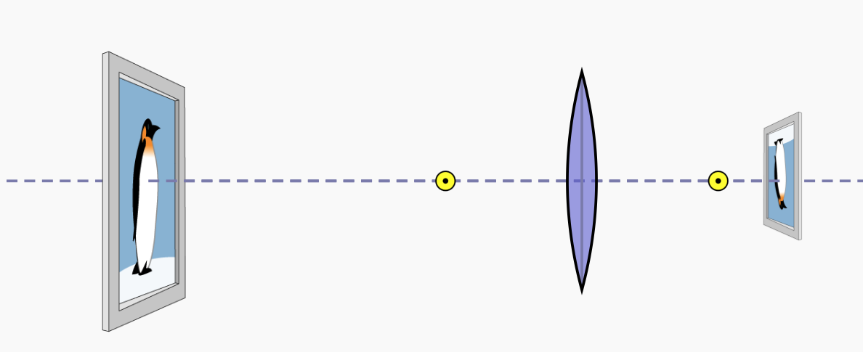
https://phet.colorado.edu/sims/html/geometric-optics-basics/latest/geometric-optics-basics_all.html

Slide 10
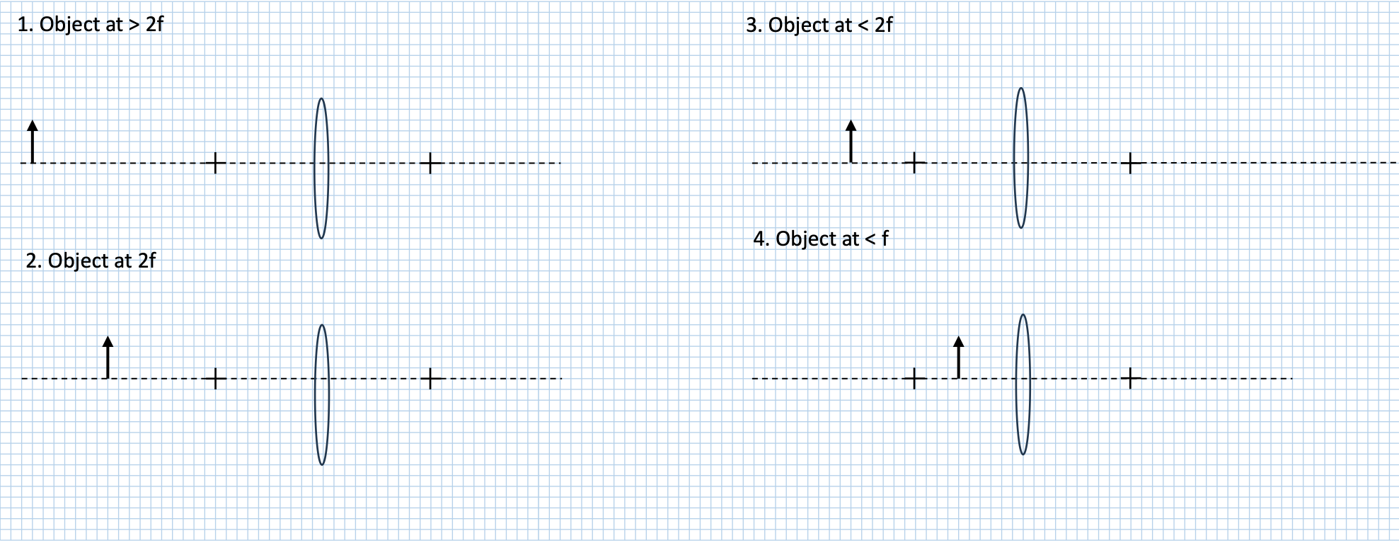

Slide 11
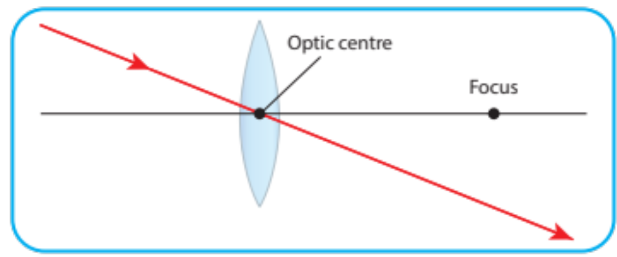
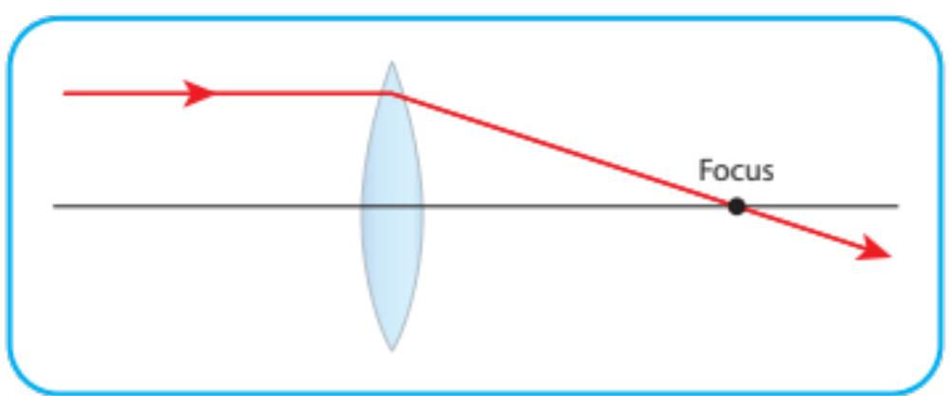
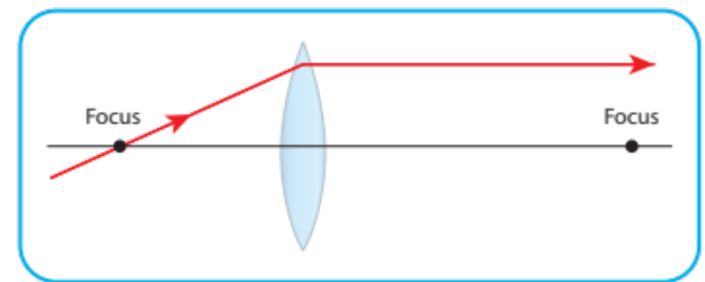
Rules for drawing ray diagrams

Slide 12
Converging lens: There are 5 Cases i.e. 5 possible positions for the object
O
O
O
O
O
2f
f
f
2f
◆
❖
⬥



Slide 13
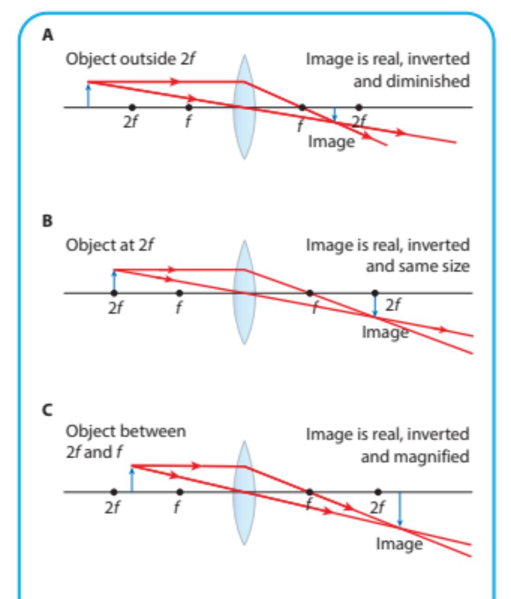
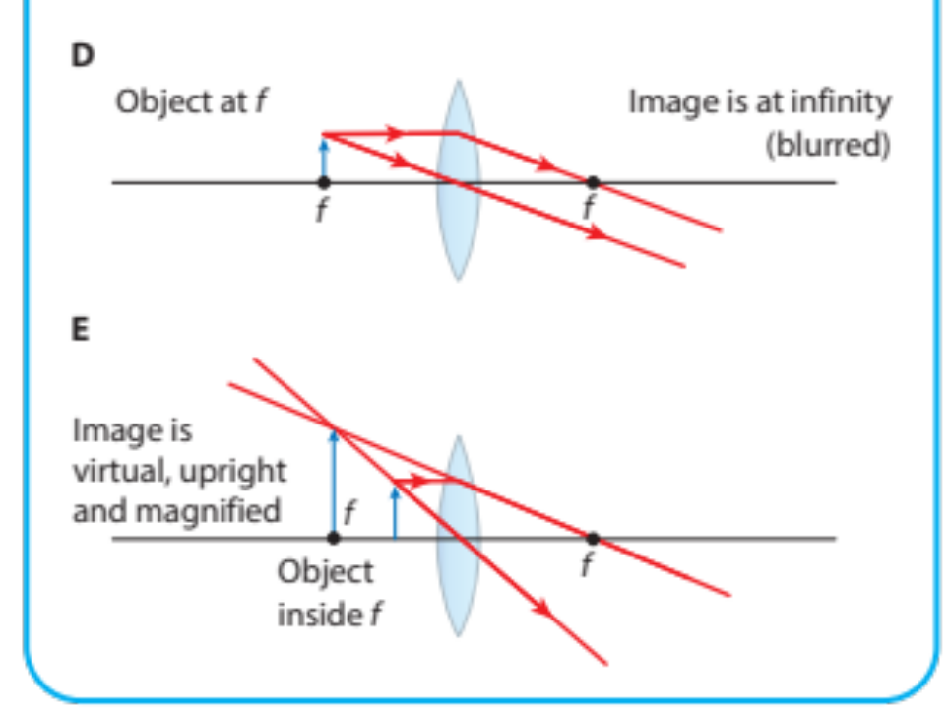

Slide 14
How do we describe images?
Object
Image
Description
/
Diminished / magnified
/
Inverted / upright
/
Real / virtual
virtual image
Same side / Opposite side of lens (as the object)
Remember compare image to object
Notes:
V 1.1 new slide

Slide 15
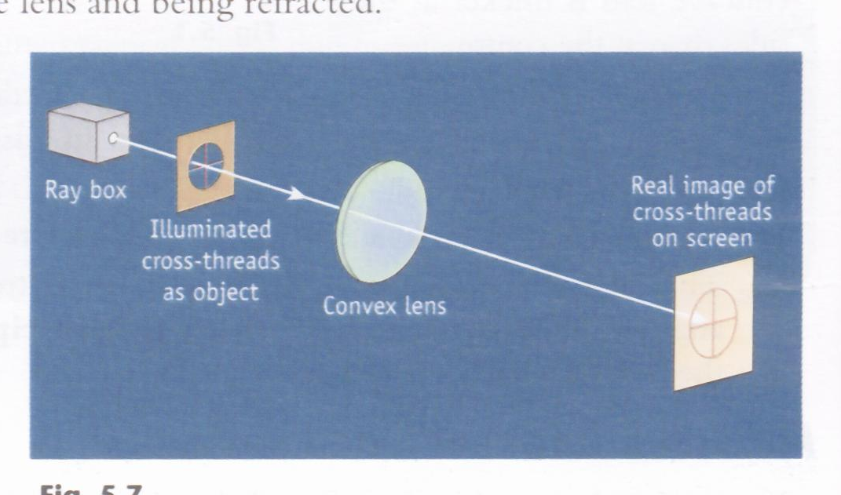
Real Image
A real image is an image formed by the actual intersection of rays. It can be located on a screen.

Slide 16
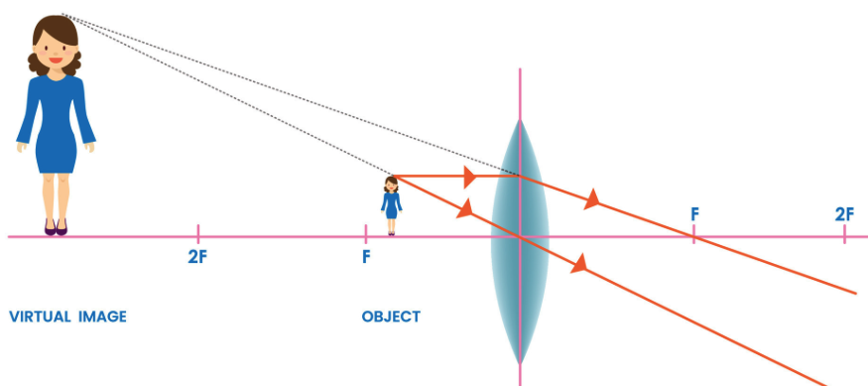
Virtual Image
A virtual image is an image formed by the apparent intersection of rays. It cannot be located on a screen.

Slide 17
Converging Lens - Case 1:
Object Located outside 2f i.e. u > 2f
O
2f
f
f
2f
I

Slide 18
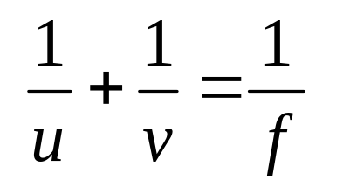
Converging Lens - Case 1:
Object Located Outside 2f i.e. u > 2f
O
2f
f
f
2f
u
f
I
v
The image is ①Real, ② Inverted, ③ Diminished.

Slide 19
Converging Lens - Case 2:
Object Located AT 2f. u = 2f
O
2f
f
f
2f
u
f
I
v
The image is ①Real, ② Inverted, ③ Same size.

Slide 20
Converging Lens - Case 2:
Object Located AT 2f i.e. u = 2f
O
2f
f
f
2f
I
The image is ①Real, ② Inverted, ③ Same size.

Slide 21
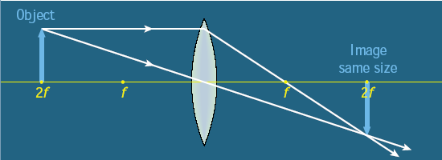
Converging Lens – Case 2:
Object on 2f i.e. u = 2f
The image is real, inverted and it is
the same size as the object.

Slide 22
Converging Lens - Case 3:
Object Located between 2f and the Focal Point i.e. f < u < 2 f
O
2f
f
f
2f
I

Slide 23
Converging Lens - Case 3:
Object Located between 2f and the Focal Point i.e. f < u < 2 f
O
2f
f
f
2f
I
The image is ①Real ② Inverted, ③ Magnified.

Slide 24
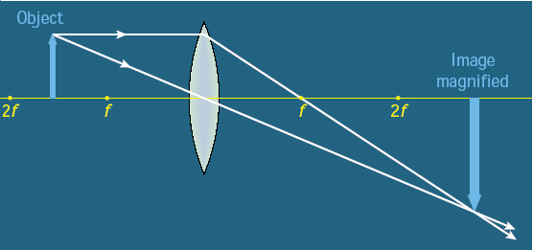
Converging Lens - Case 3:
Object Located between 2f and the Focal Point [f < u < 2 f ]
The image is real, inverted and magnified.

Slide 25
Converging Lens - Case 4:
Object located at the focal point [u = f ]
O
2f
f
f
2f
The image is ① Virtual ② At Infinity.

Slide 26
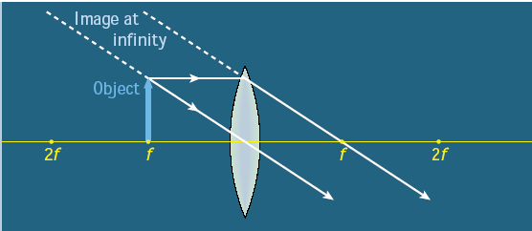
Converging Lens – Case 4:
Object on f i.e.u = f
The image is virtual & at infinity.

Slide 27
SPECIAL CASE:Converging Lens - Case 5:
Object INSIDE the focal point i.e. u < f
I
O
2f
f
f
2f
The image is ①Virtual, ② Magnified, ③ Erect.

Slide 28

SPECIAL CASE: Converging Lens - Case 5:
Object INSIDE the focal point i.e. u < f
I
O
2f
f
f
2f
The image is ①Virtual, ② Magnified, ③ Erect.

Slide 29
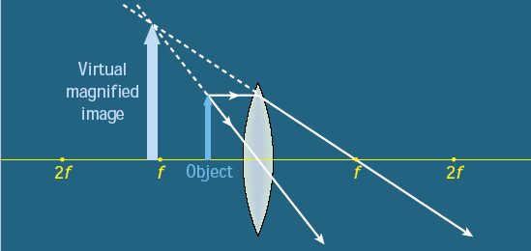
SPECIAL CASE:Converging Lens – Case 5 Object INSIDE the focal point i.e. u < f
The image is virtual, erect and magnified.

Slide 30
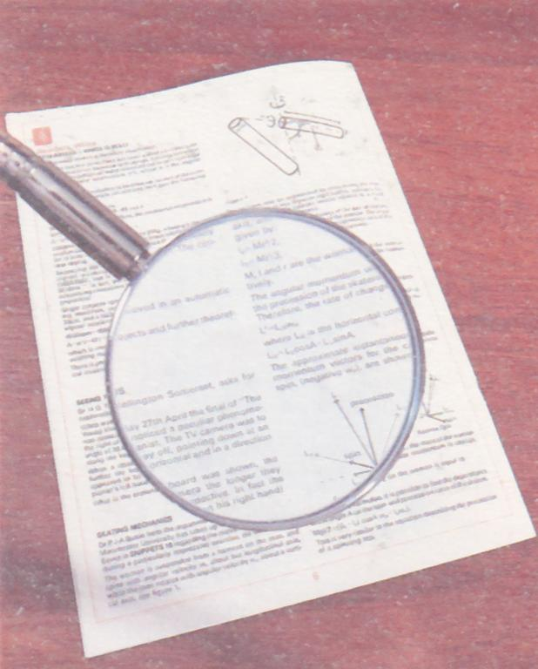
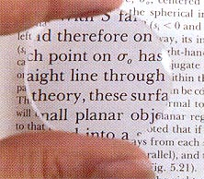
Converging Lens – Case 5:
Object inside f
This is called a
Simple Microscope or
Magnifying Glass
N.B. The image is virtual, erect and magnified.

Slide 31
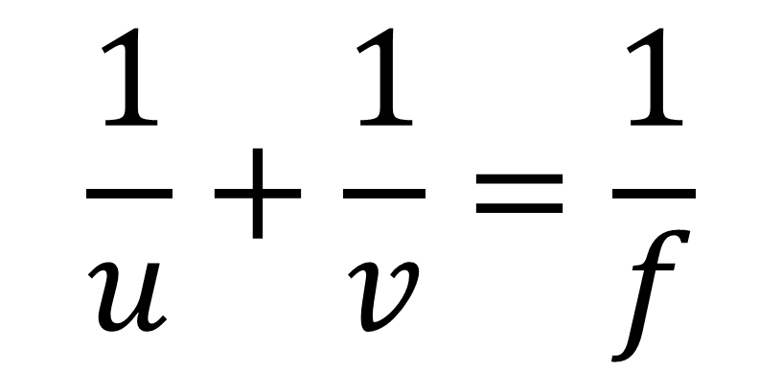
Lens Formula
$$\frac{1}{u}+\frac{1}{v}=\frac{1}{f}$$

Slide 32
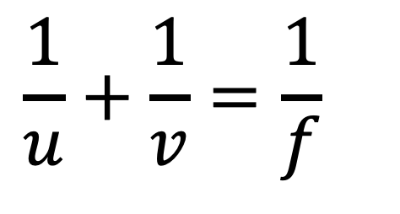


What is the lens formula
$$\frac{1}{u}+\frac{1}{v}=\frac{1}{f}$$
Object
Image
$$u$$
$$v$$
u = distance from object to the optic centre.
v = distance from image to the optic centre.
f = Focal Length of the lens.

Slide 33
What is the lens formula
$$\frac{1}{u}+\frac{1}{v}=\frac{1}{f}$$
Object
Image
$$u$$
$$v$$
u = distance from object to the optic centre.
v = distance from image to the optic centre.
f = Focal Length of the lens.

Slide 34
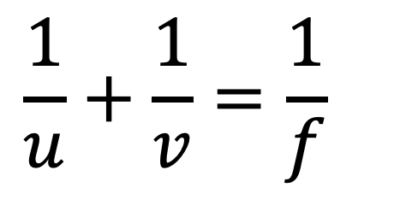
When do you get negatives in the lens formula
$$\frac{1}{u}+\frac{1}{v}=\frac{1}{f}$$
f is positive for a converging lens
f is negative for a diverging lens
v is positive for a real image and
v is negative for a virtual image

Slide 35
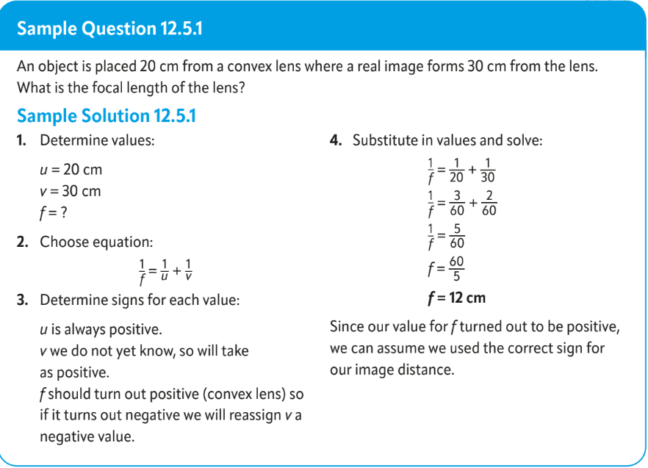

Slide 36
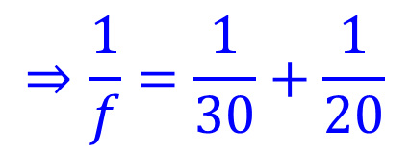
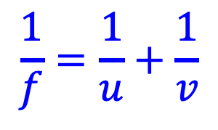
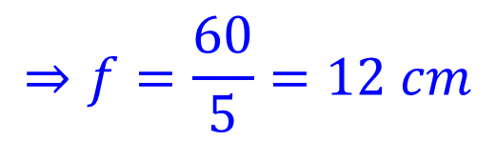
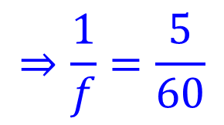
Example 1
An object 30 cm from a converging lens creates a real image 20 cm from the lens. Calculate the focal length of the lens.
$$\frac{1}{f}=\frac{1}{u}+\frac{1}{v}$$
$$⇒\frac{1}{f}=\frac{1}{30}+\frac{1}{20}$$
$$⇒\frac{1}{f}=\frac{5}{60}$$
$$⇒f=\frac{60}{5}=12 cm$$

Slide 37
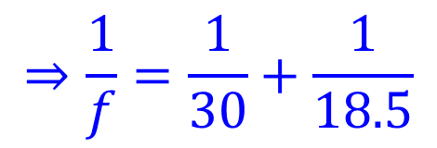
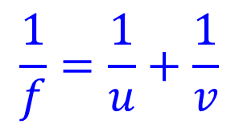
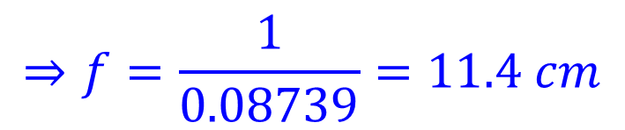
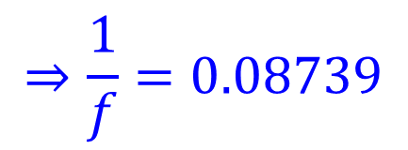
Example 2
An object 30 cm from a converging lens creates a real image 18.5 cm from the lens. Calculate the focal length of the lens to 3 significant figures.
$$\frac{1}{f}=\frac{1}{u}+\frac{1}{v}$$
$$⇒\frac{1}{f}=\frac{1}{30}+\frac{1}{18.5}$$
$$⇒\frac{1}{f}=0.08739$$
$$⇒f=\frac{1}{0.08739}=11.4 cm$$
New V1.1

Slide 38
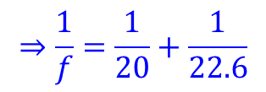
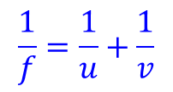
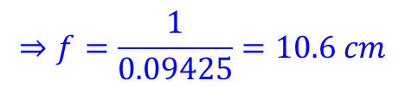
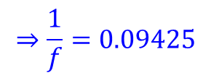
Exercise
An object 20 cm from a converging lens creates a real image 22.6 cm from the lens. Calculate the focal length of the lens to 3 significant figures.
$$\frac{1}{f}=\frac{1}{u}+\frac{1}{v}$$
$$⇒\frac{1}{f}=\frac{1}{20}+\frac{1}{22.6}$$
$$⇒\frac{1}{f}=0.09425$$
$$⇒f=\frac{1}{0.09425}=10.6 cm$$
New V1.1

Slide 39







Example 3
An object is 30 cm from a converging lens with $f=10 cm$ find the position of the image. Is it real or virtual?
$$\frac{1}{u}+\frac{1}{v}=\frac{1}{f}$$
$$⇒\frac{1}{30}+\frac{1}{v}=\frac{1}{10}$$
converging lens means f is positive
$$⇒\frac{1}{v}=\frac{1}{10}−\frac{1}{30}$$
$$⇒\frac{1}{v}=\frac{3−1}{30}=\frac{1}{15}$$
$$v is positive$$
$$⇒image is real$$
$$⇒v=15 cm$$

Slide 40






Example 4
Magnifying glasses are converging lenses. In normal use the object is closer to the lens than its Focus. If a lens has a focal length of 10 cm and an object is placed 5 cm from the lens. Will the image be real or virtual?
$$\frac{1}{u}+\frac{1}{v}=\frac{1}{f}$$
$$v is negative$$
$$⇒image is virtual$$
$$same side of lens as object$$
$$⇒\frac{1}{5}+\frac{1}{v}=\frac{1}{10}$$
$$⇒\frac{1}{v}=\frac{1}{10}−\frac{1}{5}$$
$$⇒\frac{1}{v}=\frac{1−2}{10}=−\frac{1}{10}$$
$$⇒v=−10 cm$$

Slide 41
Exercise
A converging lens has a focal length of 20 cm. An object is placed 30 cm from the lens,
calculate how far the image will be from the lens.
Is the image real or virtual.
60 cm
Real image

Slide 42
Exercise
A converging lens has a focal length of 20 cm. An object is placed 15 cm from the lens,
calculate how far the image will be from the lens.
Is the image real or virtual.
-60 cm
Virtual image

Slide 43
Exercise
A converging lens has a focal length of 15 cm. An object is placed 2 m from the lens,
To 4 significant figures, calculate how far the image will be from the lens.
Is the image real or virtual.
16.22 cm
Real image

Slide 44

Exercise
A converging lens has a focal length of 20 cm.
How far from the lens will an image of the sun be formed.
Justify your answer
Will this image be real or virtual?
20 cm
Use $u=∞$
OR
“parallel beams converge at the focus”
Real image

Slide 45
Exercise
A projector lens forms an image on a screen 3 meters from the lens. The focal length of the lens is 8 cm. How far is the internal LCD (ie the object) from the lens.
8.22 cm

Slide 46
Exercise
A phone camera lens is 4.4 mm from the sensor. If an object 3 m from the camera is perfectly in focus, what is the focal length of the lens? Answer to 4 significant figures.
4.394 mm

Slide 47


Slide 48


Slide 49

Concave (diverging lenses)
In a concave lens the rays of light are refracted OUTWARDS.
This results in diverging rays of light so they will never meet.
Only VIRTUAL images can form in concave lenses

Slide 50

Rules for drawing ray diagrams
In TOWARD f, out parallel
In optic centre, out undeflected
In parallel out as if FROM f

Slide 51

Images formed in a concave lens

Slide 52


Slide 53


