Slide 1
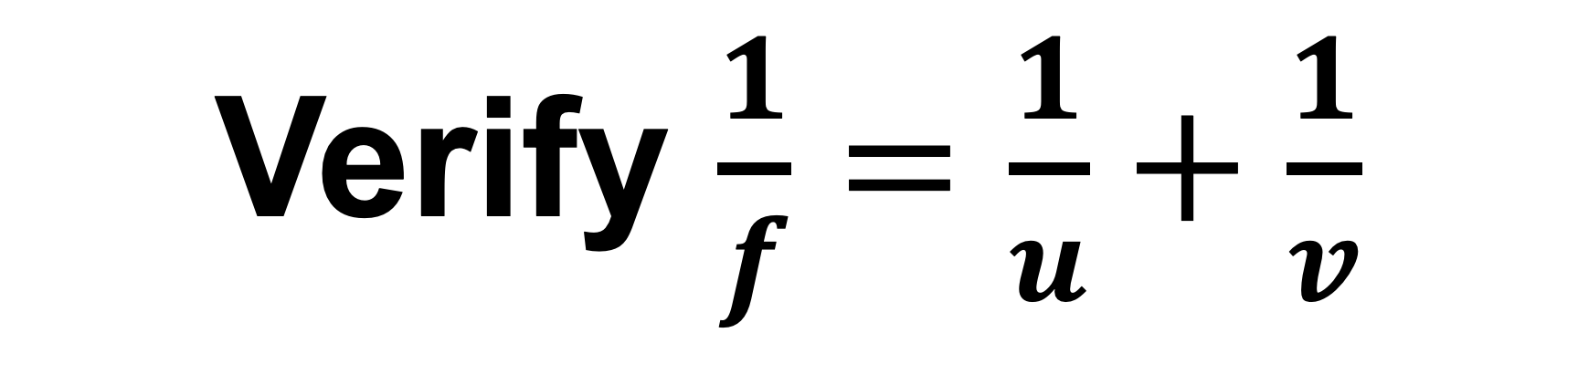
Verify $\frac{1}{f}=\frac{1}{u}+\frac{1}{v}$

Slide 2
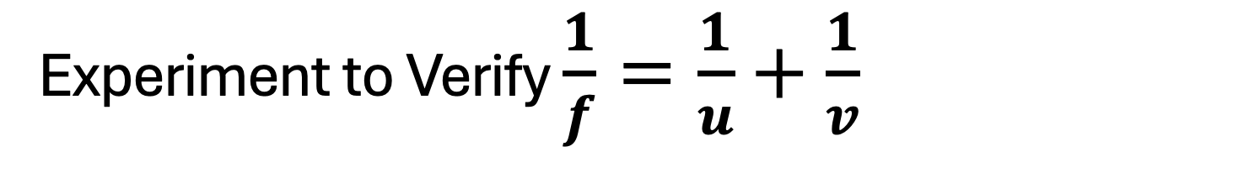


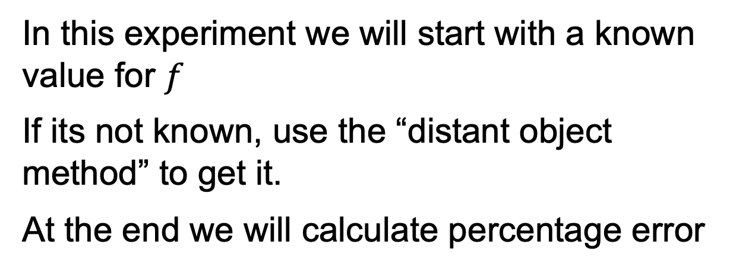
Experiment to Verify $\frac{1}{f}=\frac{1}{u}+\frac{1}{v}$
Object
Image
$$u$$
$$v$$
In this experiment we will start with a known value for $f$
If its not known, use the “distant object method” to get it.
At the end we will calculate percentage error
Notes:
Drew dashed line at centre of lens

Slide 3


find $f$ using a distant object
Image of Tree
Screen
Distant object
Convex Lens
Create an image of a distant object on a screen. Move screen until image is sharp. Measure distance from screen to centre of lens.
$$f$$
Meter stick
Notes:
Drew dashed line at centre of lens

Slide 4
find u and v
Image of cross thread
Screen (white card)
cross thread (object)
Convex Lens
Light
u
v
Meter stick
Edited V1.1
Notes:
Added the word Changed cardboard screen to “Screen (white card)”
Drew dashed line at centre of lens

Slide 5
Alternative setup using a small LED
Image of LED
Convex Lens
LED
u
v
Screen (white card)
Edited V1.1
Notes:
Changed cardboard screen to “Screen (white card)”
Drew dashed line at centre of lens

Slide 6
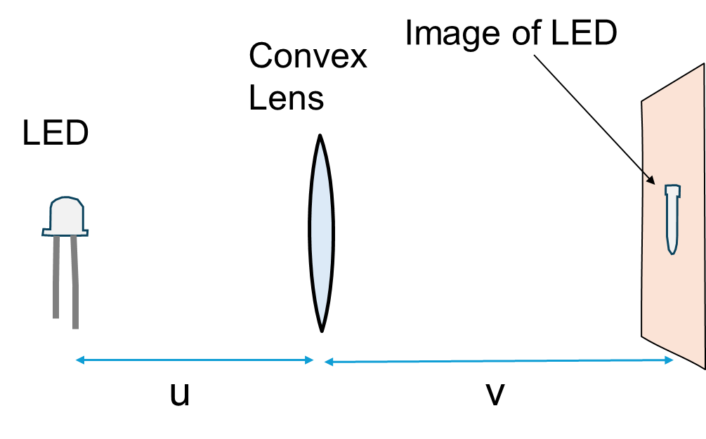
Find u and v
Create an image of a bright object on the screen
Move the screen until image is sharp.
Measure and record u and v
Repeat for different values of u
Note, when we get a sharp image we can say that it is “in focus”. This does NOT mean it is “at the focus” (its not)

Slide 7
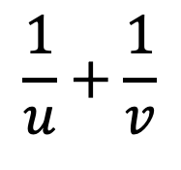
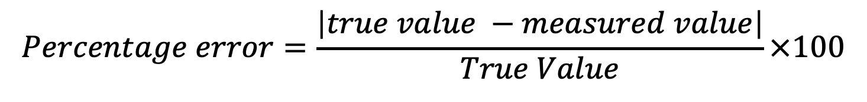


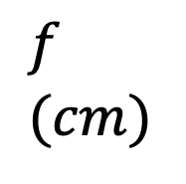
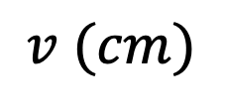
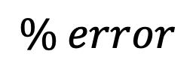
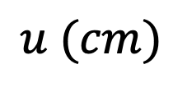

Data and calculations
$$\frac{1}{u}$$
$$\frac{1}{v}$$
$$\frac{1}{u}+\frac{1}{v}$$
$$\frac{1}{f}$$
$$f \\ (cm)$$
$$\% error$$
$$u (cm)$$
$$v (cm)$$
$$Percentage error=\frac{\left|true value −measured value\right|}{True Value}×100$$
If f is not given, use the value that you measured using a distant object as the true value.

Slide 8
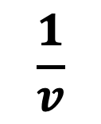
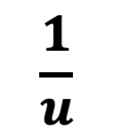
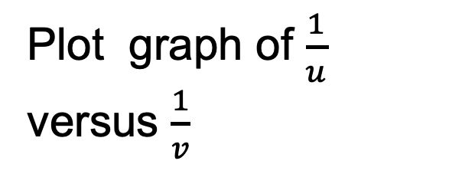
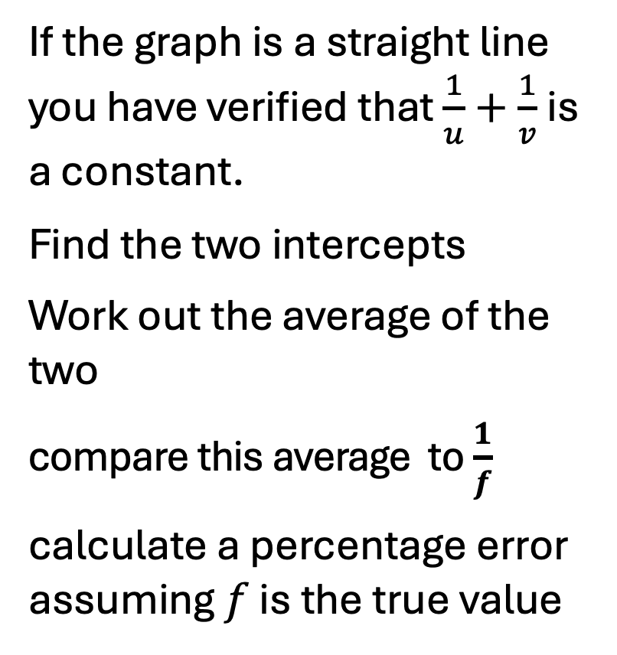
Graph
Plot graph of $\frac{1}{u}$ versus $\frac{1}{v}$
If the graph is a straight line you have verified that $\frac{1}{u}+\frac{1}{v}$ is a constant.
Find the two intercepts
Work out the average of the two
compare this average to $\frac{1}{f}$
calculate a percentage error assuming $f$ is the true value
$$\frac{1}{u}$$
$$\frac{1}{v}$$

Slide 9
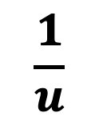
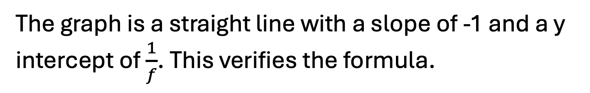

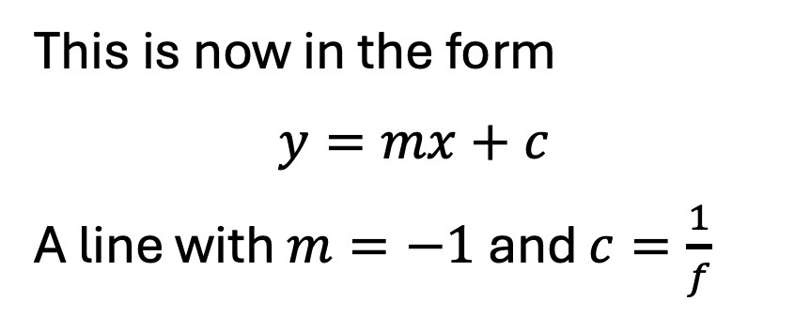
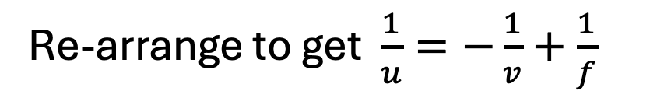
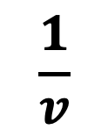
Example 5
Students obtained the below graph. Describe how this verifies the lens formula $\frac{1}{f}=\frac{1}{u}+\frac{1}{v}$v
$$\frac{1}{u}$$
Re-arrange to get $\frac{1}{u}=−\frac{1}{v}+\frac{1}{f}$
This is now in the form
$$y=mx+c$$
A line with $m=−1$ and $c=\frac{1}{f}$
$$\frac{1}{v}$$
The graph is a straight line with a slope of -1 and a y intercept of $\frac{1}{f}$. This verifies the formula.

Slide 10
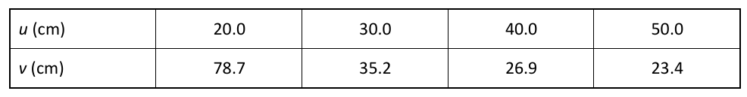


Exercise with secondary data
In an experiment to verify the lens formula students obtained the following data using a lens of focal length 16 cm. Use this data to draw a graph that verifies the formula and state how
the graph verifies the
formula
$$\frac{1}{u}$$
0.05 0.0333 0.025 0.02
$$\frac{1}{v}$$
0.0127 0.0284 0.0372 0.0427

Slide 11
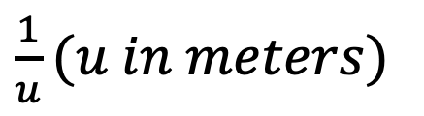
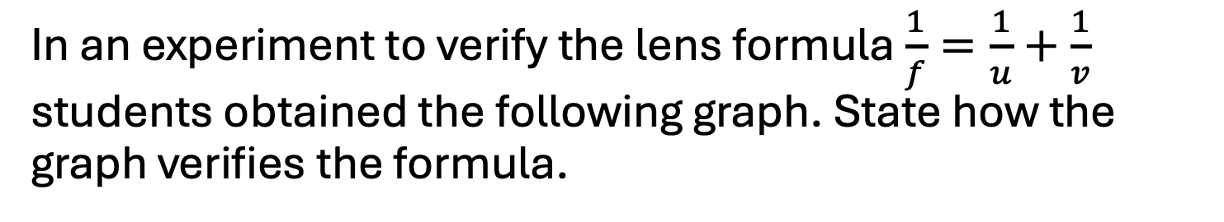
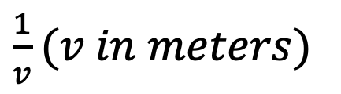
Exercise with secondary data
In an experiment to verify the lens formula $\frac{1}{f}=\frac{1}{u}+\frac{1}{v}$ students obtained the following graph. State how the graph verifies the formula.
$\frac{1}{u}(u in meters)$
6
5
4
3
2
1
1
2
3
4
5
6
$\frac{1}{v}(v in meters)$

Slide 12
Exercise with secondary data
In an experiment to verify the lens formula students obtained the following graph. Using the graph determine the focal length of the lens.
$\frac{1}{u}(u in meters)$
6
5
4
3
2
1
1
2
3
4
5
6
$\frac{1}{v}(v in meters)$

Slide 13
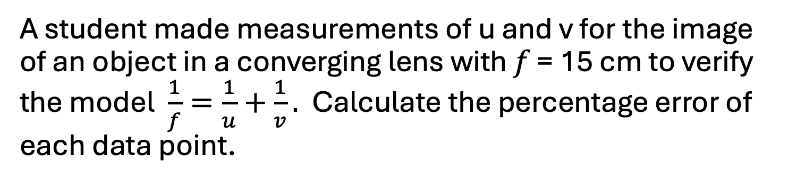
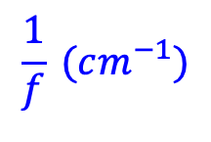
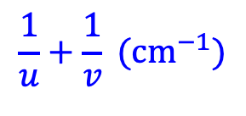
Exercise with secondary data
A student made measurements of u and v for the image of an object in a converging lens with 𝑓 = 15 cm to verify the model $\frac{1}{f}=\frac{1}{u}+\frac{1}{v}.$ Calculate the percentage error of each data point.
u (cm)
20
30
40
v (cm)
56.2
30.3
24.1
$$\frac{1}{u}+\frac{1}{v} ({cm}^{−1})$$
0.0665
0.0678
0.0663
$$\frac{1}{f} (cm^{−1})$$
0.0667
0.0667
0.0667
% error
1.8%
0.6%
0.3%

