Slide 1
X# from Scratch
Eric Selje

Slide 2

Eric Selje
FoxPro Dev from way back
Programming is my first love
Currently IT Security Officer for the U.S. Courts

Slide 3
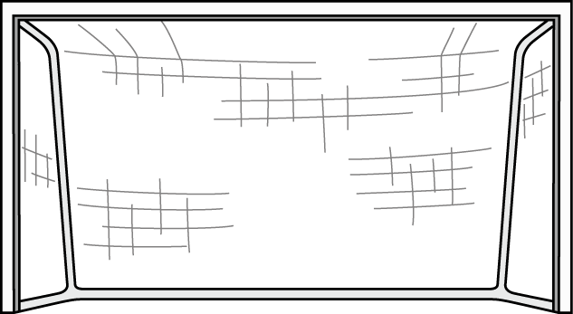
Goal!
By the end of this session you should have a solid understanding of what it takes to create an X# application from scratch.
Notes:
Thank you https://www.clipartmax.com/

Slide 4
Agenda
Take a look at our sample FoxPro application
Create a new X# solution in Visual Studio
Write and test our business objects
Create a XAML form
Discussion
Notes:
Not a lot of slides – mostly coding

Slide 5
FoxToDos

Slide 6
Here’s our Starting Point
All the code is

Slide 7
More Stuff
Abc
Def
Xyz

Slide 8
Creating the X# Solution in VS

Slide 9
Agenda #2 Title
Blah
Blah
Blah

Slide 10
More Stuff
Abc
Def
Xyz

Slide 11
Forms

Slide 12
Agenda #3 Title
Yada
Yada
Yada

Slide 13
More Stuff
Abc
Def
Xyz

Slide 14
More

Slide 15
More Stuff
Reports
Source Control
Databases
Frameworks
External Libraries
Help

Slide 16
Agenda #4 Title
Fox
Rocks

Slide 17
Summary

Slide 18
What You Learned Today
Created an X# Application from scratch
Considerations when creating classes
Converting visual classes and forms to XAML
More!

Slide 19
Eric Selje Salty Dog Solutions, LLC Eric@SaltyDogLLC www.SaltyDogLLC.com

Slide 20


Slide 21
Bonus Info

Slide 22
But wait … There’s more
If you order now…
You’ll get double the product!
And the shipping is free!
The logo at the bottom hyperlinks back to the “Thank-You” slide

Slide 23
More Stuff
Abc
Def
Xyz

Slide 25
Individual
Stacked
. . . . . . . .
.
. .
. . .
. . . .
. . . . .
. . . . . .
. . . . . . .
. . . . . . . .
. . . . . . .
.
. .
. . .
. . . .
. . . . .
. . . . . .
. . . . . . .
. . . . . .
.
. .
. . .
. . . .
. . . . .
. . . . . .
. . . . .
.
. .
. . .
. . . .
. . . . .
. . . .
.
. .
. . .
. . . .
. . .
.
. .
. . .
. .
.
. .
.

