Slide 1


X#
Eric Selje
Notes:
Presentation Reminders for Eric:
Use Chrome
Get off VPN
Make sure your Bluetooth headset is working ok
Respect the 20s delay
Turn off Camera when showing screen
1280x800
Don’t use Julia Child voice

Slide 2


Eric Selje
FoxPro Dev from way back
Programming is my first love
Currently IT Security Officer for the U.S. Courts

Slide 3

Goal!
By the end of this session you should have a solid understanding of what it takes to bake an X# application from scratch.
Notes:
Thank you https://www.clipartmax.com/

Slide 4
Agenda
Take a look at our sample FoxPro application
Create a new X# solution in Visual Studio
Write and test our business objects
Create a custom control and XAML form for UI
Q&A afterwards
Notes:
I will pause a few times to take questions – type them in the chat window.
I don’t have Robert here to help me this year so please take it easy on me.
Ok we’ve got a lot to talk about so let's get to it

Slide 5
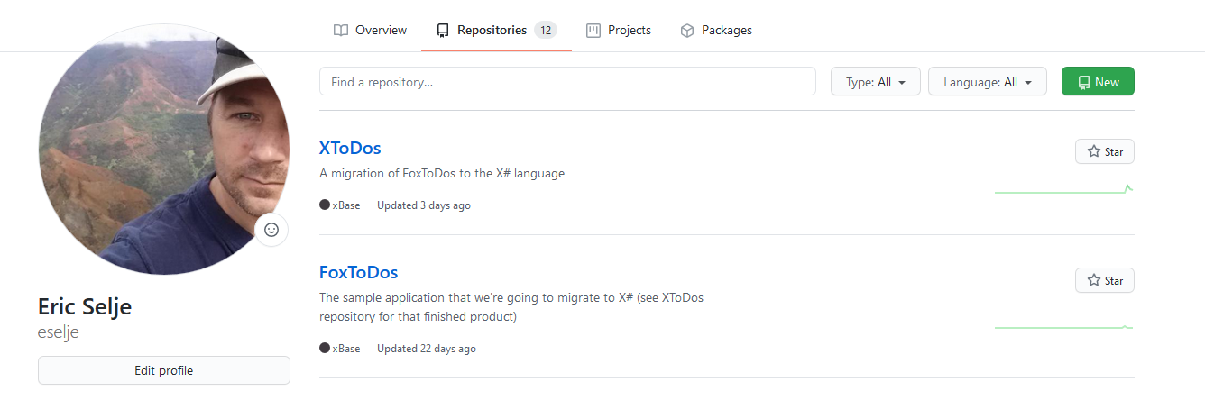
Note
Source code is at github.com/eselje/XToDos and FoxToDos
Notes:
Whatever’s in the whitepaper is probably out of date already, and I’m going to continue working on this and encourage you too participate. This whitepaper is in the Docs folder of the XToDos repository.
If you didn’t watch Rick Borup’s Git session, find that recording or read his whitepaper because he’s excellent.

Slide 6

X# Recap
.Net Language
FoxPro Dialect
Can read DBF
Open Source
Things are moving along nicely
Notes:
Overview:
.Net Language – compiles to same IL as C# and all other .Net languages. Can take advantage of all other .Net libraries and 3rd party apps.
FoxPro Dialect – Its history is Clipper, the original compiled xBase dialect. Because FoxPro was interpreted there are divergent abilities that are now being reassimilated into the language.
DBF Files is a big plus
Open Source – You can contribute
A lot of what I said last year is already out of date, and that’s going to be the case again this year. At the end I will mention a new tool that’s out that makes all of this even easier.

Slide 7

FoxToDos
Notes:
Tried to create an example with just enough scope to give you a good idea of what it takes to convert in 75 minutes.

Slide 8
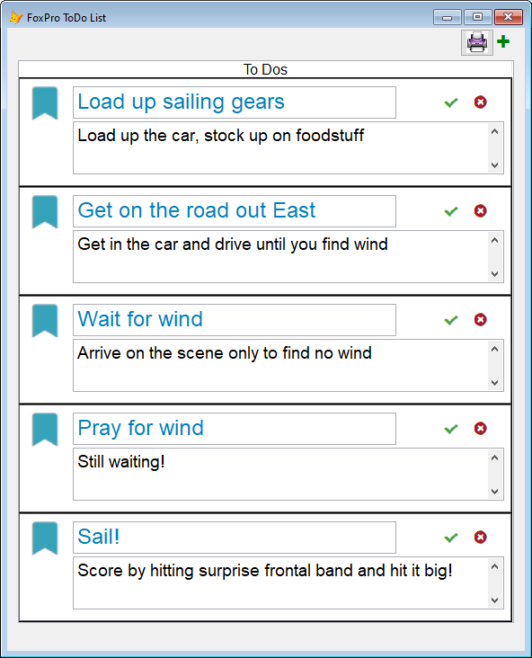
FoxToDos
Notes:
Look familiar? Based on Rick Strahl’s Vue.js session last year. Good programmers borrow, great programmers steal. This does NOT use a framework, and I would not consider this a production-ready application.
DBF files, because if I was just going to use SQL Server I could have done it all in C# and then what’s the point?
In VFP this is a grid, with one column and a custom container in that column. We’ll take a closer look at that on the next slide.
Bind the click events to our business objects to add, delete, or complete a task.

Slide 9
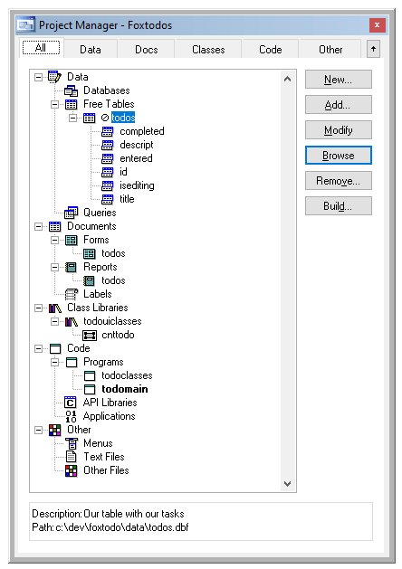
Under the Covers
Data: ToDos.dbf
Form: ToDos
Report: ToDos
Visual Classes: cntToDo
NonVisual Classes: ToDoClasses
Code: ToDoMain
Notes:
ToDos.dbf, the free table with our tasks. We are going to use the same table for both solutions.
ToDos.scx, a form that serves as the user interface and includes a grid that contains one custom control, cntToDo.
ToDos.frx, a simple, wizard-generated report for those that like their tasks on paper.
ToDoUIClasses.vcx, a visual class library , that has the cntToDo control we use in the grid on our form.
ToDoClasses.prg contains our non-visual business objects. while has one user interface control, cntToDo, for presenting each task on the form cohesively. Lastly, we have a simple wizard-generated report Converting these to X# should be enough to give us a good feel for what the experience is like.
ToDoMain.prg. A simple startup program that gets us going.
(Pause for questions)

Slide 10

Creating the Solution
Notes:
If this were a session on Test Driven Development or even good application design, I’d start with writing unit tests. We’ll get to unit tests in a bit and since our code is already written we’ve already got our design.
As far as the IDE, I could have chosen Code or Atom or COPY CON or XIDE or VI or VS Community Edition
XIDE, the X# integrated development environment that may be downloaded along with the rest of X#. XIDE is a perfectly serviceable environment and has a lot in common with Visual FoxPro’s IDE. It’s written in X# itself, so it provides a dramatic example of what the language can do in the right hands.
Visual Studio, either the Professional (ie paid) or Community (ie free) Edition. The big advantage of Visual Studio is that it’s used by a lot of developers all over the world, so it’s well-supported by its developer and the community.

Slide 11




Concocting our Solution in Visual Studio
Solution is a collection of Projects
Projects can be based on Templates
Notes:
In Visual Studio’s parlance, a “Solution” is the main structure for an application. It’s a collection of “Projects”, which are the main work units.
Our first project is going to be the nonvisual business objects from our FoxPro class, ToDoClasses

Slide 12
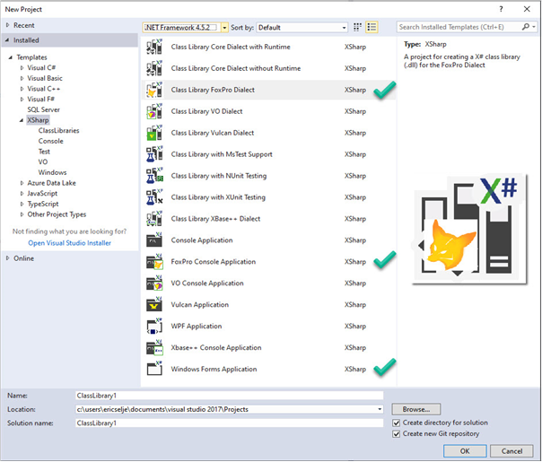
Project Templates
Set properties of the project
Seed the project with starter File Templates
Notes:
Because we’ve already installed X#, we have Project Templates available to us.
(Take a moment to highlight the options for creating a directory and git and naming the Solution)
You may be wondering about Solution Frameworks or Wizards. We’ll talk about that in a bit…

Slide 13
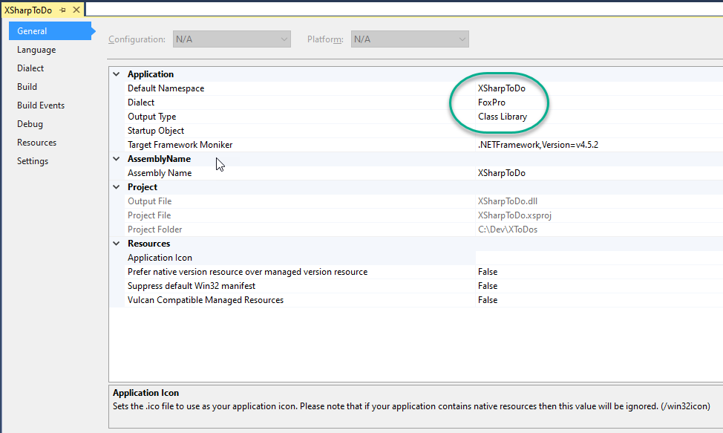
Project General Properties
FoxPro Dialect
Output Type
Notes:
FoxPro “Dialect”
Output type (console application, DLL, Windows EXE)
Pay extra special attention to the Visual FoxPro Compatibility / Inherit from Custom Class setting. If you want your code to behave the way it does in VFP, you want that set to True. Among other things, that causes X# to fire an Init() method (which wasn’t a thing in X# before, as they use Constructor()) and create virtual _access and _assign methods for our “properties” – more on that later.
[Show code – take a moment to highlight the options for creating a directory and git]

Slide 14
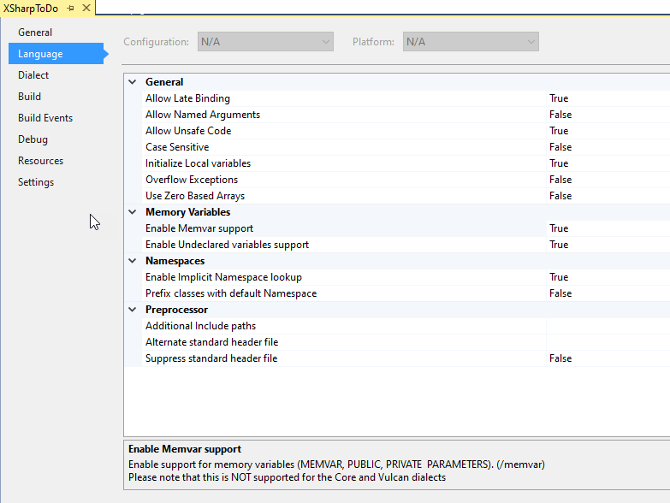
Project Language Properties
Memvar
Undeclared variables
Notes:
These default to the values you’re used to in FoxPro so you should have to change

Slide 15
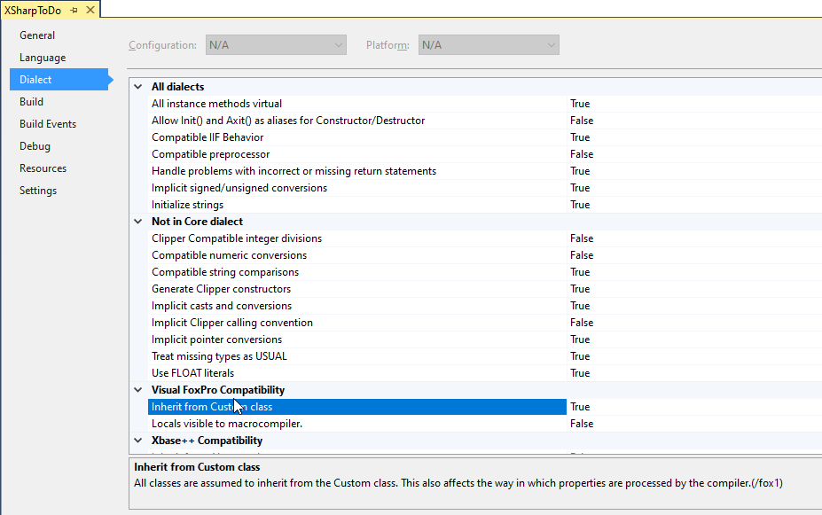
Project Dialect Properties
Inherit from Custom class
Notes:
Pay extra special attention to the Visual FoxPro Compatibility / Inherit from Custom Class setting. If you want your code to behave the way it does in VFP, you want that set to True.
Causes X# to fire an Init() method (which wasn’t a thing in X# before, as they use Constructor())
Create virtual _access and _assign methods for our “properties” – more on in the next slide

Slide 16
Our First Class - XToDo
DEFINE CLASS ToDo AS Custom
Name = "ToDo"
cId = ""
oData = .null.
lNew = .f.
lSaved = .f.
lLoaded = .f.
oException = .null.
PROCEDURE Init
LPARAMETERS cId
This.cId = cId
IF EMPTY(cId)
This.New()
ELSE
This.Load(This.cId)
ENDIF
ENDPROC
* More function here
END DEFINE
USING System
USING System.Collections.Generic
USING System.Text
BEGIN NAMESPACE XSharpToDo
DEFINE CLASS XToDo as Custom
id = ""
title = ""
descript = ""
entered = DateTime.Now
completed = .f.
isEditing = .f.
isNew = .f.
PUBLIC FUNCTION Constructor() // No Parameter. New Task.
This.new()
PUBLIC FUNCTION Constructor(cId AS String) // Parameter. Existing Task
This.id = cId
This.load(cId)
END DEFINE
END NAMESPACE
Notes:
Overall you should be struck by how similar and familiar the X# code is.
The next few slides are going to highlight some differences
USING
NAMESPACES
In FoxPro I stored our data in an object, which I called oData. SCATTER/GATHER now works in X# so I could have done that but it wasn’t when I first started this conversion, so I didn’t use them. This is the fast moving progress I’m talking about.
Properties v. Fields
There is a fundamental difference in .NET classes vs Visual FoxPro classes. In VFP when we added what we called a “property” to a class, we could immediately assign values to that property without going through any hoops. This is bad, because there were no checks on the input at all, and anyone could read the value. We got around that by adding _access and _assign methods to the properties. The “visibility” of the property (public, protected, hidden) affected how whether other objects could see the properties, but had no effect on what values were visible within the class itself.
.Net classes call those “Fields” rather than properties, and their visibility is determined by whether they’re Public or Private. Public fields are akin to our Properties, but this isn’t recommended because all the reasons mentioned above.
Best Practice
Use PRIVATE fields and PUBLIC properties
Properties on a .Net class are the public-facing interface, akin to our _access and _assign, they have get() and set() methods, which filter the input to the fields or restrict the output. In order to emulate Visual FoxPro’s class behavior, there’s an option for X# classes to “Inherit from Custom Class”, which is set to True by default in the FoxPro Project Templates. Under the covers, this Custom class emulates FoxPro Properties in .NET’s Fields.
Notice the DateTime
2 Constructor() methods with different signatures. FoxPro dialect does have INIT()

Slide 17
XToDo.New()
PROCEDURE New
lUsed = This.OpenToDos()
SCATTER BLANK NAME This.oData MEMO
This.lNew = .t.
This.CloseTodos(lUsed)
RETURN This.oData
PUBLIC FUNCTION New()
This.New("")
RETURN This.id
PUBLIC FUNCTION New(cTitle AS STRING)
This.Clear()
VAR g = GUID.NEWGUID()
This.id = g.TOSTRING()
this.entered = DateTime.Now
This.isNew = .t.
This.title = cTitle
RETURN This.id
Notes:
Because I’m using SCATTER BLANK, I have to open the table. Don’t have to do that in X#
Better design in X# is completely due to Unit Testing, which we’ll talk about soon.
Again with the overloading of a function, this time New can take a title but if I don’t send one it seeds it with blank. There may be a way to assign default values right in the signature of the function.
Here I’m taking advantage of the GUID class in .NET. When we get to the saving I’ll show you the equivalent in FoxPro.

Slide 18
XToDo.Load()
PROCEDURE Load
LPARAMETERS cId
LOCAL lUsed
cId = EVL(cId,This.cId)
IF NOT EMPTY(cId)
TRY
lUsed = This.OpenToDos()
LOCATE FOR id = cId
IF FOUND()
SCATTER NAME This.oData MEMO
This.cId = cId
This.lLoaded = .t.
This.lNew = .f.
ENDIF
CATCH TO oEx
This.oException = oEx
FINALLY
This.CloseTodos(lUsed)
ENDTRY
ENDIF
RETURN This.lLoaded
PUBLIC FUNCTION load(cId AS String) AS Boolean
var lReturn = False
This.openToDos()
SET EXACT OFF
GO TOP
LOCATE FOR ToDos.id = cId
lReturn = FOUND()
IF lReturn
This.id = ToDos.id
This.title = ToDos.title
This.descript = ToDos.descript
This.entered = Todos.entered
This.completed = ToDos.completed
else
This.clear()
ENDIF
This.CloseToDos()
return lReturn
END FUNCTION
Notes:
Notice how I mixed False with .f.
Case insensitive

Slide 19
XToDo.Save()
PROCEDURE Save
LOCAL lUsed
This.lSaved = .F.
TRY
lUsed = This.OpenToDos()
IF This.lNew
LOCAL oGUID
oGUID = CreateObject("scriptlet.typelib")
This.oData.Id = Strextract(oGUID.GUID, "{", "}" )
This.oData.Entered = DATETIME()
INSERT INTO ToDos FROM NAME This.oData
This.cId = This.oData.Id
ELSE
LOCATE FOR id = This.cId
GATHER NAME This.oData MEMO
ENDIF
This.lSaved = .t.
This.lNew = .f.
CATCH TO oEx
This.oException = oEx
FINALLY
This.CloseTodos(lUsed)
ENDTRY
RETURN This.lSaved
PUBLIC FUNCTION SAVE() AS Boolean
LOCAL lSaved AS Boolean (… et al)
cId = This.id
TRY
This.openToDos()
LOCATE FOR ToDos.ID = cId
lReturn = FOUND()
IF NOT lReturn
APPEND BLANK
REPLACE id WITH cId, Entered WITH DateTime.Now
ENDIF
cTitle = This.title
cDescript = This.descript
lCompleted = This.completed
IF RLOCK()
REPLACE Title WITH cTitle, ;
Descript WITH cDescript, ;
Completed WITH lCompleted, ;
isEditing WITH .f.
UNLOCK
ENDIF
This.isNew = .f.
lSaved = .t.
CATCH
FINALLY
This.closeToDos()
END TRY
RETURN lSaved
END FUNCTION
Notes:
* There are many ways to create a GUID, including calls to CoCreateGUID in Ole32.dll, but this is easy
This may not always work. The .NET equivalen
Can use sql insert to add record
This is the biggest shortcoming of X# right now but things are changing quickly!
Can also use GATHER to move info from object into cursor

Slide 20
XToDo.OpenToDos()/CloseToDos()
PROCEDURE OpenTodos
LOCAL lUsed
lUsed = USED("ToDos")
IF NOT lUsed
USE C:\DEV\XToDos\ToDos IN 0
ENDIF
SELECT ToDos
RETURN lUsed
PROCEDURE CloseToDos
LPARAMETERS lLeaveOpen
IF NOT lLeaveOpen
USE IN SELECT("ToDos")
ENDIF
RETURN NOT USED(“ToDos”)
public FUNCTION openToDos() AS Boolean
IF NOT USED("TODOS")
SET DEFA TO "C:\DEV\XTODOS"
SELECT 0
USE "TODOS" ALIAS "ToDos" SHARED
ENDIF
RETURN used("TODOS")
END FUNCTION
public FUNCTION closeToDos() AS Boolean
USE IN (CoreDb.SymSelect("ToDos"))
// USE IN SELECT(“ToDos”)
return not used("Todos")
END FUNCTION
Notes:
One warning about SET DEFAULT – it will not warn you if the folder you set it to doesn’t exist
When you try to open the table it will fail
I dare you to try this syntax in C#
“IN 0” syntax not supported
USE IN SELECT(Workarea)

Slide 21
Our Second Class - XToDos
First class was singular – XToDo
This one is a collection of those objects
I don’t know why I didn’t call them “Tasks”
In FoxPro, we would simply start a new DEFINE CLASS …
Best practice for .Net Code is to create a separate file for each class in the same namespace
Name the file the same as the class
Notes:
…and for that we “Add New Item” to our existing Project (next slide)

Slide 22
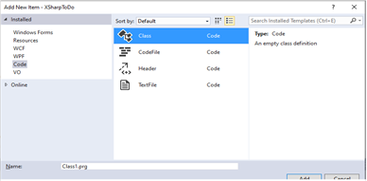
File Templates
USING System
USING System.Collections.Generic
USING System.Text
BEGIN NAMESPACE XSharpToDo
/// <summary>
/// The Class1 class.
/// </summary>
CLASS Class1
CONSTRUCTOR()
RETURN
END CLASS
END NAMESPACE // XSharpToDo
Notes:
“Codefile” is a straightforward FoxPro program.
What’s interesting about the starter class from the item template is that it gives us non-FoxPro like syntax even though we chose that.
I suspect the templates were written before the new VFP syntax was officially supported and haven’t been updated, but we can pull out that start class code and replace it with our own…
Show code – pull in all code from side project

Slide 23
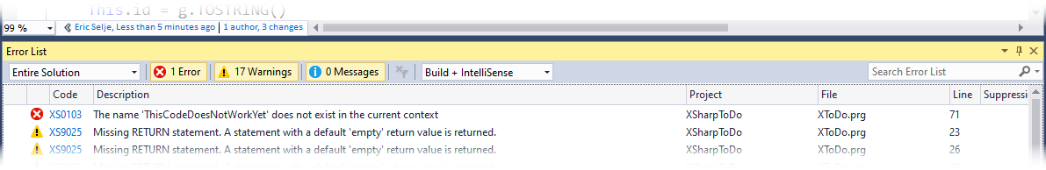

Testing our Class
Does it Compile?
Notes:
If not you can doubleclick on error to jump straight to the code
Can also click on error code to get help on that particular error
.Net debugger works a lot like FoxPro’s. Step through code, set breakpoints etc.
Once it compiles, we can ship it! No? I guess that’s not a valid test of whether it works.

Slide 24

Testing our Class
Command
Window?
Notes:
We FoxPro developers love to “test” our code by opening the Command Window, instantiating an instance of our class, and invoking the methods manually. If they didn’t do what we expected, we’d set a Breakpoint and walk through the code in debug mode.
Visual Studio doesn’t have a Command Window though. If you installed the XIDE environment you will get something like a Command Window called XSI, the X# Interpreter (there’s more on XSI in last year’s whitepaper.) Since we are using Visual Studio for this demonstration, we’ll instead create a quick Console Application that we can use to “test” our code.

Slide 25
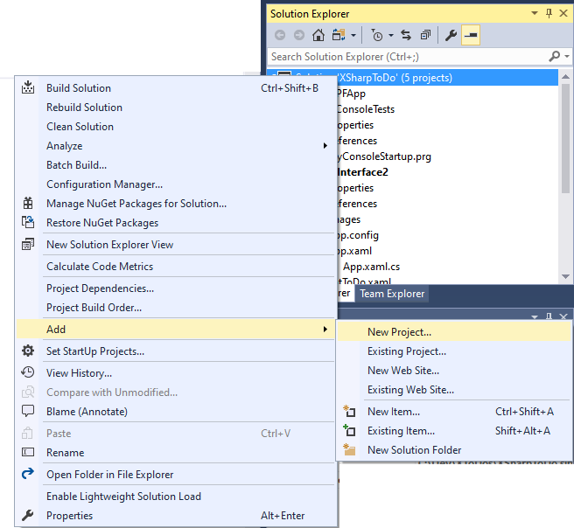
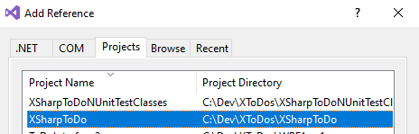
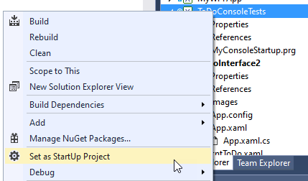
Testing our Class – Console App
Notes:
Let’s add a second project to our solution, a Console App
Our first “UI”
Add a “Reference” to our Business Objects
Set it as the Startup Project

Slide 26
Testing our Class – Console App
USING System
USING XSharpToDo
FUNCTION Start() AS VOID STRICT
LOCAL oToDo AS XToDo, cTestId AS String, cDescript As String
cTestId = "EDF53AEF-5C29-4DC4-A"
oToDo = createObject("XToDo")
IF oToDo.openToDos()
SET DELETE ON
SCAN
Console.Write("{0:00}: ID: {1}, {2}", RECNO(), ToDos.id, ToDos.descript)
Console.WriteLine(" - Status: {0}", IIF(ToDos.Completed, "Complete", "Incomplete"))
ENDSCAN
oToDo.Load(cTestId)
? "Loaded " + cTestId + "? " + iif(oToDo.id = cTestId, "Yes", "No")
? oToDo.id +": " + oToDo.Descript + ' - Status: ' + IIF(oToDo.Completed, "Complete", "Incomplete")
oToDo.closeToDos()
ELSE
? "Could not open ToDos.dbf"
? "Default folder is " + SET("DEFAULT")
ENDIF
WAIT
RETURN
Notes:
Every solution has to have a Start() somewhere in there to get going
Threw some gratuitous Console.Writes and WriteLines in there to show off the power of .NET Syntax
Set startup project

Slide 27
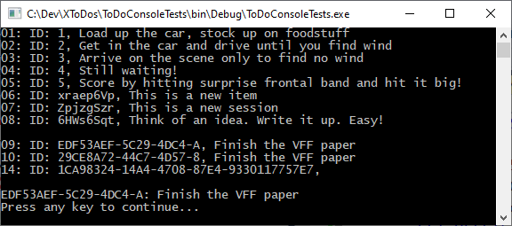
Testing our Class – Console App

Slide 28
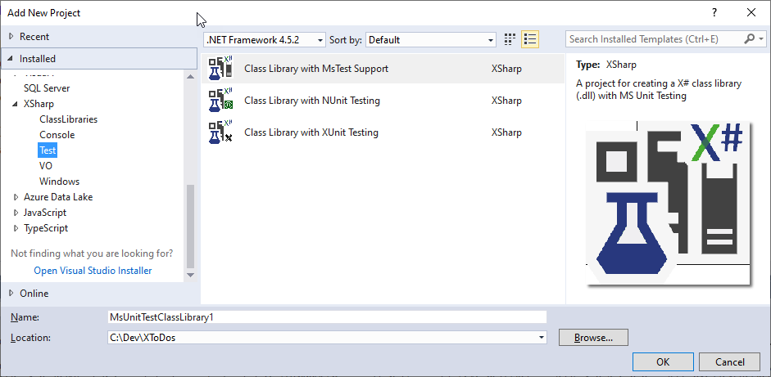
Testing our Class – Unit Tests
Notes:
A better way to test your code is to write unit tests, and in fact true Test-Driven development would have directed us to write those even before we started coding. But this isn’t real TDD because a) these aren’t “true” unit tests (they interact with the real database), and b) we’re just getting around to writing them now.
With FoxPro there is one popular unit testing harness, FoxUnit. It’s a separate install (via Thor, ideally) and not integrated into the IDE at all.
Visual Studio on the other hand has testing built into the IDE from the ground up, and you have multiple testing frameworks to choose from. I chose Nunit to demo because it’s very similar to FoxUnit.
Add references to our business object classes, Xsharp.rt, XSharp.core, XSharp.VFP

Slide 29
Testing our Class – Unit Tests
[Test];
METHOD openToDo AS VOID STRICT
VAR oToDos := XToDos{}
VAR lReturn := oToDos.openTodos()
Assert.IsTrue(lReturn, "Could not open ToDos.dbf")
RETURN
[Test];
METHOD closeToDo AS VOID STRICT
VAR oToDos := XSharpToDo.XToDos{}
VAR lReturn := oToDos.closeTodos()
Assert.IsTrue(lReturn, "Could not close ToDos.dbf")
RETURN
[Test];
METHOD getToDo AS VOID STRICT
LOCAL cExpected AS String
VAR oToDos := XSharpToDo.XToDos{}
VAR oTodo := oToDos.getToDo("EDF53AEF-5C29-4DC4-A")
VAR cActual := oTodo.title
cExpected := "Finish paper"
Assert.AreEqual(cExpected, cActual, "Did not get the right TODO")
RETURN
…
Notes:
Creating a text fixture is a lot like creating a class, but you annotate each method with [Test] syntax.
Notice I’m using the := syntax, which I first learned in Pascal and actually does make more readable code
I’m also using an alternative syntax to create objects
You can mix and match syntax, dialects, and even other languages in one solution
[Add a Test]

Slide 30
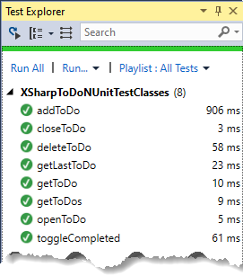

Testing our Class – Unit Tests
Notes:
Also more comfortable now making changes to my objects without worrying too much about breaking them.
One very frustrating problem I was having, and this is an Nunit problem and not an X# problem, is that I kept getting this message when trying to run my tests.

Slide 31

The User Interface
Notes:
At this point our business logic is converted and tested, but this application does not yet have a proper user interface (the Console Project notwithstanding). We can choose from any number of user interfaces for our business classes, e.g. an Angular website or a mobile phone app, but a Windows Form is going to emulate our existing VFP application closest.

Slide 32
WinForms or WPF?
Windows Presentation Framework (WPF) is
More scalable
Vector based
More complex in general
Easier to customize
Styleable
Probably going to stick around longer
Notes:
There are two flavors of Windows Forms. The original WinForms at first glance seems to have a lot in common with Visual FoxPro forms. The design surface looks similar, and there is a toolbox with a lot of familiar controls like TextBox and CheckBox. But FoxPro forms were deceptively powerful, allowing you to include controls that were layers upon layers of composition and inheritance (btw if you haven’t seen Joel Leach’s session, make sure you check that out), and WinForms simply cannot match that power.
I’ll also mention that Microsoft did say at one point that WinForms was not going to make the leap to .Net Core, the multiplatform version of the .Net framework. They have since walked back on that but the future for WinForms is less certain than the alternative.
Then there’s the newer, more complex, and more powerful WPF (Windows Presentation Format) forms. Under the covers it uses an XML dialect called XAML to lay out the interface, but the commands are written using C# or X#. The idea here is that the UI/UX designers on your staff can create the forms, and the coders can work on the actual logic. We FoxPro developers usually do both roles, of course.

Slide 33
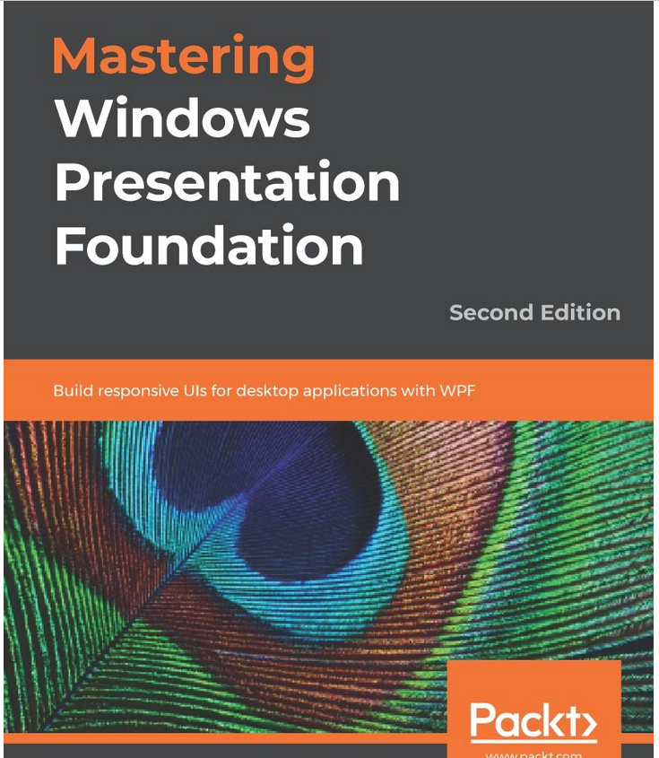
Create a WPF Form Project
Notes:
Entire books have been written about creating WPF forms, so we can only go into the shallowest of details here, just enough to emulate our VFP form. I will say that of all the things I worked on when writing this paper, getting the forms, and particularly the databinding, working correctly was the most difficult. This isn’t a knock on X# at all, since it’s not their fault. In fact, the X# devs are working on a utility to convert FoxPro’s forms to either WPF or WinForms, but it’s not available quite yet. It will be invaluable to getting us over the hump once it’s released.

Slide 34
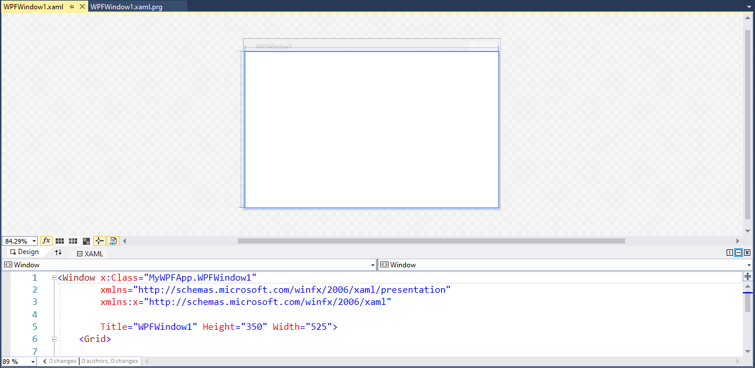
Create a WPF Form Project
Notes:
The Project Template for WPF Apps includes a starter file for a WPF form which includes a “code-behind” file (WPFWindow1.xaml.prg). It’s PRG because we chose the XSharp Project Template, so it uses the X# “Core” dialect syntax. If you want to use VFP syntax you’ll need to modify your Project properties.

Slide 35
The XAML Application Class
<Application x:Class=“WPFApp1.App” xmlns="http://schemas.microsoft.com/winfx/2006/xaml/presentation"
xmlns:x="http://schemas.microsoft.com/winfx/2006/xaml"
StartupUri="WPFWindow1.xaml">
<Application.Resources>
</Application.Resources> </Application>
using System.Windows;
namespace WPFApp1
{
/// <summary>
/// Interaction logic for App.xaml
/// </summary>
public partial class App : Application
{
}
}
Notes:
and a code-behind App.xaml.prg which has no code in it. If you set this new XAML Project to be your Startup Project, build and run your app, it actually works (figure 10)! But how did the application know that it should fire up that form when it began if there isn’t a Start() method? In XAML, an alternative way to indicate the starting form is in the StartupURI attribute of the Application tag in the XAML, which you can see in our code listing points to WPFWindows1.xaml.
Let’s run this app and see what happens!

Slide 36
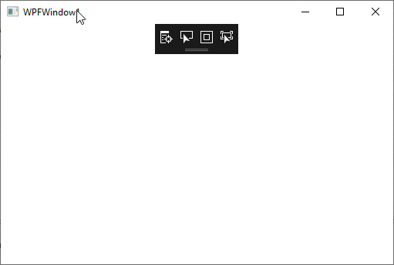
Our first WPF Form
Notes:
Isn’t that beautiful?
But how did the application know that it should fire up that form when it began if there isn’t a Start() method? In XAML, an alternative way to indicate the starting form is in the StartupURI attribute of the Application tag in the XAML,
This application isn’t particularly powerful though. In fact it does nothing, but notice that we didn’t have to do READ EVENTS or DO FORM or anything to get basic functionality, which is something. That’s because the application is an instance of the Application class in .Net, which is something VFP never had unless you went with a 3rd party framework.

Slide 37
Adding Controls
You can’t
(Directly)
Start with a layout container
Notes:
We must start by first add some type of layout container to our window. These are similar to FoxPro’s container object, but they have the different types of containers have different behaviors, and allow is to forego the absolution positioning and anchoring that we are used to. This makes the layout very flexible, and usable for all kinds of screen resolutions and devices.

Slide 38
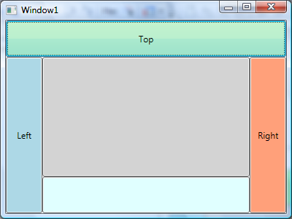
Layout Container
You can’t
(Directly)
Start with a layout container
Notes:
We must start by first add some type of layout container to our window. These are similar to FoxPro’s container object, but they have the different types of containers have different behaviors, and allow is to forego the absolution positioning and anchoring that we are used to. This makes the layout very flexible, and usable for all kinds of screen resolutions and devices.

Slide 39
Layout Container
Canvas: This is the most like a FoxPro container, where you have to position the objects manually into the space available.
Grid: Every control you add goes into a subsequent checkerboard row or column.
StackPanel: Every control you add goes next to or below the previous object, depending on orientation.
WrapPanel: Every control you add goes next to the previous one, and wraps around when the horizontal edge is reached.
DockPanel: Much like VFPs dockable containers, these get positioned along the edges, or in the center, of its parent container.
ToolBarPanel: A subclass of the StackPanel that puts extra controls into an “Overflow” area if they don’t fit.
Notes:
You man mix and nest these containers. Let’s add some buttons to our form.

Slide 40
Adding buttons into panels
<Window … > <StackPanel Orientation="Vertical">
<ToolBarPanel Height="60" Orientation="Horizontal" HorizontalAlignment="Right">
<Button Background="Transparent" BorderThickness="0">
<Image Name="imgNew" Source="Images\Ribbon.png" Height="24px" Width="24px" HorizontalAlignment="Right" Margin="10" ToolTip="Add Task"></Image>
</Button>
<Button Background="Transparent" BorderThickness="0">
<Image Name="imgPrint" Source="Images\Print.png" Height="24px" Width="24px" HorizontalAlignment="Right" Margin="10" ToolTip="Print To-Do List"></Image>
</Button>
</ToolBarPanel>
</StackPanel> </Window>
Notes:
You man mix and nest these containers. Let’s add some buttons to our form.
This may seem a little verbose at first, but it’s pretty straightforward. Intellisense inside of Visual Studio makes it very easy to add more properties to each control,

Slide 41
Binding Events to Controls
<Window.CommandBindings>
<CommandBinding Command="ApplicationCommands.New" Executed="NewCommand_Executed" CanExecute="NewCommand_CanExecute" />
<CommandBinding Command="ApplicationCommands.Print" Executed="PrintCommand_Executed" CanExecute="PrintCommand_CanExecute" />
</Window.CommandBindings>
Notes:
Right now our Add and Print buttons don’t do anything, so let’s fix that. Because Adding and Printing are events that we may also want to call from the Window’s menu (if we had one), and we don’t want to duplicate our efforts, we can create a “CommandBinding” in our Window. That gives us a central location to route things through, and also determine if the event is even doable at any given time (e.g. We can’t paste unless there’s something in the clipboard, or we can’t print a task list unless there are tasks to do). Add this code below the <Window> element:
This collection of Command Bindings gives a name to each of our commands, tells us what to do when the event gets fired, and whether the event even can be fired. In the Code Behind of the Window we add those methods (I went with C# for my WPF project, but I could have chosen X#. There is so little code here that it matters little)

Slide 42
Binding Events to Controls
private void NewCommand_CanExecute(object sender, CanExecuteRoutedEventArgs e)
{ e.CanExecute = true; } private void NewCommand_Executed(object sender, ExecutedRoutedEventArgs e)
{ MessageBox.Show("New Task"); }
private void PrintCommand_CanExecute(object sender, CanExecuteRoutedEventArgs e)
{ e.CanExecute = true; }
private void PrintCommand_Executed(object sender, ExecutedRoutedEventArgs e)
{ MessageBox.Show("Print"); }
<Button Background="Transparent" BorderThickness="0">
<Image Name="imgNew" Source="Images\Ribbon.png” Command="ApplicationCommands.New" Height="24px" Width="24px" HorizontalAlignment="Right" Margin="10" ToolTip="Add Task"> </Image>
</Button>
Notes:
Right now our Add and Print buttons don’t do anything, so let’s fix that. Because Adding and Printing are events that we may also want to call from the Window’s menu (if we had one), and we don’t want to duplicate our efforts, we can create a “CommandBinding” in our Window. That gives us a central location to route things through, and also determine if the event is even doable at any given time (e.g. We can’t paste unless there’s something in the clipboard, or we can’t print a task list unless there are tasks to do). Add this code below the <Window> element:
This collection of Command Bindings gives a name to each of our commands, tells us what to do when the event gets fired, and whether the event even can be fired. In the Code Behind of the Window we add those methods (I went with C# for my WPF project, but I could have chosen X#. There is so little code here that it matters little)
Now when we start the application, we see our window, with its two buttons inside of a ToolBarPanel inside of the StackPanel, we get what w

Slide 43
Pulling in our Business Objects
using XSharpToDo;
using XSharp.VFP;
namespace ToDoInterface
{
/// <summary>
/// Interaction logic for MainWindow.xaml
/// </summary>
public partial class MainWindow : Window
{
XToDos oTasks = new XToDos();
public MainWindow()
{
InitializeComponent();
this.DataContext = this;
this.oTasks.Load();
}
private void NewCommand_CanExecute(object sender, CanExecuteRoutedEventArgs e)
{
e.CanExecute = true;
}
private void NewCommand_Executed(object sender, ExecutedRoutedEventArgs e)
{
// MessageBox.Show("New Task");
this.oTasks.New("");
}
private void PrintCommand_CanExecute(object sender, CanExecuteRoutedEventArgs e)
{
e.CanExecute = true;
}
private void PrintCommand_Executed(object sender, ExecutedRoutedEventArgs e)
{
// MessageBox.Show("Print");
oTasks.Print();
}
}
}
Notes:
1. Add a reference and a using XsharpToDo so the window can find our classes
2. Add a property to the class : XToDos oTasks = new XToDos();
3. Load the data into our object when we instantiate the window: this.oTasks.Load();
4. Change our commands to call our business object methods:
this.oTasks.New(""); // in the NewCommand_Executed button this.oTasks.Print(); // in the PrintCommand_Executed button

Slide 44
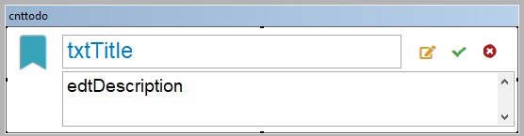
The Custom Control
<UserControl x:Class="ToDoInterface2.cntToDo” … d:DesignHeight="114" d:DesignWidth="544">
<DockPanel>
<Image Source="Images\Ribbon.png" Height="43px" DockPanel.Dock="Left" Name="imgRibbon" VerticalAlignment="Top" Margin="5 5 0 0" ></Image>
<WrapPanel Orientation="Horizontal" DockPanel.Dock="Top">
<TextBox Height="20px" Width="360px" Margin="5 5 25 5" Name="txtTitle"></TextBox>
<Image Source="Images\CheckMark.png" Margin="5" Height="20px" DockPanel.Dock="Top" Name="imgComplete" ></Image>
<Image Source="Images\Edit.png" Margin="5" Height="20px" DockPanel.Dock="Top" Name="imgEdit"></Image>
<Image Source="Images\Delete.png" Margin="5" Height="20px" DockPanel.Dock="Top" Name="imgDelete" ></Image>
</WrapPanel>
<TextBox Margin="5,0,5,15" FontSize="14" Name="edtDescription"/>
</DockPanel>
</UserControl>
Notes:
New, Item, Custom Control in our User Interface classes

Slide 45
Adding a Grid to Show Data
Cannot show data directly, have to get it into a
data structure that .NET recognizes
aToDos AS ObservableCollection<XToDo>
DbDataSource()
Notes:
Let’s add a datagrid to show the data

Slide 46
Adding a Grid to Show Data
There are multiple controls to view data in tabular formats:
DataGrid
GridView
ListView
Like layout controls, they each have their behaviors

Slide 47
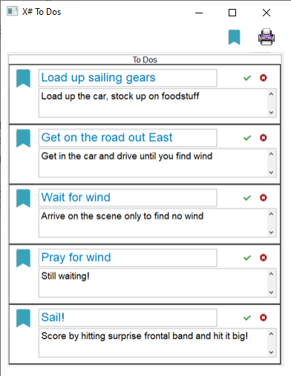
The Final Product
Notes:
Still work to do to wire up the complete and delete events

Slide 48

More!

Slide 49



VFP Exporter
Available very soon if not already
Will automate many of the things we saw today
Demo video in the Expo Sessions area
Notes:
Public installer for this available on Oct 19th
Didn’t make the cut for inclusion in this session

Slide 50
More Stuff to Talk About
Reports
Source Control
Databases
Frameworks
External Libraries
Help
Notes:
Slow down and discuss each of these items in detail.
Database
Besides the familiarity of the FoxPro-like syntax, the other compelling reason to choose X# as a development tool is its ability to use your existing DBF files, as shown. But X# can use a myriad of other databases, from SQLite to Oracle. A very popular backend, based on my perusal of the X# forums, is SQLAnywhere from Sybase. Anything that .NET can access through its System.Data library, which is vast and powerful.
Frameworks?
In FoxPro we had a stable of application frameworks that we could choose from to give us a head start when creating programs from scratch. Names like Mere Mortals, ProMatrix, and CodeBook were often used. There are currently no application frameworks for X# based on the FoxPro dialect, but many C# applications frameworks like Oak Leaf’s MM.Net can be combined with X# business objects easily enough to get you further down the road.
Libraries
If you like Thor and (and as a FoxPro dev, you should), you’re going to love Visual Studio’s equivalents. Thor is a visual manager that extends FoxPro’s IDE with utilities like GoFish5, Project Manager, PEMEditor, and FoxUnit. Visual Studio has the Visual Studio Marketplace (https://marketplace.visualstudio.com/) that has hundreds of extensions for Visual

Slide 51

.Net Core
Not Windows Only
Linux, Mac, Web Assembly
Notes:
Devs are working to make all of their libraries work with .Net core

Slide 52

Summary
Notes:
This session barely covers all of the power and awesomeness of Visual Studio and coding in X# and the .NET Framework. I hope this walkthrough of converting a simple FoxPro app to X# has been enlightening. In my limited experience I think X# provides a very nice entré into understanding .NET development. I also think it’s important to get that, though X# gives you access to FoxPro-like syntax and concepts that give you an anchor into your development history, you’re not constrained to that – the entire .NET framework is available to you.
X# is never going to be able to take your existing FoxPro code and just compile it – it will take effort on your part. But it’s really not that difficult and it will give you the opportunity to revisit and refactor your code, as well as add robustness through unit tests and integrated version control.
The FoxPro compatibility has made impressive strides since I wrote the 2019 session. X# is open source, and while other developers in our community are contributing, the focus of the core of developers will be the wish list of the people who pay to be members of Friends of X#. Hey, they have to pay the bills! If you’d like to see development focused on the FoxPro compatibility features, you will want to support them with a membership

Slide 53


What You Learned Today
Created an X# Application from scratch
Considerations when creating classes
Converting visual classes and forms to XAML

Slide 54
Why X#?
Native DBF access
Familiar syntax
Excellent Tooling
.NET Framework
Supported
Notes:
Many of the difficulties I had in putting together this session were but navigating the differences between Visual FoxPro’s development environment and Visual Studio’s. If you’re experienced with Visual Studio that will be one less barrier for you to hurdle. And if you’re experienced with developing C# applications in Visual Studio, you’ll probably find X# to be extremely easy to pick up.

Slide 55
Next
Go to the Expo Sessions and watch more videos
Download and install it from http://xsharp.info
Get on the forums
Buy a subscription to Friends of X#

Slide 56
Next
There will be Q&A with me.
Go to the live Expo Session and chat with Robert and Fabrice.
Pull down my sample app and we can use it as a prototype to help migration.
Notes:
My Q&A should focus on my experience with it
Go to the live Expo Session and chat with Robert and Fabrice.

Slide 57
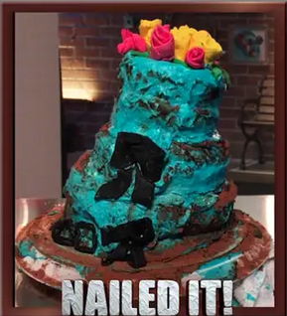
Did We Accomplish Our Goal?
Notes:
My Q&A should focus on my experience with it
Go to the live Expo Session and chat with Robert and Fabrice.

Slide 58
Eric Selje Salty Dog Solutions, LLC Eric@SaltyDogLLC www.SaltyDogLLC.com
Notes:
Evaluation link is pinned to the top of the chat.

Slide 59
Bonus Info

Slide 60
But wait … There’s more
If you order now…
You’ll get double the product!
And the shipping is free!
The logo at the bottom hyperlinks back to the “Thank-You” slide

Slide 61
More Stuff
Abc
Def
Xyz

Slide 63
Individual
Stacked
. . . . . . . .
.
. .
. . .
. . . .
. . . . .
. . . . . .
. . . . . . .
. . . . . . . .
. . . . . . .
.
. .
. . .
. . . .
. . . . .
. . . . . .
. . . . . . .
. . . . . .
.
. .
. . .
. . . .
. . . . .
. . . . . .
. . . . .
.
. .
. . .
. . . .
. . . . .
. . . .
.
. .
. . .
. . . .
. . .
.
. .
. . .
. .
.
. .
.

