Slide 1

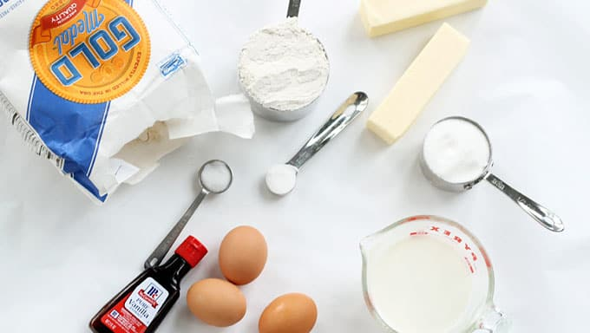
X#
Eric Selje

Slide 2


Eric Selje
FoxPro Dev from way back
Programming is my first love
Currently IT Security Officer for the U.S. Courts

Slide 3
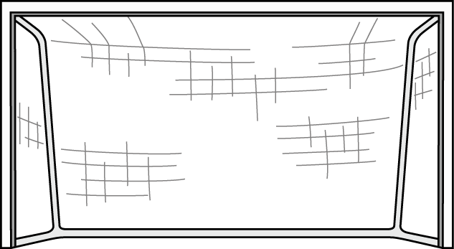
Goal!
By the end of this session you should have a solid understanding of what it takes to create an X# application from scratch.
Notes:
Thank you https://www.clipartmax.com/

Slide 4
Agenda
Take a look at our sample FoxPro application
Create a new X# solution in Visual Studio
Write and test our business objects
Create a XAML form
Discussion
Notes:
Not a lot of slides – mostly coding

Slide 5
FoxToDos

Slide 6
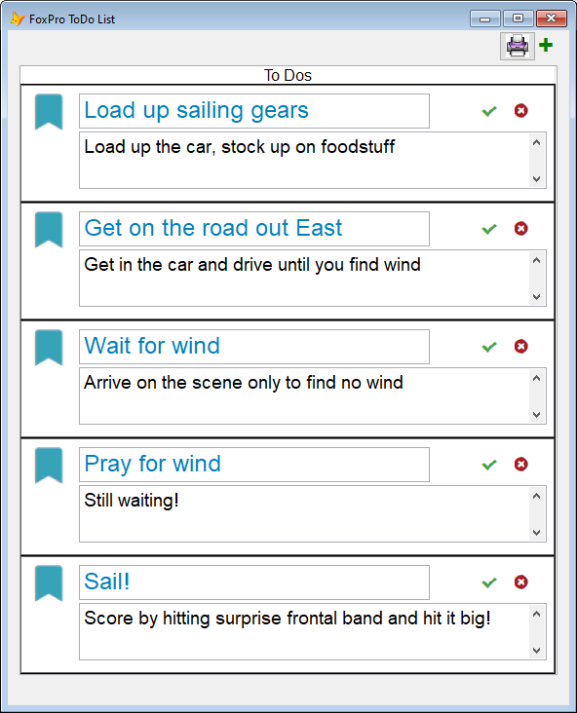
Here’s our Starting Point
Notes:
Look familiar?
DBF files

Slide 7
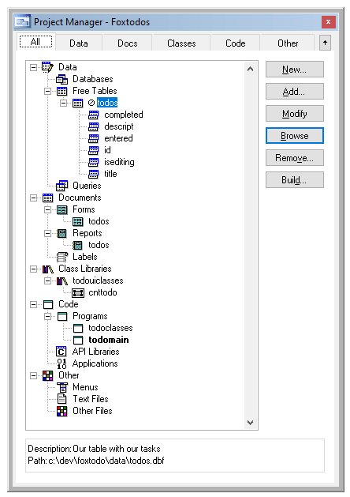
Under the Covers
Data: ToDos.dbf
Form: ToDos
Report: ToDos
Visual Classes: cntToDo
NonVisual Classes: ToDoClasses
Code: ToDoMain

Slide 8
Creating the X# Solution in VS

Slide 9
Creating a Solution
Project Templates
Creating a Class

Slide 10
Testing our Class
Console App
Unit Testing

Slide 11
Forms

Slide 12
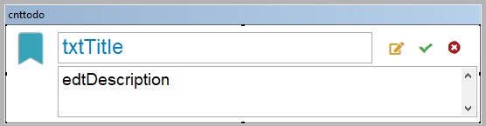
Visual Class
Create a panel in XAML

Slide 13
XAML Form
Create a Form
Add our Panel
Add a couple more controls
Bind the events
Tie our business objects to it

Slide 14
More

Slide 15
More Stuff
Reports
Source Control
Databases
Frameworks
External Libraries
Help

Slide 16
Summary

Slide 17
What You Learned Today
Created an X# Application from scratch
Considerations when creating classes
Converting visual classes and forms to XAML
More!

Slide 18
Eric Selje Salty Dog Solutions, LLC Eric@SaltyDogLLC www.SaltyDogLLC.com
Notes:
Presentation Reminders for Eric:
Use Chrome
Get off VPN
Make sure your Bluetooth headset is working ok
Respect the 20s delay
Turn off Camera when showing screen

Slide 19


Slide 20
Bonus Info

Slide 21
But wait … There’s more
If you order now…
You’ll get double the product!
And the shipping is free!
The logo at the bottom hyperlinks back to the “Thank-You” slide

Slide 22
More Stuff
Abc
Def
Xyz

Slide 24
Individual
Stacked
. . . . . . . .
.
. .
. . .
. . . .
. . . . .
. . . . . .
. . . . . . .
. . . . . . . .
. . . . . . .
.
. .
. . .
. . . .
. . . . .
. . . . . .
. . . . . . .
. . . . . .
.
. .
. . .
. . . .
. . . . .
. . . . . .
. . . . .
.
. .
. . .
. . . .
. . . . .
. . . .
.
. .
. . .
. . . .
. . .
.
. .
. . .
. .
.
. .
.

