Slide 1
Intro to SignalR
EASY REALTIME IN .NET
Ahmed Alani
www.ahmedalani.com
@skMed

Slide 2
SignalR
.NET Server + Client libraries allowing you to build realtime, multi-user applications
Like Socket.IO and Now.JS
Open Source created by David Fowler and Damien Edwards @Microsoft https://github.com/SignalR/SignalR

Slide 3
WHY DO WE CARE?

Slide 4
Demo – SignalR stock ticker?

Slide 5

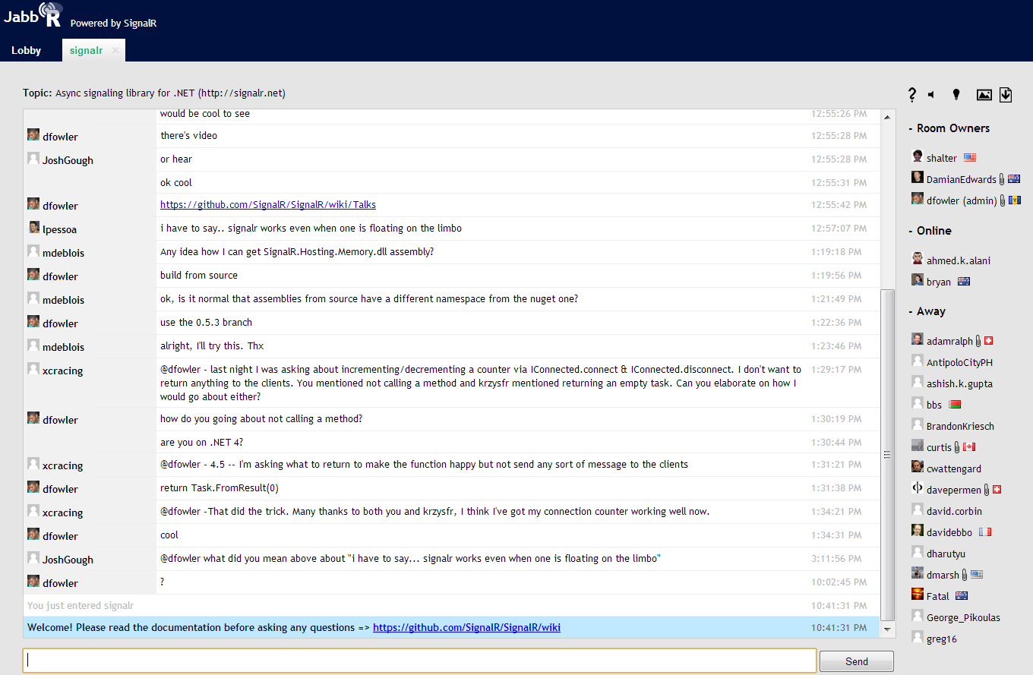
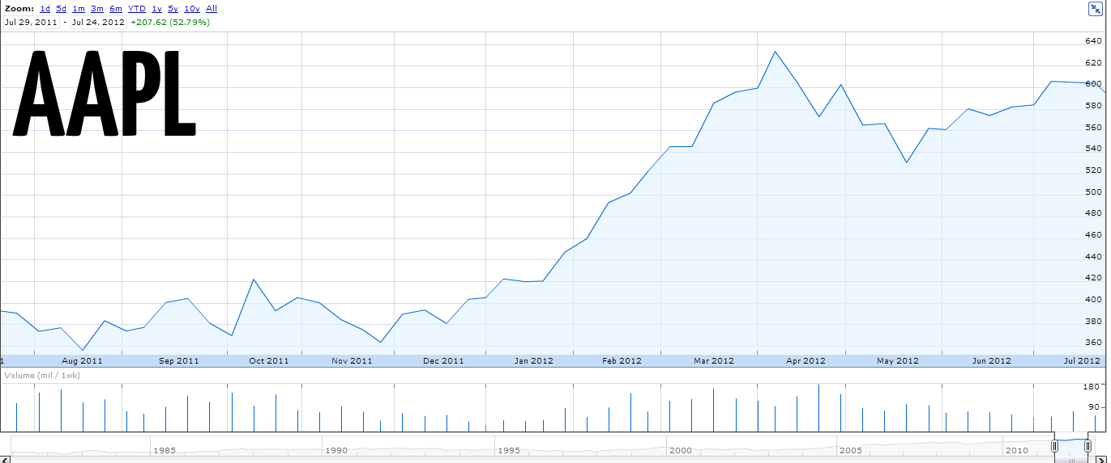

Headphone jack on the bottom
Notes:
Ebay

Slide 6
POLL POLL POLL POLL POLL POLL POLL POLL POLL POLL POLL POLL POLL POLL POLL POLL POLL POLL POLL POLL POLL POLL POLL POLL POLL POLL POLL POLL POLL POLL POLL POLL POLL POLL POLL POLL POLL POLL POLL POLL POLL POLL POLL POLL POLL POLL POLL POLL POLL POLL POLL POLL POLL POLL POLL POLL POLL POLL POLL POLL POLL POLL POLL POLL POLL POLL POLL POLL POLL POLL POLL POLL POLL POLL POLL POLL POLL POLL POLL POLL POLL POLL POLL POLL POLL POLL POLL POLL POLL POLL
Who cares? I can POLL!
Notes:
Go back to stock ticker example. (Set it up) to explain why it may not be responsive

Slide 7
Demo – Polling stock ticker?

Slide 8
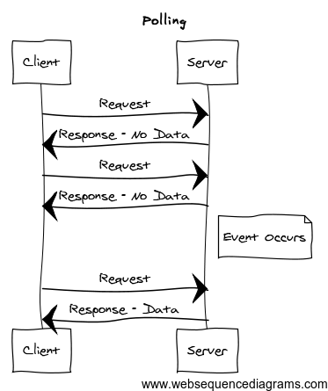

Polling
Easy to understand + implement
setInterval + $.ajax
Trade off between server event latency and server load
Update Panels
↑ Frequency
↑ Server Load
↓ Frequency
↓ Server Load
Notes:
Go back to stock ticker example. (Set it up) to explain why it may not be responsive
****HTTP IS not persistent connection, explain how it does not conform to standard HTTP***
Leave note about hybrid polling
Strategy by most AJAX apps
Conforms to HTTP – not meant to have persistent connections

Slide 9
BETTER!
Notes:
Notes for Long Polling.

Slide 10
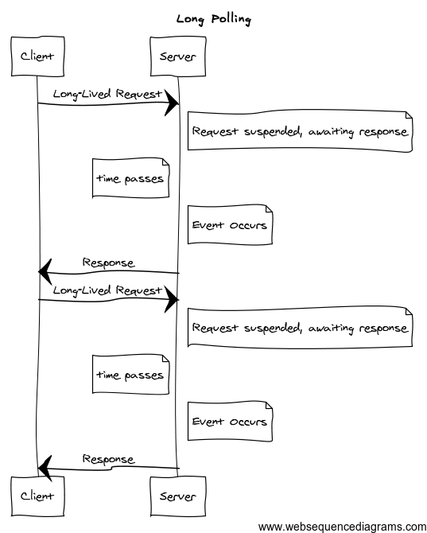
Long Polling
Emulates Server Push
☹ Latency
More complex than traditional polling
Standard AJAX, supported in most browsers
Notes:
HTTP Hack.

Slide 11
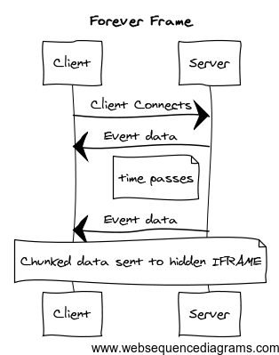
Forever Frame
Exploits HTTP 1.1 chunked encoding by sending chunks of a client data and response over time
Hidden IFRAME is used to output each chunk of response wrapped in a script block
Low latency
Notes:
Another HTTP Hack.

Slide 12
BETTER!

Slide 13
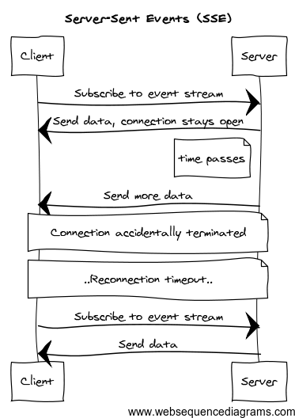
Server-Sent Events
HTML5 Browser API Feature
Client initiates connection and it is kept open as long as possible
Server sends events to client over time
Notes:
Request sent w/ header “Event source request’
Server keeps request open and streams information over response stream
-> Single HTTP connection
-> faster latency, no period between response sent back, processing, and request again

Slide 14
BETTER!

Slide 15
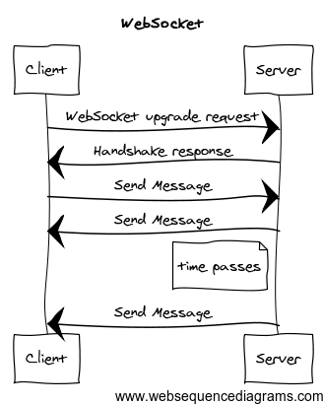
WebSocket
Full-duplex, bi-directional connection to server
No polling, server can initiate calls after initial upgrade request
HTML5 component, W3C API, protocol IETF
Notes:
GET request
Raw connection, like a TCP socket. Very little overhead.
Everything between your browser and the server, which can be endless, firewalls, routers, etc. has to understand websocket protocol. That
Will take a while…big implications, security etc.

Slide 16

WebSocket
TO THE RESCUE!
... RIGHT?

Slide 17
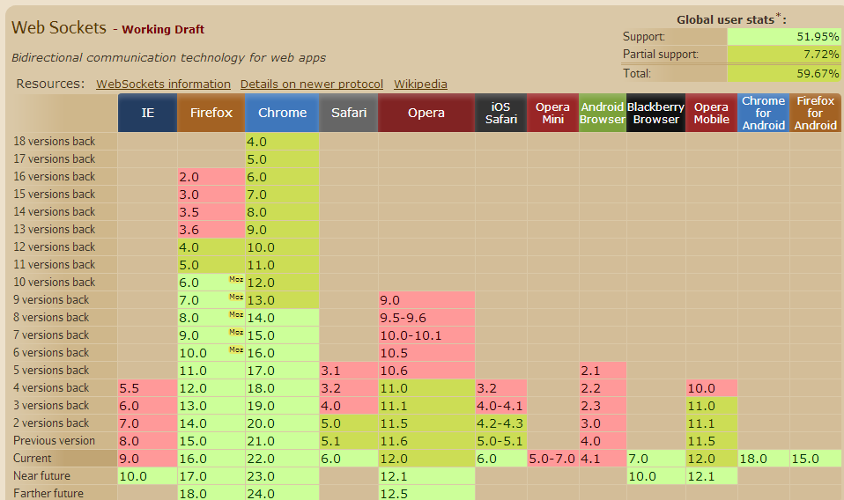
Browser Support
☹
http://caniuse.com/websockets
Notes:
GET request
Raw connection, like a TCP socket. Very little overhead.
Everything between your browser and the server, which can be endless, firewalls, routers, etc. has to understand websocket protocol. That
Will take a while…big implications, security etc.

Slide 18
Coverage Map of what you want to cover for all support + Code snippets / pics of it
Long Polling
SSE
Etc.

Slide 19
HOW DO YOU MANAGE THESE?

Slide 20
SignalR ☺
Abstraction around a persistent connection
Chooses best communication transport for server + client (WebSocket, SSE, Long Polling, etc.)
Takes care of the annoying stuff (message routing, framing, buffering, keep-alives, timeouts, graceful disconnects, …)

Slide 21
BUILD YOUR APP

Slide 22
Demo – Polling Chat w/ SignalR

Slide 23
Typically with .NET ihttphandler this would hold onto a request thread, wouldn’t scale beyond 20-30 threads Last 5 years. How asp.net uses threads -> when app starts up it uses the .NET threadpool (CLR Threadpool), allocated when app starts up. request thread comes in from IIS -> handed off to your app, your app uses threadpool thread and is assigned to that request this is modeled off of quick request/response, not good for persistent connection Prior to .NET 4, default # of threads is low as hell (10 per cpu). this is good for throughput and avoid thrashing with your CPU…not holding a long connection open in .NET 4, limits increased on # of threads per cpu IAsyncHttpHandler, keeps a request open and dissolve thread associated with request until work needs to happen with request. Async Programming Model easy to understand, but it gets difficult: - Difficult to do multiple sets of work - or loops of work so it was not easy to do this and there is a lot of infrastructure work to take care of doing this Introduction of TPL made this above work easier, so it led to this library Rather than dealing with IasyncResult and method pairs, we deal with tasks.
Why wasn’t this popular before?

Slide 24
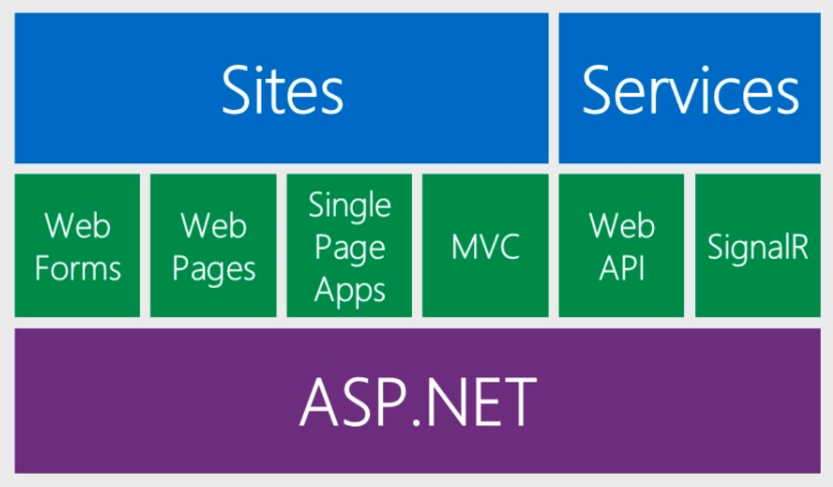
One ASP.NET
“SignalR and Web Sockets” – Scott Hanselman (http://www.asp.net/vnext/overview/videos/signalr-and-web-sockets)

Slide 25
Roadmap
Version
Roadmap

Slide 26
THANKS ☺

