Slide 1
Intro to SignalR
EASY REALTIME IN .NET
Ahmed Alani
www.ahmedalani.com
@skMed

Slide 2
SignalR
.NET Server + Client libraries allowing you to build realtime, multi-user applications
Like Socket.IO and Now.JS
Open Source created by David Fowler and Damien Edwards @Microsoft https://github.com/SignalR/SignalR

Slide 3
WHY DO WE CARE?

Slide 4
Demo – Realtime?

Slide 5

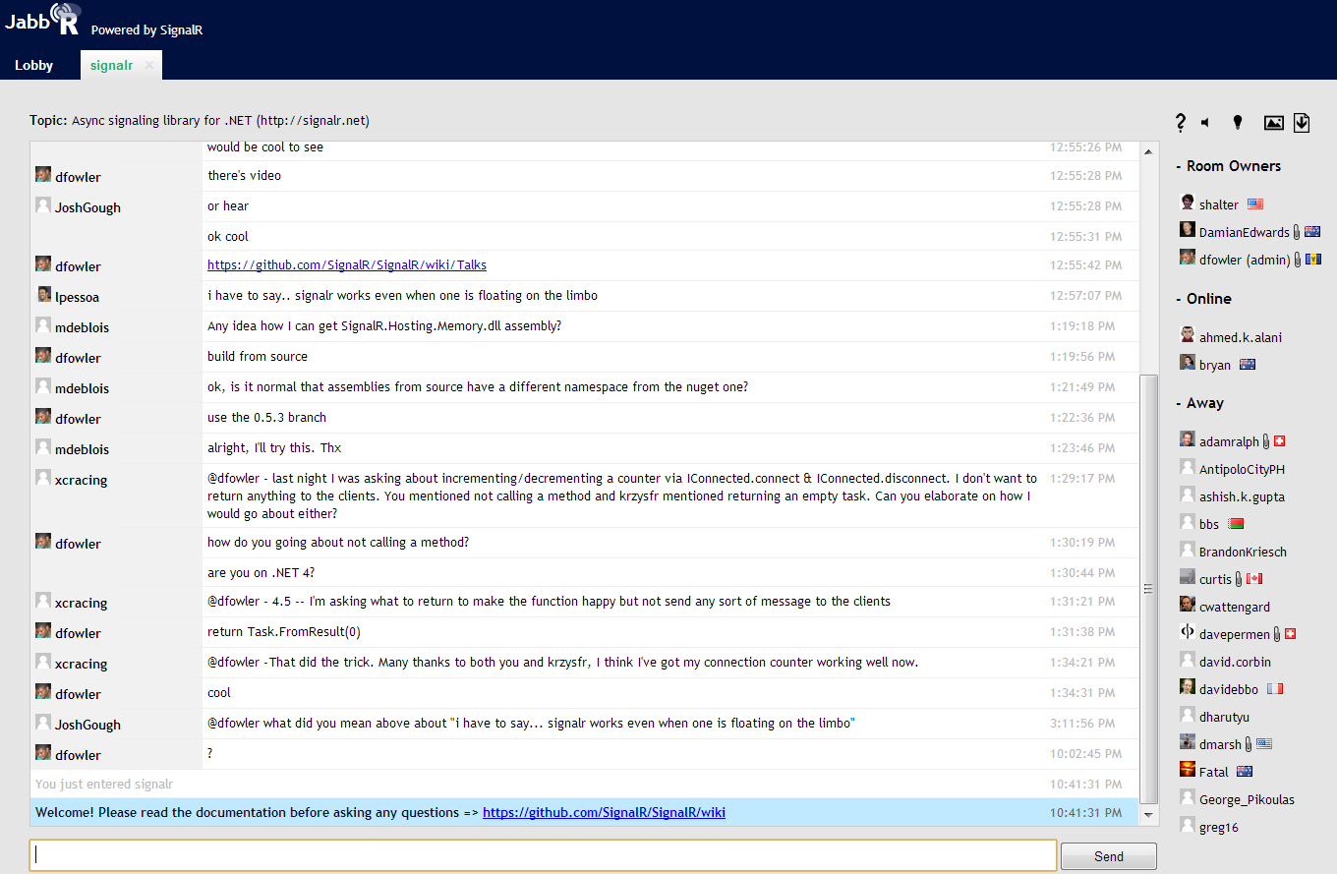

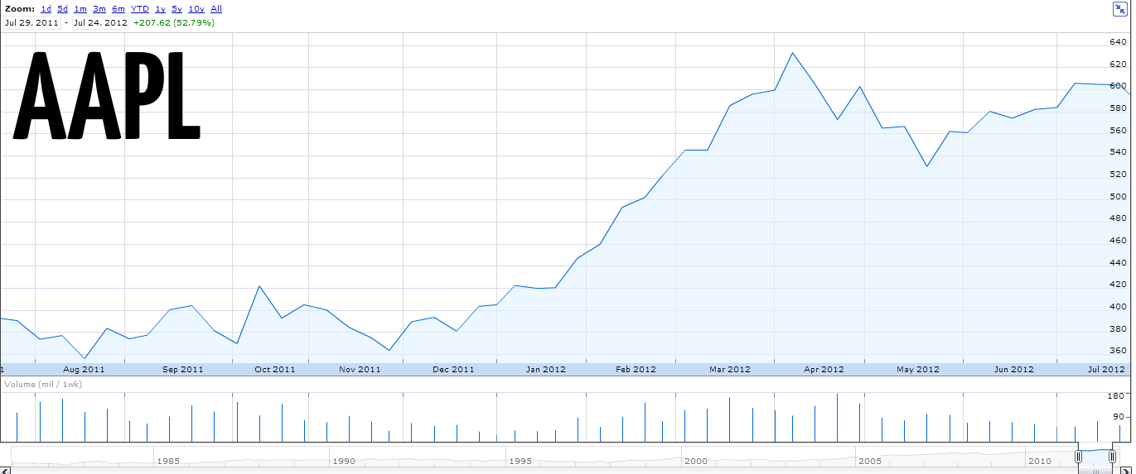
Headphone jack on the bottom
Notes:
Ebay

Slide 6
POLL POLL POLL POLL POLL POLL POLL POLL POLL POLL POLL POLL POLL POLL POLL POLL POLL POLL POLL POLL POLL POLL POLL POLL POLL POLL POLL POLL POLL POLL POLL POLL POLL POLL POLL POLL POLL POLL POLL POLL POLL POLL POLL POLL POLL POLL POLL POLL POLL POLL POLL POLL POLL POLL POLL POLL POLL POLL POLL POLL POLL POLL POLL POLL POLL POLL POLL POLL POLL POLL POLL POLL POLL POLL POLL POLL POLL POLL POLL POLL POLL POLL POLL POLL POLL POLL POLL POLL POLL POLL
Who cares? I can POLL!

Slide 7
Demo – Polling Chat?

Slide 8
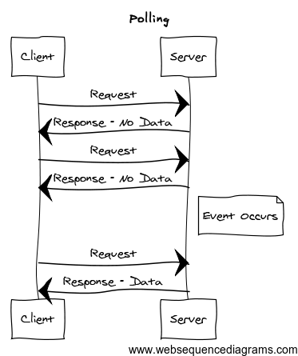

Polling
Easy to understand + implement
setInterval + $.ajax
Trade off between server event latency and server load
Update Panels
↑ Frequency
↑ Server Load
↓ Frequency
↓ Server Load
Notes:
Leave note about hybrid polling
Strategy by most AJAX apps
Conforms to HTTP – not meant to have persistent connections

Slide 9
We need more…what else is there??

Slide 10
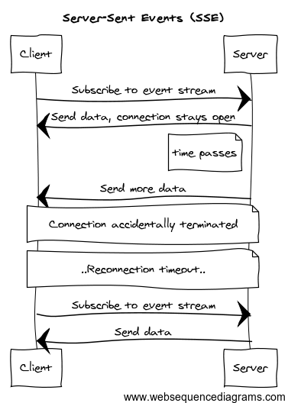
Server-Sent Events
HTML5 Browser API Feature
Client initiates connection and it is kept open as long as possible
Server sends events to client over time
Notes:
Request sent w/ header “Event source request’
Server keeps request open and streams information over response stream
-> Single HTTP connection
-> faster latency, no period between response sent back, processing, and request again

Slide 11
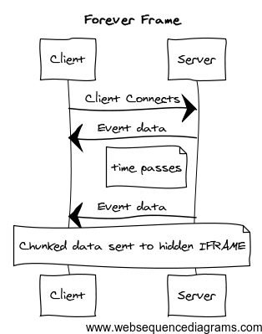
Forever Frame
Exploits HTTP 1.1 chunked encoding by sending chunks of a client data and response over time
Hidden IFRAME is used to output each chunk of response wrapped in a script block
Low latency

Slide 12
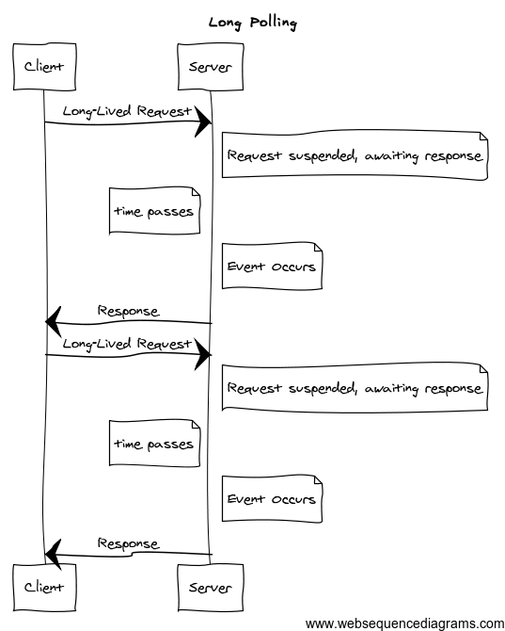
Long Polling
Standard AJAX
support in all browsers
Sends request to server, but no response is returned until available
Connection is typically refreshed at fixed, longer duration intervals
Requires complex JS + XmlHttpRequest

Slide 13
HTTP +S tateless + request/response slide?

Slide 14
Got anything else??

Slide 15

WebSocket
TO THE RESCUE!
... RIGHT?

Slide 16
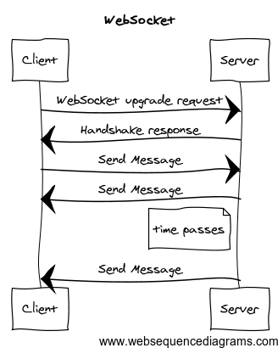
WebSocket
Notes:
Everything between your browser and the server, which can be endless, firewalls, routers, etc. has to understand websocket protocol. That
Will take a while…big implications, security etc.
GET request
Raw connection, like a TCP socket

Slide 17
WebSocket
Full-duplex, bi-directional connection to a server
Little overhead per message relative to HTTP
No polling, server can initiate calls after initial upgrade request
HTML5 component, W3C API, protocol IETF

Slide 18
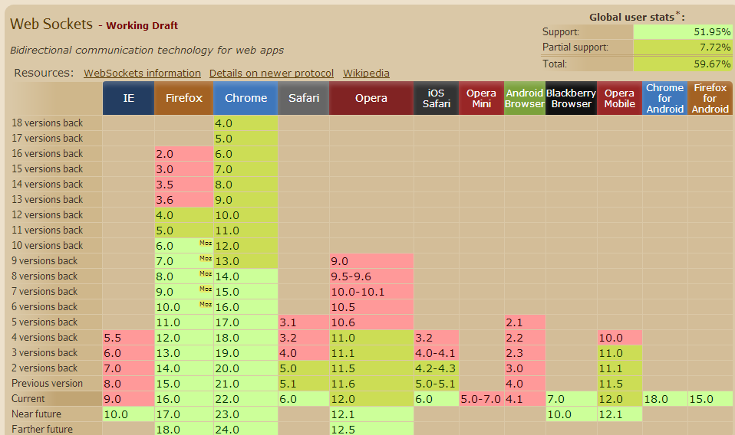
☹
http://caniuse.com/websockets

Slide 19
Coverage Map of what you want to cover for all support + Code snippets / pics of it
Long Polling
SSE
Etc.

Slide 20
HOW DO YOU MANAGE THESE?

Slide 21
SignalR Good! ☺
Abstraction around a persistent connection
Chooses best communication transport for server + client (WebSocket, SSE, Long Polling, etc.)
Takes care of the annoying stuff (message routing, framing, buffering, keep-alives, timeouts, graceful disconnects, …)

Slide 22
BUILDING YOUR APP

Slide 23
Demo – Polling Chat w/ SignalR
Notes:
Persistentconnection
Hubs
Browser
Adjust Protocols
WPF (clients)

Slide 24
Typically with .NET ihttphandler this would hold onto a request thread, wouldn’t scale beyond 20-30 threads Last 5 years. How asp.net uses threads -> when app starts up it uses the .NET threadpool (CLR Threadpool), allocated when app starts up. request thread comes in from IIS -> handed off to your app, your app uses threadpool thread and is assigned to that request this is modeled off of quick request/response, not good for persistent connection Prior to .NET 4, default # of threads is low as hell (10 per cpu). this is good for throughput and avoid thrashing with your CPU…not holding a long connection open in .NET 4, limits increased on # of threads per cpu IAsyncHttpHandler, keeps a request open and dissolve thread associated with request until work needs to happen with request. Async Programming Model easy to understand, but it gets difficult: - Difficult to do multiple sets of work - or loops of work so it was not easy to do this and there is a lot of infrastructure work to take care of doing this Introduction of TPL made this above work easier, so it led to this library Rather than dealing with IasyncResult and method pairs, we deal with tasks.
Why wasn’t this popular before?

Slide 25
Demo – StackHack
Notes:
Persistentconnection
Hubs
Browser
Adjust Protocols
WPF (clients)

Slide 27
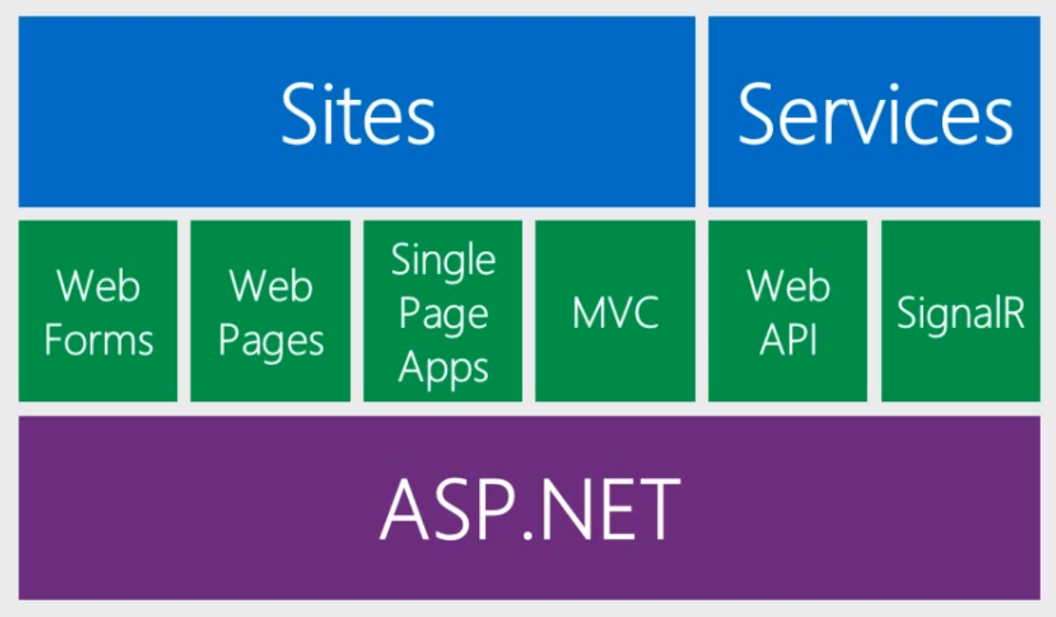
One ASP.NET
“SignalR and Web Sockets” – Scott Hanselman (http://www.asp.net/vnext/overview/videos/signalr-and-web-sockets)

Slide 28
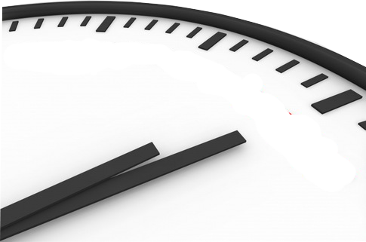
Intro to SignalR
EASY REAL-TIME IN .NET

