Slide 1
Intro to SignalR
EASY REALTIME IN .NET
Ahmed Alani
ahmed.k.alani@gmail.com
@skMed

Slide 2
SignalR
.NET Server + Client libraries enabling you to build realtime, multi-user applications
Like Socket.IO and Now.JS
Created by David Fowler and Damien Edwards @Microsoft

Slide 3
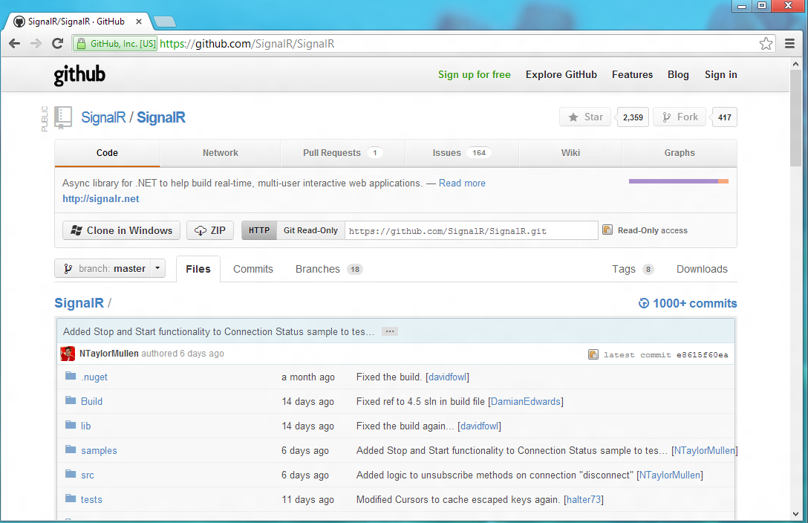
Open Source
SignalR
https://github.com/SignalR/SignalR

Slide 4
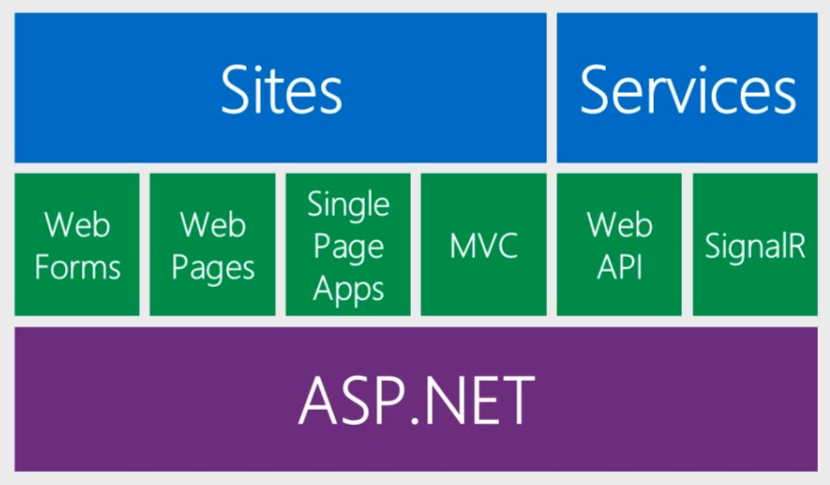
Roadmap - ASP.NET
“SignalR and Web Sockets” – Scott Hanselman http://www.asp.net/vnext/overview/videos/signalr-and-web-sockets

Slide 5
WHY DO WE CARE?
Notes:
My first question
We’ve seen realtime, and I could jump right into coding, but it’s important to know WHY we use tools…and why
Traditional methods may not be the most apt tools to handlet his situation

Slide 6
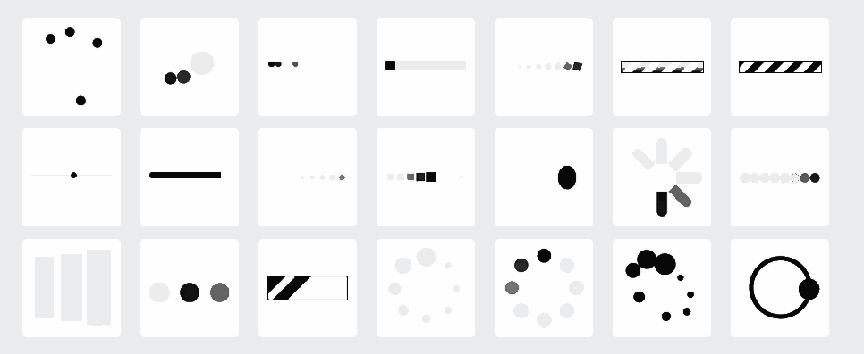
Notes:
Not really realtime.

Slide 7
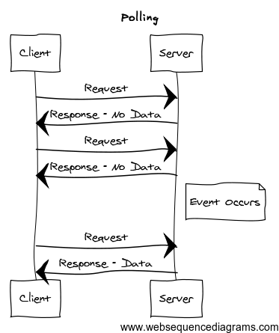

Polling
Easy to understand + implement
setTimeout + $.ajax
Trade off between server event latency and server load
Update Panels
↑ Responsive
↑ Frequency
↑ Server Load
Notes:
Go back to stock ticker example. (Set it up) to explain why it may not be responsive
Ok all use update panels right?...maybe not
Polling works in some cases…Zuckerberg feed hacked up solution, but what if I need it realtime and more in sync?
****HTTP IS not persistent connection, explain how it does not conform to standard HTTP***
Leave note about hybrid polling
Strategy by most AJAX apps
Conforms to HTTP – not meant to have persistent connections

Slide 8
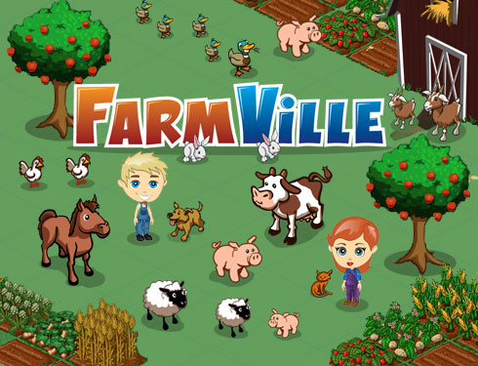
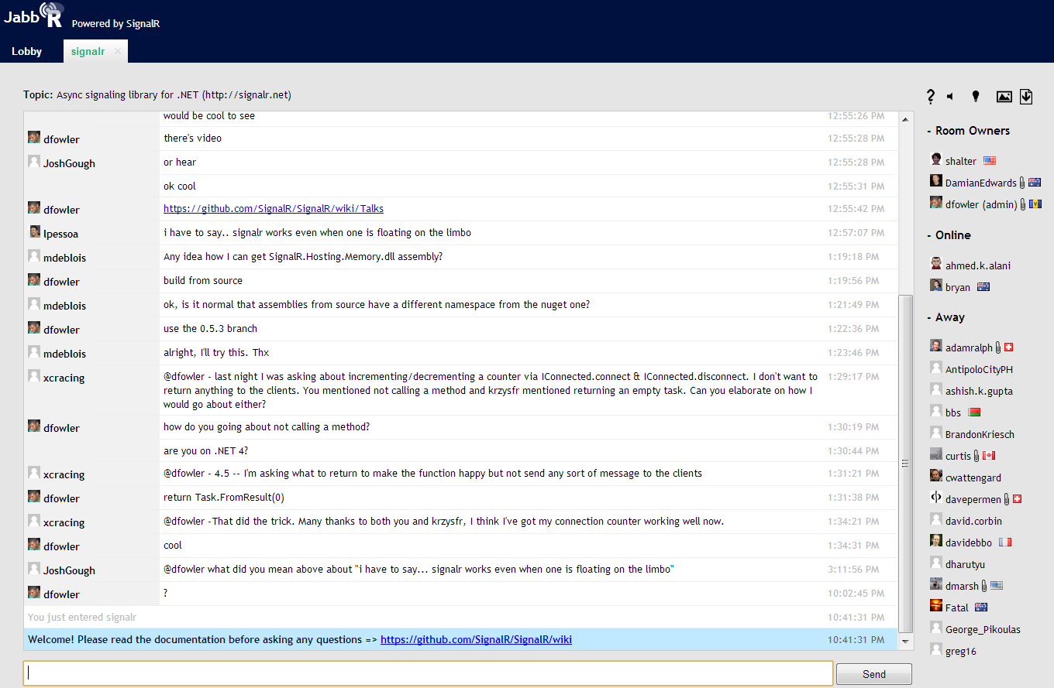
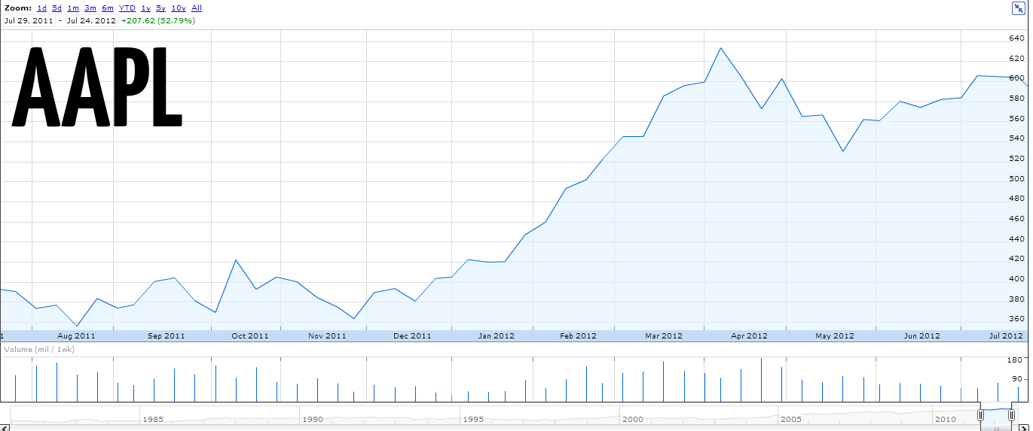

Headphone jack on the bottom
Notes:
Ebay
Jitter (network traffic)

Slide 9
Demo – SignalR stock ticker?

Slide 10
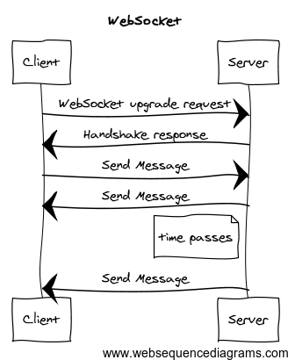
WebSocket
HTML5
Full-duplex, bi-directional connection to server
No polling, server can initiate calls after initial upgrade request
Notes:
GET request
Raw connection, like a TCP socket. Very little overhead.
Everything between your browser and the server, which can be endless, firewalls, routers, etc. has to understand websocket protocol. That
Will take a while…big implications, security etc.
If the server accepts the request to upgrade the application-layer protocol, it returns a HTTP 101 Switching Protocols
HTTP/1.1 101 Switching Protocols Upgrade: websocket Connection: Upgrade
The client handshake established a HTTP-on-TCP connection between IE10 and server. After the server returns its 101 response, the application-layer protocol switches from HTTP to WebSockets which uses the previously established TCP connection.

Slide 11

WebSocket
TO THE RESCUE!
... RIGHT?

Slide 12
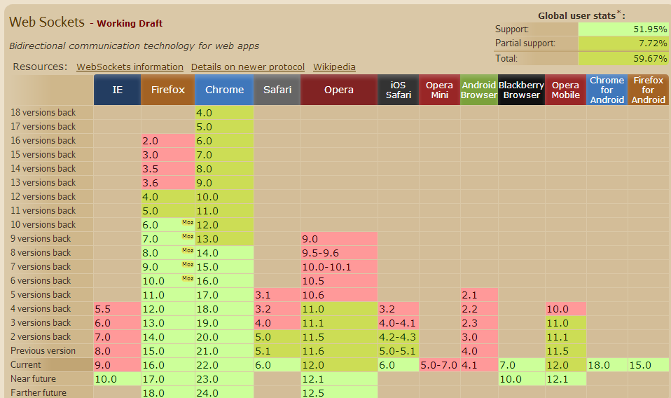
Browser Support
☹
http://caniuse.com/websockets
Notes:
GET request
Raw connection, like a TCP socket. Very little overhead.
Everything between your browser and the server, which can be endless, firewalls, routers, etc. has to understand websocket protocol. That
Will take a while…big implications, security etc.

Slide 13
What else?

Slide 14
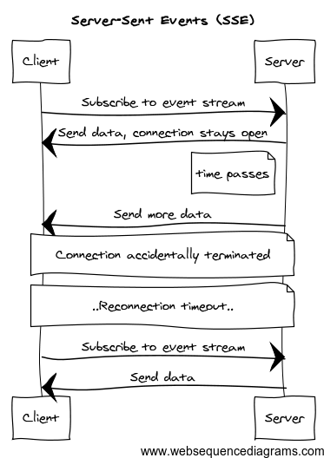
Server-Sent Events
HTML5 Browser API Feature
Client initiates connection and it is kept open as long as possible
Server -> Client only
Notes:
Request sent w/ header “Event source request’
Server keeps request open and streams information over response stream
-> Single HTTP connection
-> faster latency, no period between response sent back, processing, and request again
JavaScript API called EventSource, through which a client requests a particular URL in order to receive an event stream.
No IE support.
WebSockets is the only true full-duplex connection transport. All other transports listed here use the technique/technology named for the incoming data from the server, and standard AJAX POSTS for sends from the client to the server.

Slide 15
What else?

Slide 16
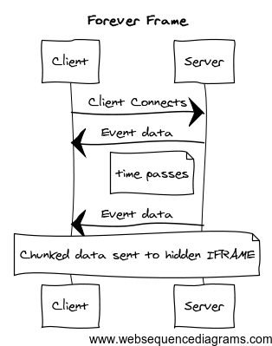
Forever Frame
Send chunked data to hidden iFrame
Single connection, decent latency
Notes:
Another HTTP Hack.
Connection does not last forever, client needs to terminate and request again..plus some cleanup on the DOM side…but better than long polling.
http://cometdaily.com/2007/11/05/the-forever-frame-technique/
The forever-frame technique uses HTTP 1.1 chunked encoding to establish a single, long-lived HTTP connection in a hidden iframe. Data is pushed incrementally from the server to the client over this connection, and rendered incrementally by your web browser.
Every time a <script> chunk is received, the javascript is evaluated, exeuting the local p() function, which is actually a link to the process function in the parent frame
WebSockets is the only true full-duplex connection transport. All other transports listed here use the technique/technology named for the incoming data from the server, and standard AJAX POSTS for sends from the client to the server.

Slide 17
What else?

Slide 18
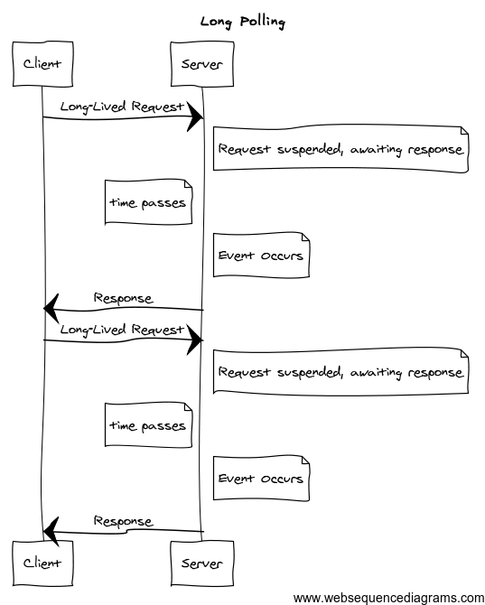
Long Polling
Emulates Server Push
☹ Latency
More complex than traditional polling
Standard AJAX, supported in most browsers
Notes:
More options for hacking HTTP to emulate realtime
Latency + server resources, not ideal’
http://tools.ietf.org/html/draft-loreto-http-bidirectional-07#section-2.2
WebSockets is the only true full-duplex connection transport. All other transports listed here use the technique/technology named for the incoming data from the server, and standard AJAX POSTS for sends from the client to the server.

Slide 19






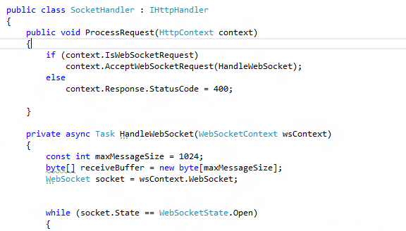
WebSocket
Notes:
GET request
Raw connection, like a TCP socket. Very little overhead.
Everything between your browser and the server, which can be endless, firewalls, routers, etc. has to understand websocket protocol. That
Will take a while…big implications, security etc.

Slide 20
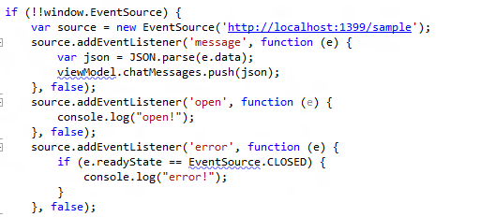
Server-Sent Events
Notes:
GET request
Raw connection, like a TCP socket. Very little overhead.
Everything between your browser and the server, which can be endless, firewalls, routers, etc. has to understand websocket protocol. That
Will take a while…big implications, security etc.

Slide 21
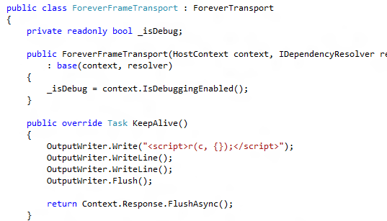
Forever Frame
Notes:
GET request
Raw connection, like a TCP socket. Very little overhead.
Everything between your browser and the server, which can be endless, firewalls, routers, etc. has to understand websocket protocol. That
Will take a while…big implications, security etc.

Slide 22
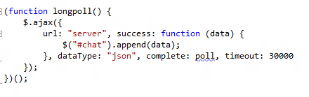
Long Polling
Notes:
GET request
Raw connection, like a TCP socket. Very little overhead.
Everything between your browser and the server, which can be endless, firewalls, routers, etc. has to understand websocket protocol. That
Will take a while…big implications, security etc.

Slide 23
HOW DO YOU MANAGE THESE?

Slide 24
SignalR
Abstraction around a persistent connection
Chooses best communication transport for server + client (WebSocket, SSE, Long Polling, etc.)
Takes care of the annoying stuff (message bus, routing, framing, buffering, keep-alives, timeouts, graceful disconnects, …)
Notes:
SignalR uses a fallback mechanism to connect the browser to the server. After an initial negotioatin request the following transports are triedi n order until a successful connection can be made.
1. WebSockets (if both the server and browser indicate they can support websockets)
2. Server Sent events, aka EventSource (if the browser supports Server Sent Events, whichi s basically all browsers except Internet Explorer)
3. Forever Frame (for Internet explorer only)
4. Ajax long polling
WebSockets is the only true full-duplex connection transport. All other transports listed here use the technique/technology named for the incoming data from the server, and standard AJAX POSTS for sends from the client to the server.

Slide 25
BUILD YOUR APP

Slide 26
Demo – Polling Chat w/ SignalR

Slide 27
RECAP

Slide 28
Recap – Connection Types
PersistentConnection
Lower-level connection
OnReceivedAsync ( string data )
OnConnected, OnDisconnected
Hubs
RPC: Client -> Server && Server -> Client
SignalR handles dispatching
Model Binding

Slide 29
Recap – Communication
Send || Broadcast
Send to a Specific connection
Send to Group of connections
Send to All connections
Context
GlobalHost.ConnectionManager
.GetHubContext<HubName>()
.GetConnection<ConnName>()

Slide 30
Recap - Graceful Degradation
WebSocket
Server-Sent Events
Forever Frame
Long Polling

Slide 31
Recap - Clients
.NET
JavaScript
WPF
Silverlight
WinRT
Objective-C

Slide 32
Not Discussed
Group Management
Hosting
Scale Out
Performance

Slide 33
Why now?
.NET Thread Pool
IAsyncHttpHandler
Task Parallel Library (TPL)
Notes:
Typically with .NET ihttphandler this would hold onto a request thread, wouldn’t scale beyond 20-30 threads Last 5 years. How asp.net uses threads -> when app starts up it uses the .NET threadpool (CLR Threadpool), allocated when app starts up. request thread comes in from IIS -> handed off to your app, your app uses threadpool thread and is assigned to that request this is modeled off of quick request/response, not good for persistent connection Prior to .NET 4, default # of threads is low as hell 25 default per cpu, increased to 250 and 1000 IO completion
CLR threadpool adjusts the number of threads according to workload
quick request/response, low threads = higher throughput, few per cpu
longer, higher latency threads, persisten connection, higher concurrency, more threads needed
higher probability of deadlocks of there is synchronization happening w/ persisten connection
this is good for throughput and avoid thrashing with your CPU…not holding a long connection open in .NET 4, limits increased on # of threads per cpu IAsyncHttpHandler, keeps a request open and dissolve thread associated with request until work needs to happen with request. Async Programming Model easy to understand, but it gets difficult: - Difficult to do multiple sets of work - or loops of work, i.e. queieing sets of connections and processing events is difficult so it was not easy to do this and there is a lot of infrastructure work to take care of doing this Introduction of TPL made this above work easier, so it led to this library Rather than dealing with IasyncResult and method pairs, we deal with tasks.

Slide 34
Resources
SignalR (0.5.3) https://github.com/SignalR/SignalR
Jabbr https://github.com/davidfowl/JabbR https://www.jabbr.net/#/rooms/signalr
@DamienEdwards, @davidfowl

Slide 35
QUESTIONS?

