Slide 1
Boston Housing Data: Exploratory Data Analysis
DSC530

Slide 2
Hypothesis
Using the 1980 Boston Housing Data, There are variables that can be used to predict the median home value.
https://www.kaggle.com/c/boston-housing

Slide 3
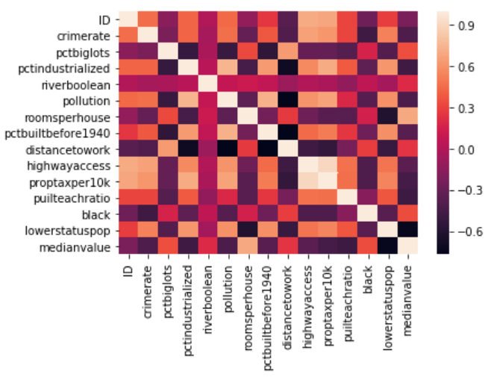
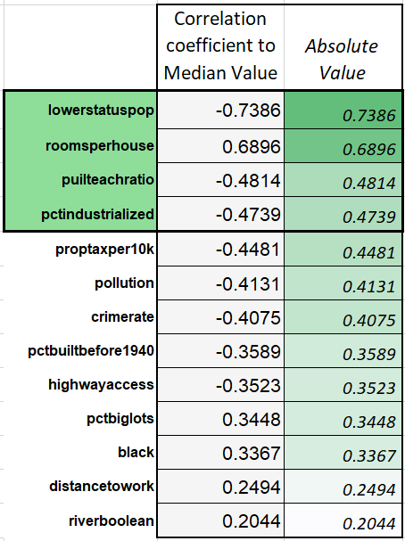
Correlation Analysis -> Variable Selection

Slide 4

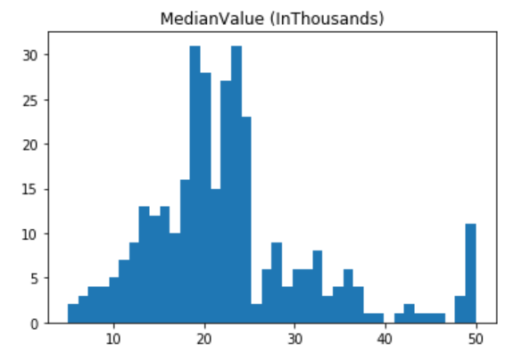
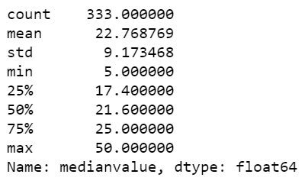
Median Value

Slide 5

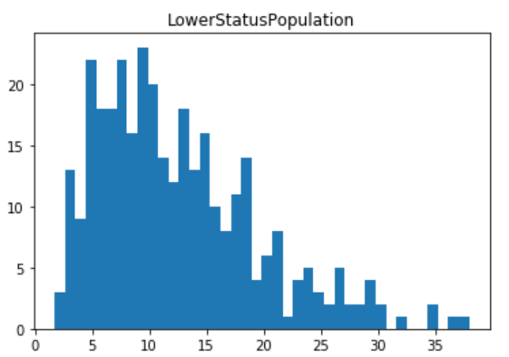
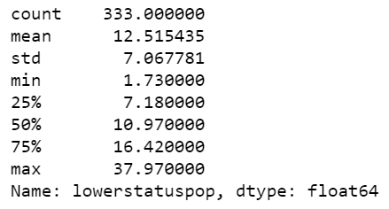
Lower Status Population

Slide 6

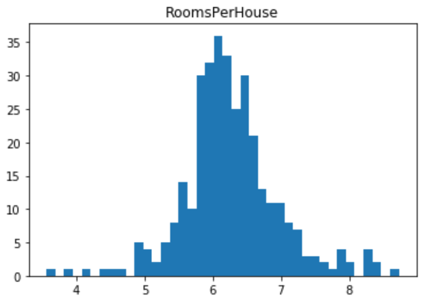
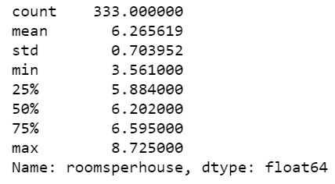
Rooms Per House

Slide 7

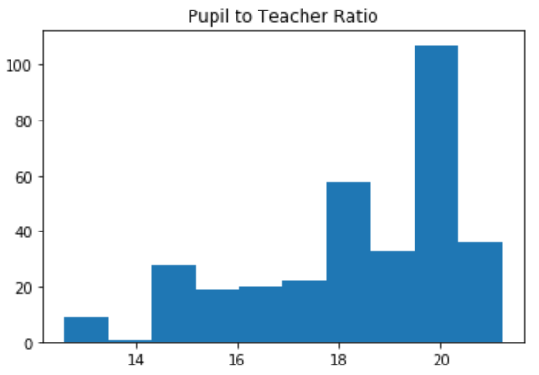
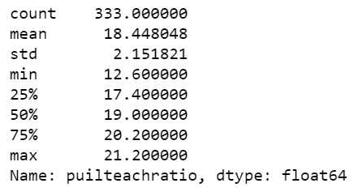
Pupil Teacher Ratio

Slide 8

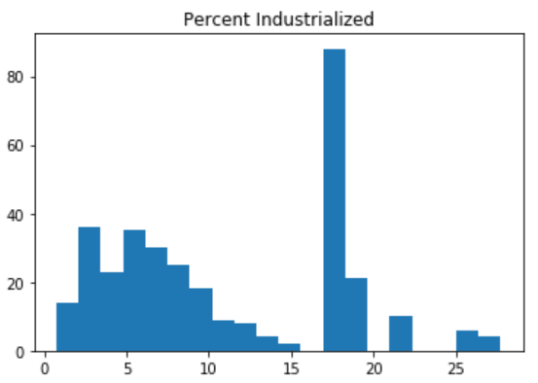
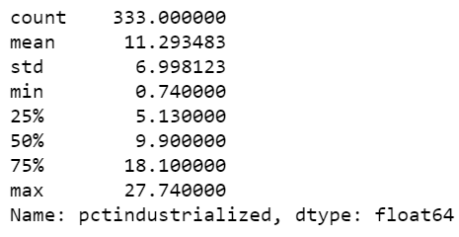
Percent Industrialized

Slide 9
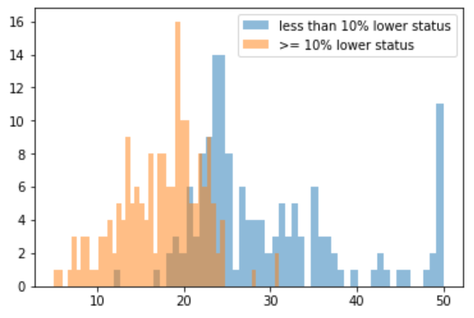
Probability Mass Function
PMF Split by Lower Status Population at 10%

Slide 10
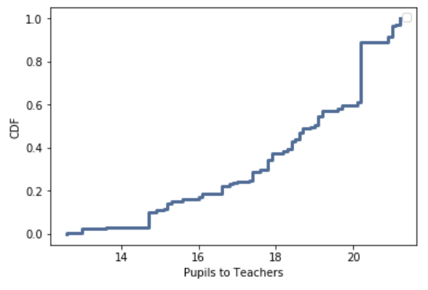
Cumulative Distribution Function
CDF of Pupil to Student Ratio

Slide 11
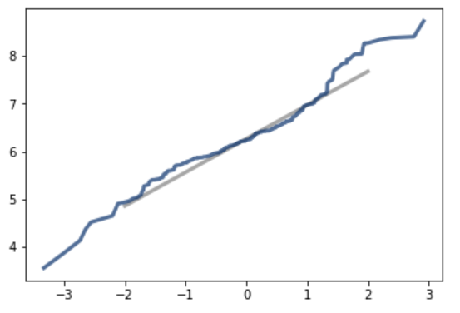
Analytical Distribution
Rooms Per House Normal Distribution

Slide 12
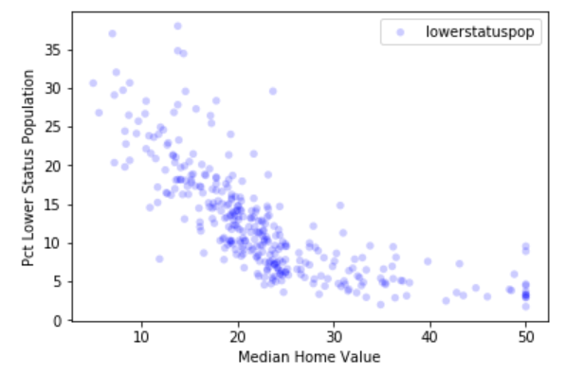
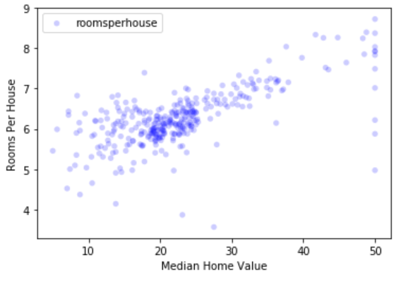
Scatter Plots

Slide 13
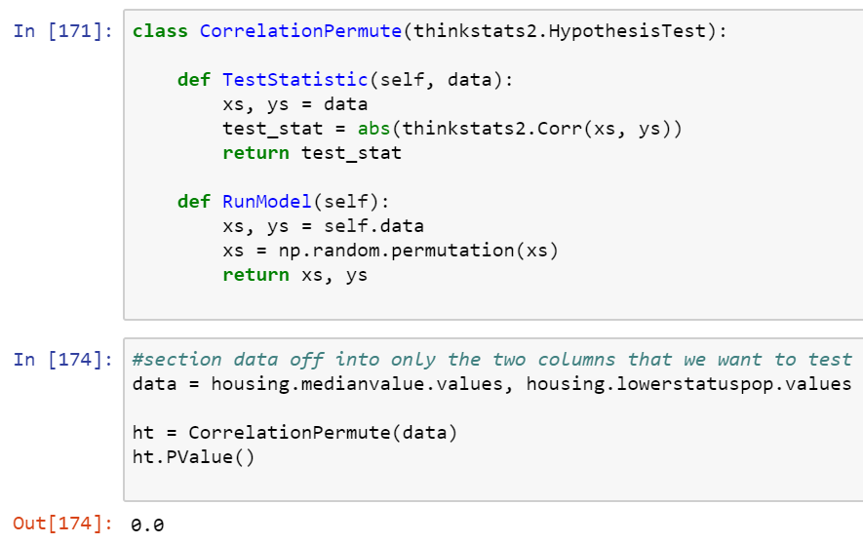
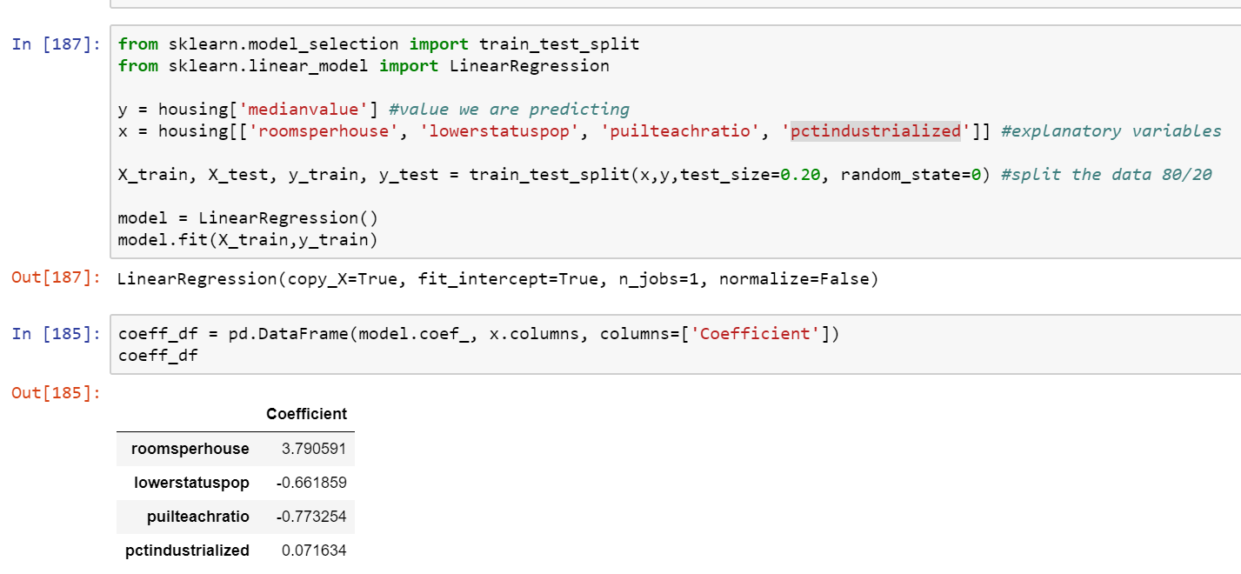
Test and Regression

