Slide 1


Workshop on Data Analysis Tools
DATA ANALYTICS AND
DECISION
MAKING TOOLS
Power BI | Tableau | Google Data Studio

Slide 2
WHAT IS A DATA ANALYSIS ?
Data Analysis is the process of collecting, cleaning, and studying data to find useful information and make better decisions.
It answers questions like:
• What happened?
• Why did it happen?
• What will happen next?

Slide 3




WHY DATA ANALYSIS IS IMPORTANT
Helps to make decisions based on facts
Finds patterns and trends
Predicts future outcomes
Used in all field:
Business,Health,
Education,Engineering

Slide 4





DATA ANALYTICS LIFE CYCLE
Discovery
Data Collection
Data Preparation
Data Modeling
Visualization
Decision Making

Slide 5





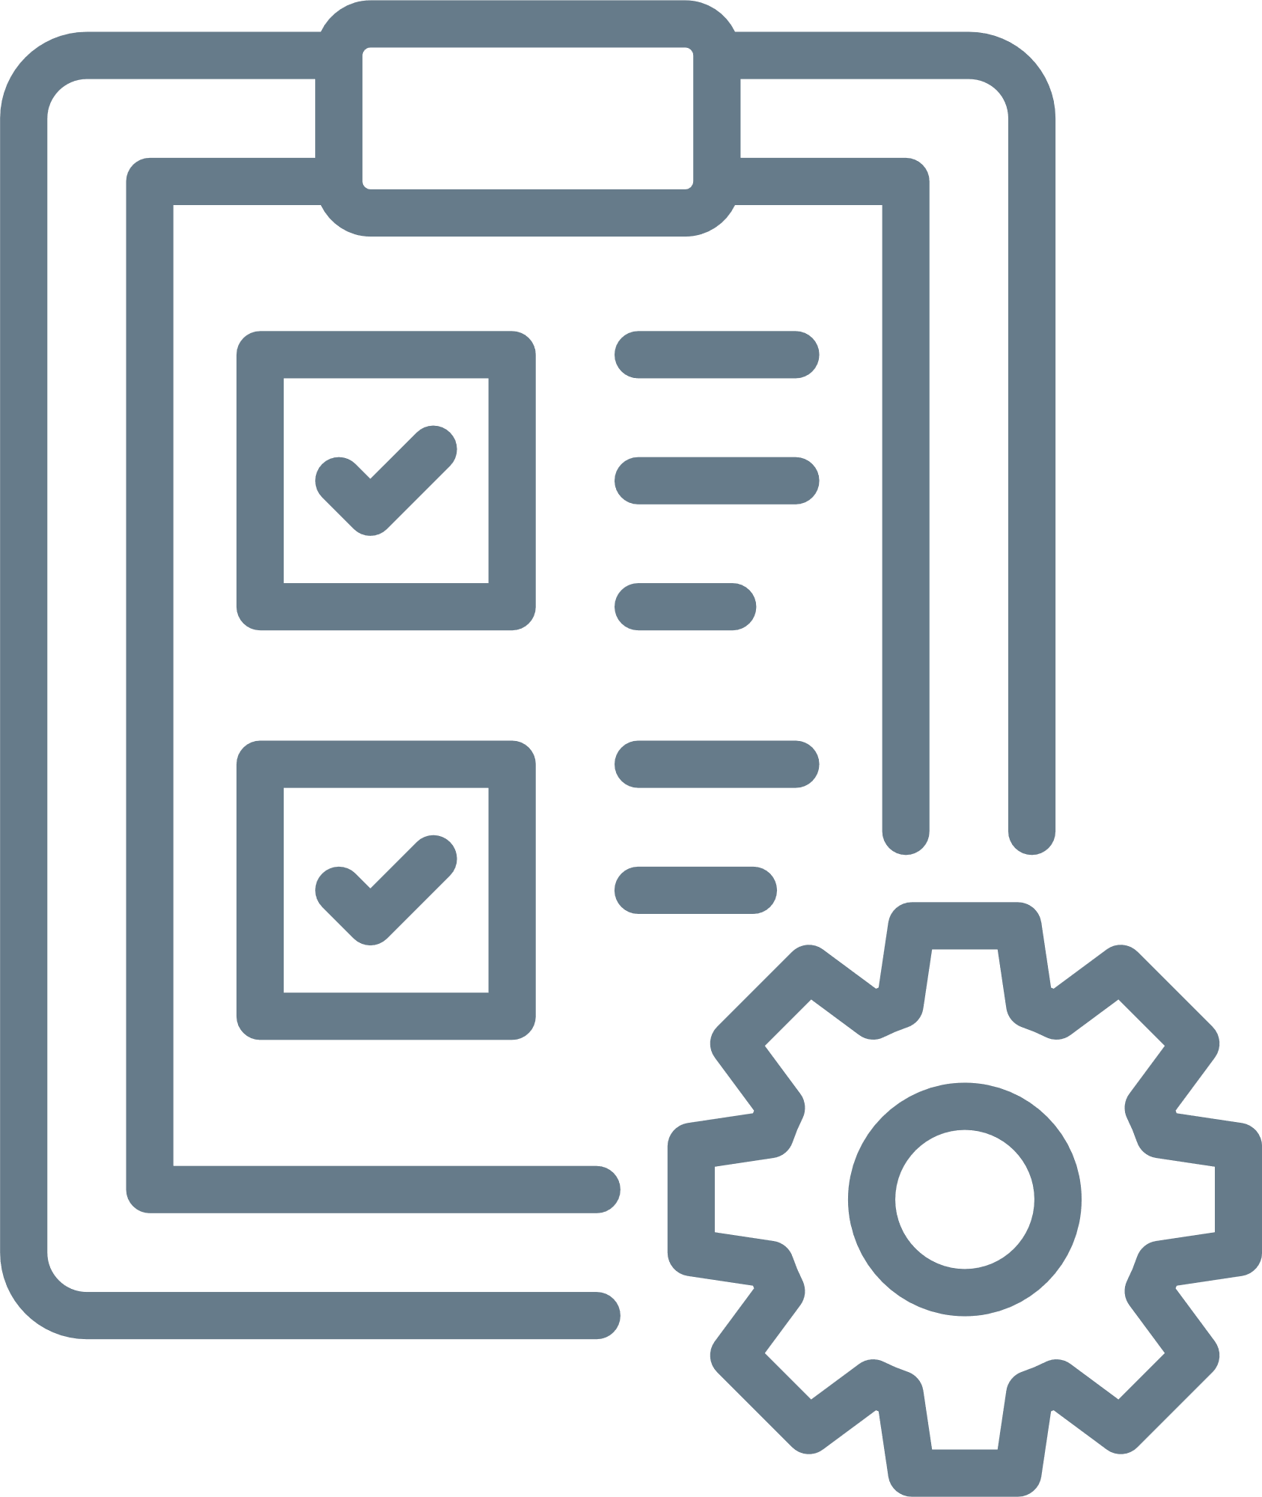
DETAILED STEPS
STEP 1
STEP 2
STEP 3
STEP 4
STEP 5
STEP 6
Discovery
Data Collection
Data Preparation
Data Analysis/ Modeling
Data Visualization
Decision Making
Understand the problem or question.
Define goals and data needs.
Example: Why are sales decreasing this quarter?
Gather data from databases, Excel, sensors, or websites.
Data can be structured or unstructured.
Clean the data:
• Remove duplicates
• Handle missing values
• Fix wrong entries
Clean data = accurate results.
Use tools or algorithms to find insights.
Techniques:
• Statistical analysis
• Regression
• Clustering
• Correlation
Show data through charts, graphs, and dashboards.
Tools: Power BI, Tableau, Google Data Studio.
Use insights to make real decisions.
Example: Increase marketing budget in top-performing cities.

Slide 6







Structured
Data
Unstructured
Data
Organized in tables, easy to analyze
• Example: Excel, SQL
No fixed format
• Example: Images, videos, social media posts
TYPES OF DATA

Slide 7










SUMMARY
Clean
Visualize
Collect
Analyze
Act

Slide 8




REAL-LIFE APPLICATION
Business
Education
Track students results
Forecast sales
Healthcare
Engineering
Predict diseases
Monitor performance

Slide 9








Power BI
Microsoft’s interactive tool for creating data visualizations and dashboards from multiple data sources.
Tableau
A powerful data visualization platform that helps turn complex data into clear, interactive visuals and insights.
DATA ANALYSIS TOOLS
Google Data Studio(Looker Studio):
A free, web-based tool for building customizable, shareable data dashboards using Google and other data sources.

