Slide 1



POWER BI
Transforming Data into Actionable Insights

Slide 2
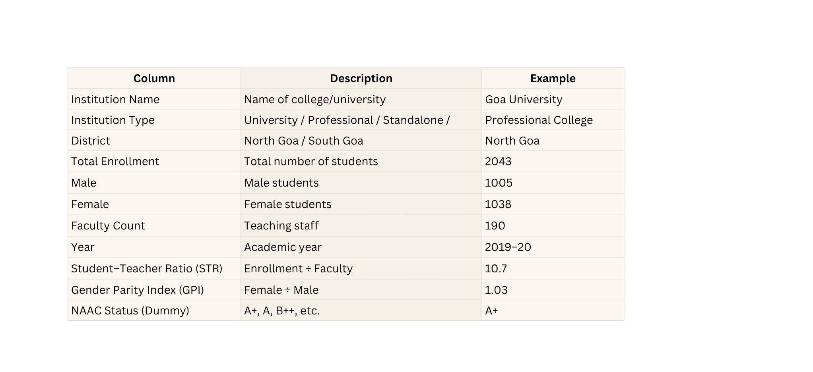


DATASET DESCRIPTION ..............................................................

Slide 3

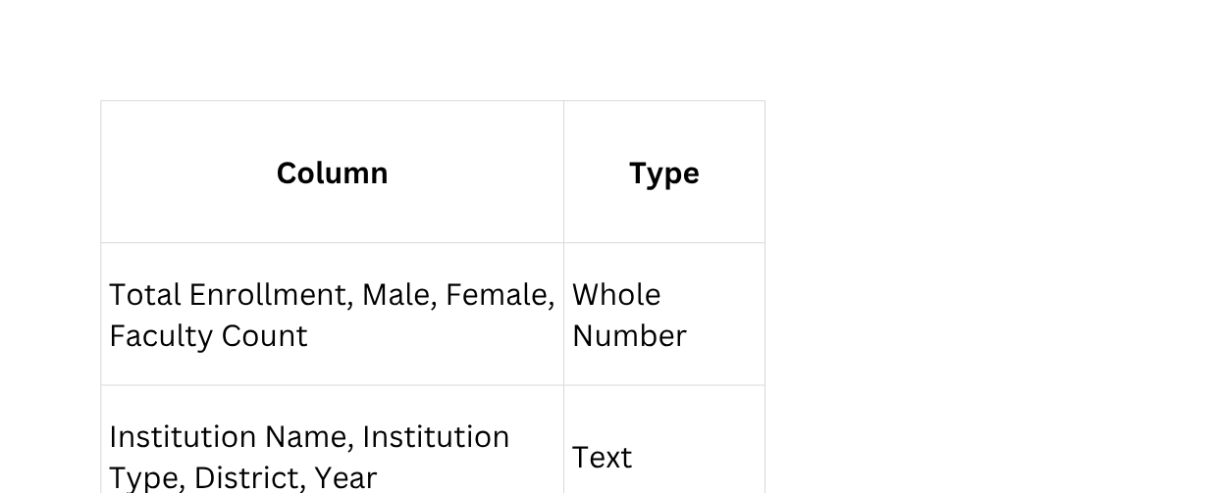
DATA CLEANING (Power Query) ..............................................................
Check Column Types
Go to Add Column → Custom Column, then create:

Slide 4


DATA CLEANING (Power Query) ..............................................................
Add Custom Columns
Go to Add Column → Custom Column, then create:
(a) Student–Teacher Ratio (STR)
if [Faculty Count] <> null and [Faculty Count] <> 0
then Number.Round([Total Enrollment] / [Faculty Count], 2)
else null
Shows number of students per teacher

Slide 5
DATA CLEANING (Power Query) ..............................................................
Add Custom Columns
Go to Add Column → Custom Column, then create:
(b) Gender Parity Index (GPI)
if [Male] <> null and [Male] <> 0
then Number.Round([Female] / [Male], 3)
else null
Equal female & male enrollment.

Slide 6
DATA CLEANING (Power Query) ..............................................................
Add Custom Columns
Go to Add Column → Custom Column, then create:
(c) Dummy NAAC Status (for demo)
if Text.Contains([Institution Name], "University") then "A+"
else if Text.Contains([Institution Name], "Government") then "A"
else if Text.Contains([Institution Name], "Engineering") then "B++"
else if Text.Contains([Institution Name], "College") then "B+"
else "Not Accredited"
Adds illustrative NAAC grades for visualization

Slide 7











CREATE MEASURES (DAX) ..............................................................
01
Total Students
SUM('page1'[Total Enrollment])
02
Total Faculty
SUM('page1'[Faculty Count])
03
Total Institutions
DISTINCTCOUNT('page1'[Institution Name])
04
Average STR
DIVIDE([Total Students], [Total Faculty], BLANK())
05
Overall GPI
DIVIDE(SUM('page1'[Female]), SUM('page1'[Male]), BLANK())

Slide 8

Data Analytics ..............................................................
BUILD VISUALS

Slide 9

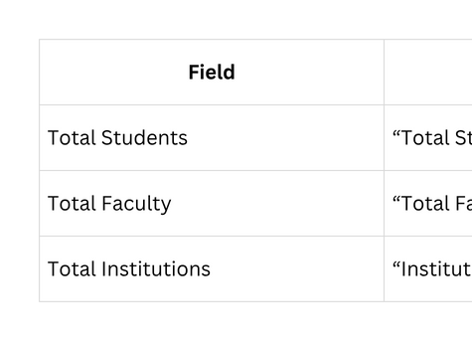
1.KPI CARDS ..............................................................
Purpose: Display main totals.
💅 Format →
Background: #F5E6A8 Font: 28–36 pt Color: Navy #002855
📈 Insight: Gives overview of Goa’s higher education scale.

Slide 10
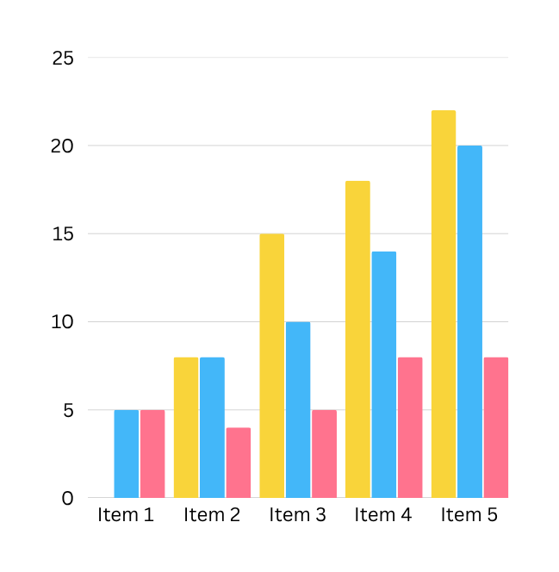
2.CLUSTERED BAR CHART ..............................................................
Gender-wise Enrollment
  Y-axis: District
  X-axis: Male, Female
🎨 Colors:
  Male → Blue #2E86C1
  Female → Gold #F4D03F
📈 Insight: Compare gender balance in North vs South Goa.

Slide 11
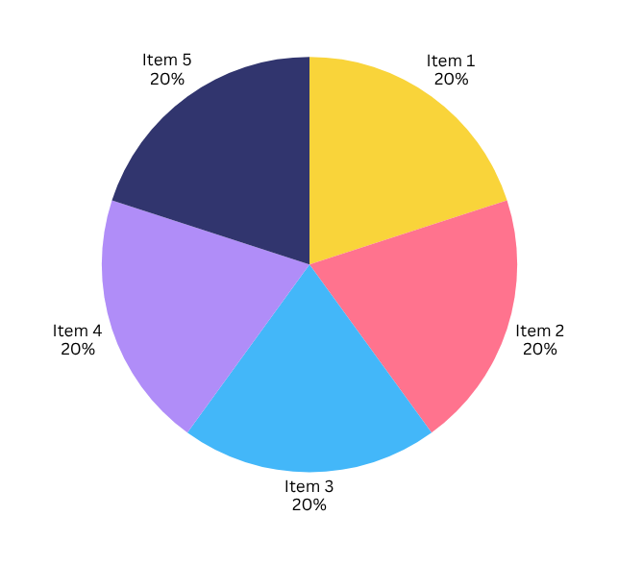
3.PIE CHART..............................................................
Enrollment by Institution Type
  Legend: Institution Type
  Values: Total Enrollment
  Data Labels: Percent of total
📈 Insight: See which institution type has largest enrollment share.

Slide 12
4.TABLE ..............................................................
Institution-wise STR
  Fields: Institution Name, District, Faculty Count, Total Enrollment, Student–Teacher Ratio
  Format: Alternating rows ON
🪄 Filter →
  Top N → 5 → By Total Enrollment → Apply
📈 Insight:Top 5 institutions by student count; compare teaching quality.

Slide 13
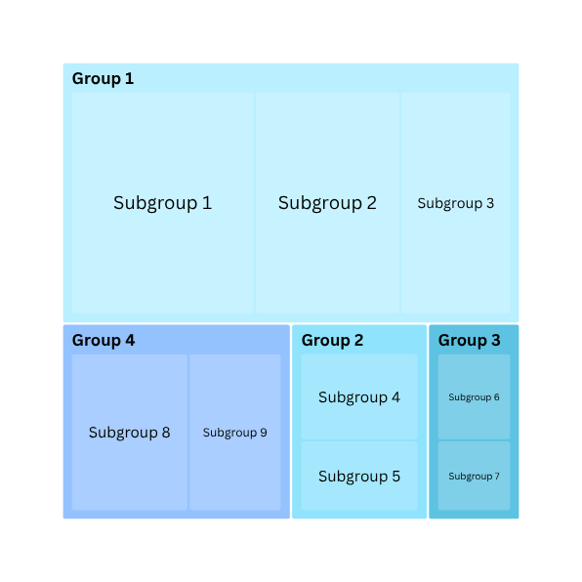
5.TREE MAP ..............................................................
Enrollment by Institution Type
  Category: Institution Type
  Values: Total Enrollment
📈 Insight:Area of each block shows proportion of total students in that type.

Slide 14

6.GAUGE ..............................................................
Overall Gender Parity Index
  Value: Overall GPI
  Target: 1 Min: 0 Max: 1.2
  Colors: Teal fill, Red target line
📈 Insight:Needle near 1 → equal gender ratio.
Below 1 → more male; Above 1 → more female.

Slide 15
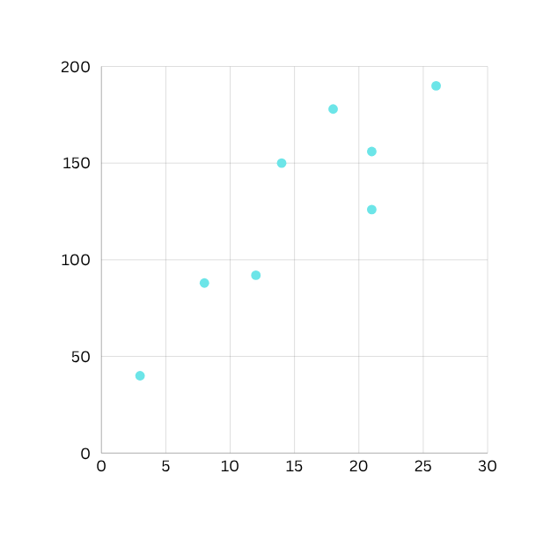
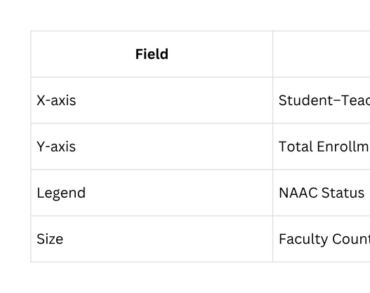
7.SCATTER CHART ..............................................................
Overall Gender Parity Index
🎨 Colors:
A+ → Gold A → Blue B++ → Green B+ → Purple Not Accredited → Gray
📈 Insight:Higher NAAC grades often cluster at lower STR (better quality) and moderate enrollment.

Slide 16
SLICERS..............................................................
01
02
District
Institution Type
  Insert a Slicer visual
  In Fields pane, drag District into the slicer’s Field well.
  It will show both “North Goa” and “South Goa”.
  Add another Slicer visual.
  Drag Institution Type to its Field well.
  Resize it beside the first slicer.
🧩 Tip:
You can change the layout:
Click ⚙️ (settings) → Slicer settings → Style → switch between List and Dropdown.
📈 Use:
Select “South Goa” to see only that district’s institutions reflected across all visuals.
Insight Example:
Helps analyze how student–teacher ratios vary between government and private colleges.
You can observe STR and GPI changes instantly when toggling filters.

Slide 17
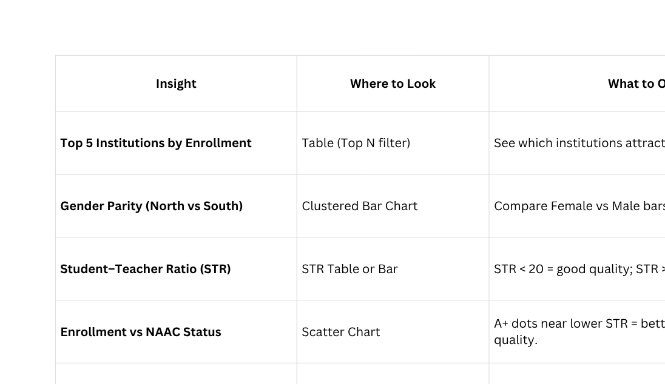
INSIGHTS TO DISCUSS.............................................................

