Slide 1



TABLEAU
Driving Discovery Through Dynamic Dashboards

Slide 2
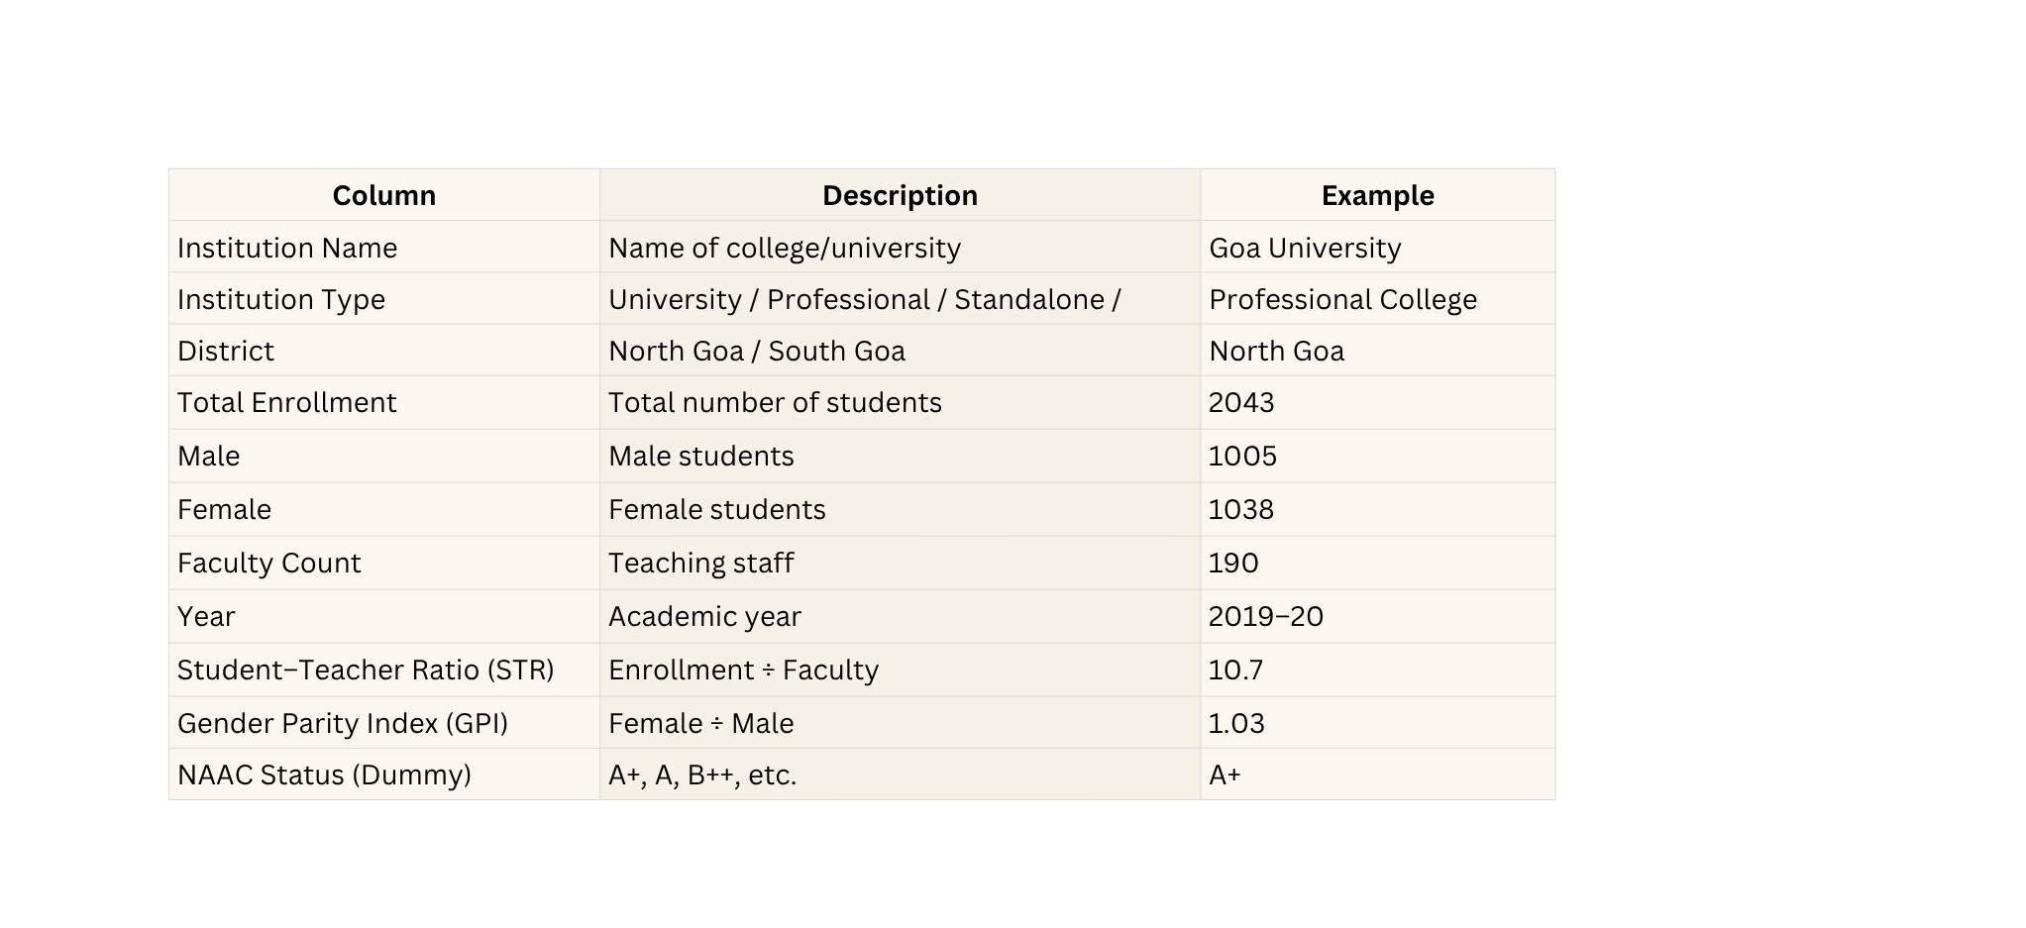


DATASET DESCRIPTION ..............................................................

Slide 3

IMPORTING & UNDERSTANDING DATA
Open Tableau and Load Data
  Launch Tableau Public.
  Click File → Open or Connect → Microsoft Excel.
  Select your Excel file:
  In the Data Source page, ensure the sheet page1 is selected.
  Tableau automatically previews your data.

Slide 4
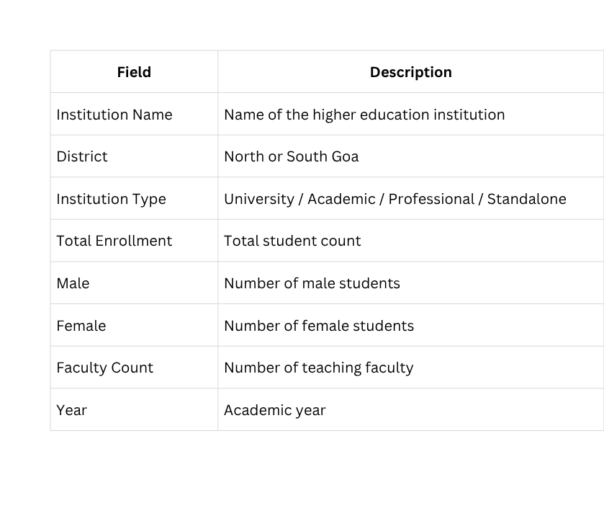
IMPORTING & UNDERSTANDING DATA
Understand the Columns

Slide 5

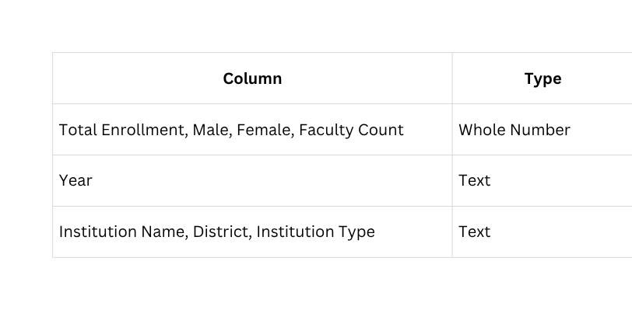

DATA CLEANING AND PREPARATION
Check Data Types
If a column shows Abc instead of #:
Right-click column → Change Data Type → Whole Number

Slide 6
Remove Null and Zero Rows
Remove Null and Zero Rows
  Go to the Data Source tab (bottom left)
  Click the filter icon on Faculty Count and Male columns.
  Uncheck (Null) and 0 values.
Now only valid institutions remain.

Slide 7
Create Calculated Fields
Student–Teacher Ratio (STR)
Right-click in Data Pane → Create Calculated Field → name: Student–Teacher Ratio
Formula:
IF [Faculty Count] <> 0 THEN ROUND([Total Enrollment] / [Faculty Count], 2)
ELSE NULL END
Shows number of students per teacher (indicator of academic quality).

Slide 8
Create Calculated Fields
Gender Parity Index (GPI)
Right-click in Data Pane → Create Calculated Field → name: Gender Parity Index (GPI)
Formula:
IF [Male] <> 0 THEN ROUND([Female] / [Male], 3)
ELSE NULL END
Measures female-to-male enrollment ratio (1.0 = perfect parity)

Slide 9

Data Analytics ..............................................................
BUILD VISUALS

Slide 10
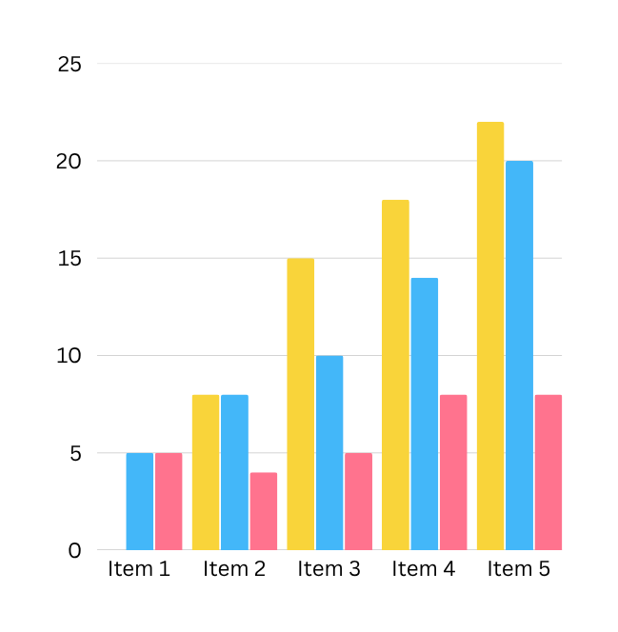
1.CLUSTERED BAR CHART ..............................................................
Gender by District
Goal: Compare male vs female student counts in North vs South Goa.
Steps:
  Click “New Worksheet” → rename it Gender by District.
  Drag District → Rows.
  Drag Male and Female → Columns.
  Click Show Me → Clustered Bar Chart.
  Click Color → assign:
Male → Blue (#2E86C1)
Female → Gold (#F4D03F)
  Turn on Data Labels → Label → Show Mark Labels.
Title: Gender-wise Enrollment by District – Goa HEIs
Interpretation:
North Goa has higher enrollment overall; the gender gap is moderate but noticeable.

Slide 11
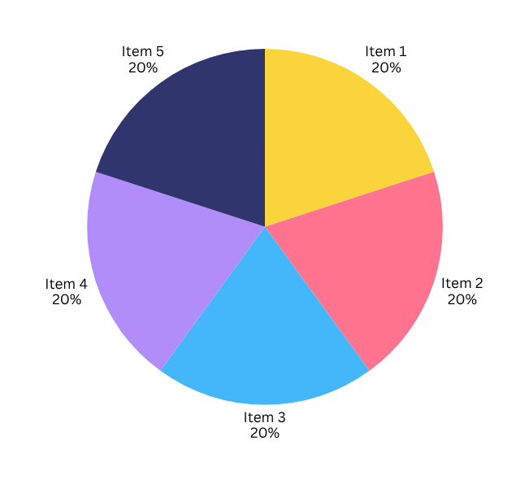
2.PIE CHART ..............................................................
Enrollment by Institution Type
Goal: Show which type of institution has the highest student enrollment.
Steps:
  Click “New Worksheet” → rename it Enrollment by Institution Type.
  Drag Institution Type → Color.
  Drag Total Enrollment → Angle and Label.
  Click Show Me → Pie Chart..
  Resize using the Size button
  Turn on Data Labels → Label → Show Mark Labels.
Title: Enrollment by Institution Type (2019–20)
Insight:
Academic Colleges dominate Goa’s higher education sector, followed by Professional Colleges.

Slide 12
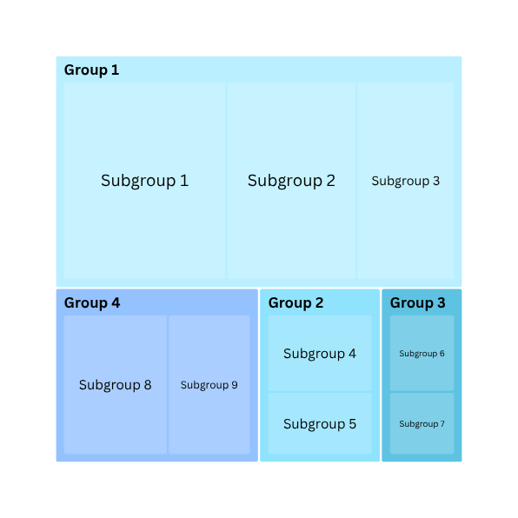
3. STR Table ..............................................................
Student–Teacher Ratio Table
Goal: Display institutional teaching quality with STR.
Steps:
  Click “New Worksheet” → rename it Enrollment by Institution Type.
  Drag Institution Name | District | Faculty Count | Total Enrollment | Student–Teacher Ratio
  Sort by Total Enrollment → Descending.
  Format: Font: Calibri 11pt.Headers: Bold, Alternating Row Shading: Light Gray (#F2F2F2)
Add Color to STR Column:
  Drag Student–Teacher Ratio → Color (in Marks pane).
  On right side → click color legend ▼ → Edit Colors.
  Palette → Green–Red Diverging
  Check ✅ Reverse
  (Green = Good STR, Red = Overloaded Teachers)
Interpretation:
Green cells → Better faculty-student ratio
Red cells → High student load per teacher.

Slide 13










BUILD THE DASHBOARD.............................................................
01
02
03
04
  Create a New Dashboard
  Add Visuals
  Add Filters
  Add a Title
  Click New Dashboard (bottom, next to sheets).
  In the left panel under Sheets, drag the following
  Click the bar chart → small arrow ▼ (top right).
  Click the dashboard title area → type: Higher Education Institutions – Goa (2019–20)
  Rename it: Goa Education Dashboard.
  Choose Filters → District.
  On left side → under Size, choose Automatic or 1280×720 (HD).
  Repeat for Institution Type if needed.
  Format: Font : Segoe UI Bold.
  Size: 18pt, Color: #1A5276 , Center align

Slide 14
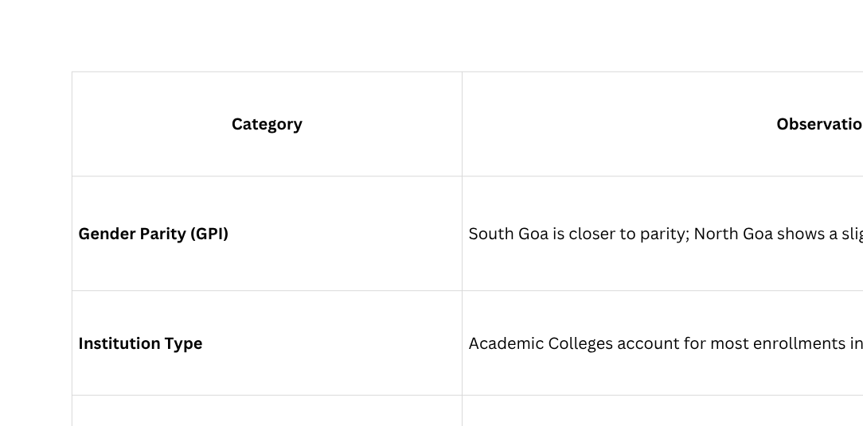
INSIGHTS.............................................................

