Slide 1
Internship Project
Soil moisture detection (IoT)

Slide 2
INtroduction
Basically this is a soil moisture monitoring system, which detects if the moisture content in the soil is above or below a certain satisfactory threshold value. If it goes below a certain critical point, it is time to water the plant until the soil surrounding the plant is moist enough. An arrangement of a DC motor and a servo motor is used to control the watering mechanism.

Slide 3
Equipments required
1. Arduino
2. Moisture Sensor
3. Jumper Cords
4. Wires
5. LEDs
6. DC Motor

Slide 4
How it works?
The Soil moisture sensor continuously monitors the volumetric moisture content in the soil and sends that information to the Arduino with particular values .
If the soil moisture content goes below a certain point, which is decided by the threshold value given in the Arduino code, the Arduino signals the servo motor and the dc motor to start the watering mechanism.(In this project we used LED indication instead of DC Motors. 3 LEDs are used to indicate 3 distinct colours . Red for low water content ,Yellow for Medium water content and Green for indicating that the soil having sufficient water)

Slide 5
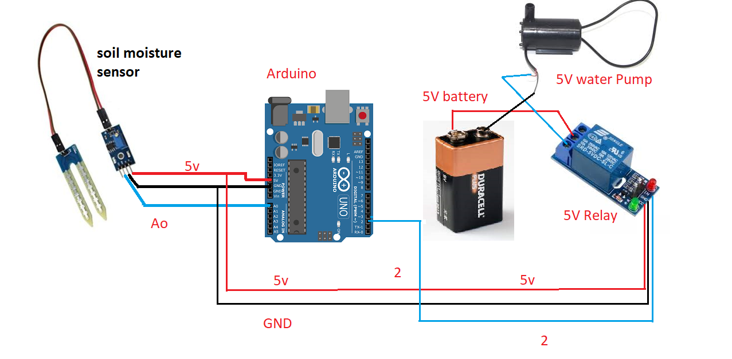
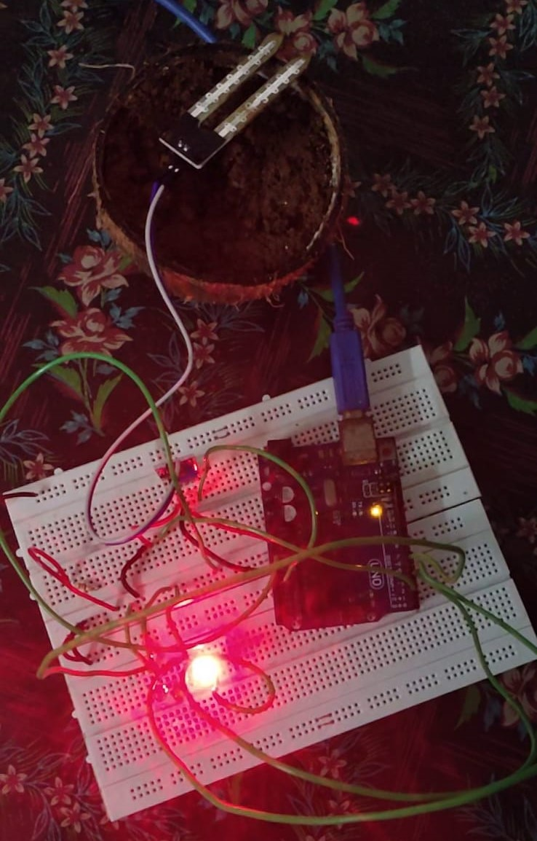
Architecture

Slide 6
Overview
In this project, we have merely built a prototype. But the advantages of this project are numerous. If we can implement this technology in the real world, a lot of water can be saved! The world uses about 70% of freshwater for irrigation and on the other hand irrigation multiplies yield of most crops by almost 2 to 5 times. So irrigation seems to be a necessary evil. The best solution out of this is controlled usage of water for;
Irrigation purpose - a purpose successfully fulfilled by this project.

Slide 7
Thank you!
Done By ,
Alan Joy | B-Tech CSE | SJCET Pala,
Internship On Soil Moisture Detection,
Internet Of Things(IoT),
Company Name : Exposys Data Labs

