Slide 1

Coded Source Separation for Video Compressed Sensing
Alankar Kotwal | 12D070010
Department of Electrical Engineering
IIT Bombay
Notes:
Hello. I’m Alankar, and I’ll talk about nice ways to do video compressed sensing. I will also talk about how we try to optimize these ways to get better reconstructions and sense faster than the state of the art.

Slide 2
Coded Source Separation for Video Compressed Sensing
Notes:
Compressed sensing is an alternative method to sample continuous-time signals. Given certain assumptions, it can recover signals from a lot less samples than those required by the Nyquist-Shannon sampling theorem.

Slide 3
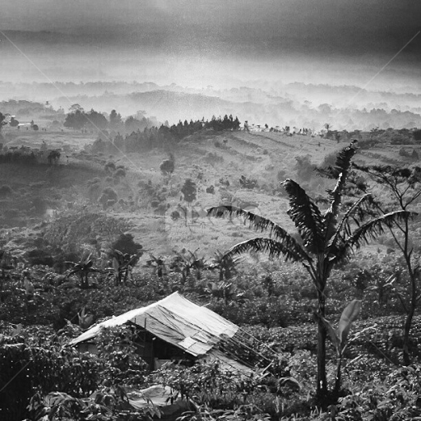
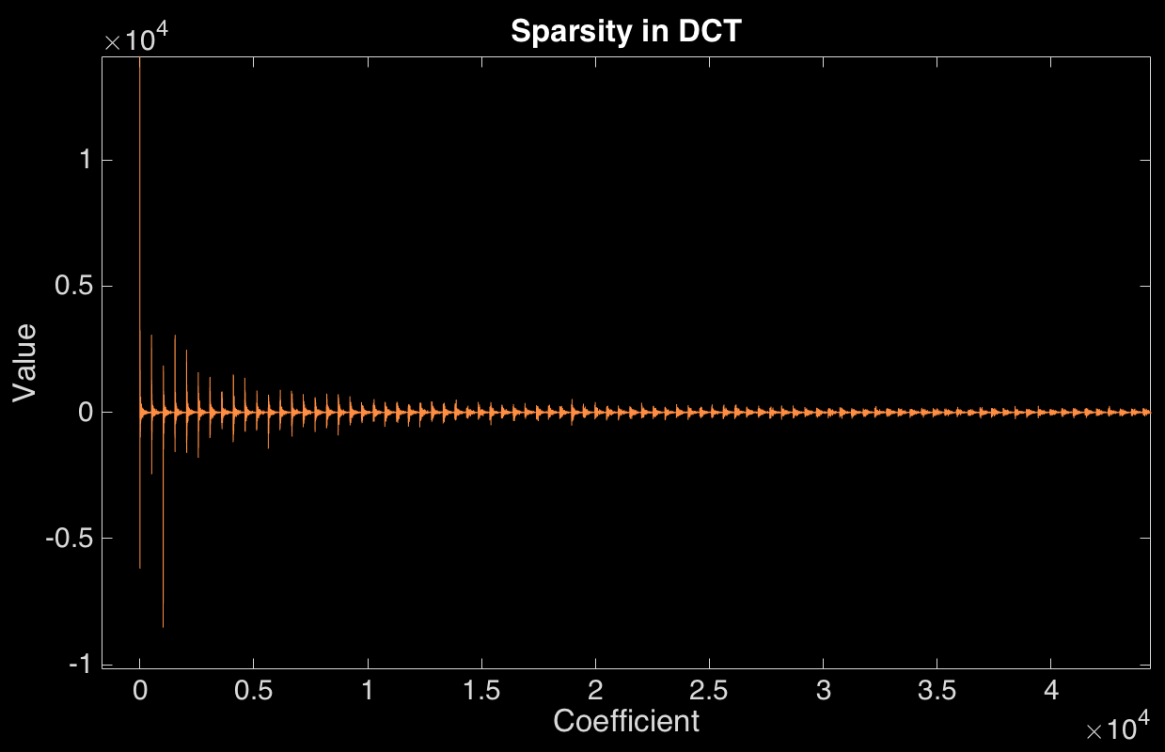

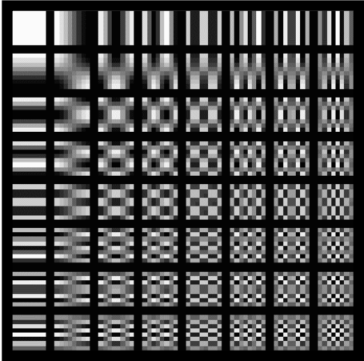

Compressed Sensing
Representation in a dictionary
Sparsity: “Prior” information
Figure from math.dartmouth.edu
Notes:
The process starts with recognizing that the class of signals we want to sense can be represented in a basis (given by the D matrix in the equation above). We’re given that this representation is sparse, that is, requires a lot less coefficients than the degrees of freedom in the image. This, vectorized, is expressed by this equation.
For example, natural images, like the image shown above, are sparse in the DCT domain (which, incidentally, allows JPEG to compress images). This means that this image can be formed by linearly combining only a “few” of the DCT basis atoms. To show this, I plotted the first 50k of the 250k coefficients of this image, and you can see that only a few are significantly non—zero.

Slide 4
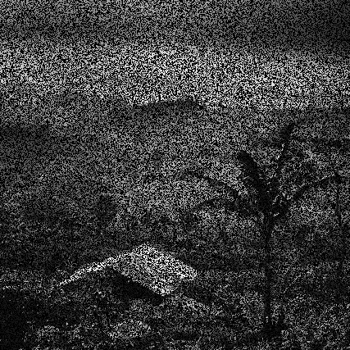


Compressed Sensing: Process
Sensing step
Reconstruction
Notes:
We then acquire linear combinations of the signal elements, with to a sensing matrix. Note that in the typical CS scenario, m is much less than n, giving rise to the compressive nature of the measurement. For example, if the sensing matrix was a 0-1 matrix, it would either sample a given pixel or not. Effectively, we have data only from the pixels which are sensed, and those which aren’t sensed are masked out in this image.
Next, the recovery step requires us to solve this optimization problem. There are guarantees on exact recovery if the underlying scene is exactly sparser than some function of the sensing matrix and the dictionary.

Slide 5
Coded Source Separation for Video Compressed Sensing
Notes:
The success of compressed sensing on still images has inspired efforts to apply it to video data. This involves compression potentially across both space and time, as opposed to just space in the still image case.

Slide 6

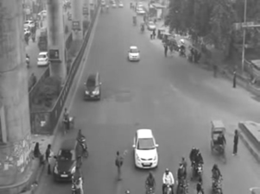
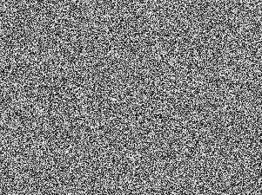
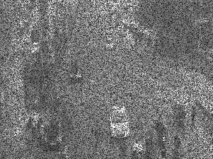
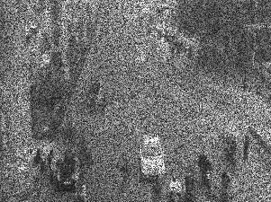
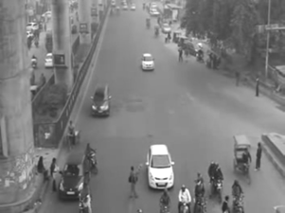
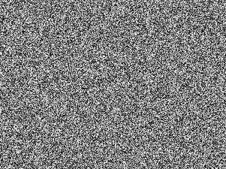
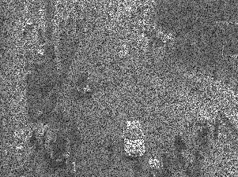
Video Compressed Sensing: Process
Sensing step
.*
=
.*
=
Notes:
The sensing model we will be dealing with is one in which the compression happens purely across time. This is because most ordinary cameras do not have the capability to sense linear combinations of pixel values across space. Instead, we choose to sense positive linear combinations of T frames across time, dictated by the phis. The process is illustrated in the images here. Suppose T is two, then we have two successive frames of a video being masked by some sensing matrices, and them getting added up to form the output image. This linear combination happens in hardware when the camera senses the sequence of frames.

Slide 7
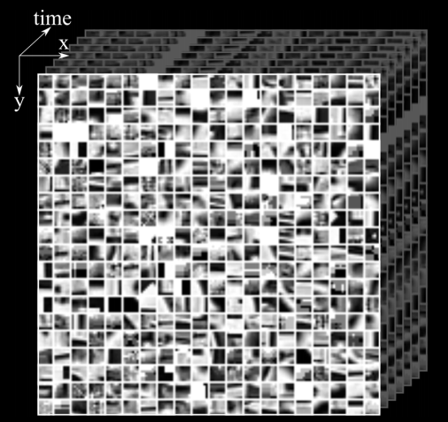

Video Compressed Sensing
Representation in learned dictionary
Hitomi, Y., Gu, J., et al., “Video from a Single Coded Exposure Photograph using a Learned Over-Complete Dictionary”
Notes:
Representation in a dictionary is a choice we can make in this 3D case. The dictionary atoms, in this case, are themselves videos we want our output to “look like”. In case we have samples of videos we want our algorithm to work well on, we can extract an over--complete dictionary from them and sparsify our input signal, like the paper by Hitomi and co. does. In the general case, a basis like the 3D DCT might be used. The representation of the ith vectorized frame, then, is given by the equation here. Since we deal with the general compressed sensing scenario, we work with DCT bases

Slide 8

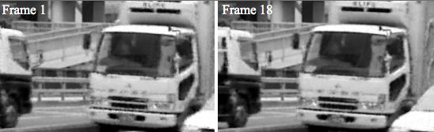
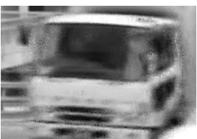
Video Compressed Sensing
Solving video compressed sensing
Hitomi, Y., Gu, J., et al., “Video from a Single Coded Exposure Photograph using a Learned Over-Complete Dictionary”
Notes:
Equipped with this, we cast the compressed sensing problem into the optimization problem above. This problem is approximately solved using techniques like orthogonal matching pursuit. Below, we see two frames from the input video, with a zoomed output reconstructed using the 3D DCT basis.

Slide 9



Coded Source Separation: Our Approach
Representation in our dictionary
⇒
Our optimization problem
Our measurement
Notes:
The problem with a 3D basis, however, is that linear combinations of atoms cannot speed dictionary atoms up! So, very roughly, the sensed scene must have objects moving at approximately the “same speed” as the dictionary atoms, or the dictionary must be very large. Also, changing the number of linearly combined frames requires training a different dictionary. To overcome these problems, we propose modelling each frame as coming from a 2D DCT basis. Thus, the vectorized form of all frames, x, is given by this equation. Our measurement, then, looks like (), where the effective dictionary is called psi. We use an L1-regularized least-squares solver to solve a related unconstrained optimization problem, which is equivalent to this constrained version.

Slide 10
Video Compressed Sensing Results
Notes:
I will now show some results from our proposed method.

Slide 11
Coded Source Separation: Results, Simulated
Input 1
Output 1
Input 2
Output 2
Notes:
We start with a pair of simulated input images. These are two 20x20 images with only three of their 400 DCT coefficients set to non—zero values. We observe exact reconstruction. This is exact to the point that when I inserted these images into the presentation, I couldn’t decide which two were the inputs!

Slide 12

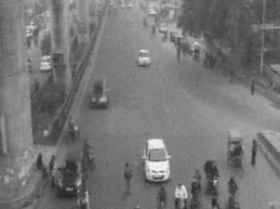
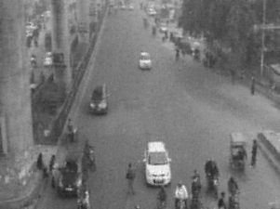
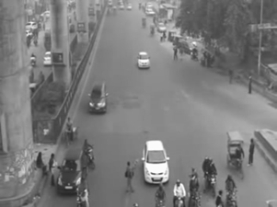
Coded Source Separation: Results, Gaussians
Notes:
These are outputs when the sensing matrices phi have Gaussian—random entries on their diagonals. Note the difference from the real scenario. One nice thing we observe about our algorithm is we observe no “leakage” from one image into the other whatsoever in any case!

Slide 13




Coded Source Separation: Results, Positive Sensing
Notes:
Here, the sensing matrices are the more realizable positive diagonal matrices. Notice the presence of ghosting in the reconstructed image.

Slide 14
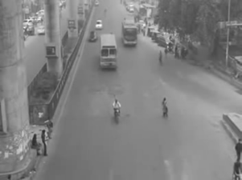
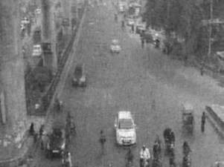


Coded Source Separation: Results, Positive Sensing
Inputs
Outputs
Notes:
Just to be more adventurous, these are results for separating three images with positive random matrices. The reconstruction quality is acceptable, though there is some deterioration, and the reconstruction can be improved with better—tuned matrices.

Slide 15
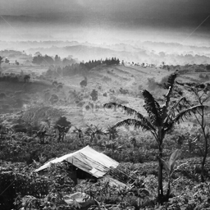
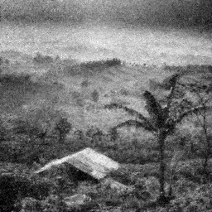
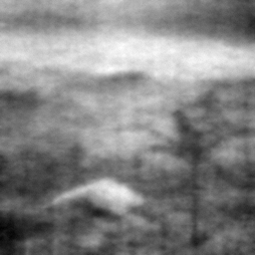
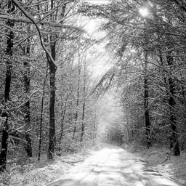
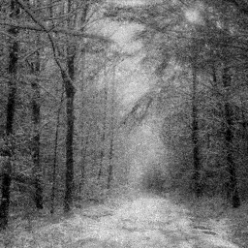
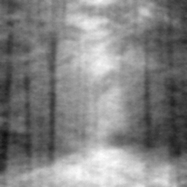
Coded Source Separation: Results, Sudden Change
Middle: Our output 1, right: 3D DCT output 1
Input 1
Middle: Our output 2, right: 3D DCT output 2
Input 2
Notes:
To simulate sudden changes, we try separating two images that are very different from one another. We compare the performance of our method against using a 3D DCT dictionary.

Slide 16
Sensing Matrix Optimization
Notes:
We move on to the next part of my work. What distinguishes compressed sensing from other branches of vision is the existence of recovery guarantees. The recovery guarantees, however, need some conditions to be met.

Slide 17


Sensing Matrix Optimization
Exact reconstruction condition
⇒ DECREASE COHERENCE! ☺
Coherence definition
Studer, C., Baranuik, R. G., “Stable Restoration and Separation of Approximately Sparse Signals”
Notes:
For instance, for exactly sparse vectors, exact reconstruction happens when (). The function mu is a measure of how orthogonal the columns of the effective dictionary Phi Psi are. The sparsity bound is a decreasing function of mu, so we can allow “more”, less sparse, vectors if we decrease mu! So, optimizing a sensing matrix involves decreasing its coherence.

Slide 18

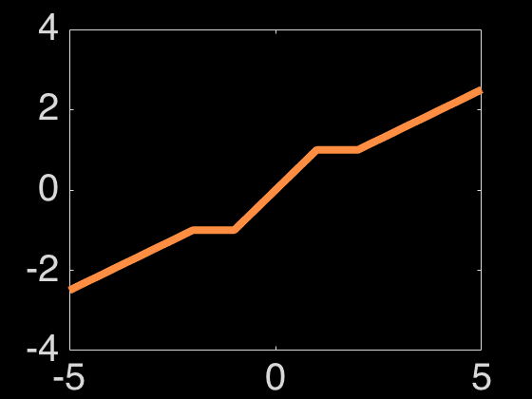


Sensing Matrix Optimization: Approach 1
⇒
Coherence definition
Gram matrix, assuming normalized columns
⇒
⇒
⇒
Building the new D matrix from shrunk G
Shrinking Function
Elad, M., “Optimized Projections for Compressed Sensing”
Notes:
Our definition for coherence was the following. However, if we normalize the columns of the matrix D, the dot products of columns i and j are exactly the ij^{th} elements of D^T D!. Our goal, then, is to reduce the maximum off-diagonal element of D^T D. To this end, since the max is a non-smooth function, the average of absolute coherences above some threshold t is minimized. The Gram matrix off—diagonal elements above t are “shrunk” by a factor. This shrunk matrix, we hope, is the Gram matrix of a “better” D (with lower coherence). We then build the square-root of the “better” Gram matrix and evaluate the coherence of the resultant D. However, there is no guarantee that the square root exists. Also, minimizing an average gives no guarantee of actually minimizing the maximum, so there is no guarantee of the coherence decreasing across iterations.

Slide 19





Sensing Matrix Optimization: Approach 2
The goal
Some manipulation
Duarte-Carvajalino J. M., Sapiro G., “Learning to Sense Sparse Signals …”
Notes:
The second approach we surveyed took an indirect approach at trying to make the Gram matrix approximately identity. This means (). A few substitutions yield (). We can reduce this to an optimization problem in the columns of \Lambda \Gamma^T. Taking this column-wise, we get (). This, however, is a rank-1 approximation problem. We solve this with the SVD, to get \Gamma, which gives us \Phi. The same problem as in Elad’s method also exists here: We’re minimizing some averaged coherence, not the maximum. Also, this method will not directly yield to us diagonal sensing matrices that we can use in our sensing framework.

Slide 20




Sensing Matrix Optimization: Our Approach
Effective dictionary
⇒
Squared Coherence
⇒
Unnormalized Gram Matrix
⇒
⇒
Normalized Gram Matrix
Notes:
We, on the other hand, try to perform descent directly on the coherence of the effective dictionary. We assume a general T, and a general image size, therefore an n. The DCT matrix D is then calculated from the image size. We initialize diagonal \phis due to our hardware requirements. The optimization is carried out on the diagonal elements of the \phis, and the rest of the elements are held to zero. We, therefore, have (\Phi \Psi). We call the index that does from 1 to T as \mu. Then, the \mu \nu th block of the un-normalized Gram matrix is (), where d_\alpha is the \alpha th column of D^T. For normalizing the effective dictionary columns, we divide by the diagonal elements of the un-normalized matrix to get the normalized matrix. This yields ().
Next, we need the absolute maximum of all non—diagonal elements in this matrix. For this, we notice that the absolute square maximum can be approximated as

Slide 21



Sensing Matrix Optimization: Our Approach
⇒
Normalized Gram Matrix
Notes:
We then call the numerator and denominator of the expressions for the Gram matrix as chi and xi respectively, and calculate their derivatives with respect to the sensing matrix. The details are omitted here for sanity. The expressions, for completeness, are (). We then do projected gradient descent with adaptive step—size and use a multi—start strategy to combat the non—convexity of the problem. This, however, is slow, and we’re optimizing the algorithm to exploit the structure of the DCT dictionary for speed-ups.

Slide 22
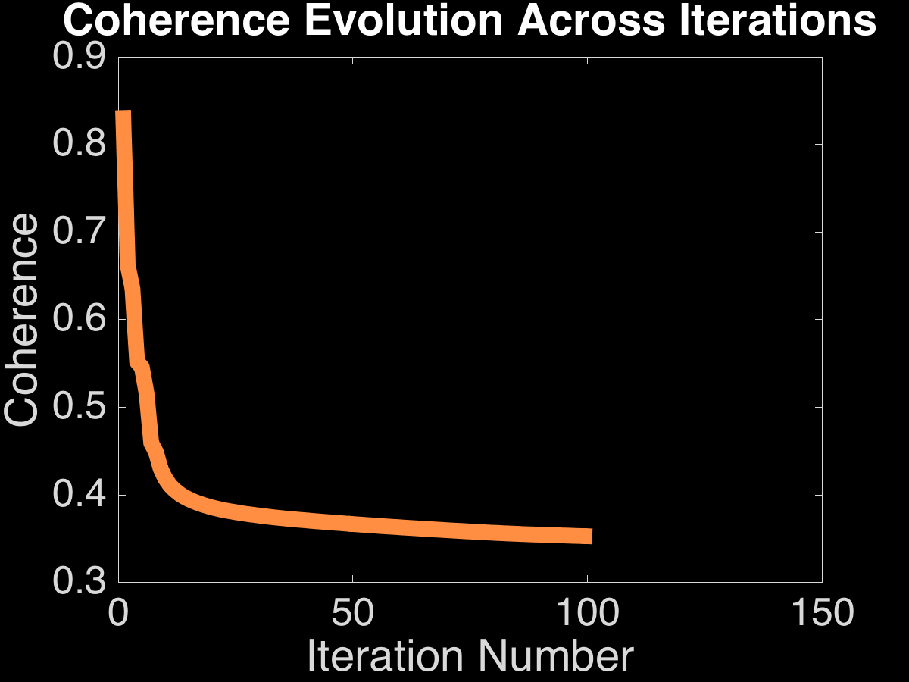
Sensing Matrix Optimization: Results, Coherence
Notes:
These are results from gradient descent on 8x8 patches and T = 2 on coherence. For our kind of matrices, using uniformly random numbers from 0 to 1 on the diagonals of phi gives a starting coherence of about 0.8-0.9, and we are able to reduce that to around 0.27-0.35. The remarkable thing is that almost every start in the multi—start strategy gets us to at least as low as 0.35. Even when T = 3, we get as low as 0.39 on coherence.

Slide 23
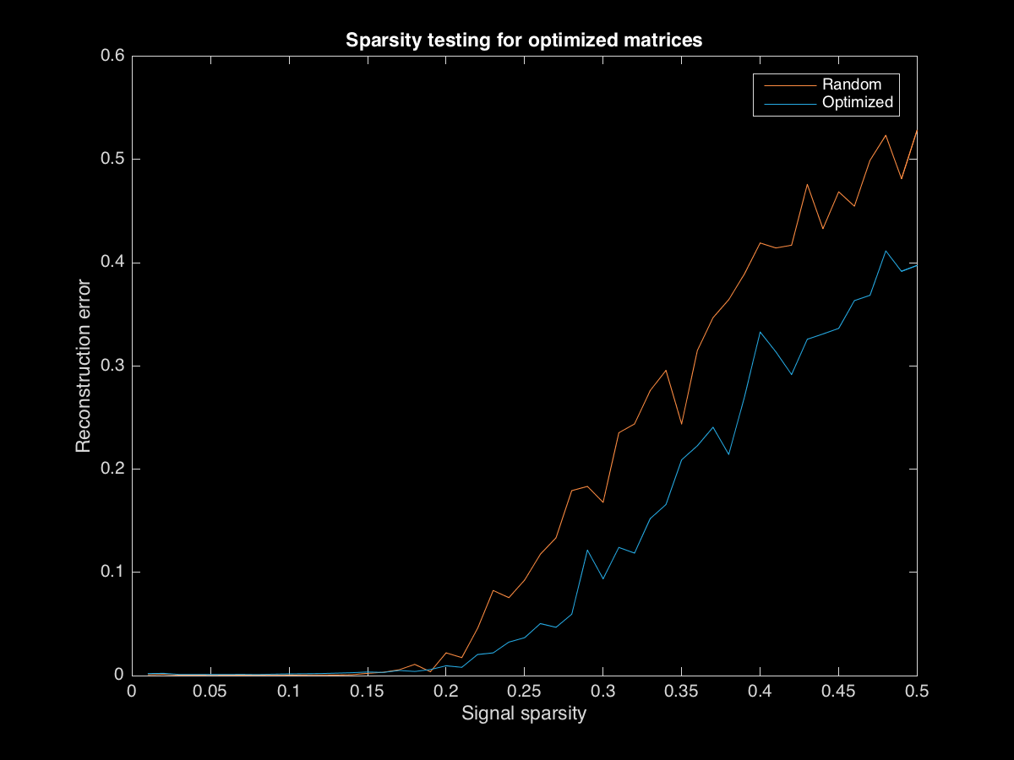
Sensing Matrix Optimization: Results vs Sparsity
Relative
Notes:
To test if the optimized matrices work well, we obtain average reconstruction errors for T=2 for various s—sparse signals. This plot of preliminary results shows our errors are lower than random matrices, which is encouraging. This part, however, is very new and very untested yet.

Slide 24
Sensing Matrix Optimization: Others Ideas
nT
⇒ Packing nT vectors in ℝ^{n}!
n
Effective dictionary
Cohn, H., Elkies, N., “New upper bounds on sphere packing I”
https://terrytao.wordpress.com/2013/07/18/a-cheap-version-of-the-kabatjanskii-levenstein-bound-for-almost-orthogonal-vectors/
Notes:
There’re other applications of this and ideas to accomplish this on the plate. For instance, our dictionary looks like (). It is n units tall, nT units fat, and we want the columns to be near-orthogonal. This is

Slide 25
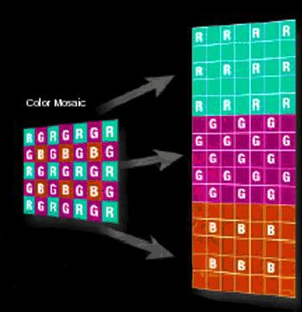

Sensing Matrix Optimization: Others Uses
Designing CDMA codes
Demosaicing
Notes:
There’re other applications of this and ideas to accomplish this on the plate. For instance, the vector packing approach could help design almost-orthogonal CDMA codes, where a large number near-orthogonal codes are required in a given number of time-slots.
Resolving color components from the sensor pixel mask, called demosaicing, also benefits from this.

Slide 26
Coded Source Separation: Questions? ☺
Notes:
☺

