Slide 1

Gesture-Controlled Telescope Mount
Institute Technical Summer Projects
Manmohan Mandhana
Alankar Kotwal
IITB

Slide 2
Conceptual Background

Slide 3
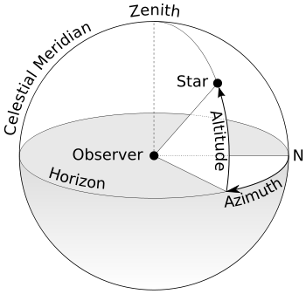
Observational Degrees of Freedom
An observer can set his direction of sight in two ways: “Upward” or “Downward” and “Sideways”. These two are given names: Altitude and Azimuth respectively. Since effectively a telescope is an observer, even pointing a telescope is the sane process.

Slide 4
Celestial Coordinates
Of course the Altitude and Azimuth of objects change with time. This is due to the rotation of the Earth and its motion around the Sun.
So we need something more permanent for keeping track of objects in the sky.
Such a system of coordinates based on the rotation of the Earth is called as an RA-Dec system, or an Equatorial system.

Slide 5
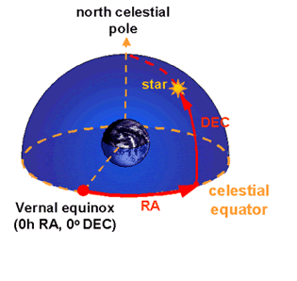
Equatorial System of Coordinates
Imagine for a moment stopping the rotation of the Earth. Consider the equator of the Earth projected outwards to the 'sphere' of the stars. Very much like our usual coordinate system, then, we can measure distances parallel (wrt a reference point) and perpendicular to it.
Parallel: Right Ascension
Perpendicular: Declination

Slide 6
Changes in Position due to Rotation
But now as we can see, since the Earth is rotating, the reference point we chose for the RA itself is moving. Hence its like a coordinate system wherein we have a moving origin. Hence we conclude that along the Equator, the RA of the objects at highest point changes linearly with the Earth's rotation.
We call this RA of objects at their highest point as the Local Sidereal Time, or the LST.
It can be shown that the LST gains four minutes per day due to the Earth's revolution around the Sun

Slide 7
Relations
We have the following relations that can calculate Altitude and Azimuth of an object given RA, Dec and LST, with the latitude of the observing place.
sin(ALT) = sin(DEC) sin(LAT) + cos(DEC) cos(LAT) cos(LST-RA)
sin(AZ) = - sin(LST-RA) cos(DEC) / cos(ALT)

Slide 8
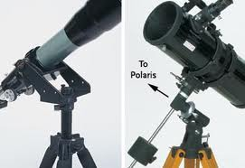
Telescope Mounts
A mount is the structure on which a telescope can move in the required manner. Depending upon which motions a telescope allows, it may be an Alt-Az mount or an Equatorial mount.

Slide 9
Implementation
We have chosen to use an Alt-Az mount for the project.
Hence, an input of the Altitude and Azimuth of an object to the system will point the telescope at the required coordinates.
The system has four interfaces to do this as explained further.

Slide 10
Interfaces
Gesture Control
A device consisting of an accelerometer that gives the altitude angle and a compass to give the azimuth attached to the wrist, so that the telescope aligns it to the position pointed to by the hand

Slide 11
Interfaces
Android App
An Android app that sends alt-az information over a Bluetooth protocol.

Slide 12
Interfaces
Computer Control
Input from a computer via Bluetooth.

Slide 13
Interfaces
Manual Override by Joystick
A joystick can be used to control the telescope manually.

Slide 14
Extra Features
In case of Android and Computer control, an option of pointing to a library of interesting objects can be given.
An auto-correction code can be written, so that when the telescope is pointing at a direction that is close to an interesting object, the telescope realigns it at the press of a button.

Slide 15
Work Done
The Android App is under construction and is nearly completed.
Codes for the Arduinos at both the telescope and gesture control sides are ready.
Joystick circuits are ready.
A lot still remains!

Slide 16
Thank You!
I should have stopped a lot earlier. ;)

