Slide 1
HyperLocalize
Context-Aware Identity-Preserving Video Localization
[STUDENT NAME] · [REGISTER NUMBER]
Guide: [GUIDE NAME], [DESIGNATION]
[DEPARTMENT OF CSE] · [COLLEGE NAME] · [MONTH YEAR]
Notes:
Introduce yourself and the project. HyperLocalize is a controlled workflow for localizing video, so that important information can cross language barriers without trusting AI output blindly. Replace the bracketed placeholders with your details before presenting.

Slide 2



Automatic dubbing treats AI output as final
Trust
Identity
Accountability
A dropped "not" or a changed number (2 sachets → 5) can reverse a health message, and nobody is asked to check.
Voice cloning can copy a real speaker. Consent is at best a one-time tick box, and revoking it rarely stops work in progress.
The output file carries no record of who reviewed it, which models made it, or which consent applied.
Problem: build a localization workflow where AI output is only a draft, critical content is checked, a human approves every scene, identity is used only under valid consent, and every action is auditable.
Notes:
Video carries public information in health, food, water and energy, but mostly in a few languages. ASR to MT to TTS pipelines make dubbing easy, but they create three problems: trust in critical facts, identity and consent when a voice is reproduced, and accountability for what was approved. The italic line is our problem statement.

Slide 3


A controlled workflow, not an autonomous pipeline
HyperLocalize is
HyperLocalize is not
A general, context-aware video localization workflow
An information-access layer for important video information (health, food, water, energy)
Human-reviewed: AI output is always a draft
Consent-governed for any use of a speaker's identity
Traceable: every governance action is audited
A health, ORS or Tamil-only app (that is the demo scenario)
A voice-cloning product
A competitor on raw dubbing quality
A fully autonomous pipeline
A solution to physical problems in any domain
Described as "secure", "compliant" or "production-ready"
Notes:
Positioning matters for the viva. The product is a general localization workflow. English to Tamil health information is only the current demo scenario. We make no security or compliance claims.

Slide 4





Objectives
Context-aware drafts
Critical-content checks
Scene-level regeneration
Localize each line with its neighbours, speaker, audience, glossary and timing budget
Numbers, units, glossary, structure and overrun checks block approval
Redo one problematic scene without touching the rest
Enforced consent
Approval and export gates
Auditable evidence
Backend gate at every stage; revocation stops running jobs
Frozen snapshot, separation of duties, MOCK never exported
Hash-chained audit log; chain head inside every export
Notes:
Six objectives, each mapped to a use case. Also a constraint: zero rupee budget, so every AI stage is behind an interface and can run on free or local models.

Slide 5
The workflow: AI drafts, humans decide
1
Create project
2
Upload & analyze video
3
Context-aware localization
4
Generate preview
5
Human review
6
Regenerate scene (if needed)
7
Approve
8
Export package
Human governance steps: only a person can accept, approve or export
Asynchronous jobs: never block a web request
Notes:
This is the confirmed workflow. Teal steps run as background jobs with explicit states. The two marigold steps are human gates: the reviewer accepts scenes, and a manager approves. Regeneration loops back for one scene only.

Slide 6
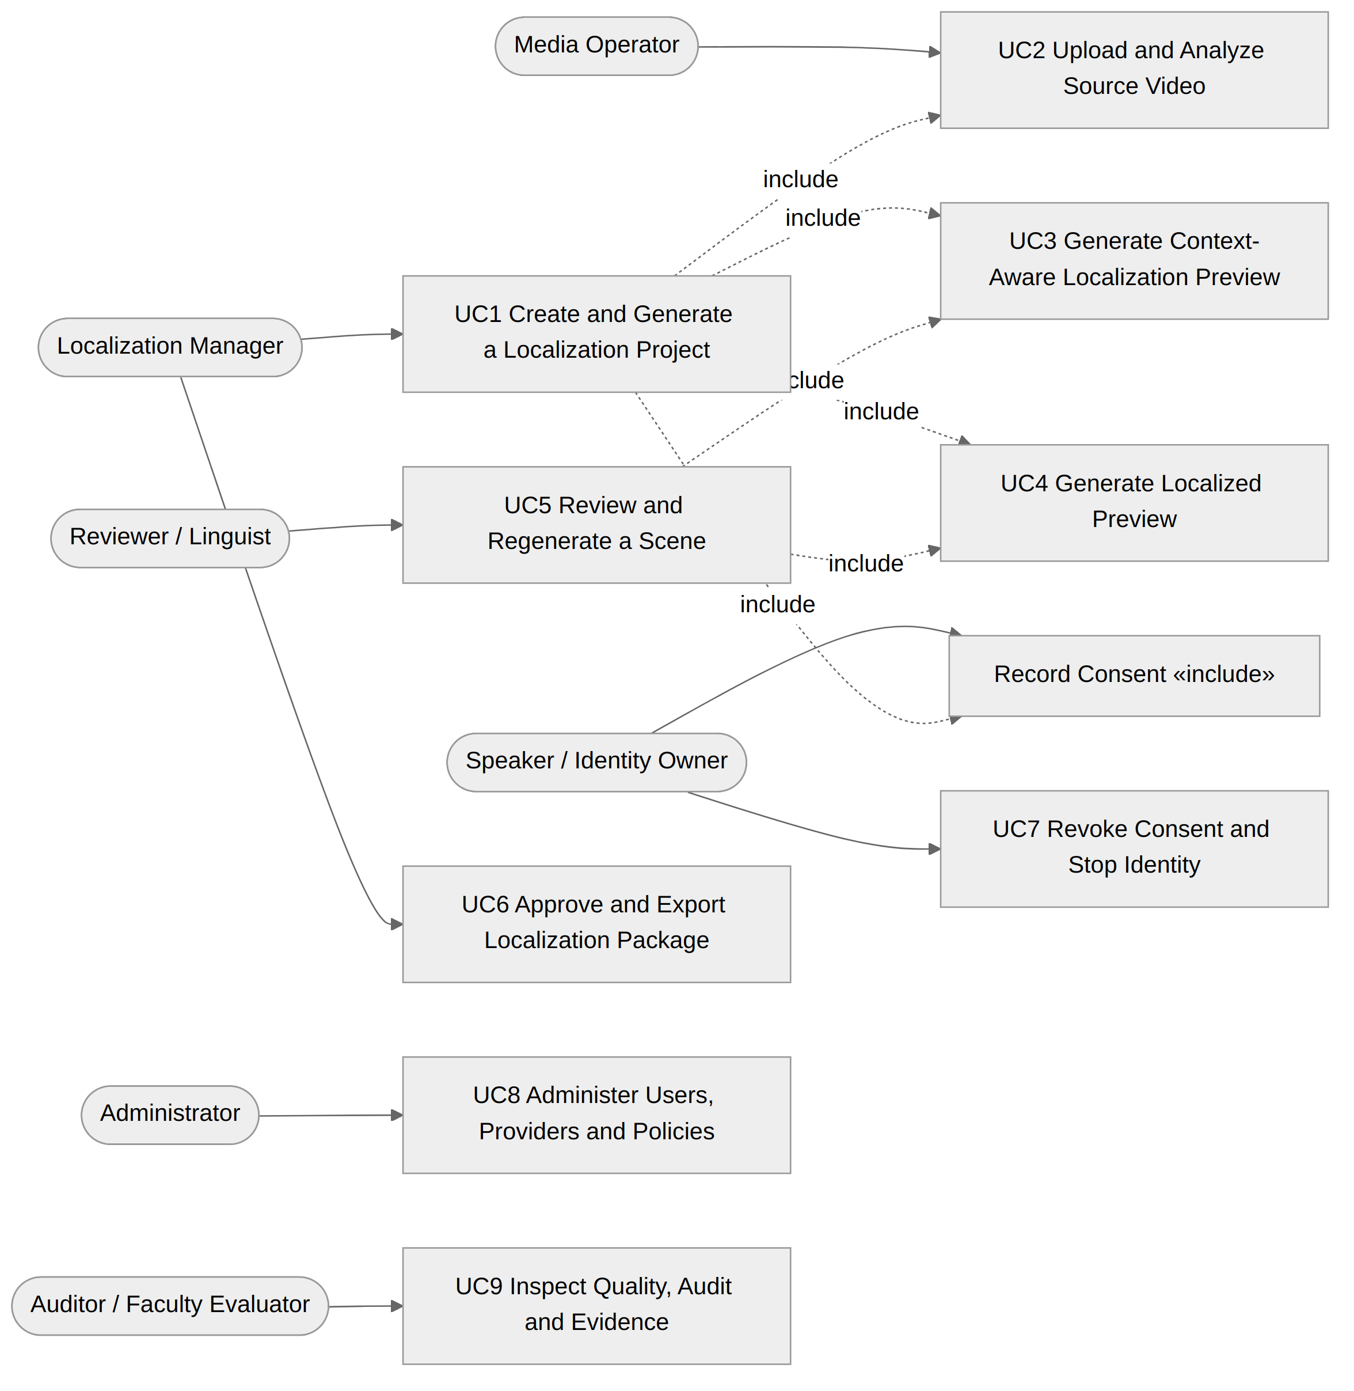
Six actors, nine use cases
Localization Manager
Creates projects, approves, exports
Reviewer / Linguist
Edits, overrides with reasons, regenerates, accepts scenes
Media Operator
Uploads video, links speakers, watches jobs
Speaker / Identity Owner
Grants, narrows, revokes or withdraws consent
Administrator
Users, provider chains, policies, quota limits (cannot grant consent)
Auditor / Faculty Evaluator
Inspects audit trail, verifies the hash chain
Notes:
The use-case diagram is drawn from the implemented code. Record Consent is an included sub-use case. Note separation of roles: the Administrator cannot grant consent on behalf of a speaker; a test proves it.

Slide 7
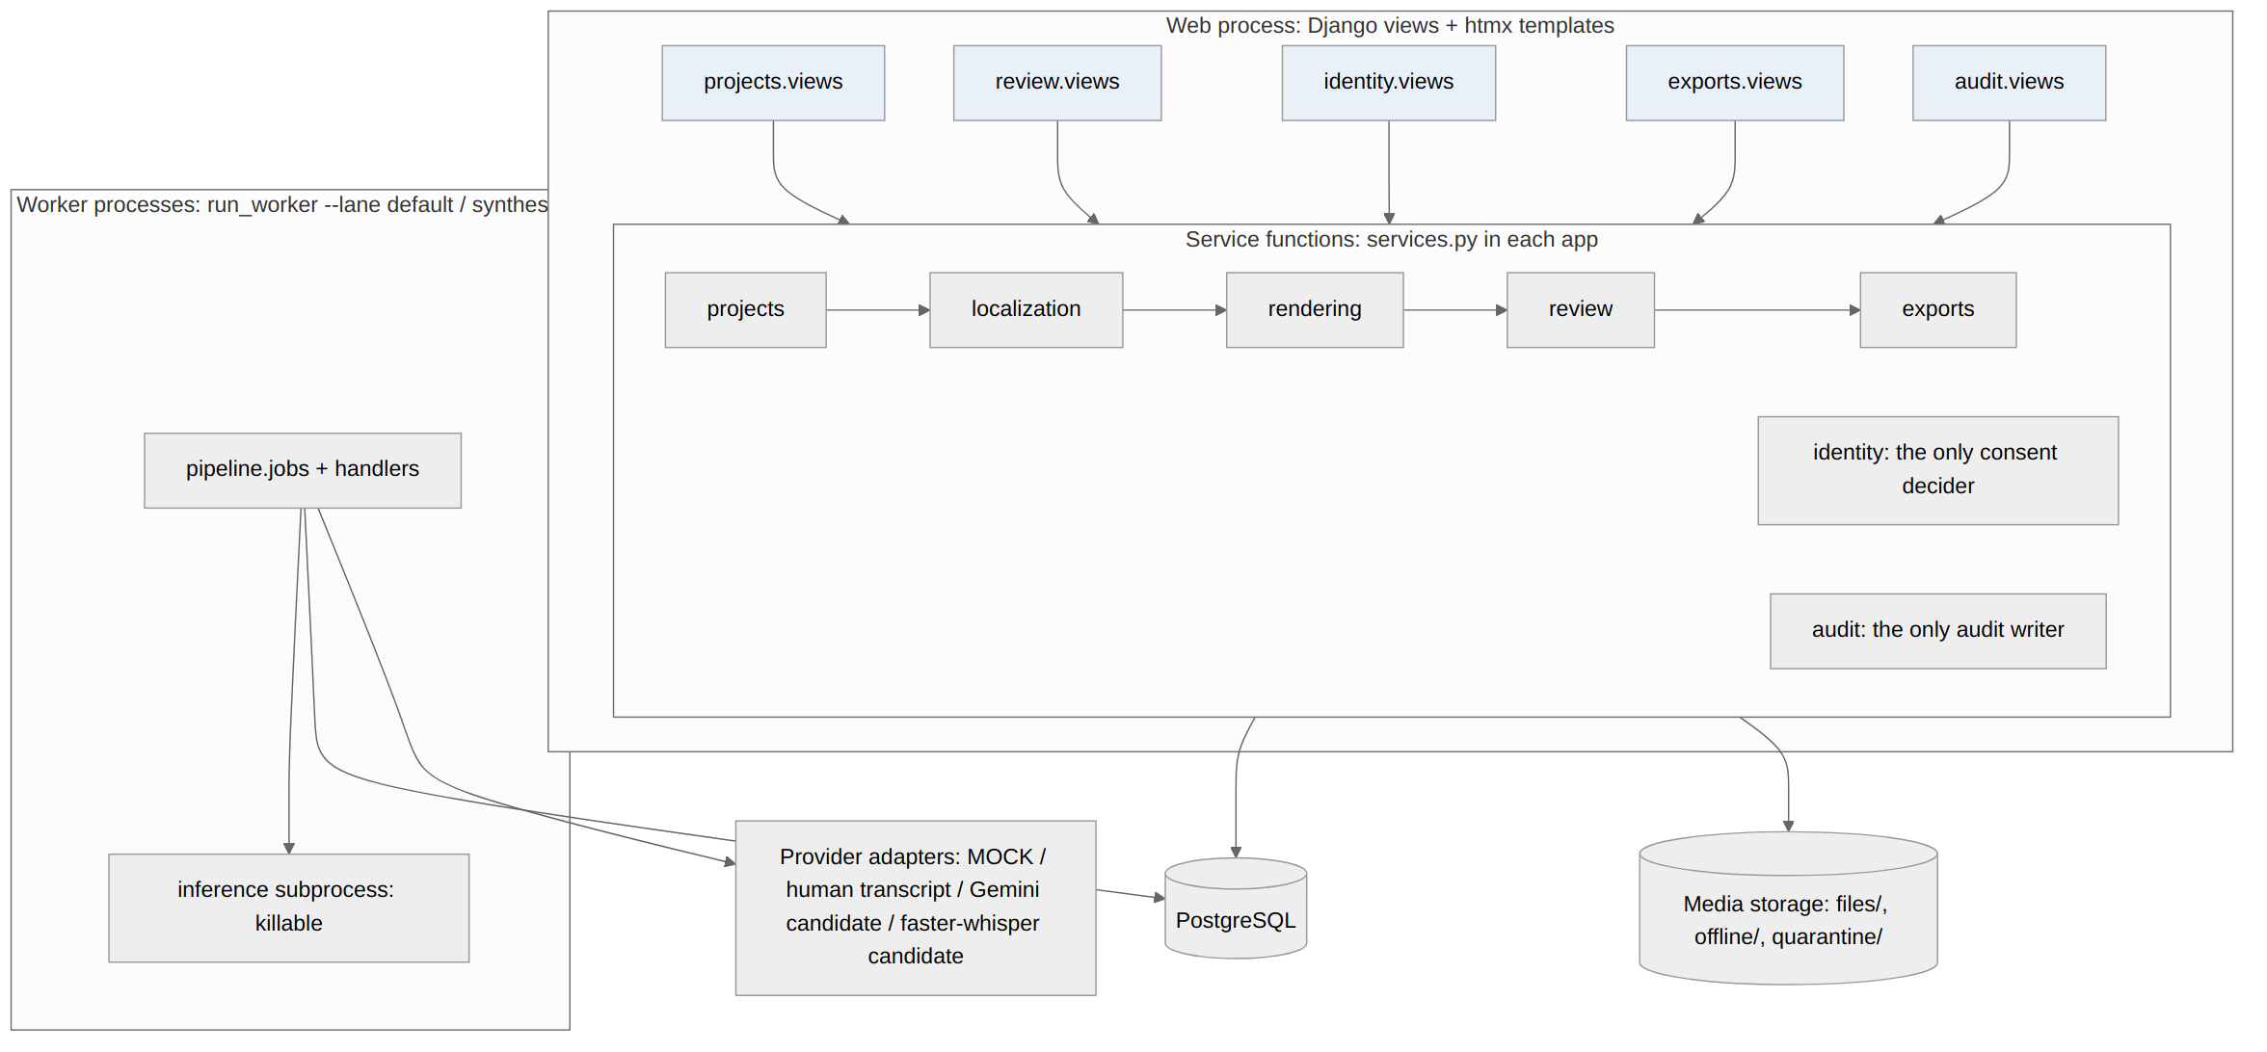



Architecture: a modular monolith
Web never blocks
Long work becomes jobs in a hand-written PostgreSQL queue (SKIP LOCKED)
Killable inference
Models run in a subprocess the worker can kill on revocation
9 Django apps
Apps call each other only through services.py; no signals
Why not microservices? One developer, a laptop demo and a ₹0 budget; database locks give consent the guarantees it needs (ADR 0001).
Notes:
One codebase, one database, a web process and worker processes with lanes. The identity app is the only consent decider and the audit app is the only audit writer. Every major choice is an ADR; 22 exist.

Slide 8







Technology stack (₹0 budget)
Django 6.1.1
PostgreSQL 17
Templates + htmx
ffmpeg / ffprobe
Backend, no REST framework
Data, job queue, audit triggers
Server-rendered pages per role
Validation, shot cuts, mixing
faster-whisper small
Gemini free tier
MMS-TTS Tamil
Docker Compose
English ASR on CPU (candidate)
Context-aware translation (candidate)
Stock voice on CPU (non-commercial licence)
Files written; not yet run
Marigold = AI candidates behind provider interfaces; final choices wait for the measured evaluation (spike).
Notes:
Everything runs on one laptop: i5-13450HX, 14 GiB RAM, Ubuntu. The three AI providers are candidates, not final choices. Voice cloning is still a mock. Docker files exist but have not been run because Docker is not installed.

Slide 9
Context-aware localization
2 neighbouring lines each side
Speaker
Audience profile
Quota-safe by design
Free tier: about 20 requests / day / model (measured)
Whole clip in 1 request, meaning check in 1 more (was ~16 for clip 01)
Provider fails → scenes stay PENDING, "Translation pending" + Retry
Never silently fills in MOCK text
Every draft records its context, adapter, model and prompt version
Segment draft
subtitle + speakable speech + rationale
Glossary
Length budget (11 chars/s)
Reviewer instruction
Visual context is not used yet. Whether context improves quality is NOT MEASURED.
Notes:
Each segment is sent with its context. The length budget comes from the stock voice's measured speaking rate. The prompt tells the model never to drop a number, unit, negation, warning or instruction to fit. Be honest in the viva: we have not yet measured whether context helps; that is the planned ablation.

Slide 10

Critical-content checks block approval
Check | What it catches | Effect
Numbers | Changed or missing numbers; Tamil digits and number words 0–100 | FAIL / UNVERIFIABLE
Units | Missing or changed units; declared conversions | FAIL / UNVERIFIABLE
Glossary | Key terms not using an accepted target form (prefix match for inflections) | No forms → UNVERIFIABLE, never PASS
Structure | Empty, untranslated, mostly Latin script, over reading budget | FAIL
Speech overrun | Line still too long at the 1.2× speed-up cap | FAIL: "shorten the speech"
AI meaning flag | Possible meaning reversal, e.g. a dropped "not" | Needs acknowledgement
A FAIL or UNVERIFIABLE result blocks approval until the text is fixed or a reviewer overrides it with a written, audited reason. Known gap: numbers are compared as counts, not positions.
Notes:
Rules are explainable and deterministic, so they are the gate. AI only flags, and a flag is never called verification. Unverifiable is fail-safe: if the system can't prove a term is right, a person must confirm it. Known limitation: swapping 2 tablets 3 times to 3 tablets 2 times still passes the count-based number check.

Slide 11
Consent is enforced in the backend
On revocation
Identity use is allowed only if
1
Running job: worker polls every ~1 s and kills the subprocess
the owner has not withdrawn
project consent is ACTIVE, unexpired, covers the use and language
it sits within an ACTIVE standing consent for this purpose
the job is not flagged for cancellation
re-checked at every stage boundary (checkpoints CP1–CP10), under a row lock on save
only the owner can grant; an Administrator's grant is refused
2
Scenes → NEEDS_REGENERATION; render jobs cancelled
3
This owner's audio quarantined, then purged
4
Only approvals and exports with this voice invalidated
5
Stock-voice fallback queued; must be reviewed again
< 8 s mid-job stop test bound (actual stop time not recorded)
Notes:
Consent is safety-critical, so a UI check is not enough. The gate is one function, identity.services.evaluate, re-run at every stage boundary. Revocation is one transaction plus a kill of the running inference subprocess. Exports already downloaded cannot be recalled, and the system says so honestly.

Slide 12


Three gates before anything leaves the system
Review
Approve
Export
Edits create new HUMAN versions
Override only with a written reason
AI flags need acknowledgement
Accept only with no open checks and a current preview
Regenerate one scene, with an instruction
Every scene accepted
No blocking checks on latest versions
Consent CP8 passes
Separation of duties: approver did not edit
Freezes an immutable snapshot
Refused if any artefact is MOCK
Refused if quarantined or CP9 fails
MP4 + SRT + VTT (tagged Tamil)
script.json, quality_report.json
evidence_manifest.json with chain head
Any edit, regeneration or revocation after approval invalidates it. Exports already downloaded cannot be recalled, and the system says so.
Notes:
Any change after approval invalidates it. The export refusal of MOCK output is a hard rule, which is what keeps placeholder output from ever being presented as real. Since 22 October a project rule also says the AI assistant used in development never reviews, approves or exports.

Slide 13
Audit: an append-only hash chain
#41 CONSENT_GRANTED
who · what · when · project · scene · consent version
prev: 9f2c…
#42 SCENE_ACCEPTED
who · what · when · project · scene · consent version
prev: a71e…
#43 APPROVED
who · what · when · project · scene · consent version
prev: 3b08…
#44 EXPORT_CREATED
who · what · when · project · scene · consent version
prev: e5d4…
Illustrative records; hash values shortened
hash = SHA-256( prev_hash + canonical_json(record) )
One writer (audit.services.record); appends serialised by locking one chain-head row
PostgreSQL triggers reject UPDATE, DELETE and TRUNCATE
verify_audit_chain recomputes every hash; each export manifest carries the chain head
Tamper-evident,
not tamper-proof
Notes:
Each record includes the previous hash, so changing any old record breaks every later hash. Someone with full database rights could rebuild the whole chain, which is why we copy the head into every exported package and why we say tamper-evident, never tamper-proof.

Slide 14
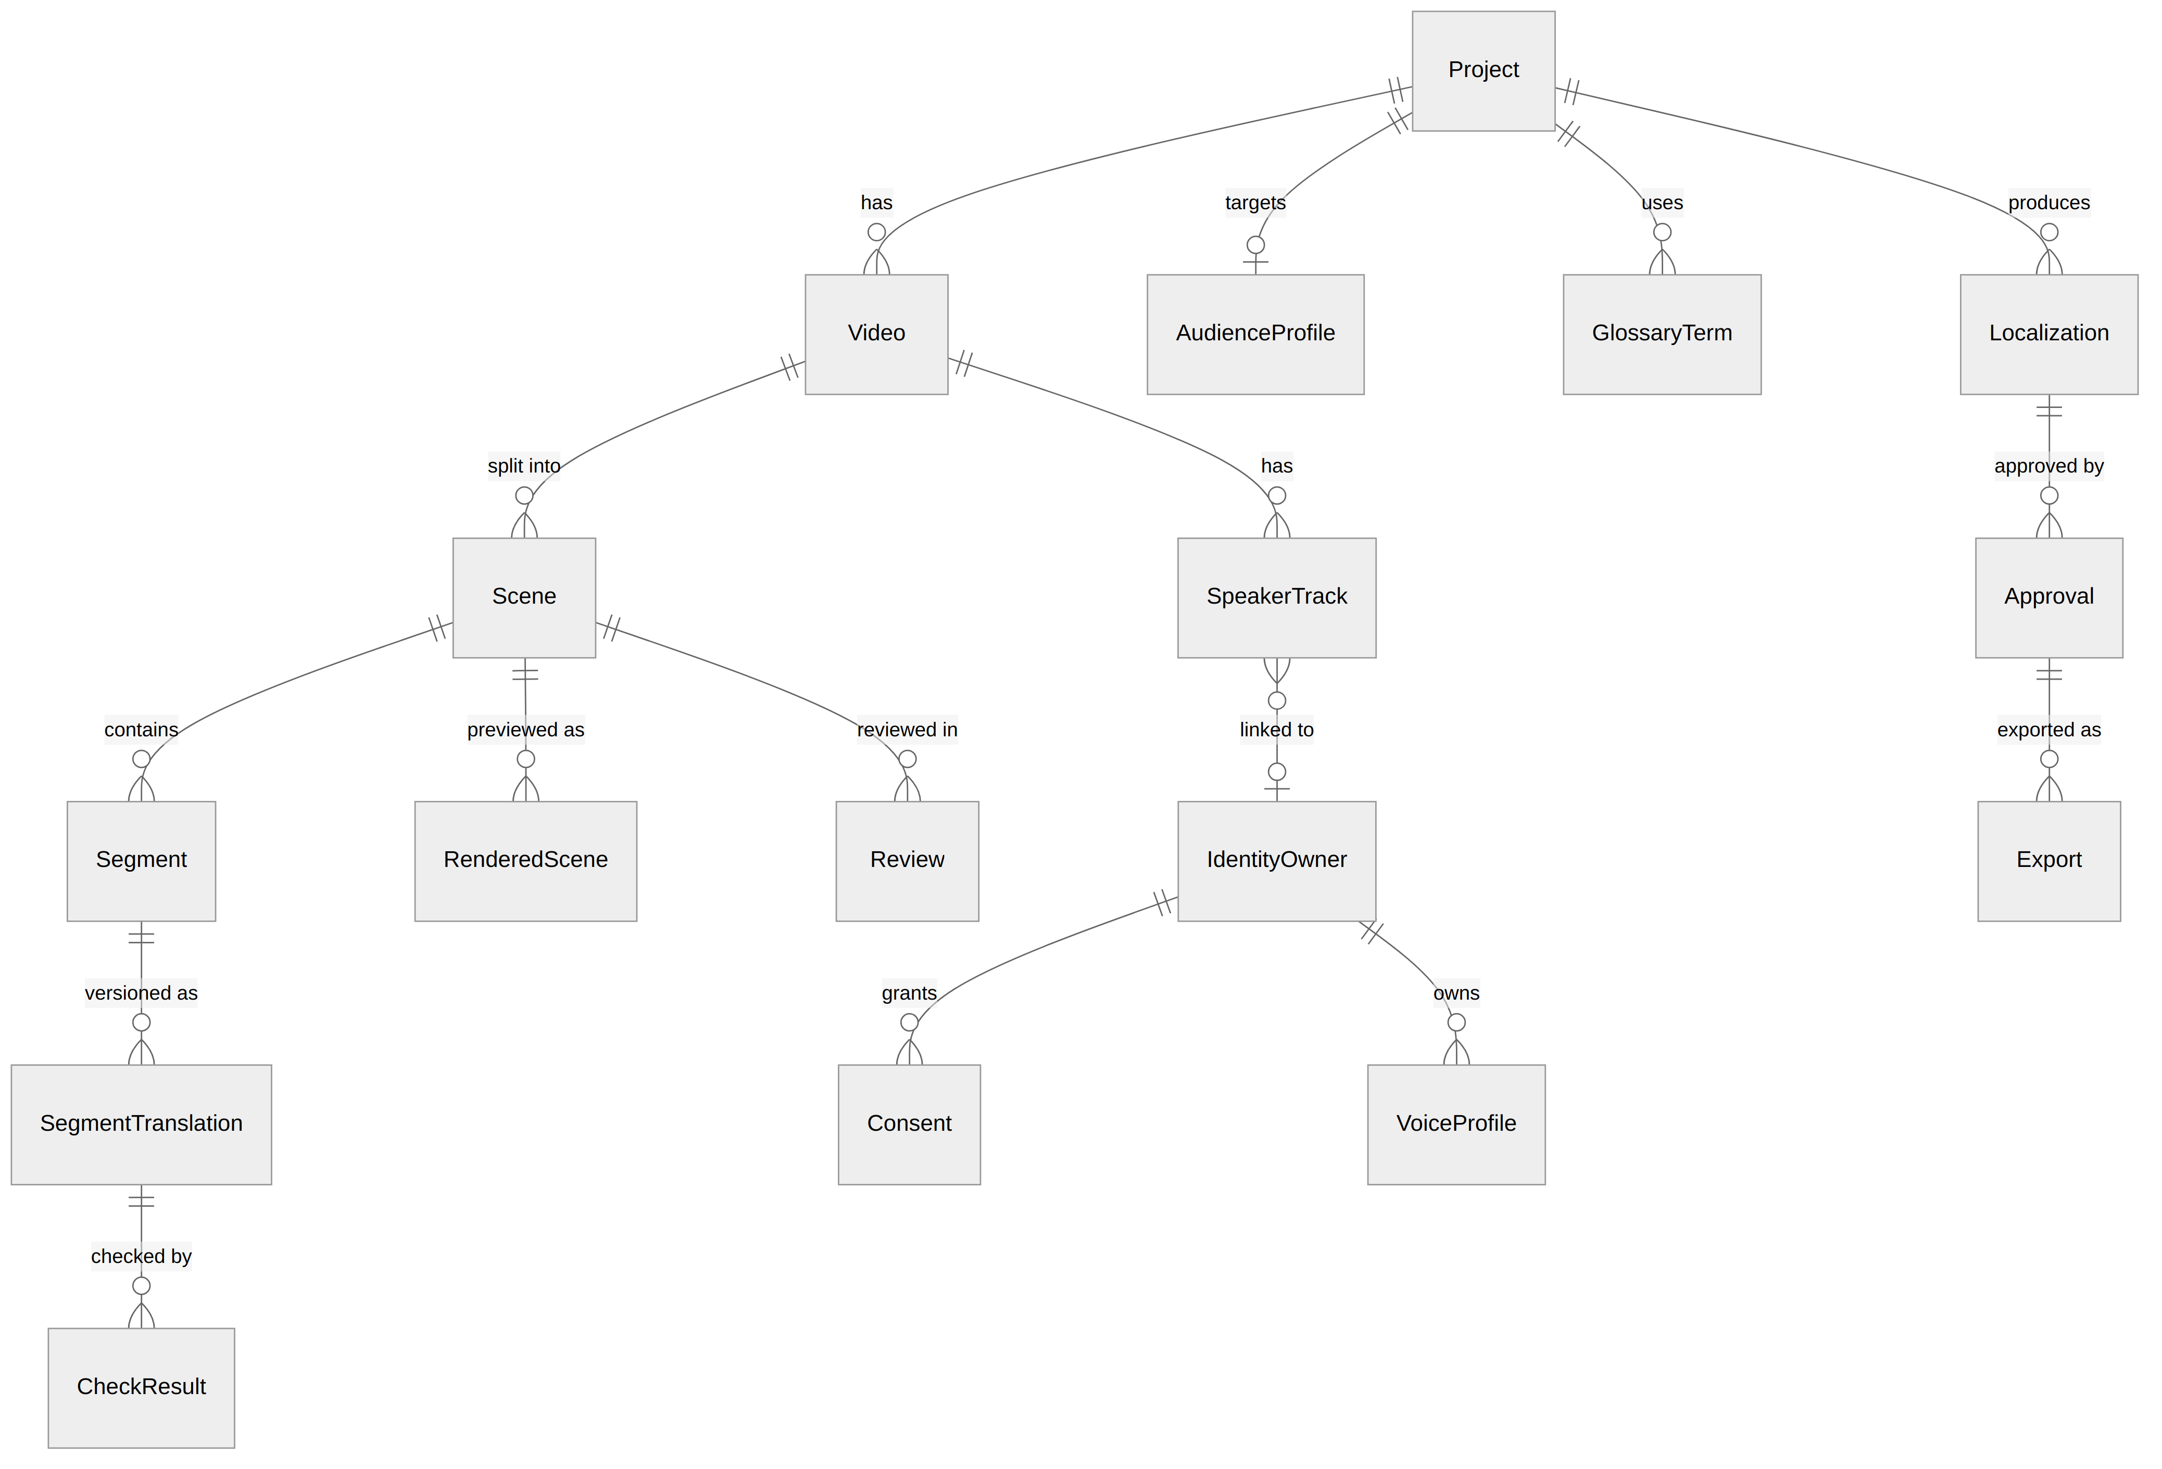
Data model: 28 classes in 9 apps
Key invariants
Translations, consent versions and audit records are append-only
An Approval stores a snapshot of exact version ids
Every AI artefact records adapter, model, prompt version and is_mock
The full class diagram is generated from the Django models
Notes:
This is the core of ADR 0014. The full generated class diagram is in the report appendix and in docs/uml. Versioning is what makes stale previews and invalid approvals detectable.

Slide 15
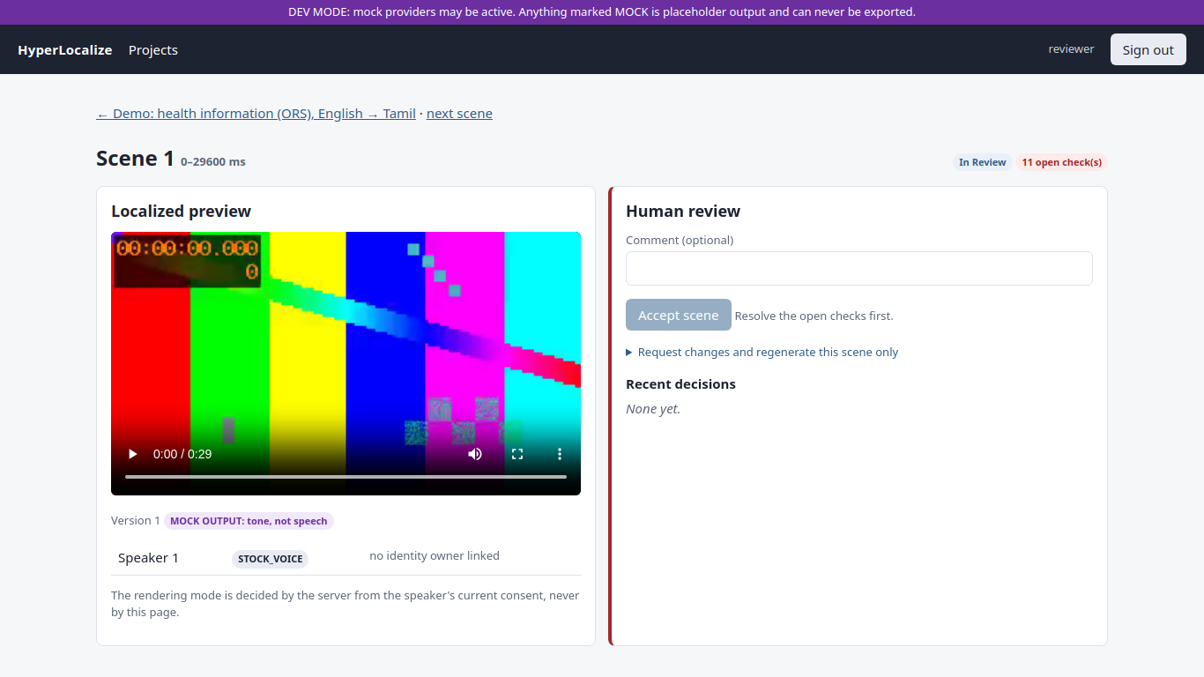
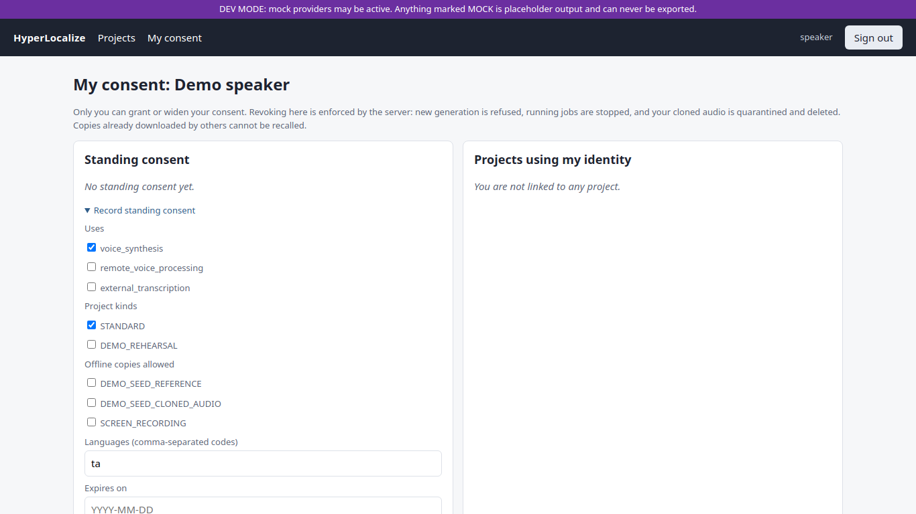
One page per role
Reviewer: preview, per-line checks, override with reason, regenerate this scene only
Speaker / Identity Owner: standing and project consent, reference clip, revoke, withdraw
Screenshots from a seeded test database (2026-10-12). The purple banner and MOCK badges are deliberate: placeholder output is always labelled.
Notes:
Server-rendered pages with htmx. Eight role pages were checked in headless Chromium. If time allows, switch to the live demo here: upload, analysis, review page, then revoke consent and show the fallback.

Slide 16
Testing: negative-first, all measured
210
15/15
11
1 + 6
tests passed
end-to-end HTTP steps
black-box tests passed
review findings fixed
2 optional real-model tests skipped · 125 s · 2026-10-22
live server + worker · 2026-10-06
equivalence partitions + boundary values
1 blocker, 6 majors in consent and audit code
What the tests prove
Not tested yet
Every tested denied consent state is refused; a real subprocess is killed mid-job
0 bypasses of the review and approval gates in the tested cases; MOCK never exportable
Audit edits rejected by the database; tampering detected by the verifier
Real models at evaluation scale
Docker images
Browser form submission
Performance and load
Notes:
Tests run on real PostgreSQL and real ffmpeg with mock AI providers. Consent tests were written negative-first. The black-box suite uses equivalence partitioning and boundary value analysis: for a one-second line the budget is 28 characters, so 28 passes and 29 fails.

Slide 17
First real clip: a trial that found real problems
14 / 14
lines translated by Gemini (after HTTP 429 and 503 fallbacks)
2 / 14
lines fitted their slot: 79.1 s of speech for 58.0 s
0.16
back-transcription CER (intelligibility PROXY, not a listening test)
MEASURED on n = 1 public clip (58 s, CC BY 3.0). Directional, not a quality evaluation.
Notes:
Upload, Whisper, Gemini, MMS-TTS, end to end on one public hand-washing video. Translation kept every number and the negation, by my reading, which is unverified until a Tamil rater checks it. Timing was poor: only two lines fit. Important honesty point: the review in that run was done by the AI assistant, so that export was withdrawn and is never cited as human-reviewed.

Slide 18



What the trial changed (ADR 0022)
Problem observed
Change made and tested
Free-tier quota ran out; chain silently fell back to MOCK
Batch whole clip: ~16 → 2 requests; never fall back to MOCK after a real failure; "translation pending" + Retry
Only 2 / 14 lines fitted their slot
Length budget in the prompt (11 chars/s); speed-up cap 1.2×; blocking overrun check
Export tracks tagged "und"
Audio and subtitles tagged with the target language (tam)
Tamil number words unverifiable
Draft parser for 0–100: a wrong number word now FAILS
Re-run (project 5) stopped honestly at "translation pending": daily quota used, 0 translations, 0 MOCK. The timing fix is NOT yet re-measured.
Notes:
Every problem the trial found was turned into a design change with tests: 210 pass. The re-run then hit the daily quota and did exactly what it should: no fake text, a clear pending state, and a retry button. The improvement in timing is not measured yet, so I don't claim it.

Slide 19
Honest status of the nine use cases
Use case | Status (2026-10-22)
UC1 Create and Generate a Localization Project | Implemented and tested
UC2 Upload and Analyze Source Video | Implemented; faster-whisper ran on real clips; no diarization
UC3 Context-Aware Localization Preview | Implemented; Gemini candidate partial; quality not measured
UC4 Generate Localized Preview | Stock voice real (MMS-TTS); cloned voice MOCK
UC5 Review and Regenerate a Scene | Implemented and tested
UC6 Approve and Export Localization Package | Implemented and tested
UC7 Revoke Consent and Stop Identity | Implemented and tested with MOCK voices
UC8 Administer Users, Providers and Policies | Implemented and tested
UC9 Inspect Quality, Audit and Evidence | Implemented and tested
Not measured yet: transcription WER, translation quality (MQM, chrF), speaker similarity, speed, and whether context helps.
Notes:
This table is copied from docs/STATUS.md, our honest source of truth. Implemented means written and tested. The governance features are solid; the AI quality claims are not yet measured, and I say so.

Slide 20

Limitations and future work
Limitations
Future work
Formal evaluation not run; one real clip so far
Cloned voice is MOCK; no faces or lip-sync
No speaker diarization or visual context
Number check compares counts, not positions
Free tier ≈ 20 requests/day; Docker not yet run
Run the spike: consented speakers, Tamil raters, MQM, WER, listening tests
Context ablation vs an IndicTrans2 baseline
Choose a cloned-voice provider from measured results
Re-measure timing after ADR 0022
Diarization, visual context, more language pairs
Lip-sync and face processing stay future scope: they would need their own consent design.
Notes:
Limitations first, then what removes them. The spike needs consent forms, two speakers and Tamil-literate raters, so it is planned rather than done. Lip-sync and faces stay out of scope until they have their own consent design.

Slide 21
Thank you
Questions?
HyperLocalize turns commodity AI models into an accountable workflow: drafts are checked, humans decide, consent is enforced, and every export carries its own evidence.
Notes:
Close with the one-sentence summary. Likely questions and honest answers are in docs/VIVA.md: is this just ASR to MT to TTS; how do you know context helps; what is identity here; can an admin enable someone's voice; is the audit log tamper-proof.

