Slide 1


Inside the ROSMASTER X3: Boards, Wiring and Basic Control
Nguyen Khoi Nguyen
Hardware Lecture
The robot platform you will use for your projects
EC545 Cyber-Physical Systems, Fall 2026
Department of Physics
Department of Computer Science
Boston University
Notes:
Three parts: the project area (slides 2 to 13), two ideas on top of LEAD (14 and 15), next steps (16). Backup slides hold details for questions.

Slide 2
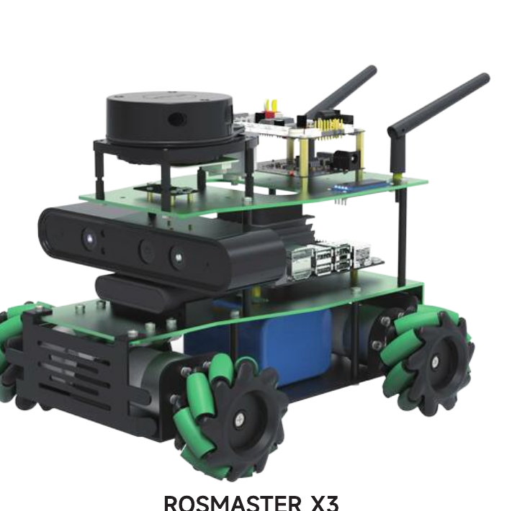
What is the ROSMASTER X3?
A small car with the parts of a real autonomous robot: a computer, a microcontroller, sensors and omnidirectional wheels.
A four-wheel mecanum car by Yahboom: drives forward, sideways and spins, with no steering.
Jetson Nano 4GB: runs Linux and ROS. Your code runs here.
ROS robot expansion board (STM32): drives the motors, reads the encoders and IMU, runs the buzzer and lights.
Sensors: lidar, Astra Pro depth camera, 9-axis IMU, four wheel encoders.
Many parts are optional. Check which lidar and camera your car has.
Goal: trace a command from your code to a turning wheel.
ROSMASTER X3 with lidar, depth camera and mecanum wheels.
Source: Yahboom, ROSMASTER X1/X3 manual, cover
Notes:
Motivation slide. Point at the photo: lidar on top, Jetson in the middle deck, battery and motors underneath, depth camera at the front.

Slide 3
Key terms
Term | Plain meaning
Main controller (host) | Jetson Nano. Linux computer for ROS, vision and planning. Not real-time.
MCU | STM32 microcontroller on the expansion board. Runs one firmware loop with exact timing.
Expansion board | Yahboom board carrying the MCU, motor drivers, IMU and power converters.
PWM | Pulse-width modulation: fast on/off switching; the duty cycle sets the average voltage.
H-bridge | Four switches around a motor; set current direction and strength.
Encoder | Shaft sensor that pulses as the wheel turns. Pulses give speed and distance.
IMU | Accelerometer, gyroscope, magnetometer. Measures tilt, rotation rate and heading.
Odometry | Position estimated by integrating wheel motion (plus IMU).
ROS node / topic | A node is a program. Nodes exchange messages on named topics.
cmd_vel | Standard ROS velocity command: vx, vy, wz.
UART / serial, I2C | Wired links. Serial (over USB) carries host–MCU packets; I2C drives small chips like the OLED.
The Yahboom tutorials use the same terms.

Slide 4
System overview: two processors
The Jetson decides where to go. The MCU makes the wheels follow within milliseconds.
Linux can pause your program for tens of milliseconds. Motor control and encoder counting cannot wait, so they run on the MCU.
Jetson Nano 4GB
Ubuntu + ROS
Your code: perception,
mapping, planning, teleop
Publishes /cmd_vel
Expansion board (STM32)
Parses serial packets
PID speed loop per wheel
Reads encoders + IMU
Buzzer, RGB, servos
Motor drivers → 4 motors
commands
4 encoders
USB serial
speed, IMU, battery
9-axis IMU
Lidar, depth camera, handle receiver (USB)
Rule of thumb: millisecond timing goes on the MCU; heavy computation goes on the Jetson.
Notes:
Ask the class: what goes wrong if the Jetson counted encoder pulses itself? (It would miss pulses whenever Linux schedules something else.)

Slide 5
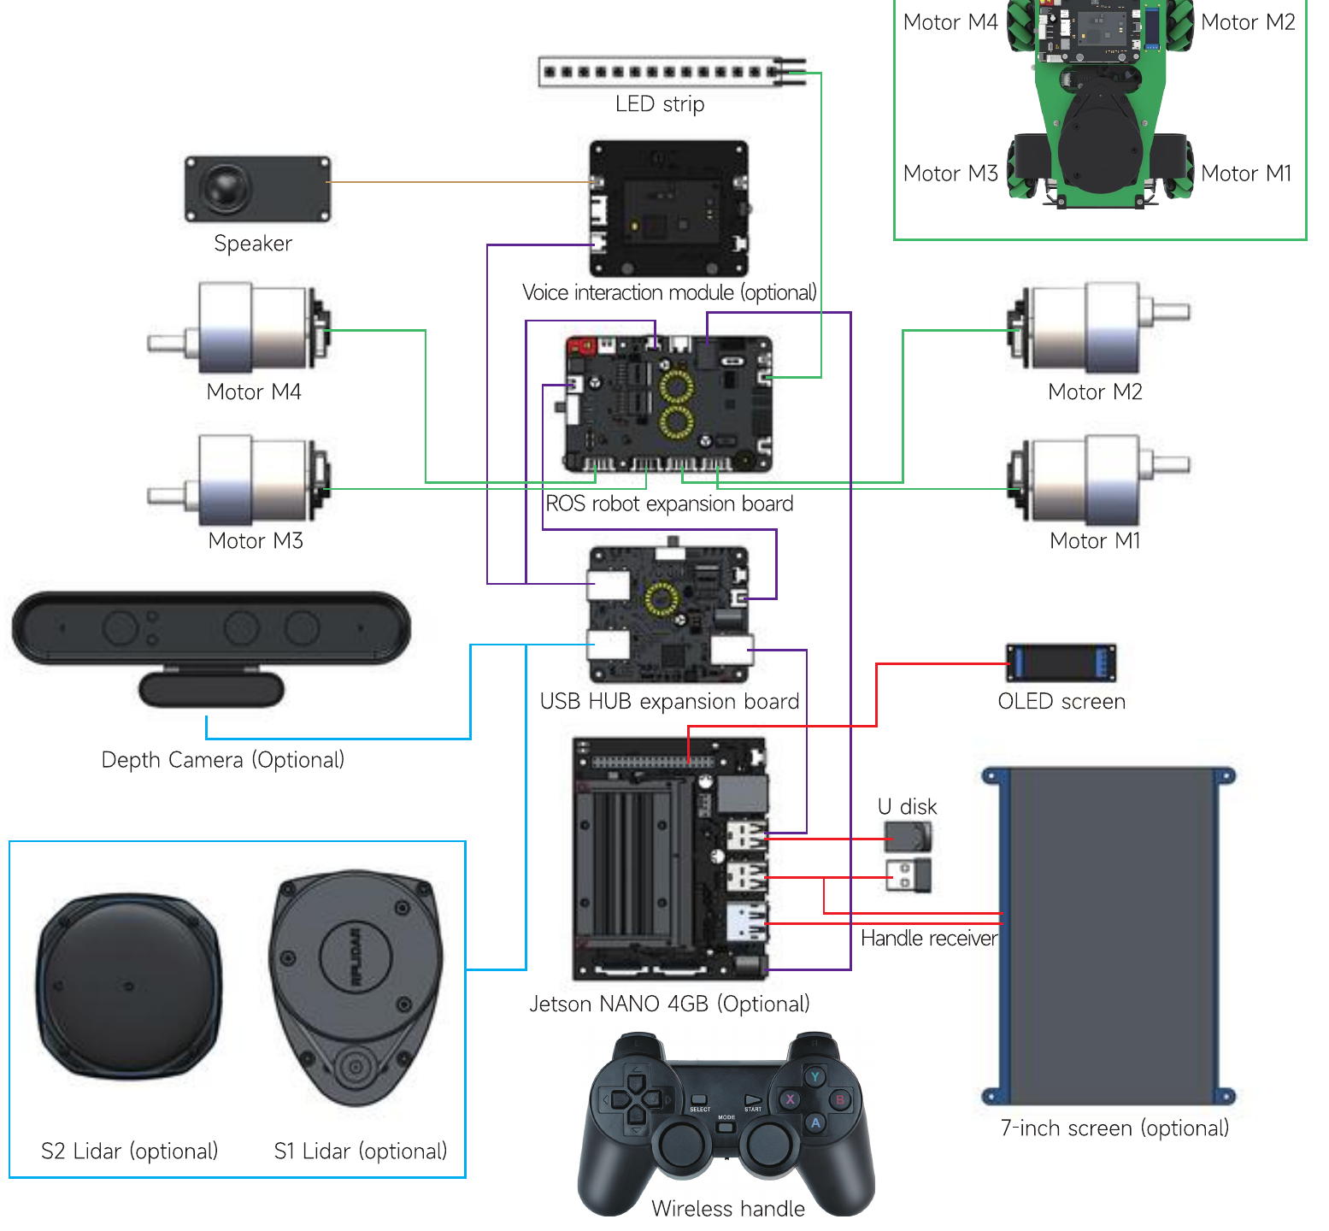
Wiring diagram (Jetson Nano 4GB version)
Three groups: expansion-board devices, USB-hub devices, and devices on the Jetson.
Green: four motors and the RGB strip → expansion board. Inset: M1 rear right, M2 front right, M3 rear left, M4 front left.
Purple: USB data. Expansion board and voice module → USB hub → Jetson.
Blue: depth camera and lidar → USB hub.
Red: OLED (I2C, 40-pin header), U disk, handle receiver, 7-inch screen → Jetson.
Swapped motor plugs make the car drive the wrong way. Check M1–M4 first.
Source: Yahboom, ROSMASTER X1/X3 manual, "Wiring diagram for Jetson NANO 4GB version"

Slide 6
Power distribution
One battery, one switch. The expansion board powers the whole robot.
Expansion board
T-plug 12 V in → power switch
Buck converters (the two yellow coils)
Motors (12 V, via drivers)
Servos (5 V or 6.8 V jumper)
Li-ion battery
12.6 V, 6000 mAh (about 1.5 h)
Jetson Nano (DC 5 V out)
Lidar, camera (5 V via hub)
USB HUB board (12 V out)
MCU, IMU (3.3 V)
The expansion board’s DC 5 V output powers the Jetson through its barrel jack.
The USB hub takes its own 12 V, so the lidar and camera do not load the Jetson’s USB ports.
Below 9.6 V the buzzer beeps and the MCU light flashes: switch off and charge. Never drive while charging.
Storage: 11.1–11.7 V, battery out of the car, away from metal and heat.
Source: Yahboom, ROSMASTER X1/X3 manual, FAQ 4 and "Lithium-ion battery safety specification"

Slide 7
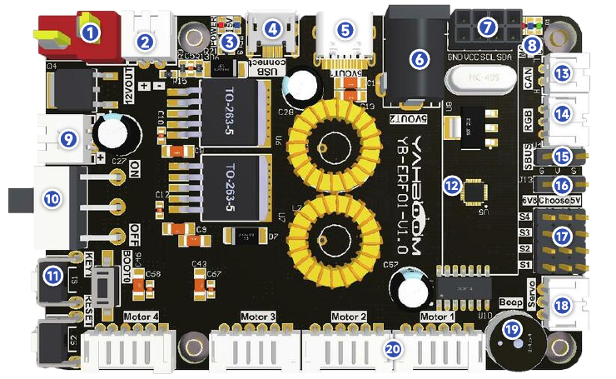
Expansion board: front side
# | Interface | What it is for
1, 10 | T-type DC 12 V in, switch | Battery input and the main power switch
2, 9 | DC 12 V out | 12 V for external devices (e.g. USB hub)
6, 5 | DC 5 V out, Type-C 5 V | 5 V to the Jetson; Type-C is power only
4 | Micro USB | Data link to the Jetson (serial over USB)
7 | I2C header | External I2C devices, e.g. an OLED
11 | KEY1, RESET, BOOT0 | User button, MCU reset, firmware flashing
12 | 9-axis attitude sensor | IMU: accel + gyro + magnetometer
13, 15 | CAN, SBUS | CAN bus devices; RC aircraft receiver
14 | RGB light bar | The LED strip at the rear
16, 17 | PWM servo + voltage jumper | 4 servos at 5 V or 6.8 V
18 | Serial servo | Bus servos of a robotic arm
19, 20 | Buzzer, 4 motor ports | Alarm; motors with encoders
Numbers match the table.
Source: Yahboom, ROSMASTER X1/X3 manual, "Expansion board functional layout"
Only port 4 carries data to the Jetson. The rest is power or MCU peripherals.

Slide 8
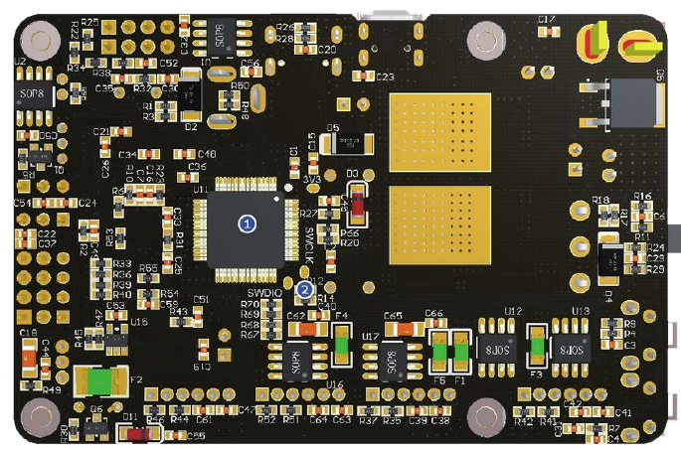
Expansion board: the MCU (back side)
The MCU is a dedicated co-processor running one loop forever, so its timing is predictable.
Chip: STM32F103RCT6 (ARM Cortex-M3, 72 MHz), linked to the Jetson by a USB-to-serial converter.
Controls: motors and encoders, PWM and serial servos, buzzer, RGB strip, IMU, KEY1, SBUS, CAN.
Firmware is preflashed. To reflash: hold BOOT0, press RESET, download over USB; or use ST-Link / J-Link on the SWD pads.
Do not reflash unless a tutorial says so. Wrong firmware breaks every ROS node.
You normally do not program the MCU. You command it from the Jetson.
(1) the on-board MCU; (2) the SWD debugging pads (SWDIO, SWCLK).
Source: Yahboom, ROSMASTER X1/X3 manual, expansion board, back side
Source: Yahboom, ROSMASTER X1/X3 manual, FAQ 5 and 6

Slide 9
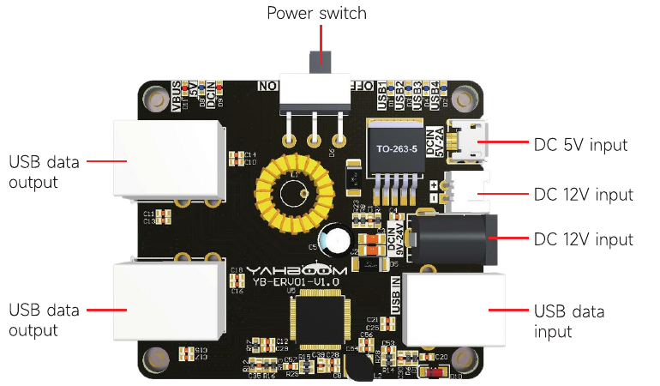
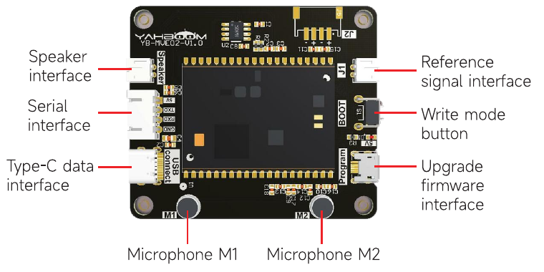
USB hub board and voice module
Optional voice module: two microphones, speaker port, serial link via the hub.
Source: Yahboom, ROSMASTER X1/X3 manual, same page
USB hub: one input from the Jetson, several outputs, its own 12 V input and switch.
Source: Yahboom, ROSMASTER X1/X3 manual, "Expansion board interface description"
The Jetson has four USB ports; the car needs more (expansion board, lidar, camera, voice module, handle receiver, U disk).
The hub is self-powered from 12 V, so the lidar motor does not brown out the Jetson.
A USB device keeps dropping? Check the hub power cable and switch first.

Slide 10
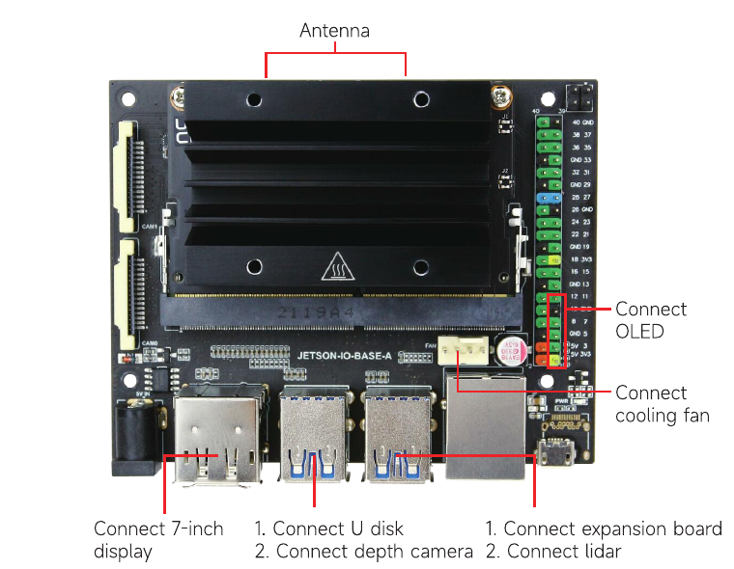
Main controller: Jetson Nano 4GB
Spec | Jetson Nano 4GB developer kit
CPU | Quad-core ARM Cortex-A57, 1.43 GHz
GPU | 128-core NVIDIA Maxwell (CUDA)
Memory | 4 GB LPDDR4, shared by CPU and GPU
Power | 5 V barrel jack, 5 W or 10 W mode
I/O | 4× USB 3.0, Ethernet, HDMI, 40-pin header, 2× CSI
OS on the car | Ubuntu 18.04, ROS 1 Melodic + ROS 2 Foxy (Docker)
Login: jetson / yahboom. Boots from the supplied U disk.
The GPU runs small neural networks (detection, segmentation) on camera frames in real time.
CPU and GPU share 4 GB. RViz + SLAM + a neural network will run out of memory.
Port assignments on the car.
Source: Yahboom, ROSMASTER X1/X3 manual, "JETSON NANO 4GB board interface description"
Source: NVIDIA, Jetson Nano Developer Kit specifications

Slide 11
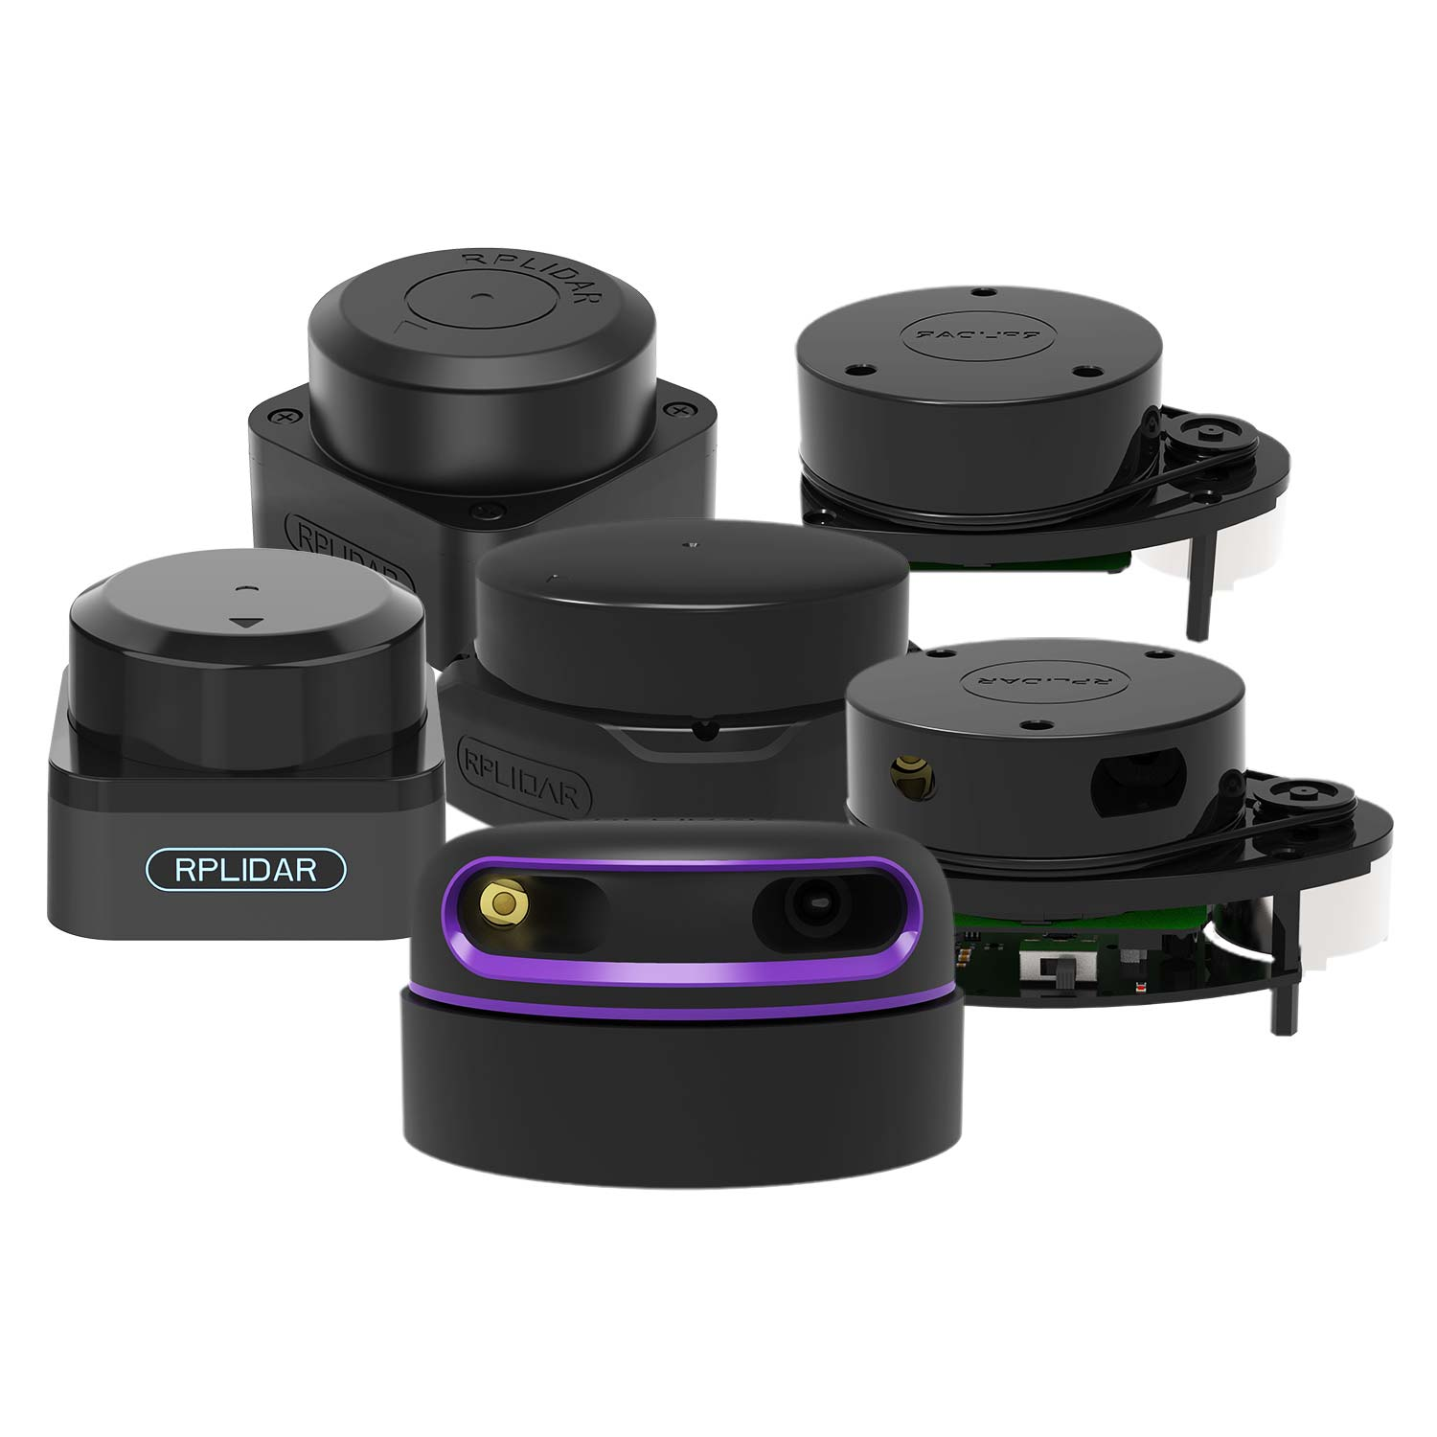
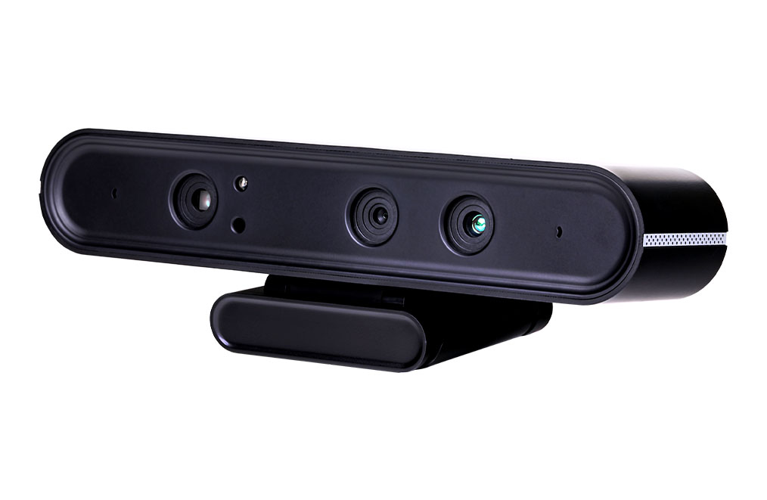
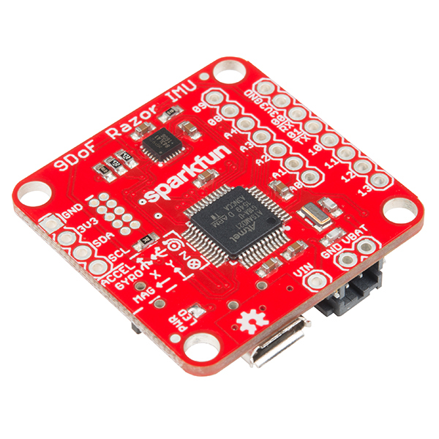
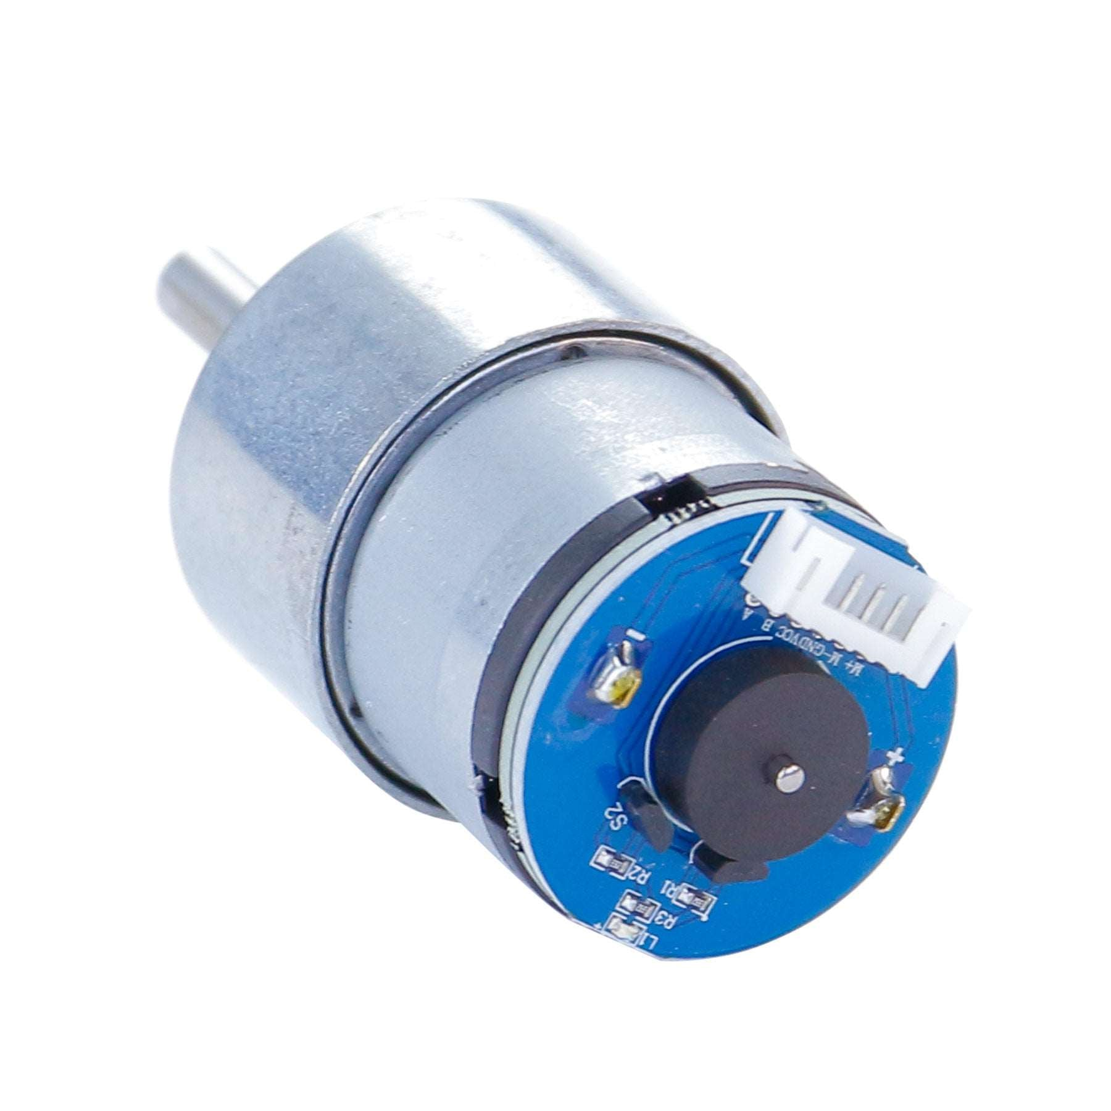
Sensors
Lidar (RPLIDAR S1/S2 or A1)
360° spinning laser rangefinder. Topic /scan. Used for SLAM and obstacle avoidance.
Depth camera (Orbbec Astra Pro)
RGB camera plus infrared depth sensor: colour image and per-pixel distance.
9-axis IMU (on the expansion board)
Accelerometer, gyroscope and magnetometer, read by the MCU. Gives rotation rate and tilt; corrects odometry when wheels slip.
Wheel encoders (one per motor)
Hall-effect encoder on each motor, counted by the MCU. Gives wheel speed and odometry.
Images: RPLIDAR range and 520 encoder motor, Yahboom store; Astra camera, Orbbec; 9DoF Razor IMU (MPU-9250), SparkFun, CC BY 2.0. The X3 board uses an MPU9250 (V1.0) or ICM20948 (V3.0).

Slide 12
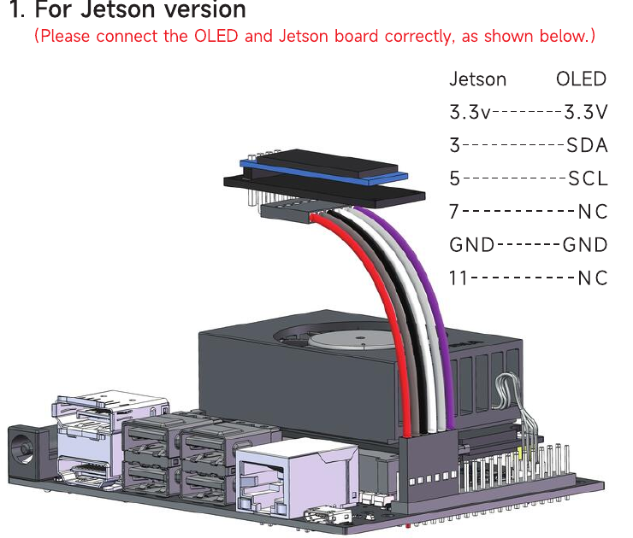
Peripherals: OLED, LED strip, buzzer, gamepad, screen
OLED (I2C): shows the car’s IP address and status after boot. Use it to find the car on the network.
RGB LED strip: on the expansion board; set from the app or code. Useful as a state indicator.
Buzzer: three beeps = system up; fast beeping = low battery.
Wireless handle: PS2-style gamepad. USB receiver on the Jetson; appears in ROS as /joy.
7-inch screen (optional): HDMI display for the Jetson desktop.
The OLED connector spans six pins but only four are wired. Check the header before powering on.
OLED on the Jetson 40-pin header: 3.3 V, pin 3 = SDA, pin 5 = SCL, GND.
Source: Yahboom, ROSMASTER X1/X3 manual, "OLED module wiring diagram"

Slide 13
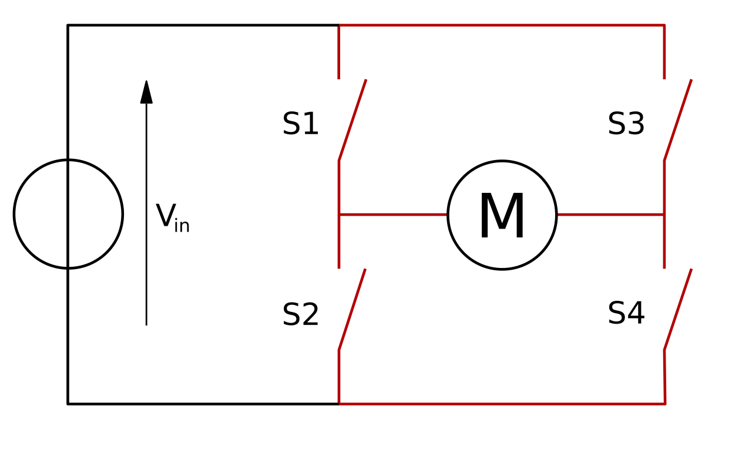
DC motors, H-bridges and PWM
Motor speed follows the average voltage; direction follows its sign.
An H-bridge has four switches: S1+S4 drive current one way, S2+S3 the other.
PWM: instead of an analog voltage, the MCU switches 12 V on and off thousands of times per second.
Duty cycle D = fraction of time on. Motor inertia averages the pulses: V_avg = D × 12 V.
X3 motors: 520 metal gear motor, 1:30 ratio (about 330 rpm), with a Hall encoder, on a 65 mm mecanum wheel.
The same PWM gives different speeds with battery level, load and floor. Hence feedback control.
H-bridge: four switches around motor M.
Source: Cyril Buttay, Wikimedia Commons, CC BY-SA 3.0
PWM at 25% and 75% duty
3 V
9 V

Slide 14
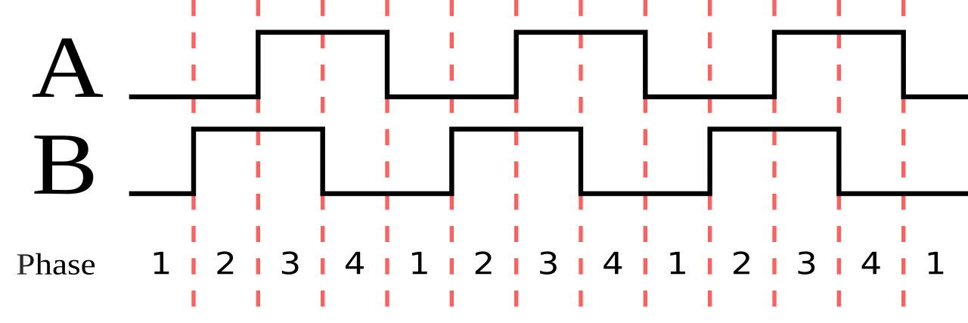
Encoders: measuring wheel rotation
A shaft magnet passes two Hall sensors; each pass is a pulse. Pulses per second give speed.
Channels A and B are 90° apart; which one leads gives the direction.
Counting every edge on both channels gives 4× resolution ("4× decoding").
Counts per wheel turn: 4 × 11 × 30 = 1320 (assumes an 11-line encoder; verify on your motor).
Speed: ω = 2π · Δcounts / (CPR · Δt), v = ω · r.
Example: 132 counts in 50 ms = 2 rev/s. With a 65 mm wheel, v ≈ 0.41 m/s.
Quadrature: A leads B in one direction, lags in the other.
Source: Sagsaw, Wikimedia Commons, public domain
Summary: encoders measure the robot’s own motion. They feed the MCU speed loop and the Jetson’s odometry.
Encoders measure the wheel, not the ground. Slip corrupts them; the IMU helps.

Slide 15
Closed-loop speed control
Measure, compare, correct: the MCU adjusts PWM until the measured wheel speed matches the target.
Target speed
from cmd_vel
error
PID
on the MCU
H-bridge
PWM duty
Motor
+ wheel
speed
Σ
−
Encoder
measured speed
P reacts to the current error, I removes steady error, D damps overshoot: u = Kp·e + Ki·∫e dt + Kd·de/dt.
Two loops: a fast inner PID per wheel on the MCU, and your slower outer loop on the Jetson, which publishes /cmd_vel.
Send velocity targets, not raw PWM, unless you are testing motor control.

Slide 16
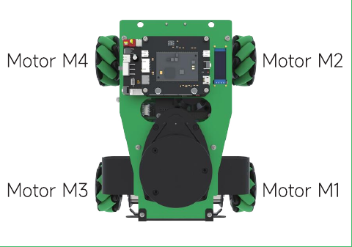
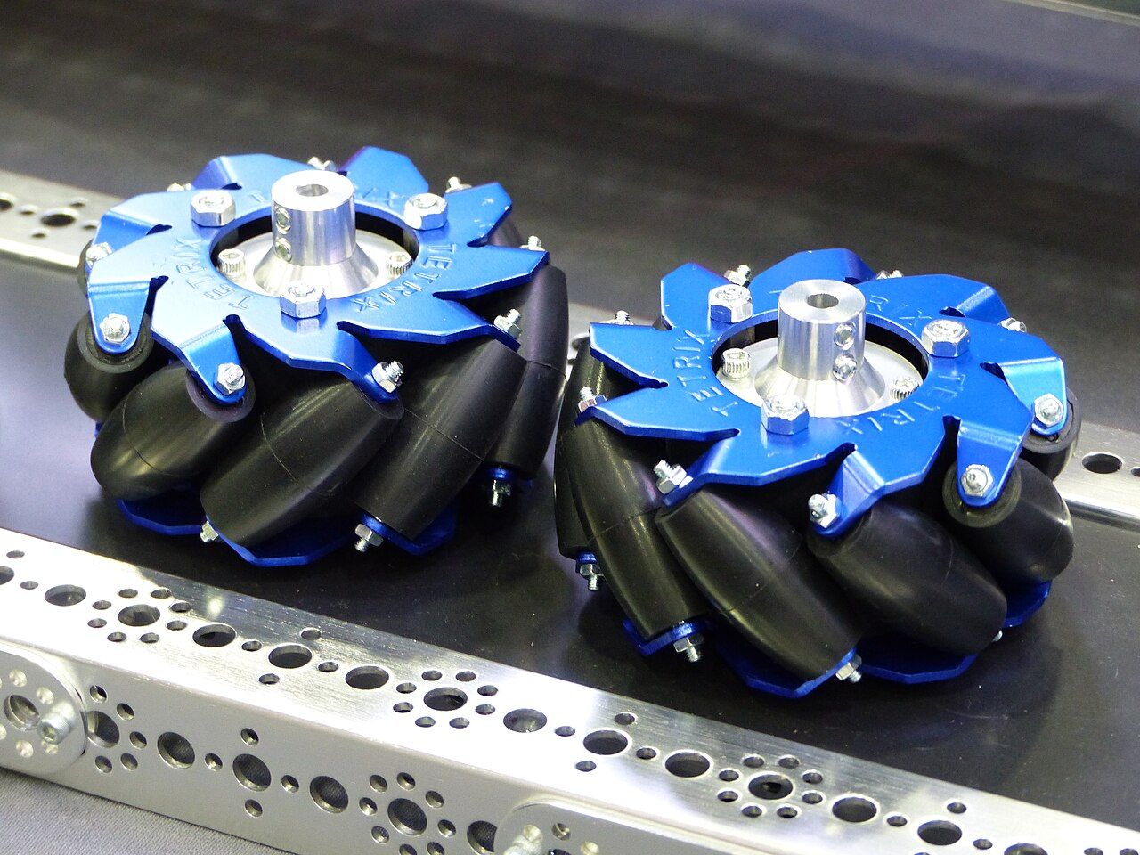
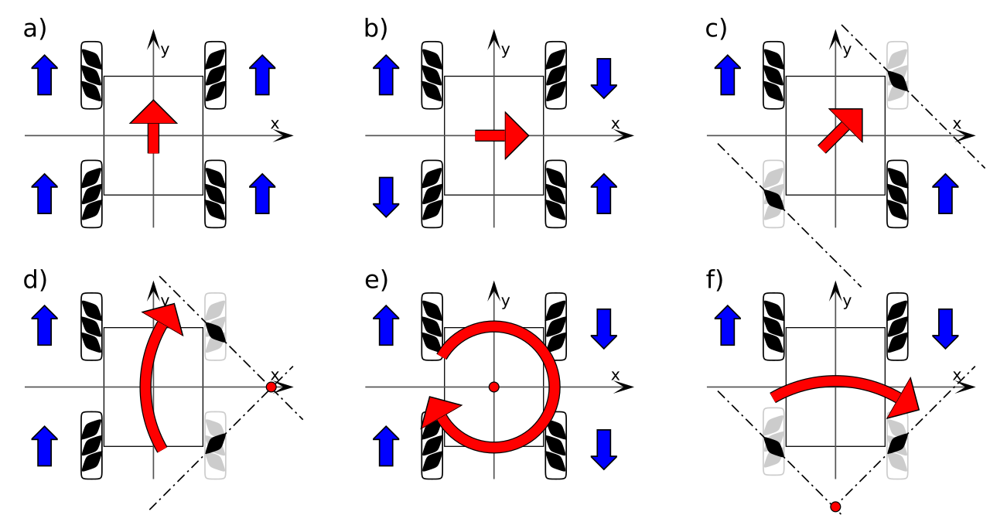
Mecanum wheels
X3 motor numbering (top view, front up).
Source: Yahboom, ROSMASTER X1/X3 manual, wiring diagram inset
Mecanum wheel: free rollers at 45°.
Source: Stilfehler, Wikimedia Commons, CC BY-SA 4.0
Wheel directions for each motion.
Source: Mrmw, Wikimedia Commons, CC0
Each wheel pushes along one diagonal; its rollers spin freely in the other direction.
The four pushes add: all forward → forward; left and right sides opposite → spin; diagonal pairs opposite → sideways.

Slide 17
Mecanum kinematics: (vx, vy, ωz) to wheel speeds
Each wheel speed = forward term + sideways term + rotation term.
Motion | M4 FL | M2 FR | M3 RL | M1 RR
Forward (vx > 0) | + | + | + | +
Slide left (vy > 0) | − | + | + | −
Spin left (ωz > 0) | − | + | − | +
Diagonal front-left | 0 | + | + | 0
L = half wheelbase, W = half track, r = wheel radius; x forward, y left:
v_FL = vx − vy − (L+W)·ωz (M4)
v_FR = vx + vy + (L+W)·ωz (M2)
v_RL = vx + vy − (L+W)·ωz (M3)
v_RR = vx − vy + (L+W)·ωz (M1)
X3: L + W ≈ 0.18 m, r = 0.0325 m. Wheel rate = v / r. set_car_motion(vx, vy, vz) does this on the MCU.
Sign of wheel speed; + = rolls forward.
Derived from the equations (X roller pattern, top view).
Inverse (odometry): vx = r(ωFL+ωFR+ωRL+ωRR)/4, integrated by the driver.
Four wheels, three unknowns: when they disagree, a wheel is slipping. Mecanum odometry drifts faster than differential drive.
Test vx, vy and ωz one at a time with the wheels lifted; compare to the table.

Slide 18
Host–MCU link: serial and Rosmaster_Lib
The Jetson and the MCU exchange small binary packets over USB serial.
Port: /dev/myserial, 115200 baud.
Jetson → MCU: 0xFF 0xFC, length, function, data, checksum. MCU → Jetson: 0xFF 0xFB.
Python wrapper: Rosmaster_Lib, class Rosmaster.
A background thread reads MCU reports; getters return the latest values.
One program per serial port. Stop the ROS driver before running a Rosmaster_Lib script.
from Rosmaster_Lib import Rosmaster
import time
bot = Rosmaster(car_type=1, # 1 = X3
com="/dev/myserial")
bot.create_receive_threading() # start reader
bot.set_beep(100) # beep 100 ms
bot.set_colorful_lamps(0xFF, 0, 255, 0) # all green
bot.set_car_motion(0.2, 0, 0) # vx=0.2 m/s
time.sleep(1.0)
bot.set_car_motion(0, 0, 0) # stop
print(bot.get_motor_encoder()) # 4 counts
print(bot.get_imu_attitude_data()) # roll,pitch,yaw
print(bot.get_battery_voltage()) # volts
Source: Yahboom ROSMASTER X3 tutorials (github.com/YahboomTechnology/ROSMASTERX3); Rosmaster_Lib V3.3.9

Slide 19
ROS on the X3: nodes and topics
Only the driver node talks to the hardware. Everything else uses topics.
joystick / keyboard teleop
lidar node → /scan
Driver node
Mcnamu_driver_X3
/cmd_vel
MCU via serial
camera node → images
your planner / navigation
SLAM, EKF, nav use these topics
Jetson Nano image: ROS 1 Melodic native, ROS 2 Foxy in Docker. Driver: ros2 run yahboomcar_bringup Mcnamu_driver_X3
Useful: ros2 topic list, ros2 topic echo /vel_raw, rqt_graph.
/vel_raw
measured robot velocity
/imu/data_raw
accel + gyro
/imu/mag
magnetometer
/voltage
battery voltage
Source: Yahboom ROSMASTER X3 ROS 2 tutorial, "Bot information release" (github.com/YahboomTechnology/ROSMASTERX3)

Slide 20
The X3 as a cyber-physical system
A CPS is software in a feedback loop with a physical process: outputs change the physics, and the physics changes the next inputs.
The physics does not wait. Timing is part of correctness: a late answer is a wrong answer.
Three questions for every CPS:
1. What is the model of the physics? (slides 21–23)
2. When does each computation run, and for how long? (slides 24–25)
3. What happens when a sensor is wrong or a message is late? (slides 26–27)
Most robot bugs live between the boxes: late samples, lost messages, drifting sensors.
Computation
MCU loop + Jetson / ROS
commands
measurements
Network: Wi-Fi, ROS
Sensors
encoders, IMU, lidar, camera
Actuators
H-bridges, PWM, motors
motion
forces
Physical process
car body, wheels, floor, battery
Definition after E. A. Lee and S. A. Seshia, "Introduction to Embedded Systems: A Cyber-Physical Systems Approach", 2nd ed., MIT Press, 2017
Try it on the car: lift the car, turn a wheel by hand and watch /vel_raw.

Slide 21
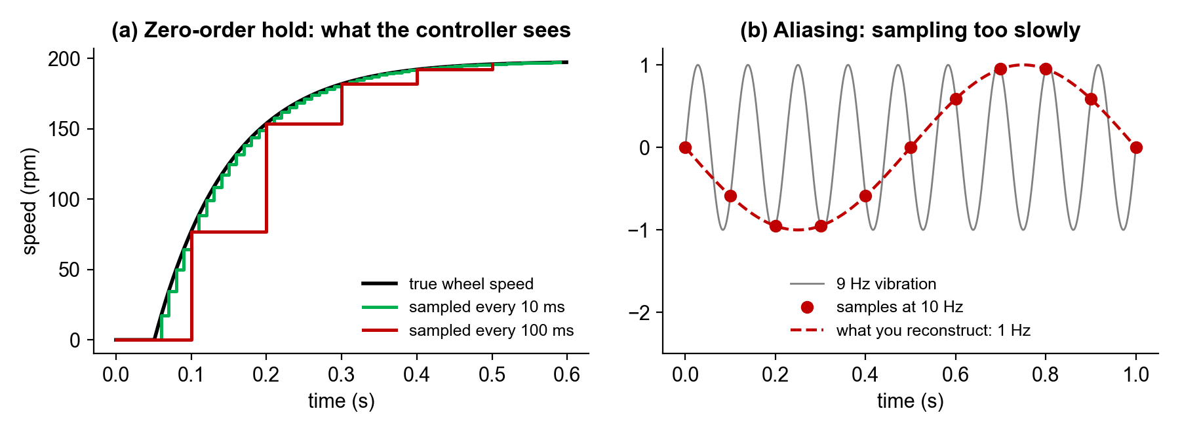
Continuous physics, discrete computation
The computer samples the wheel every Δt and holds its output until the next sample (zero-order hold).
Rule of thumb: sample 10–20× faster than the dynamics you control. Motor τ ≈ 100 ms → 5–10 ms loop.
(a) Wheel speed sampled at 10 ms vs 100 ms. (b) A 9 Hz vibration sampled at 10 Hz appears as 1 Hz.
Source: simulation made for this lecture (illustrative values, not measured on an X3)
Aliasing cannot be undone after sampling. Filter, then sample.
Try it on the car: compute speed from get_motor_encoder() at 10 ms and at 100 ms while driving; compare.

Slide 22
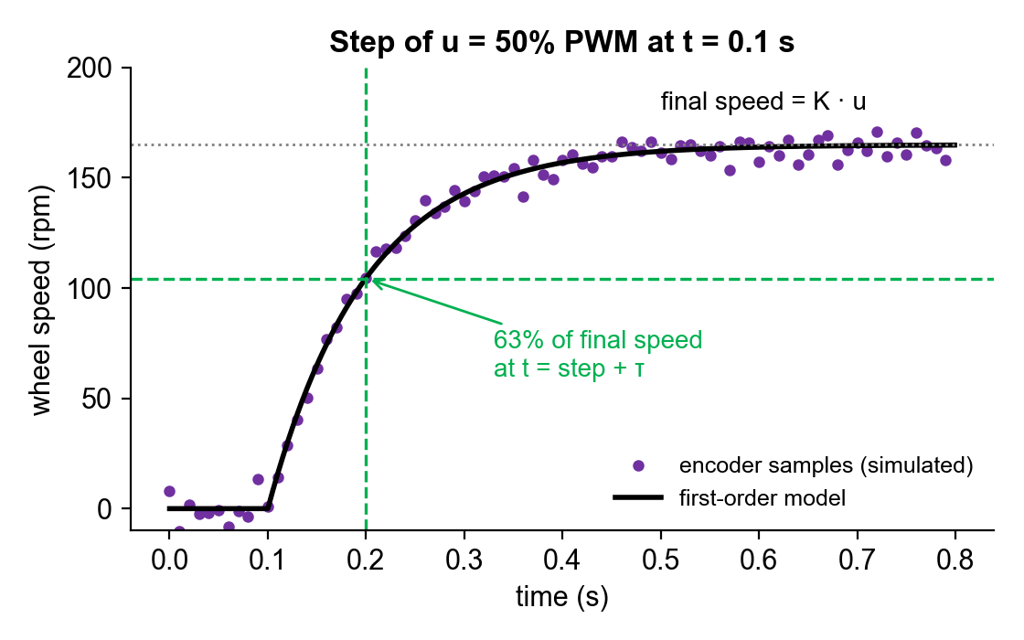
Modelling the motor
The wheel approaches a new speed exponentially; it does not jump.
Model: τ · dω/dt + ω = K · u, with u the PWM duty (%) and ω the wheel speed (rpm).
K: final speed per % PWM. τ: time to reach 63% of the final speed.
Step response: ω(t) = K·u·(1 − e^(−t/τ)). K from the final value, τ from the 63% point.
Discrete form: w[k+1] = w[k] + (dt/tau)*(K*u[k] - w[k])
Here K = 3.3 rpm/% (≈ 330 rpm at full PWM), τ = 0.1 s (assumed).
Ignores friction (small PWM may not move the wheel). K drops as the battery drains.
Simulated 10 ms encoder samples after a 50% PWM step, with the fitted model.
Source: simulation made for this lecture (illustrative values, not measured on an X3)
Try it on the car: wheels lifted, set_motor(50, 0, 0, 0), log encoders every 10 ms, fit K and τ per wheel.

Slide 23
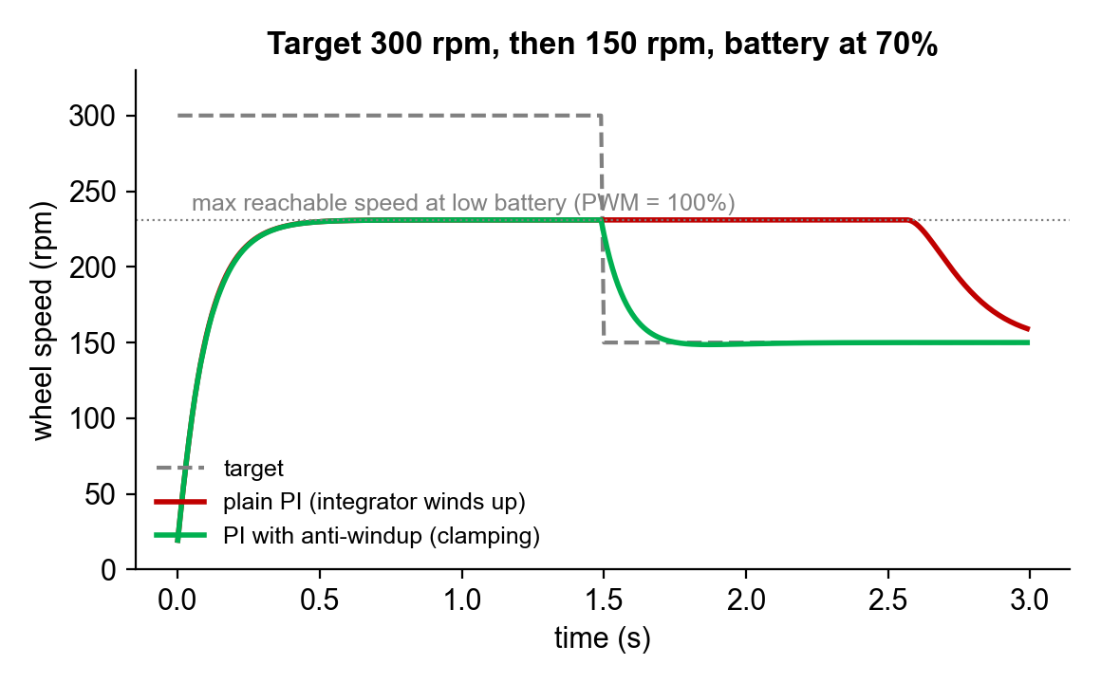
PID: saturation and integrator windup
The controller output is a PWM duty, capped at 100%.
Discrete PI: u[k] = Kp*e[k] + Ki*sum(e)*dt, clipped to ±100%.
Low battery: 300 rpm is unreachable even at 100%. The error persists and the integral grows ("winds up").
When the target drops to 150 rpm, the wound-up integral holds PWM at 100% for about 1 s (red).
Anti-windup: stop integrating while saturated. The wheel tracks the new target at once (green).
Tuning order: P, then I for steady error, then D if it overshoots.
On a mecanum car, one saturated wheel bends the path into a curve.
PI loop at 10 ms on the motor model, K at 70% (low battery).
Source: simulation made for this lecture (illustrative values, not measured on an X3)
Try it on the car: wheels lifted, send a large speed step, watch /vel_raw. Record the PID values before changing set_pid_param.

Slide 24
Timing: when computation runs matters
Every task has a period, a deadline and a worst-case execution time (WCET). Jitter is the variation in start time.
MCU: one periodic loop (e.g. every 10 ms)
Stage (camera to wheel) | Typical time
Camera frame at 30 fps | ≤ 33 ms
USB transfer + decode | 5–10 ms
Neural network on the Nano | 30–100 ms
ROS publish → driver node | 1–5 ms
Serial packet, 10 bytes at 115200 baud | ≈ 1 ms
Wait for the next MCU loop | ≤ one period
Motor reaches 63% of new speed (τ) | ≈ 100 ms
Total | ≈ 0.2–0.25 s
PID
PID
PID
PID
PID
Jetson: your ROS callback under Linux
cb
cb
cb
Linux ran something else
cb
cb
time
The MCU loop starts on time; the Linux callback starts late by a random, sometimes large, amount.
Deadline misses do not show in code review. Measure them.
Order of magnitude; only the serial time is computed. At 0.5 m/s the car travels about 10 cm before reacting.
Measure your own pipeline.
Try it on the car: log time.time() in your callback and plot the intervals, with and without RViz running.

Slide 25
Communication: publish/subscribe and stale data
ROS nodes never wait for each other. Neither the delivery time nor the delivery itself is guaranteed.
Topics run at different rates (/scan ≈ 10 Hz, camera 30 Hz). Combining them needs a freshness rule.
Fuse using the header timestamp, not the arrival time.
ROS 2 QoS settings (reliable / best-effort, queue depth) must be compatible, or no messages arrive.
If teleop stops (laptop sleeps, Wi-Fi drops), the last /cmd_vel may persist. Check your driver; if needed, add a timeout that sends zero velocity.
/cmd_vel arriving at the driver node (10 Hz)
Wi-Fi drop: no messages
time
Wheel speed the driver commands
no timeout: keeps driving
0.5 s timeout: stops
Schematic, not measured.
Try it on the car: ros2 topic hz /scan and /cmd_vel; then, wheels lifted, turn off your laptop’s Wi-Fi while driving.

Slide 26
Modes: the robot as a hybrid system
Continuous dynamics within each mode, discrete jumps between modes. Each mode has its own controller and an invariant that must hold.
Teleop
|v| ≤ 0.5 m/s
button A, map loaded
Autonomous
|v| ≤ 0.3 m/s, d_min > 0.25 m
START button
Idle
v = 0
any joystick input
V < 9.6 V (from any mode)
d_min < 0.25 m
d_min < 0.25 m
cleared + button
Protective stop
v = 0, buzzer on
Low battery
v = 0, beeping
Guards are checked at discrete times: checking d_min every 100 ms at 0.5 m/s allows a 5 cm overrun. Size margins from timing.
Try it on the car: draw your project’s mode diagram before coding; each mode becomes a state in your node.

Slide 27
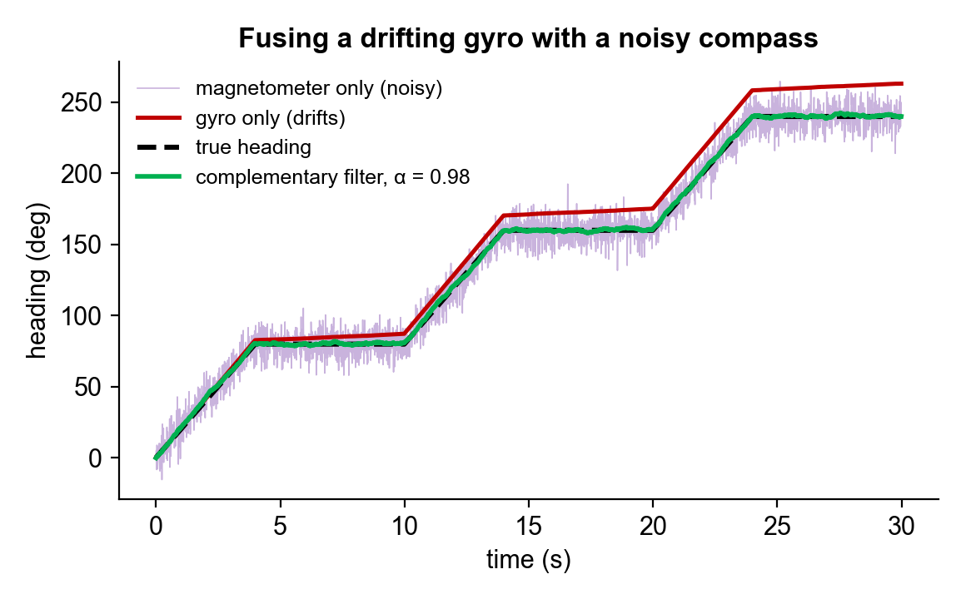
Sensing under uncertainty: gyro + compass fusion
Every sensor errs differently, so combine sensors with different errors.
Noise: random. Bias: constant offset. Drift: bias integrated over time.
Gyro: fast and smooth, but drifts (0.8°/s → 24° in 30 s).
Magnetometer: absolute but noisy; disturbed by motors and steel.
Wheel odometry: accurate until the rollers slip.
Complementary filter: th = a*(th + gyro*dt) + (1-a)*mag. Gyro for fast changes, compass for the long term.
A Kalman filter sets the weighting from the noise statistics at each step (e.g. the robot_localization EKF).
Gyro bias 0.8°/s and compass noise 8°, three 80° turns.
Source: simulation made for this lecture (illustrative values, not measured on an X3)
Try it on the car: leave the car still for 60 s, record /imu/data_raw and average the gyro z-rate. That is the bias.

