Slide 1
Rent_a_wreck
NAME – ALANKRITA SRIVASTAVA
USN -1NH16CS700
CLASS- V-C

Slide 2
OBJECTIVE
Objective of this project is to renting vehicles which have been previously owned by
individuals or other rental car companies.
They are known for accommodating younger drivers and those with poor or no
credits.
This company is very useful for the public who can hire different type of vehicle of
their own choice and can reach their destination.

Slide 3
Problem statement
● Admin module consists of admin id, password, name, phone no, email id, address
● Admin can view the feedbacks given by the customers and can also give the
information for their queries.
●Different categories of vehicles will be registered on the website which will have their
unique vehicle number. This vehicle number will be unique for every category of
vehicle.
●Customers can access the vehicles according to their requirement, customer module
consists of name, phone number, E-mail.

Slide 4
●A customer can hire more than one vehicle at a time and a vehicle can be hired by one
and only one customer.
●There will be multiple categories of vehicles e.g. cycle, scooty, bikes and cars.
●Every driver is managed by an admin and admin can manage more than one driver.
●There is a self-rental module meant for those who want to hire the vehicle and drive on their own.

Slide 5
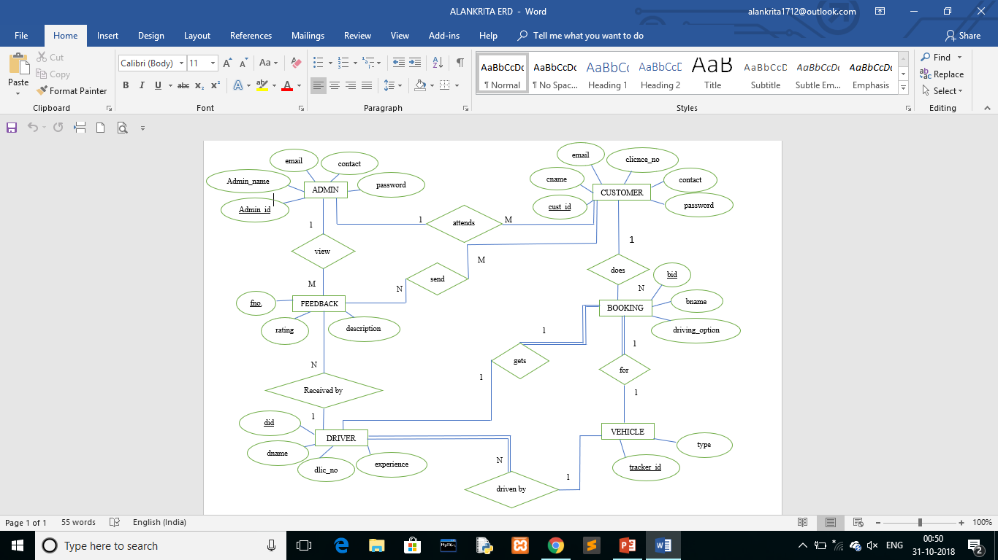
Er diagram

Slide 6
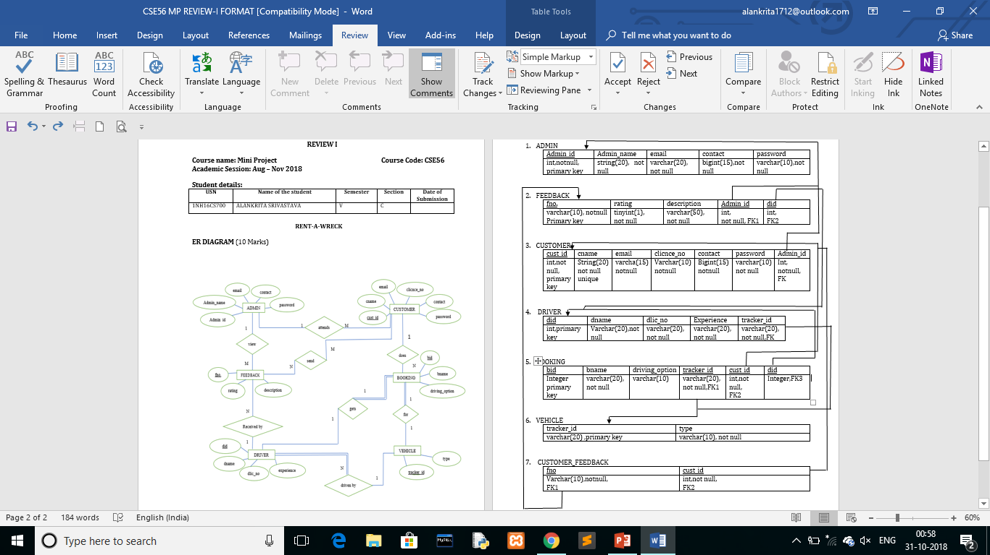
schema

Slide 7
Thank you !!!

