Slide 1
MID SEMESTER PRESENTATION DOTHASH
Estimating set similarity metrices for link prediction and document duplication
Supervisor name :-Dr. Vijay Verma
Submitted by:-Alankrita Mingwal
Roll no:-323103111

Slide 2
Introduction
DotHash offers a faster and more accurate method for comparing large sets of information.
Link prediction predicts the likelihood of a connection between two entities in a network at a given time.
Document deduplication detects and handles multiple copies or versions of the same document, vital for information system efficiency.

Slide 3
Problem statement
With the increasing amount of data to be processed, calculating the exact similarity between all pairs of sets becomes intractable.
The goal is to propose a new estimator called DotHash that can accurately estimate the intersection size of two sets and a family of related metrics, including the Jaccard index and the Adamic-Adar index.

Slide 4
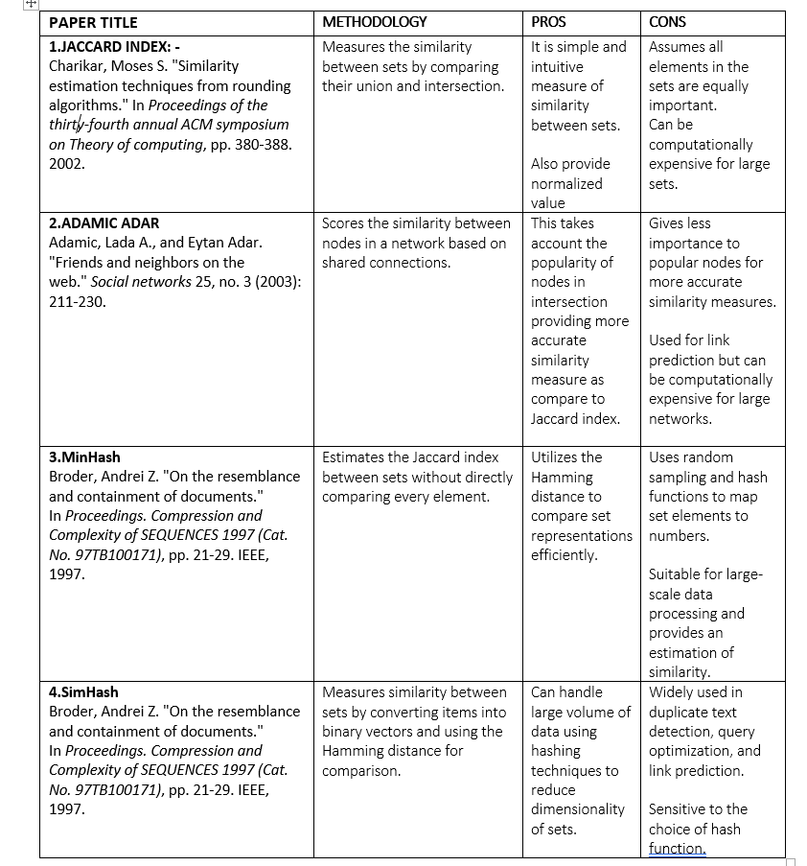
RELATED WORK

Slide 5
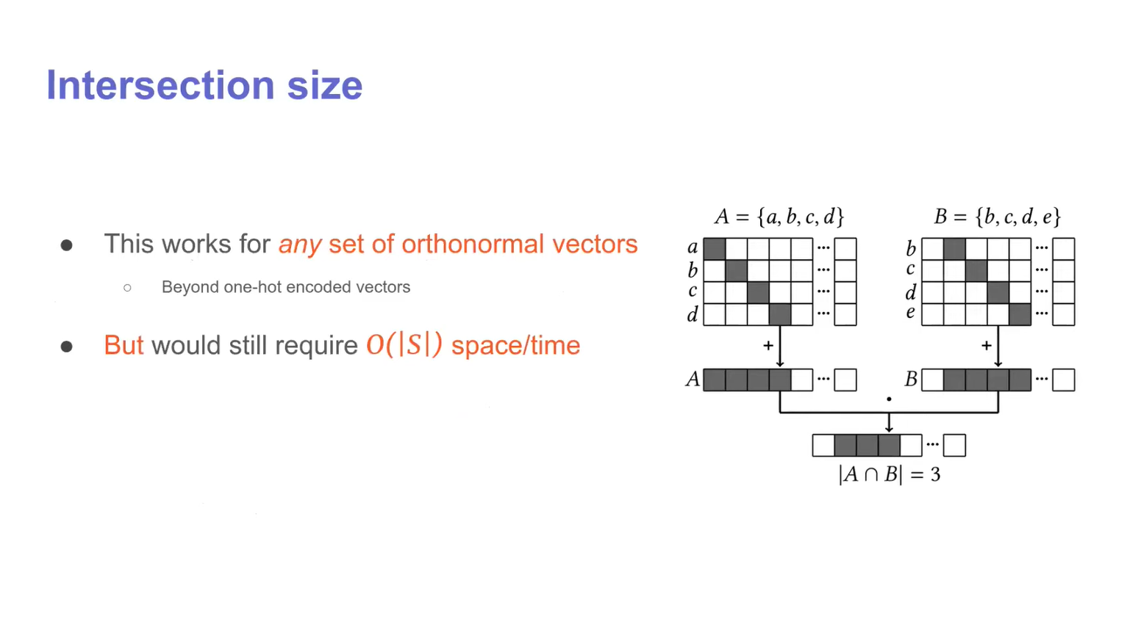
DOTHASH
Intersection calculation using one hot encoding

Slide 6
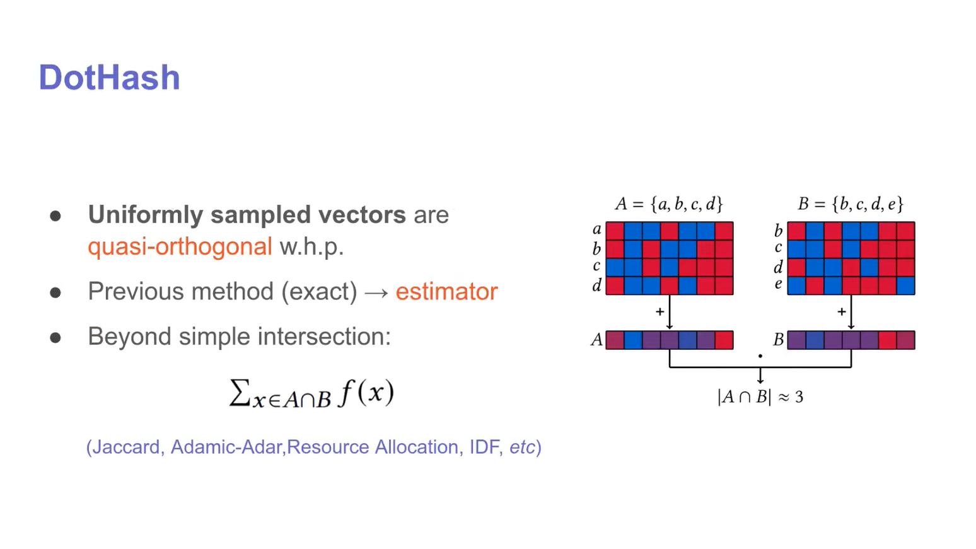
KSAK
Intersection calculation using quasi-orthogonal encoding

Slide 7
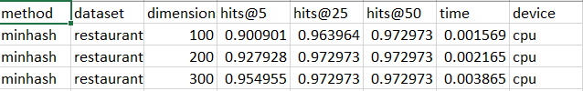
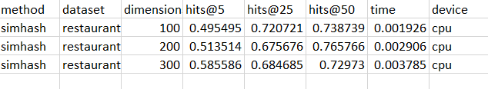
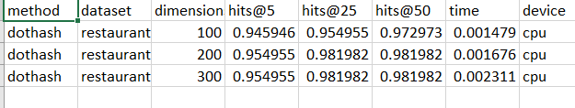
EXPERIMENTAL RESULT

Slide 8
CONCLUSION AND FUTURE SCOPE
Research aims to expand DotHash's capabilities by exploring additional complex set similarity metrics beyond the Adamic-Adar index.
Investigations into DotHash's adaptability for various applications requiring specialized similarity metrics and optimization for big data environments are ongoing.
Additionally, there's a focus on developing distributed computing frameworks to leverage DotHash for scalable and high-performance data analysis.

Slide 9
REFERENCES
Charikar, Moses S. "Similarity estimation techniques from rounding algorithms." In Proceedings of the thiry-fourth annual ACM symposium on Theory of computing, pp. 380-388. 2002Adamic, Lada A., and Eytan Adar. "Friends and neighbors on the web." Social networks 25, no. 3 (2003): 211-230.
Adamic, Lada A., and Eytan Adar. "Friends and neighbors on the web." Social networks 25, no. 3 (2003): 211-230
Broder, Andrei Z. "On the resemblance and containment of documents." In Proceedings. Compression and Complexity of SEQUENCES 1997 (Cat. No. 97TB100171), pp. 21-29. IEEE, 1997.
Nunes, Igor, Mike Heddes, Pere Vergés, Danny Abraham, Alex Veidenbaum, Alex Nicolau, and Tony Givargis. "Dothash: Estimating set similarity metrics for link prediction and document deduplication." In Proceedings of the 29th ACM SIGKDD Conference on Knowledge Discovery and Data Mining, pp. 1758-1769. 2023.

