Slide 1

Exploratory Data Analysis
G2M Insight for Cab Investment
21st May 2023

Slide 2

Agenda
Executive Summary
Data Understanding
EDA
Recommendations

Slide 3
Executive Summary
Due to remarkable growth in Cab Industry in the last few years, XYZ firm is planning to make an investment in the Cab Industry.
Problem Statement : To provide insights to help XYZ firm in identifying the right company for making investment.
General Approach:
Data Understanding
Forecasting profit and number of rides for each cab type
Finding the most profitable Cab company
Recommendations for investment

Slide 4
Data Understanding
The dataset consists of travel data of 359392 customers.
We had 4 datasets Cab_Data.csv, City.csv, Customer_ID.csv and Transaction_ID.csv. Analysis of individual datasets are performed. We also tried to get some meaningful insights after merging the datasets.
Profit is calculated by subtracting the Cost_of_Trip from the Price_Charged.

Slide 5
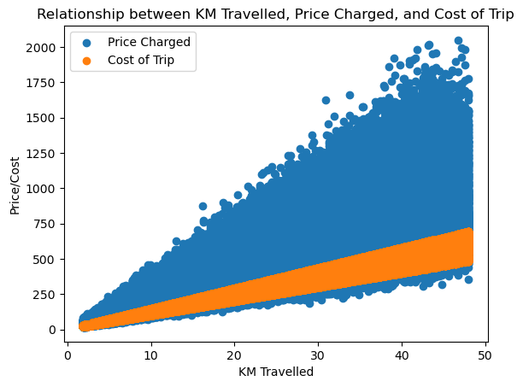
Exploratory Data Analysis:
Cab Industry worth Investing?
Profit = Price Charged – Cost of Trip
Based on the above assumption, it can be observed that the profit increased with the KM travelled.

Slide 6
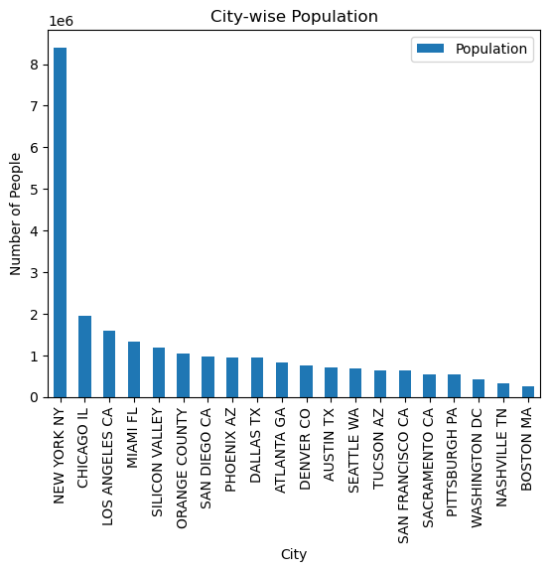
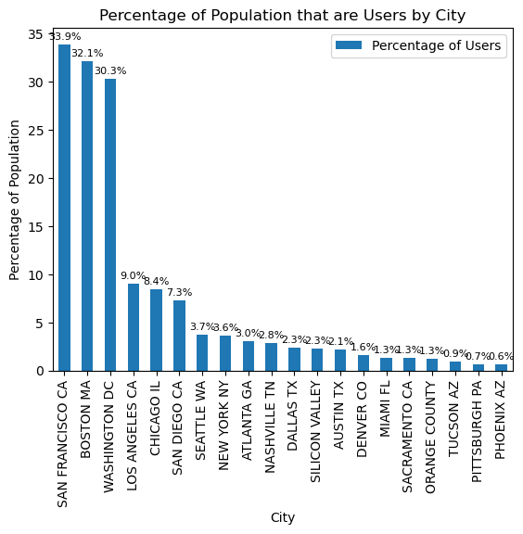
Basic Demographics:
Cab Industry worth Investing?
It can be observed that a good percentage of people use cab service in every city. San Francisco has the highest percentage of population using cab service.

Slide 7
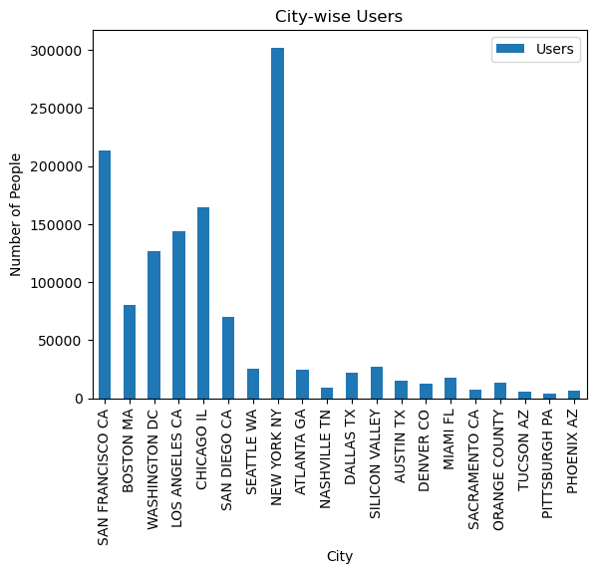
Basic Demographics:
Cab Industry worth Investing?
New York has the highest number of cab users.

Slide 8
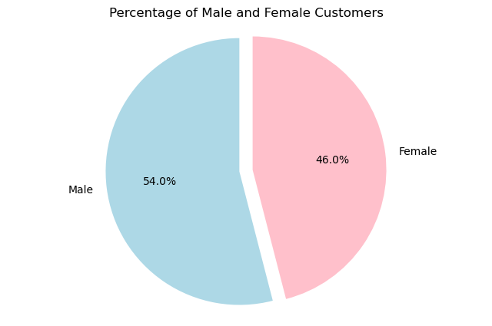
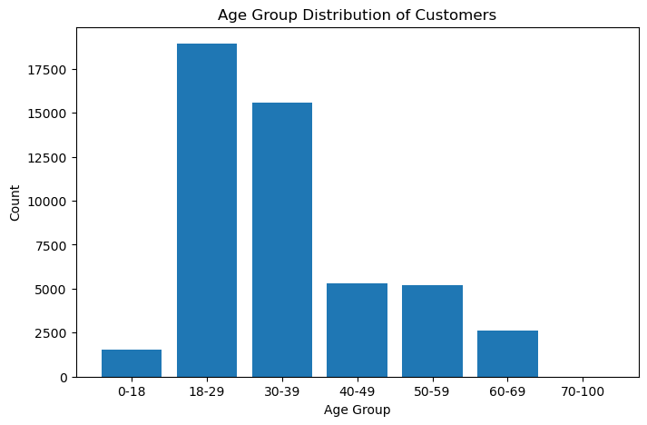
Customer Analysis:
Almost 54% of cab users are male and 46% are female. Also the cab services are popular with people in age bank of 18 years to 39 years.

Slide 9
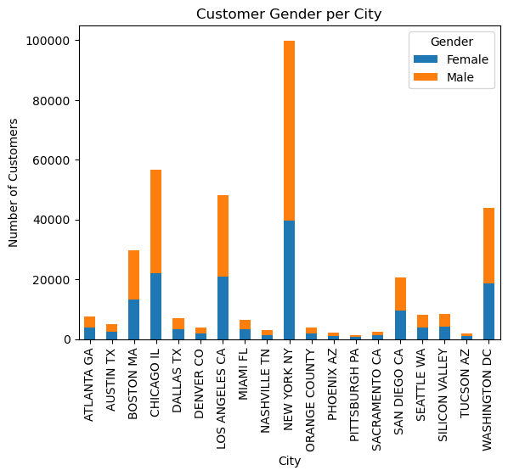
Customer Analysis:
Gender Distribution of Cab Users across different cities

Slide 10
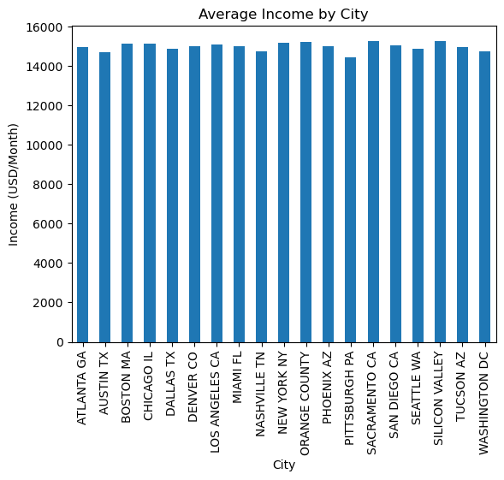
Customer Analysis:
Distribution of average monthly income of customers across different cities.

Slide 11
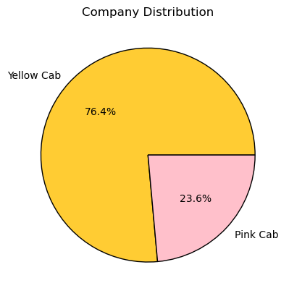
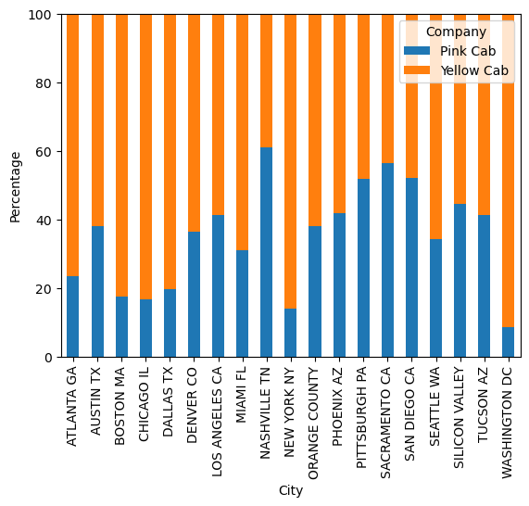
Pink Cab or Yellow Cab - Presence
Yellow Cab covers 76.4% of the Cab Market and Pink Cab is present in 23.6% in US cities.

Slide 12
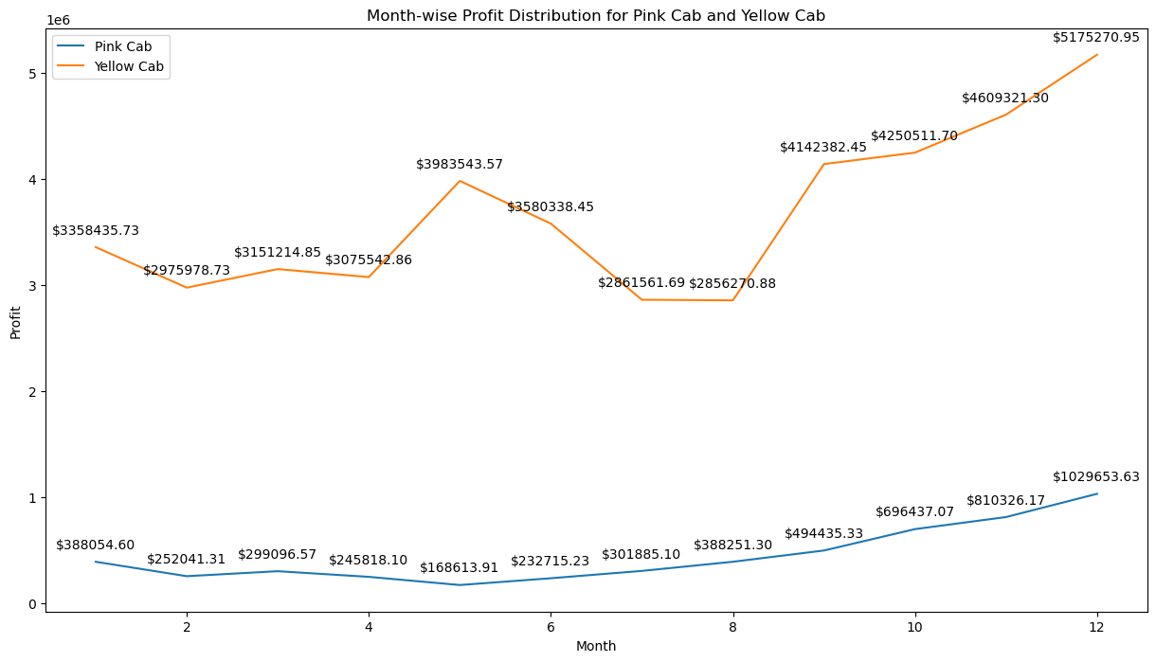
Pink Cab or Yellow Cab - Profit
Monthly profit distribution is much higher for Yellow Cabs. The profit increases during the last quarter of every year.

Slide 13
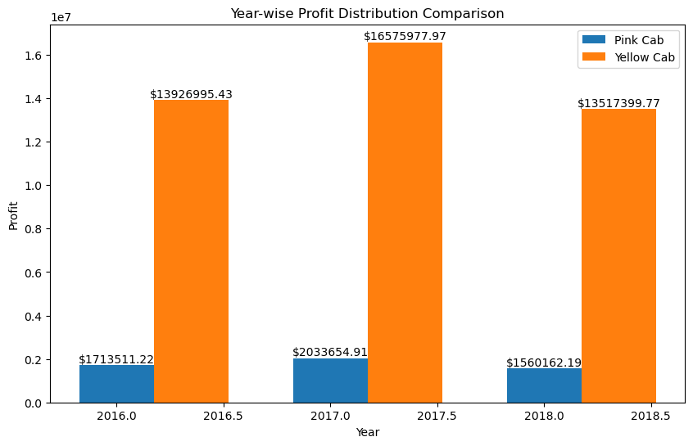
Pink Cab or Yellow Cab – Profit
Yearly profit distribution is also much higher for Yellow Cabs

Slide 14
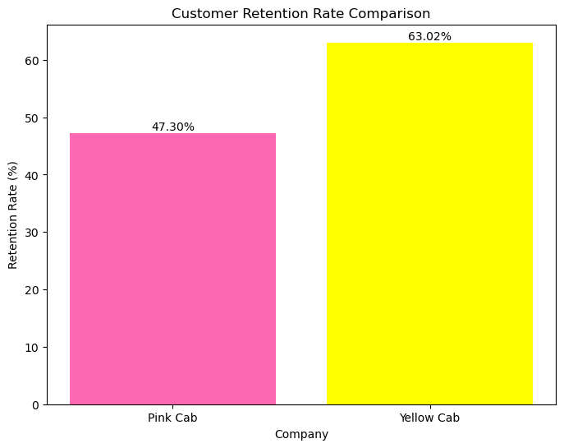
Pink Cab or Yellow Cab – Customer Retention
Customer Retention is 63.02% for Yellow cabs and 47.30% in case of Pink Cabs

Slide 15
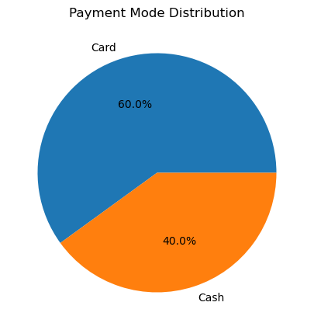
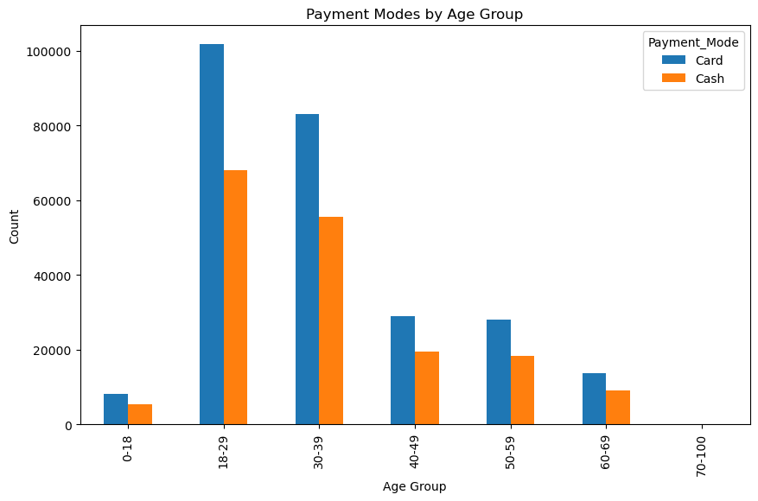
Additional Insights:
Majority of the customers prefer to pay using cards. Customers of all age groups are equally proficient using card as the mode of payment.

Slide 16
Recommendations:
Market Share: Yellow Cab has significantly more presence in US Cab Market than Pink Cabs.
Profit Margin: The profit margin of Yellow Cabs in significantly higher than that of the Pink Cabs.
Customer Retention: Customer Retention Rate is much higher in Yellow Cabs than in Pink Cabs.
On the basis of above data exploration, it is recommended that investing in Yellow Cab would be more profitable.

Slide 17
Thank You

