Slide 1

Cross Selling Recommendation
XYZ Credit Union, Latin America
29-July-2023

Slide 2
Background
XYZ credit union in Latin America is performing very well in selling the Banking products (eg: Credit card, deposit account, retirement account, safe deposit box, etc) and is planning to boost cross selling of their banking Products.
Objective : Provide actionable insights to help XYZ Credit Union to help them in cross selling their products.
The analysis has been divided into four parts:
Data Understanding
Analyzing metrics related to different baking products
Understanding popular products based on age group and segments of customers
Recommendations for cross selling based on product popularity with age group and segment of customers.

Slide 3
Data Exploration
50 Features( including 2 derived features)
Total data points :13,647,309
Assumptions:
Outliers are present in age feature and is removed as age is not generally above 115.
Income groups are segmented based on a standard binning [25000, 80000, 200000] for [ Low, Medium, High] income group.

Slide 4
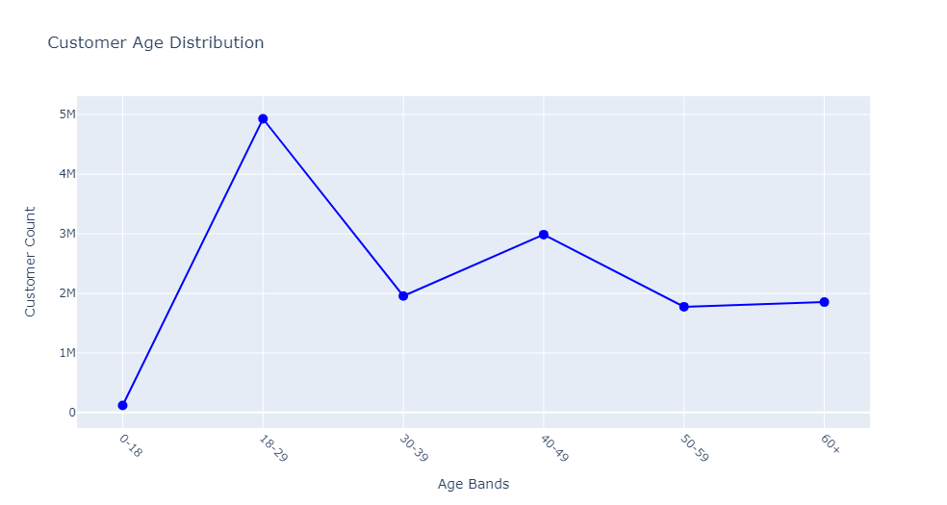
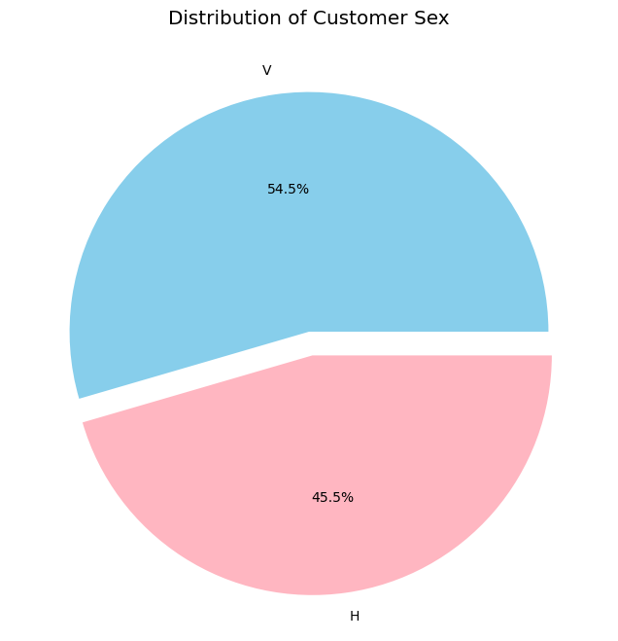
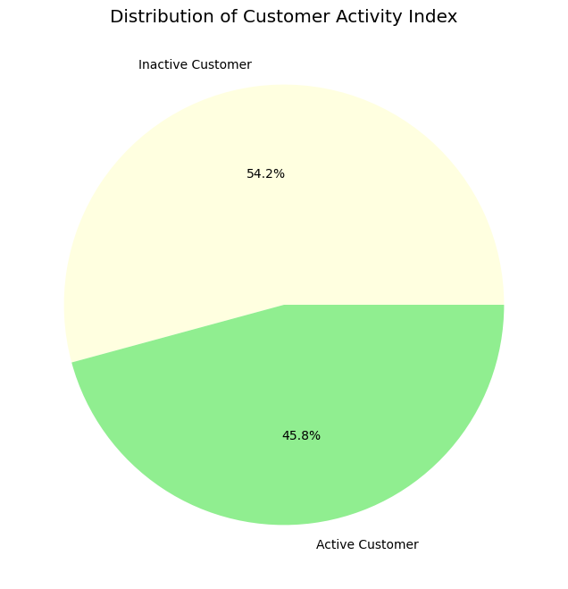
Profit Analysis
Customer Analysis

Slide 5
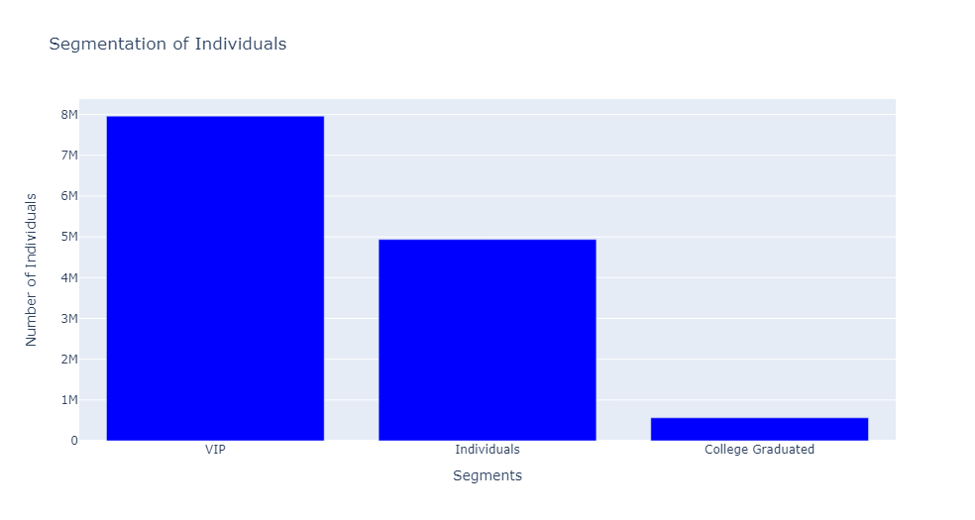
Customer Segments:

Slide 6
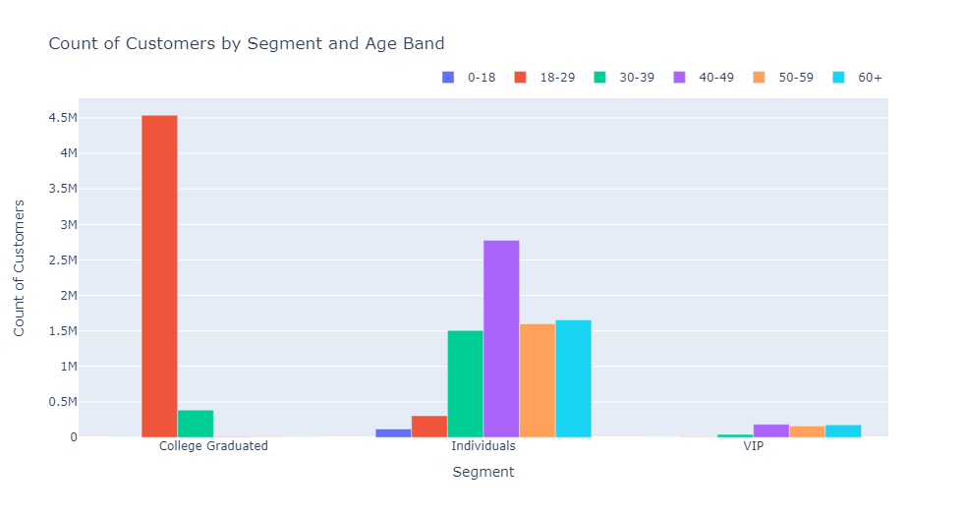
Customer Segments and Age Distribution:

Slide 7
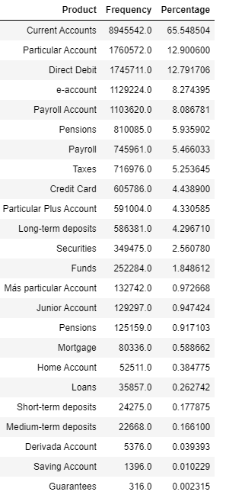
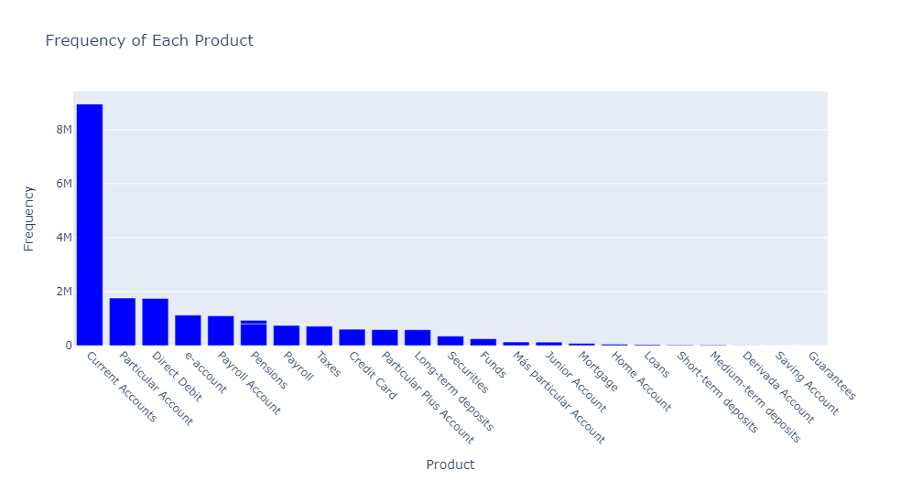
Popularity of Products

Slide 8
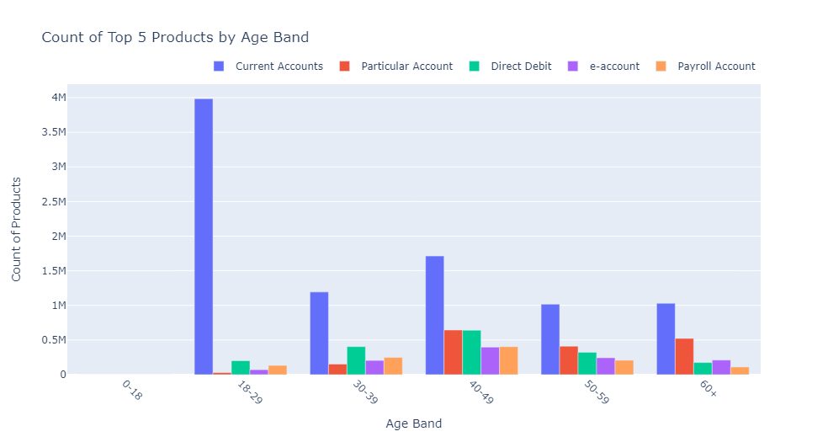
Top 5 Product Popularity by Age Group:

Slide 9
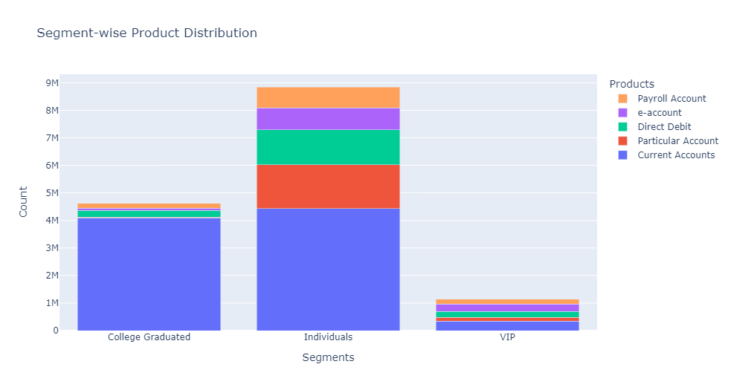
Segment wise distribution of Top 5 products

Slide 10
Recommendations
The data related to banking are evaluated and the following could be recommended based on the analysis:
Product Popularity: The most popular product is ‘Current Account’. The other most popular products are Direct Debit, Particular Account, e account and Payroll account. These products can be combined for cross selling and offered to the customers as they are in demand.
Customer Reach : XYZ Credit Union has more ‘VIP’ and ‘Individual’ customers of age 40-49 Years . The XYZ Credit Union should target these customers for cross selling. Among all segments ‘Current account’ is the most popular product followed by Direct Debit. Therefore, there is a scope to cross sell Direct Debit along with Current Account
Age wise Reach : Overall, the firm has more customers in the age band 18-29 years irrespective of segments. The XYZ Credit Union could recommend Direct Debit for the customer age band 18-39 years. Similarly, Particular account are in demand for age group of 49+ years.
Segment wise Reach : The VIP segment consists of a mix of different products. The firm should target the ‘College Graduates’ and ‘ Individual’ segments, as they are mostly concentrated on a single product ie. Current Account.

Slide 11
Thank You

