Slide 1
CloudPhy Problem
By Group 47

Slide 2
Pipeline Overview
To solve the problem, we had to build various ML models and bring them together in a single pipeline.
Segmentation Task and Image Cropping
Classification Task
Object detection task
OCR task
Heart Rate Digitization Task

Slide 3
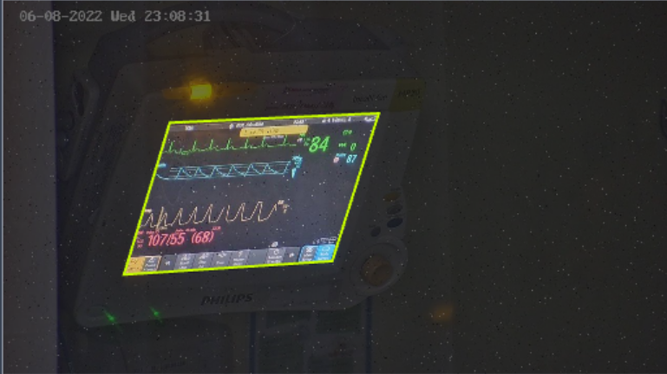
Dataset generation for Segmentation
used the given .csv files to generate COCO annotation for semantic segmentation
augmented dataset was used for segmentation on roboflow
AUGMENTATIONS : size 4.2k | 400 | 200
Brightness: Between - 25% and +25%
Blur: Up to 2.5px
Noise: Up to 1% of pixels

Slide 4
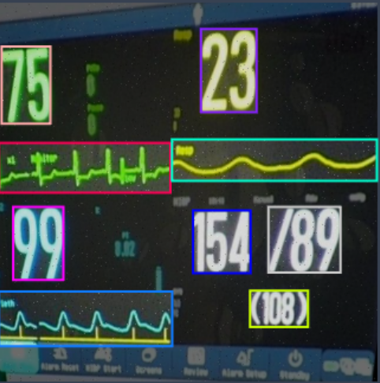
Dataset for object detection
4 datasets of 500 images for each screen -> 525 | 49 | 25
used pytorch labelling format for object detection
AUGMENTATIONS
Outputs per training example: 3
Brightness: Between -25% and +25%
Blur: Up to 1px
Noise: Up to 1% of pixels

Slide 5
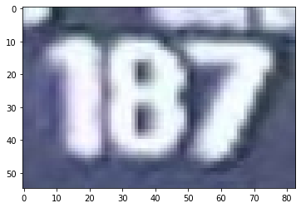
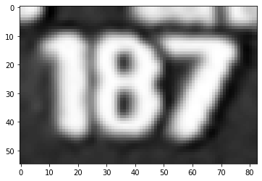
Dataset for Character Recognition
The dataset was not augmented for this task since the our team used Pytesseract to achieve this task.
However our team did perform various operations on the images to improve prediction results. These included Gaussian blur, image sharpening using convolution

Slide 6
Segmentation Task
SegFormer
SegFormer is a Transformer-based framework for semantic segmentation that unifies Transformers with lightweight multilayer perceptron (MLP) decoders. SegFormer has two appealing features:
SegFormer comprises a novel hierarchically structured Transformer encoder which outputs multiscale features. It does not need positional encoding, thereby avoiding the interpolation of positional codes which leads to decreased performance when the testing resolution differs from training.
SegFormer avoids complex decoders. The proposed MLP decoder aggregates information from different layers, and thus combining both local attention and global attention to render powerful representations.

Slide 7
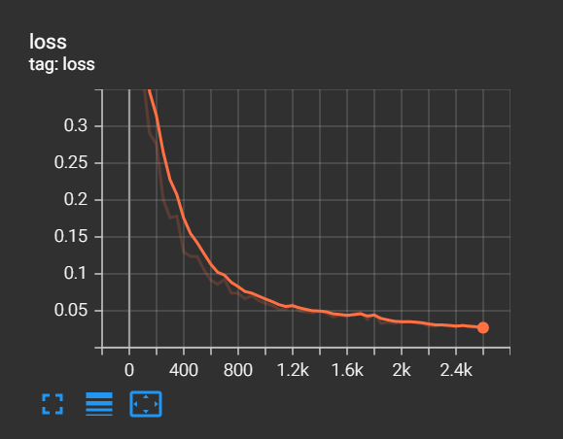
SegFormer Results
| Name | Type | Params
-----------------------------------------------------------
0 | model | SegformerForSemanticSegmentation | 3.7 M
-----------------------------------------------------------
3.7 M Trainable params
0 Non-trainable params
3.7 M Total params
14.859 Total estimated model params size (MB)
test_loss 0.025512490421533585
test_mean_accuracy 0.9899499025594901
test_mean_iou 0.9742939734272283

Slide 8
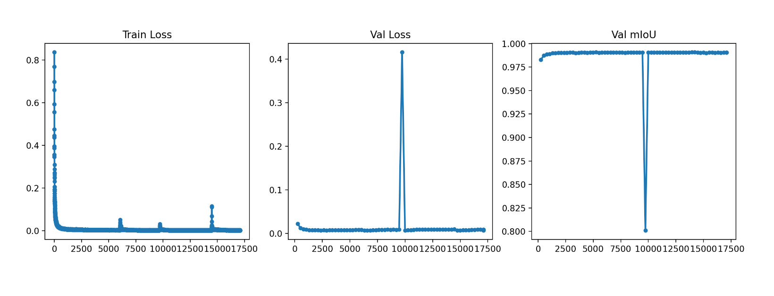
Roboflow
Semantic segmentation models, like SegFormer, are trained to predict the class of each individual pixel and their performance is evaluated by Mean Intersection Over Union where Intersection Over Union = true_positives / (true_positives + false_positives + false_negatives) → 99.1%
Model trained for 12 hours straight to achieve 99.1% mloU.

Slide 9
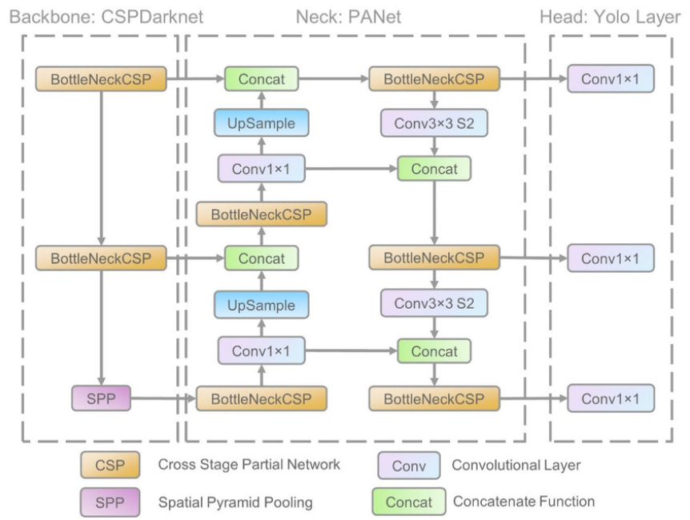
Object Detection
Trained 4 models based on each screen type using 4 labelled dataset of each region of heart rate graph and metrics
Model was trained using YOLO v5 for object detection

Slide 10
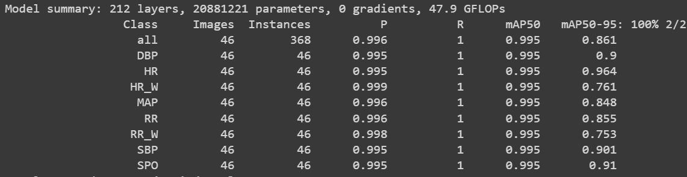
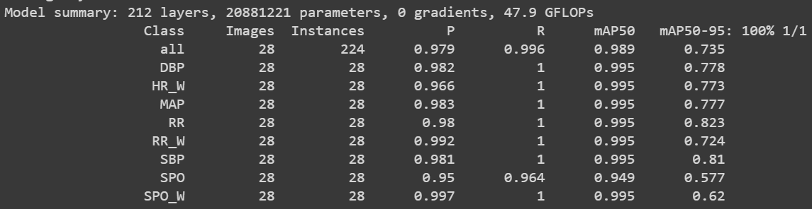
Screen 1
Screen 2

Slide 11
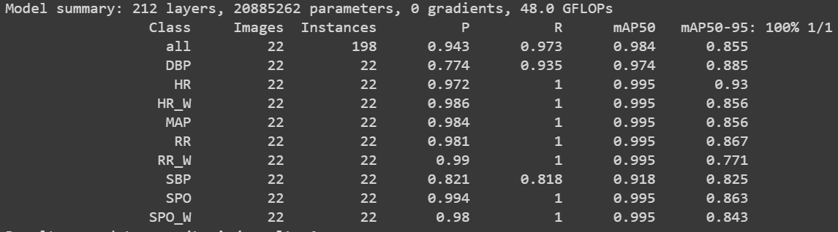
Screen 3
Screen 4

Slide 12
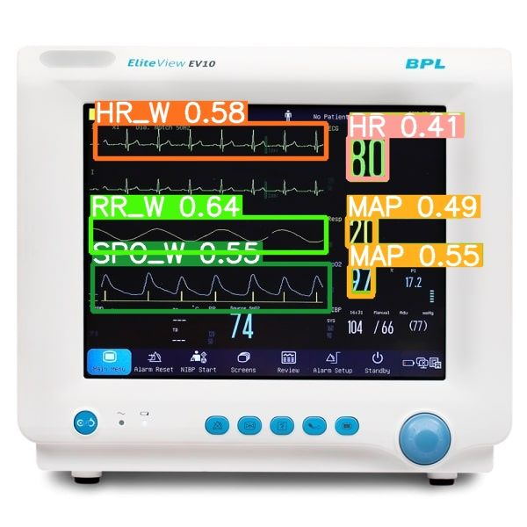






Detected Results

Slide 13
Classification Task
Classification models are a subset of supervised machine learning . A classification model reads some input and generates an output that classifies the input into some category. It can be used to identify a mail as spam or not or classify a dog or cat.
Classification algorithms, like logistic regression, generate a probability score that assigns some probability to the input belonging to a category. Then the feasible corresponding classification is chosen.
The model used here is a better version of AlexNet with an additional MaxPooling2D and Dense layers.
The activation function used here is ‘relu’. The rectified linear activation function or ReLU for short is a piecewise linear function that will output the input directly if it is positive, otherwise, it will output zero.

Slide 14
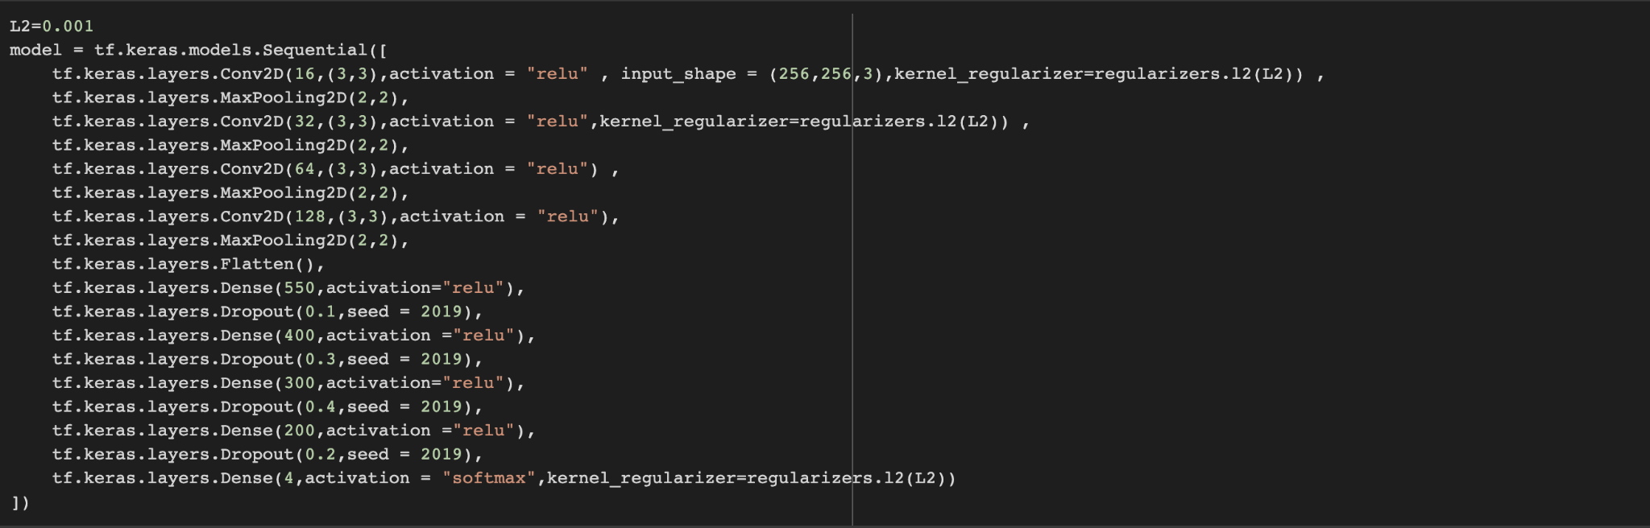
Classification Model
Just at last we used softmax function to classify the output in 4 possible classification. L2 regularization has been used to avoid overfitting on the training images. L2 Regularization, also called a ridge regression, adds the “squared magnitude” of the coefficient as the penalty term to the loss function

Slide 15
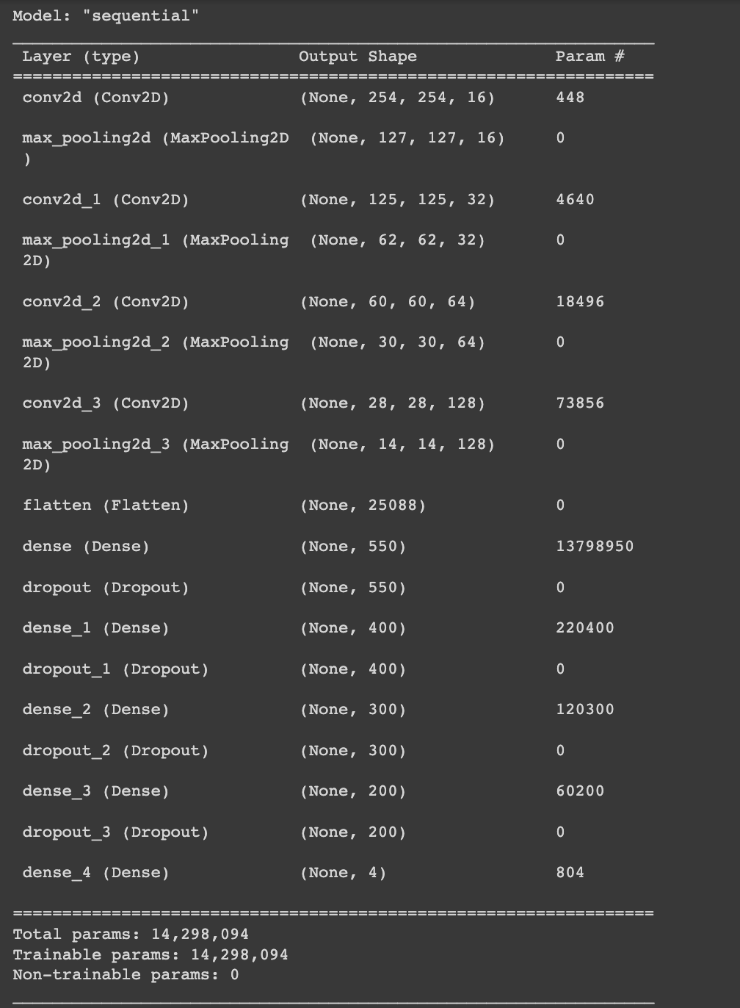
Classification Model Summary
Optimizer used is ‘Adam’. Adam is a replacement optimization algorithm for stochastic gradient descent for training deep learning models. Adam combines the best properties of the AdaGrad and RMSProp algorithms to provide an optimization algorithm that can handle sparse gradients on noisy problems
Loss function used is ‘sparse categorical cross entropy’. Used as a loss function for multi-class classification model where the output label is assigned integer value. This loss function is mathematically same as the categorical_crossentropy. It just has a different interface

Slide 16
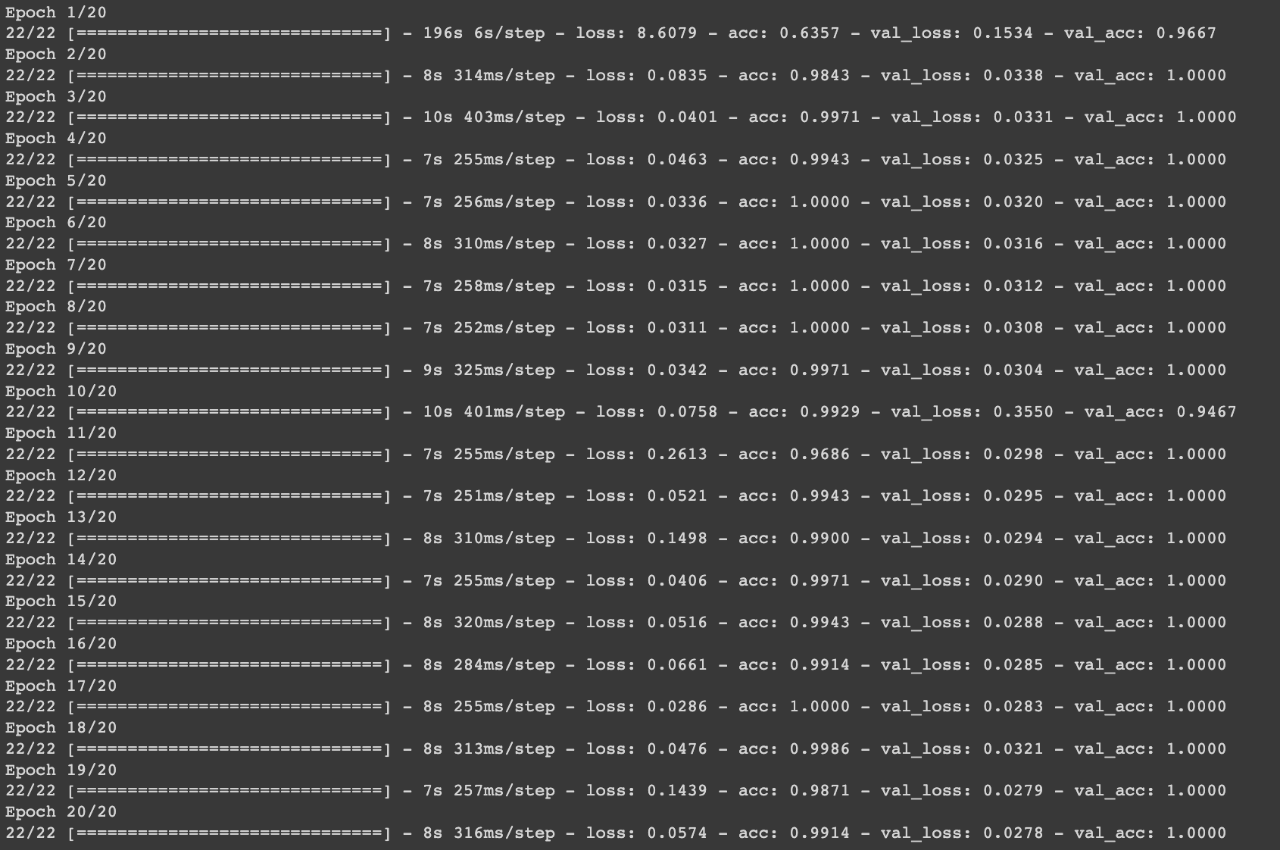
Trained Model Results

Slide 17
Optical Character Recognition
Now that we have obtained bounded boxes where heart rate, SPO2 and other important values are located in the monitor we can apply OCR models to get values from the image.
The Object detection model automatically marks the bounded box as Heart rate, SPO2 etc. So when we apply OCR on one such bounded we will be able to infer the value of different metrics.
Firstly, it converts the images to grayscale, then applies a special filter to reduce any unwanted noise. After that, another filter is applied to sharpen the image. Finally, the text is extracted from the sharpened image using a library called pytesseract and converted to numbers.
Pytesseract comes with a pre trained model with configurations which can be allow model customization.
By combining multiple Pytesseract models each with different configurations we were able to achieve higher accuracy.

Slide 18
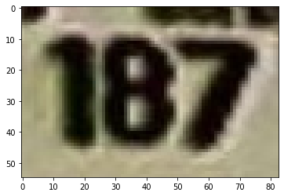
187

Slide 19
Heart Digitization (Brownie Points)
Idea : Convert the given raster image which is pixel to a vectorized image like svg or bitmap.trace which used vector polygons to make an image .
We can then use those shapes and lines to digitise the image.
But before first let’s learn about raster and vectorised image.
Raster Image: These are the types of images that are produced when scanning or photographing an object. Raster images are compiled using pixels, or tiny dots, containing unique color and tonal information that come together to create the image
Vector Images: Vector graphics are computer images created using a sequence of commands or mathematical statements that place lines and shapes in a two-dimensional or three-dimensional space

Slide 20
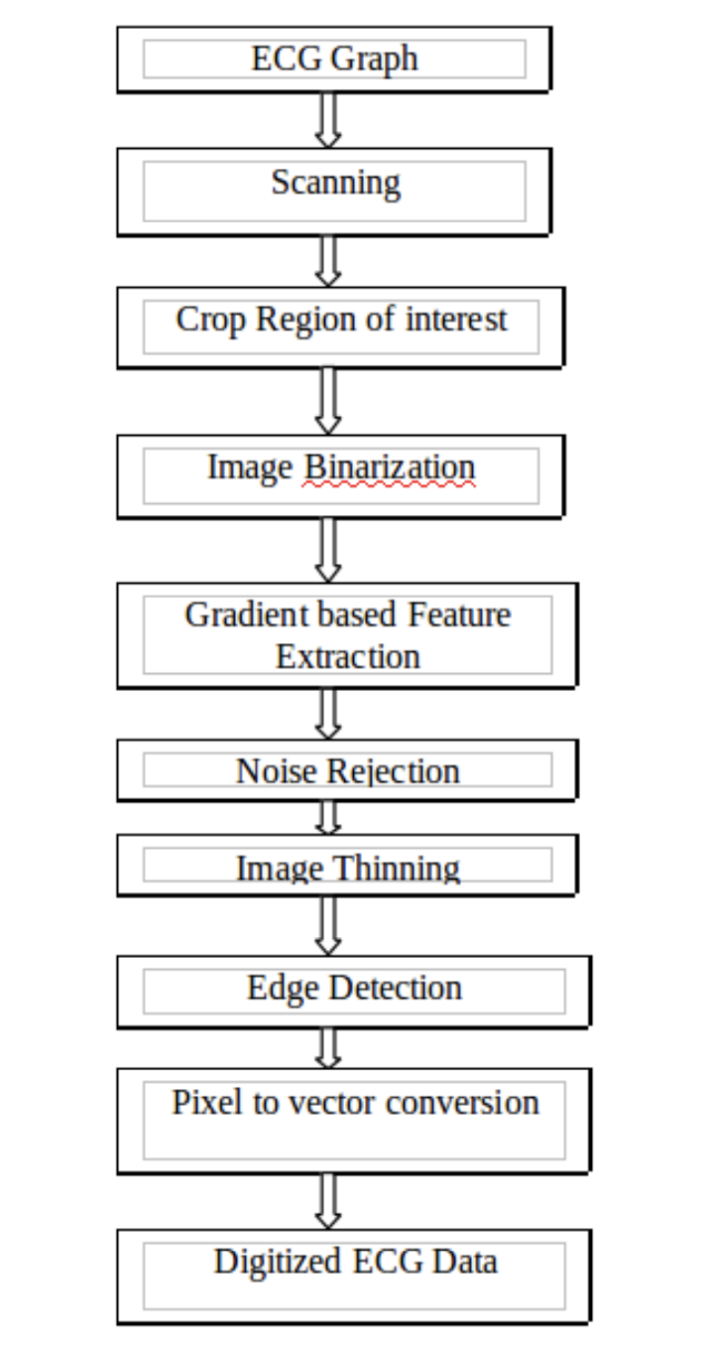
Steps involved
Image Binarization
Gradient based Feature Extraction
Noise Rejection
Image Thinning
Edge detection
Smoothing
Enhancement
Thresholding
Localization
Pixel-to-Vector conversion
Displaying the Digitised Image

Slide 21
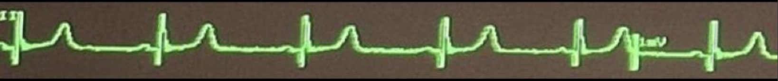
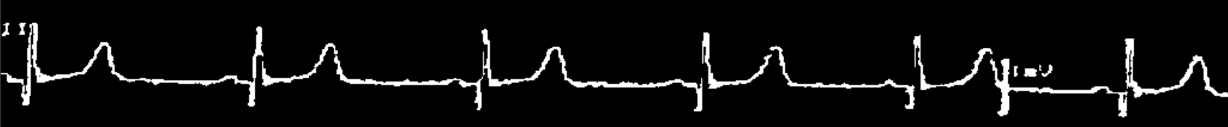
Image Preprocessing
Image Binarization, Gradient based Feature Extraction, Noise Rejection,Image Thinning, Edge detection are the preprocessing steps in which we get the image processed such that the only information left is the needed information which is the ‘Heart Rate Graph’ which is to be digitized.

Slide 22
Digitizing the Raster Image
Potrace Library of python was used to accomplish this task.
Potrace is a tool for tracing a bitmap, which means, transforming a bitmap into a smooth, scalable image. The input is a bitmap, which means, a pixel-based image composed of the two colors black and white only. The output is EPS, PDF, SVG, or one of a number of other vector formats. A typical use is to create vector graphics from scanned data, such as company or university logos, handwritten notes, etc. The resulting image is not "jaggy" like a bitmap, but smooth. It can then be rendered at any resolution.

Slide 23
How to use Potrace
We create a BItmap object of the binary image. We then use bitmap.trace() which returns a path instance which stores the vectorised image. Path object consists of a one or more curve objects which are themselves composed of list of segments.
The segments can be of two types:
Bezier Segment
Corner Segment
Since curves are always closed, segments only store their control points and end point; their starting point is always the previous segment’s end point

Slide 24
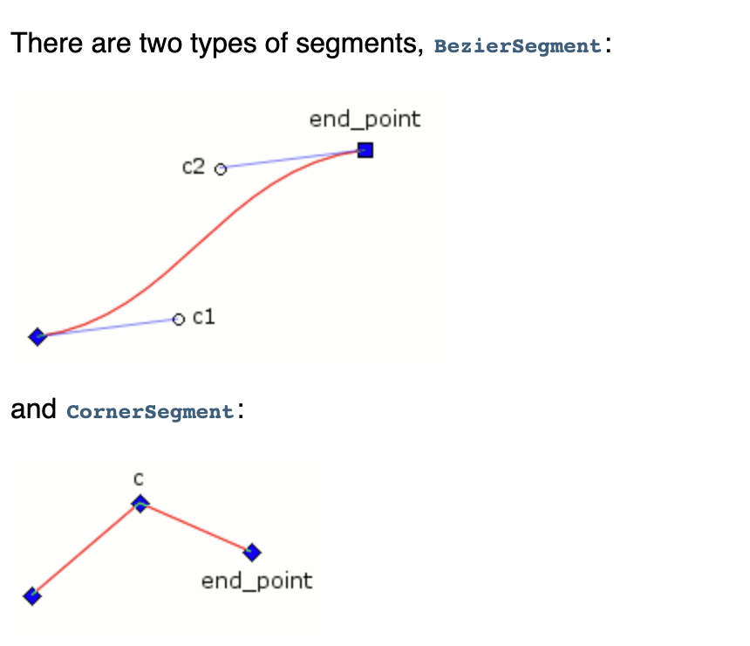
A little more about Segments
c1: The segment’s starting point control point.
c2: The segment’s end point control point.
end_point: The segment’s end point.
c: The segment’s corner point.
end_point: The segment’s end point.

Slide 25
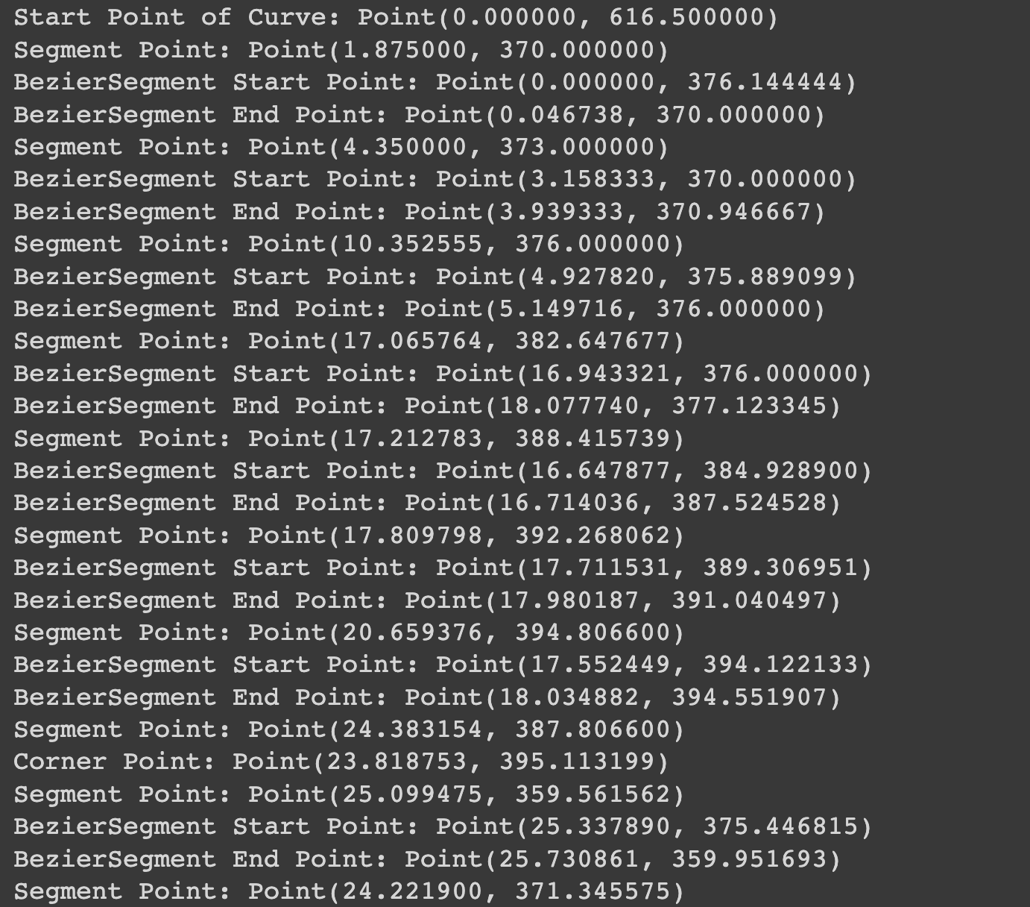
Result of Digitized Image
This is a small part of the whole image that is digitized where we get the start point of each curve in a path. Various segments in a curve is classified into Bezier Segment or Corner Point using is_corner function.
We can use the kind of segment and the coordinates of them to find various information from the digitzed image.
Research Paper Referred:
Conversion of ECG Graph into Digital Format by G.Angelo Virgin and V.Vijaya Baskar(link)

Slide 26
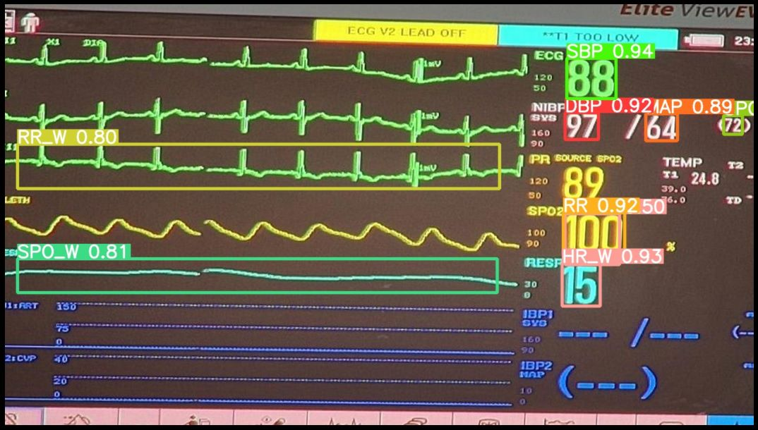
Inference Time
All the models were integrated together to form a single inference function.
The time taken to completely process 1 image and give out results is 11.5 seconds on google colab CPUs.
Extracted Data
88 - ECG
97 - DBP
64 - MAP
100 - RR
15 - HR_W
Heart Rate Digital Data

Slide 27
Thank You

