Slide 1

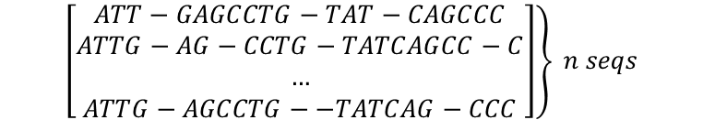
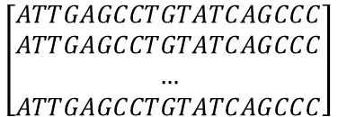
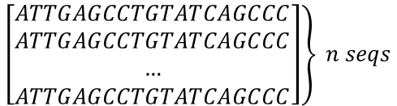
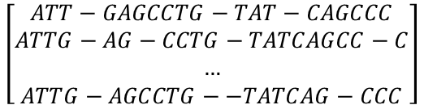
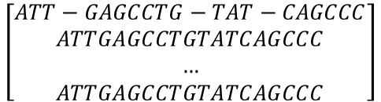
$$ATTGAGCCTGTATCAGCCC \\ ATTG−AG−CCTG−TATCAGCC−C$$
$$\left[\begin{aligned}ATTGAGCCTGTATCAGCCC \\ ATTGAGCCTGTATCAGCCC \\ … \\ ATTGAGCCTGTATCAGCCC\end{aligned}\right]$$
$$\left.\left[\begin{aligned}ATTGAGCCTGTATCAGCCC \\ ATTGAGCCTGTATCAGCCC \\ … \\ ATTGAGCCTGTATCAGCCC\end{aligned}\right]\right\} n seqs$$
$$\left[\begin{aligned}ATT−GAGCCTG−TAT−CAGCCC \\ ATTGAGCCTGTATCAGCCC \\ … \\ ATTGAGCCTGTATCAGCCC\end{aligned}\right]$$
$$\left.\left[\begin{aligned}ATT−GAGCCTG−TAT−CAGCCC \\ ATTG−AG−CCTG−TATCAGCC−C \\ … \\ ATTG−AGCCTG−−TATCAG−CCC\end{aligned}\right]\right\} n seqs$$
$$\left[\begin{aligned}ATT−GAGCCTG−TAT−CAGCCC \\ ATTG−AG−CCTG−TATCAGCC−C \\ … \\ ATTG−AGCCTG−−TATCAG−CCC\end{aligned}\right]$$

Slide 2
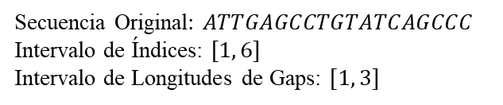
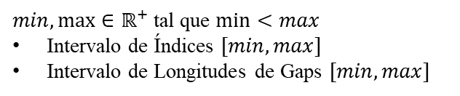

Proceso de Mutación del Mutador de Secuencias Simple (MSS)
$min,\max{∈ℝ^{+}}$ tal que $\min{<max}$
Intervalo de Índices $[min, max]$
Intervalo de Longitudes de Gaps $[min, max]$
$$ATTGAGCCTGTATCAGCCC$$
$$ATTGA−−−GC−CTG−−TATCAGC−−CC$$
Secuencia Original: $ATTGAGCCTGTATCAGCCC$
Intervalo de Índices: $[1, 6]$
Intervalo de Longitudes de Gaps: $[1, 3]$
Longitud de Arreglo de Índices Aleatorios [1, 6]: 4
Arreglo de Indices Aleatorios: (10, 5, 7, 17)
Arreglo de Longitudes de gaps [1, 3]: (2, 3, 1, 2)
INDICES ALEATORIOS |  |  |  |  | 5 |  | 7 |  |  | 10 |  |  |  |  |  |  | 17
GENES | A | T | T | G | A | G | C | C | T | G | T | A | T | C | A | G | C | C | C
INDICES DE GENES | 1 | 2 | 3 | 4 | 5 | 6 | 7 | 8 | 9 | 10 | 11 | 12 | 13 | 14 | 15 | 16 | 17 | 18 | 19
LONGITUDES DE GAPS |  |  |  |  | 3 |  | 1 |  |  | 2 |  |  |  |  |  |  | 2
A | T | T | G | A | - | - | - | G | C | - | C | T | G | - | - | T | A | T | C | A | G | C | - | - | C | C

Slide 3

Proceso de Mutación del Mutador de Cruce de Secuencias (MCS)
$min,\max{∈ℝ^{+}}$ tal que $\min{<max}$
Intervalo de Índices $[min, max]$
Intervalo de Longitudes de Gaps $[min, max]$
$$ATTGAGCCTGTATCAGCCC$$
$$ATTGA−−−GC−CTG−−TATCAGC−−CC$$
Primera secuencia: $ATTGA−−−GC−CTG−−TATCAGC−−CC$
Segunda secuencia: $ATT−−GAGC−−CTG−TATCA−−GCCC$
INDICES ALEATORIOS |  |  |  |  | 5 |  | 7 |  |  | 10 |  |  |  |  |  |  | 17
GENES | A | T | T | G | A | G | C | C | T | G | T | A | T | C | A | G | C | C | C
INDICES DE GENES | 1 | 2 | 3 | 4 | 5 | 6 | 7 | 8 | 9 | 10 | 11 | 12 | 13 | 14 | 15 | 16 | 17 | 18 | 19
LONGITUDES DE GAPS |  |  |  |  | 3 |  | 1 |  |  | 2 |  |  |  |  |  |  | 2
A | T | T | G | A | - | - | - | G | C | - | C | T | G | - | - | T | A | T | C | A | G | C | - | - | C | C
A | T | T | - | - | G | A | G | C | - | - | C | T | G | - | T | A | T | C | - | - | A | G | C | C | - | - | C | C

