Slide 1
IWLS 2022
Programming Contest
Alan Mishchenko Satrajit Chatterjee

Slide 2
Overview
The fundamental problem of logic synthesis
  Given a Boolean function as a truth table, find a minimal circuit
After decades of research, logic synthesis remains hard
  As we can see by analyzing the results of this competition
Our plan for today
  Introduce the participants
  Review the problems
  Show the results
  Congratulate the winners!

Slide 3
Participants
Team EPFL (École Polytechnique Fédérale de Lausanne):
  Andrea Costamagna, Siang-Yun Lee, Alessandro Tempia Calvino, Hanyu Wang, Mingfei Yu, Professor Giovanni De Micheli
Team Fudan (Fudan University, Shanghai):
  Yishan Zhang, Professor Chang Wu
Team NTU (National Taiwan University):
  Hao-Ren Wang, Guo-Wei He, Professor Jie-Hong Roland Jiang
Team TUW (Technische Universität Wien):
  Franz-Xaver Reichl, Friedrich Slivovsky, Stefan Szeider
Team UCAS (University of Chinese Academy of Sciences):
  Liwei Ni
Team UCB (University of California, Berkeley):
  Yukio Miyasaka
Team UFRGS/UFPEL (Federal University of Rio Grande do Sul / Federal University of Pelotas):
  João Machado (UFPEL), Gabriel Ammes (UFRGS), Renato Peralta (UFRGS), Professor André Reis (UFRGS), Paulo Butzen (UFRGS), Leomar da Rosa (UFPEL), Professor Renato Ribas (UFRGS)

Slide 4
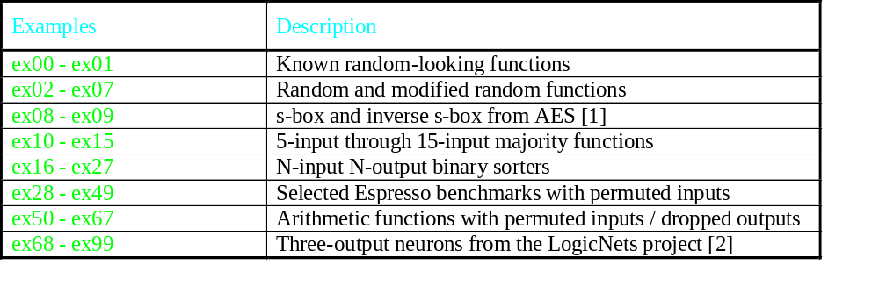
Problems
[1] https://en.wikipedia.org/wiki/Rijndael_S-box
[2] Y. Umuroglu et al., “LogicNets: Co-designed neural networks and circuits for extreme-throughput applications,” Proceedings of FPL 2020, pp. 291–297. https://github.com/Xilinx/logicnets

Slide 5
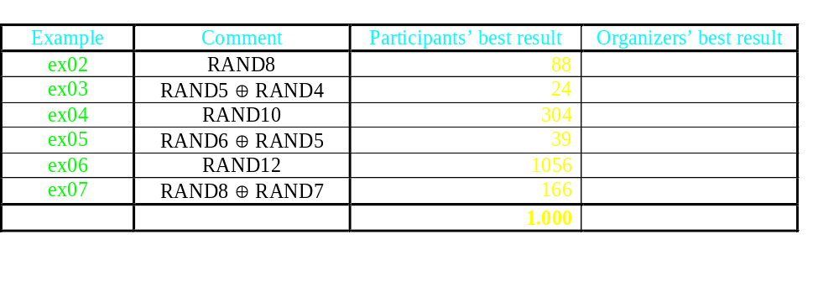
Participants vs Organizers (Round 1)
Consider these 6 examples. Participants win in all cases!

Slide 6
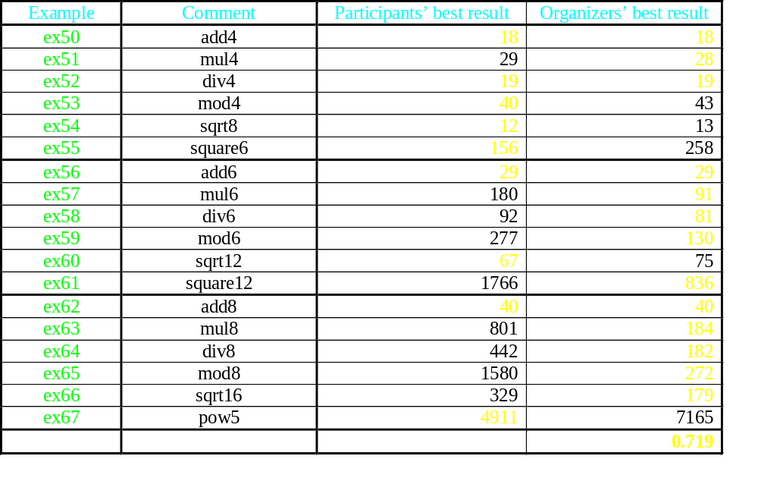
Participants vs Organizers (Round 2)
In the case of arithmetic circuits, knowledge of the function matters.

Slide 7
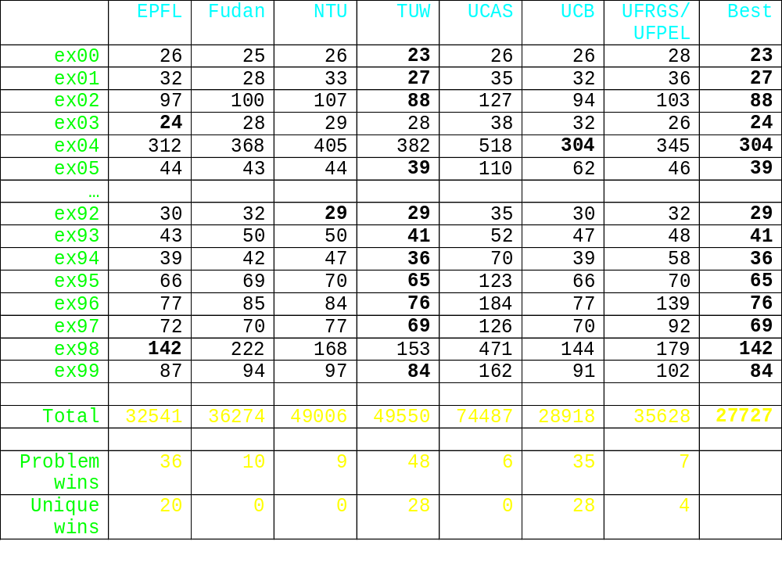
AIG Node Counts

Slide 8
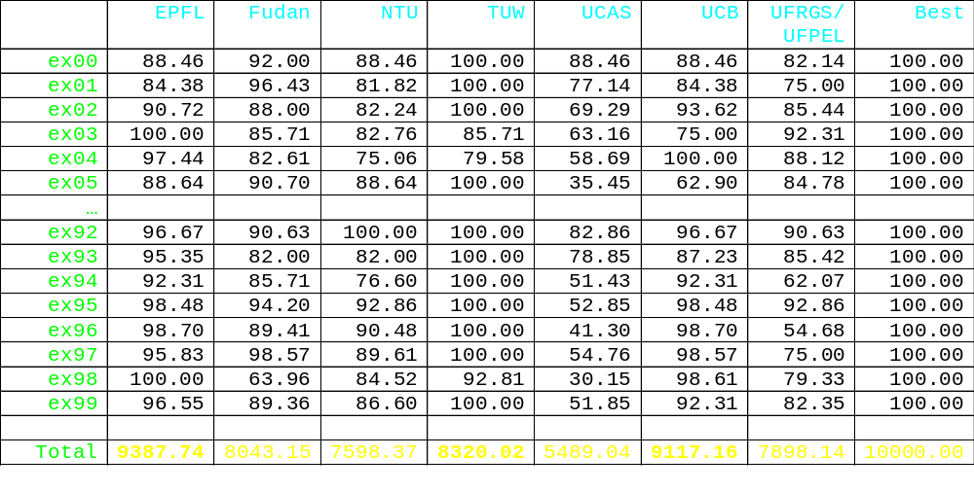
Competition Scores
Score = 100 * <cost_of_best_solution> / <cost_of_this_solution>
This score favors good solutions among those that were not solved well by other teams.

Slide 9
Winners
1st place
  Team EPFL (École Polytechnique Fédérale de Lausanne):
    Andrea Costamagna, Siang-Yun Lee, Alessandro Tempia Calvino, Hanyu Wang, Mingfei Yu, Professor Giovanni de Micheli
2nd place
  Team UCB (University of California, Berkeley):
    Yukio Miyasaka
3rd place
  Team TUW (Technische Universität Wien):
    Franz Reichl, Friedrich Slivovsky, Stefan Szeider
An honorable mention goes to Team UFRGS/UFPEL for synthesizing circuits with the smallest number of logic levels. The logic level count was not the official competition metric, but this is nevertheless a great result.

Slide 10
Additional Slides

Slide 11
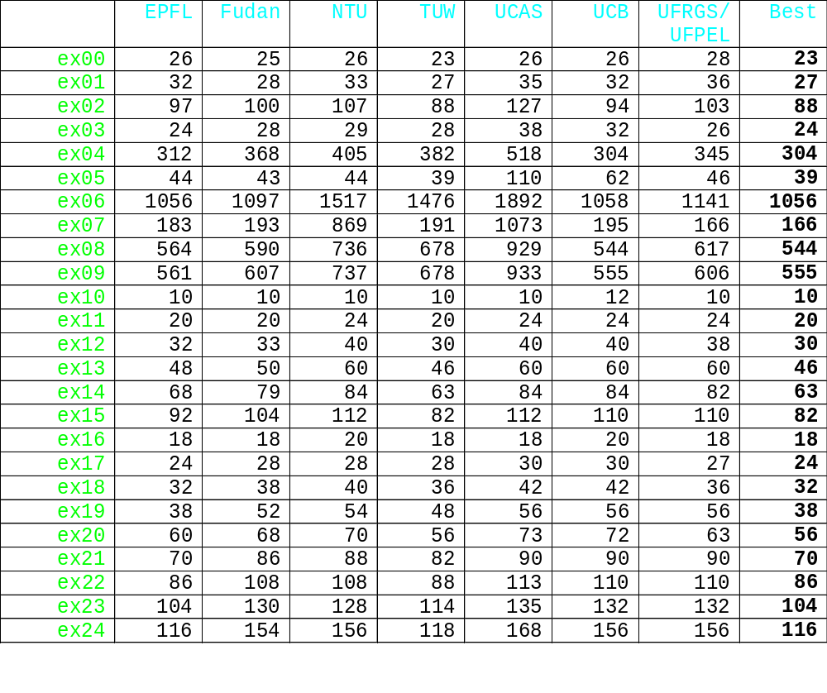
Numeric Results

Slide 12
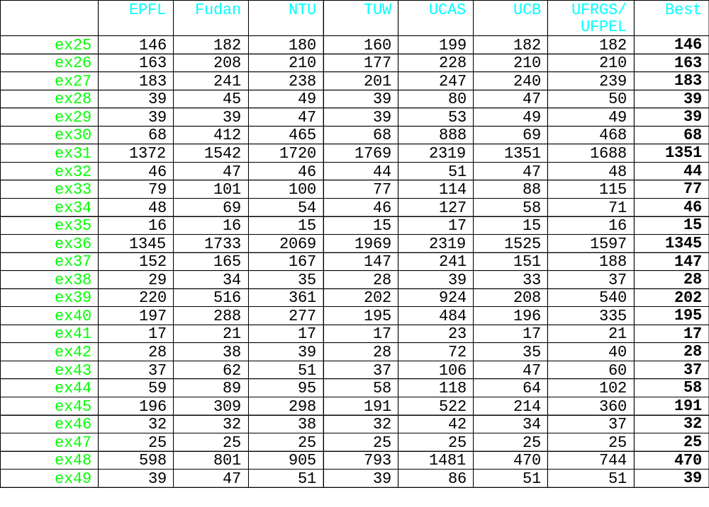
Numeric Results (cont.)

Slide 13
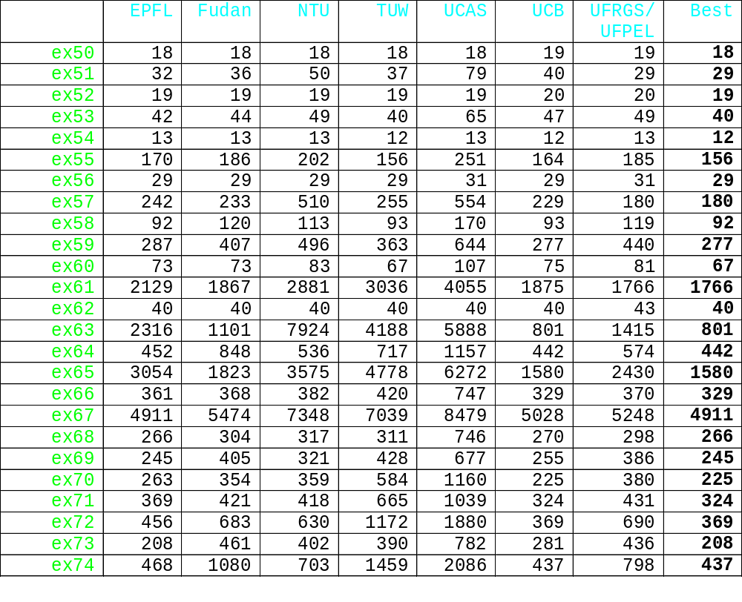
Numeric Results (cont.)

Slide 14
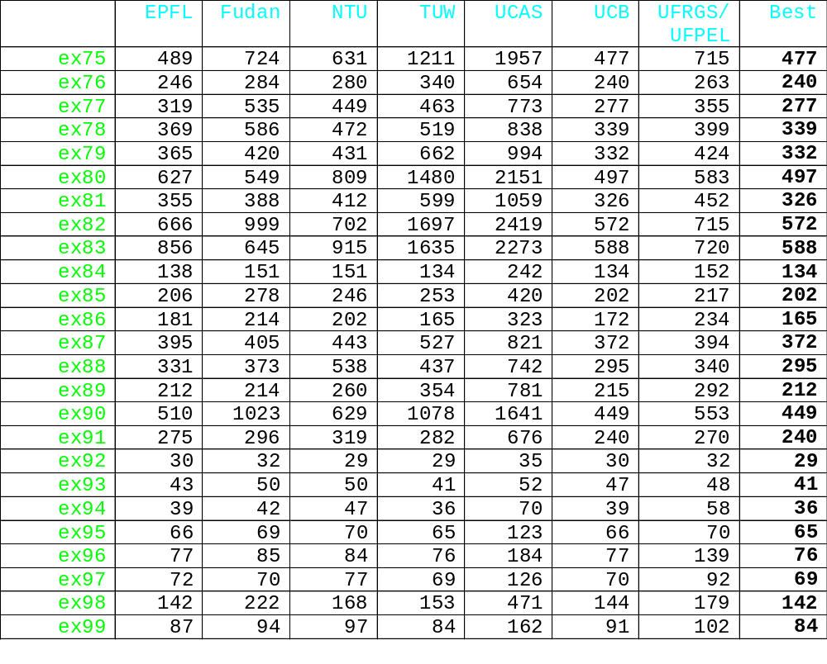
Numeric Results (cont.)

