Slide 1
Efficiency Maine Mini-Split Heat Pump Insights
Anchorage, AK
May 4th, 2017

Slide 2
What is Efficiency Maine Trust?
Formed by the Maine Legislature in 2010 as an independent administrator of statewide renewable and energy efficiency programs.
9 member Board of Directors, appointed by the Governor and approved by the Legislature Energy and Utility Committee.
Regulated by the Public Utilities Commission similarly to a utility.
The Trust mission and authority is part of state statute.

Slide 3
Maine remains the most dependent state on oil per capita with zero production.
The price of heating fuel has declined significantly since 2014, yet heat pumps persist.

Slide 4
Maine Ductless Air Source Heat Pump
Residential Rebates
$500 for One or First Zone of DUCTLESS heat pump heating
$250 for Second Zone of DUCTLESS Heating
up to $2,000 on eligible Low Income homes
Equipment criteria:
Mini-split models : HSPF > 12.0
Multi-split models: HSPF > 10.0
Simple unsecured financing available at 4.99% APR with up to a 10 year term with no upfront cost. ~$11 per $1,000 borrowed.

Slide 5
Ductless heat pumps continue to be installed at an average rate of 400 per month statewide with a clear seasonal pattern.

Slide 6
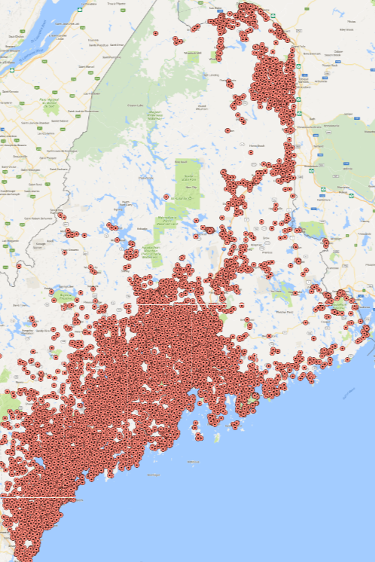
Map showing 17,500 ductless heat pump installations in the past 3.5 years.
Installation density correlates directly with population.
Very popular in far northern areas where systems are reported to continue to provide heat even at -27F.

Slide 7
Single indoor unit installations dominate the marketplace.
When centrally located and properly used, a 15k unit can displace 95% of the heating load of an average home in ME.
Chart reflects data for residential installations in Maine receiving a rebate between January 2016 and May 2017.

Slide 8
Word of mouth on what works and strong dealer networks maintain market dominance for top brands.
Chart reflects data for residential installations in Maine receiving a rebate between January 2016 and May 2017.
Notes:
Market share has not shifted significantly over the past 3 years. And while models not actively installed in Maine are eligible and may operate with equivalency to more popular models, word of mouth on what works and strong dealer support have been exceptionally strong factors in maintaining the status quo.

Slide 9
Highest efficiency equipment is popular.
HSPF 10 and HSPF 11 units in the chart are from Multi-zone units along with approximately 10 percent of units in the HSPF 12 wedge.
Chart reflects data for residential installations in Maine receiving a rebate between January 2016 and May 2017.

Slide 10
Heat Pump Rebate Key Components
Efficiency standard that is both high and simple:
Single head HSPF >12.0
Multi-head HSPF > 10.0
(New standards in development worth watching.)
Contractor credentials and training required.
List of eligible models and installation criteria.
Installation checklist must be submitted.
Independent inspection.
Rebate to cover portion of incremental cost between baseline unit and high efficiency unit.
User tips in print and from installer.
Education, outreach, promotion, web resources.

Slide 11
Key Installation Guidelines
Outdoor unit must be mounted on a wall bracket or stand above anticipated snow drift line. 18” to 24” above grade recommended in Maine.
If the outdoor unit must be placed under a roof drip line, a roof or cap must be installed to keep bulk moisture from splashing around the coils.
Professional installation required by trained technician with correct gear.
Line sets should be triple purged with nitrogen and vacuum with leak testing.
All copper lines should be insulated and covered with any penetrations into the home sealed against leaks and pests.
Critical that technician takes time to show customer how to operate the unit and how to remove and clean the indoor air handler dust filter screens.

Slide 12
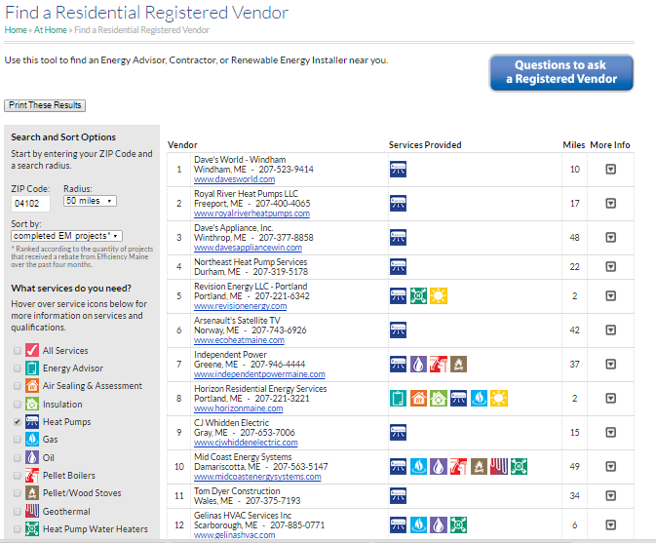
Home Energy Savings Program

Slide 13
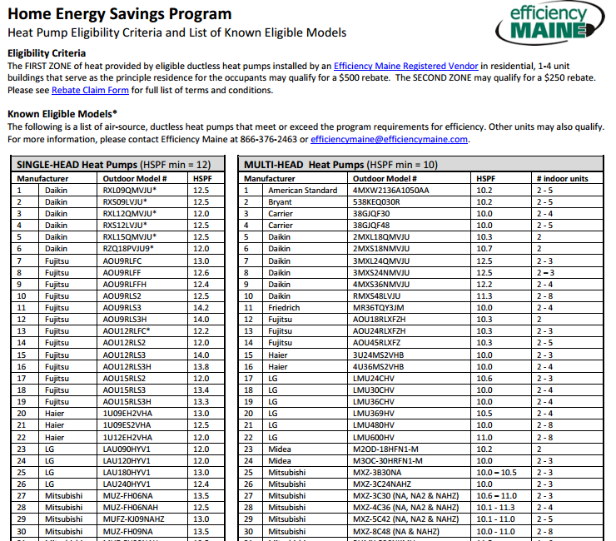

Slide 14
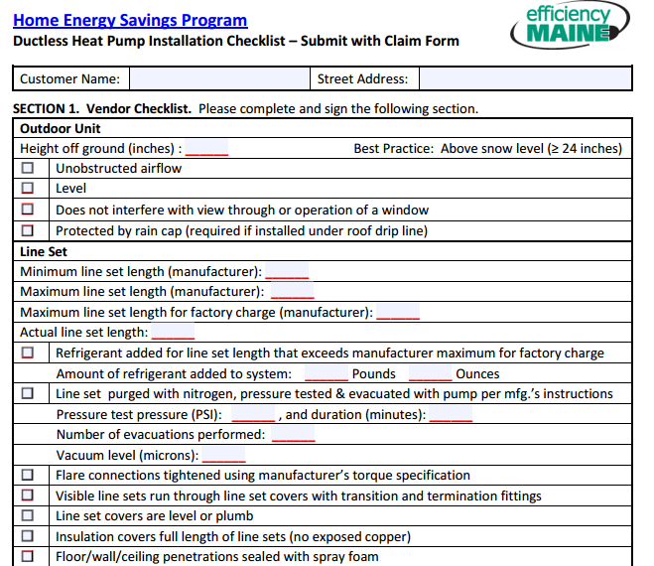
Home Energy Savings Program

Slide 15
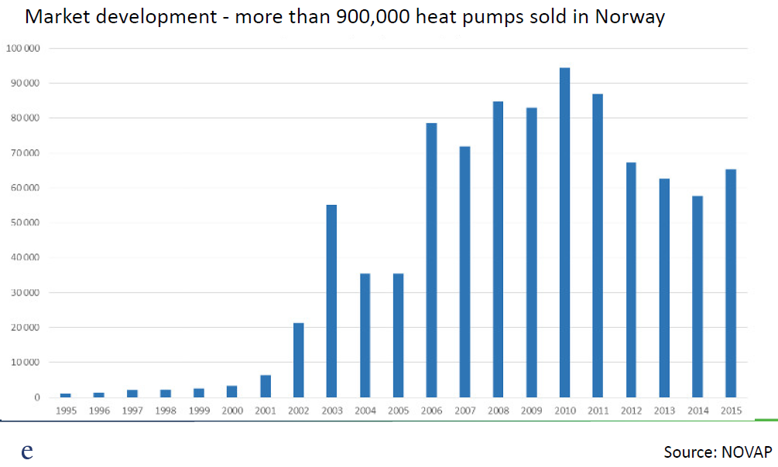
Home Energy Savings Program
Norway has 5.3 million residents.
~4X more people than ME. Therefore…200,000 heat pumps in the next 10 years possible? It’s been done.
Notes:
Helle Gronli at Yale

Slide 16
Pre-Program Pilot and Evaluation Report
http://www.emiconsulting.com/assets/Emera-Maine-Heat-Pump-Final-Report-2014.09.30.pdf

Slide 17
Comparison of hours at bin temperatures

Slide 18
Comparison of hours at bin temperatures

Slide 19
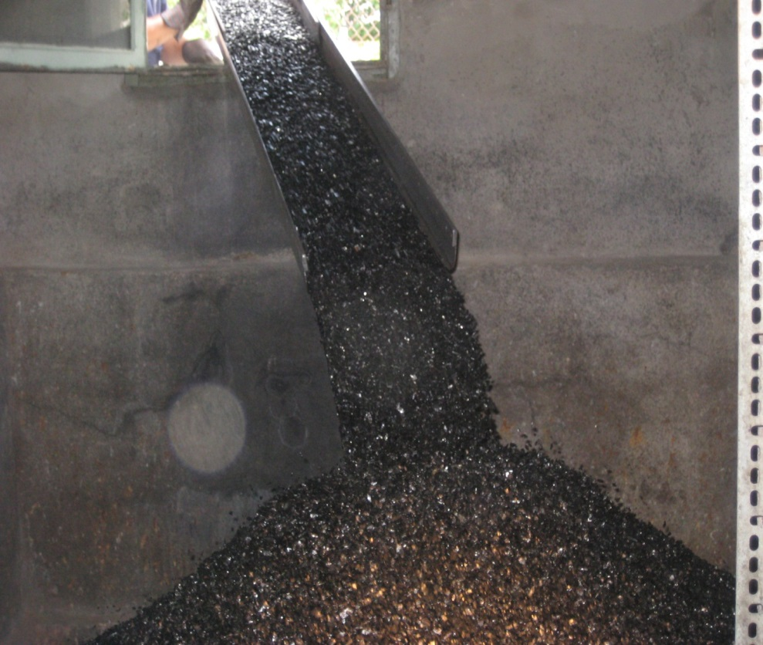
The transition to heat pumps in New England is the biggest shift in heating since the conversion from coal to oil.
1-866-ES-MAINE
www.efficiencymaine.com
dana.fischer@efficiencymaine.com

