Slide 1
Context and objectives
Our understanding of your context
Key objectives
As the core authority on GAAP, FAF’s financial accounting and reporting standards has long served as the critical backbone for TAA firms
The rapid emergence of new use cases, particularly in AI, requires forward-thinking approach to intellectual property licensing and value capture
A scalable and consistent pricing structure that can accommodate a diverse and growing base of licensees, from legacy accounting practices to disruptive technology platforms, is now imperative
To that end, you are seeking an external partner to provide expert recommendations and actionable insights to define a new pricing and market strategy that supports your mission and ensures long-term growth and relevance
Define the total addressable market (TAM) for FAF’s data, including:
Opportunities in untapped markets
Emerging industries
New product offerings
Develop a comprehensive pricing and packaging model that establishes clear and consistent rate structures, based on a robust fact base and strategic framework
Construct implementation and business case to gain alignment from organizational and board levels, ensuring a successful rollout

Slide 2
We are the most qualified partner to serve you
We know pricing …
… and your end customers
We’ve served 20+ software firms on AI-driven pricing and business model evolution, and conducted 100+ discussions with GTM CxOs on the topic
5+
200+
10+
TAA AI transformations in past 6 months
TAA customers interviews or surveyed
Due diligences on TAA mid-market assets over past 24 months
Software type
Impact
Frontier AI lab
$1B pipeline developed for new commercial product
CRM
2x consumption revenue growth
Financial management
10-20% annual organic revenue growth
AI data platform
4-5% expected revenue growth
We have developed relevant tools for TAA and beyond with QuantumBlack in order to accelerate deployment, de-risk implementation, and deliver measurable value faster through proven, pre-built AI solutions
Contact center
25% LTV
Business planning
20% annual revenue growth
Vertical ERP
10% expected revenue growth
Process automation
Commercial product launch in Q4'25
Clinical research
15-25% expected revenue growth
Additionally, we have extensive experience building out commercial excellence capabilities for professional services firms
Security monitoring
$100M pipeline developed on new model
Market intelligence
10% expected revenue growth
Adtech
15-20% revenue growth

Slide 3
Overall approach needs to answer 5 key questions
1
What are the highest-priority addressable markets and customer opportunities for FAF content? Which existing and emerging customer segments (e.g., accounting firms, software providers, AI startups) provide the greatest monetization potential?
2
How should FAF evolve its products, delivery models, and distribution strategy to address market demand? Which offerings best align with customer needs and FAF capabilities?
3
How should FAF package and position its content offerings relative to customer needs and market benchmarks? How should packages differ across customer types?
4
What pricing models and pricing structures should FAF adopt across customer segments and use cases? What prevalent industry pricing models are most applicable to FAF, and should they change by product type, customer segment, and intended use?
5
How should evolving AI-driven use cases inform FAF’s product strategy? How should packaging and pricing evolve as AI reshapes how accounting standards are consumed?

Slide 4
Proposed execution plan to address key questions across market analysis and pricing / packaging design
Market analysis
~4-6 weeks
Map full customer landscape across current and emerging segments (e.g., Big 4, AI-native startups, software/workflow providers, publishers)
Identify AI-driven emerging customer segments (e.g., model training, automation tools)
Assess how AI and automation may shift existing customer behavior and market dynamics
Prioritize opportunities by size and feasibility
Identify use cases of FAF data across customer segments (e.g., financial reporting tools, AI training material)
Prioritize opportunities to identify near-term quick wins and long-term strategic areas
Implementation
Pricing and packaging design
Design packages for each segment to maximize usability
Test implications of alternative commercialization approaches (e.g., DTC, partner/channel-based models)
Identify incremental products/services (e.g., enhanced data, APIs, derived insights, board commentary) based on revenue potential
Outline pricing model and price metrics (e.g., enterprise license, API-based, revenue-linked)
Define price points for each package based on willingness to pay for each customer segment
Benchmark price points against similar offerings
Project kickoff
SteerCo #1: Review customer segment landscape, use cases, and preliminary revenue pools
SteerCo #2: Select optimal pricing and packaging design
SteerCo #3: Finalize implementation plan and priority pilots
Weekly core team meetings

Slide 5
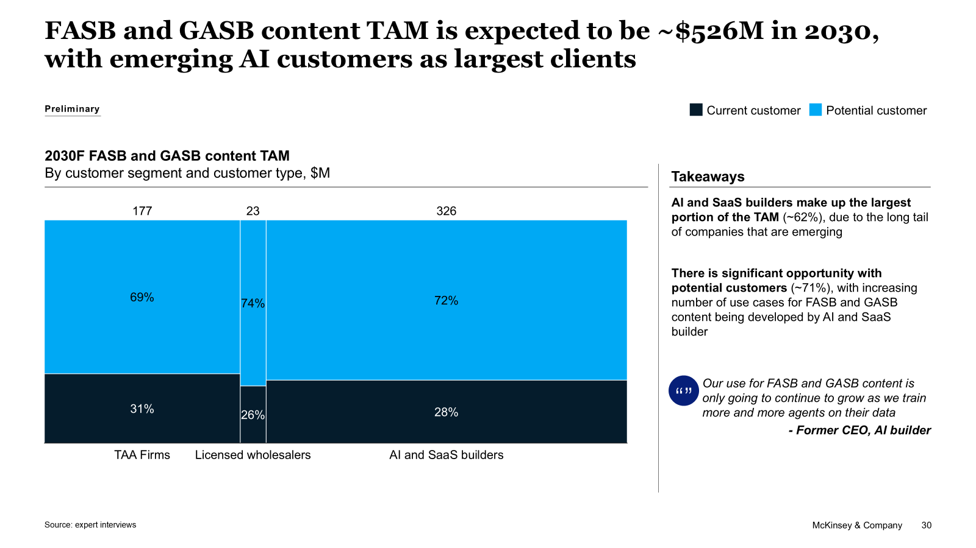
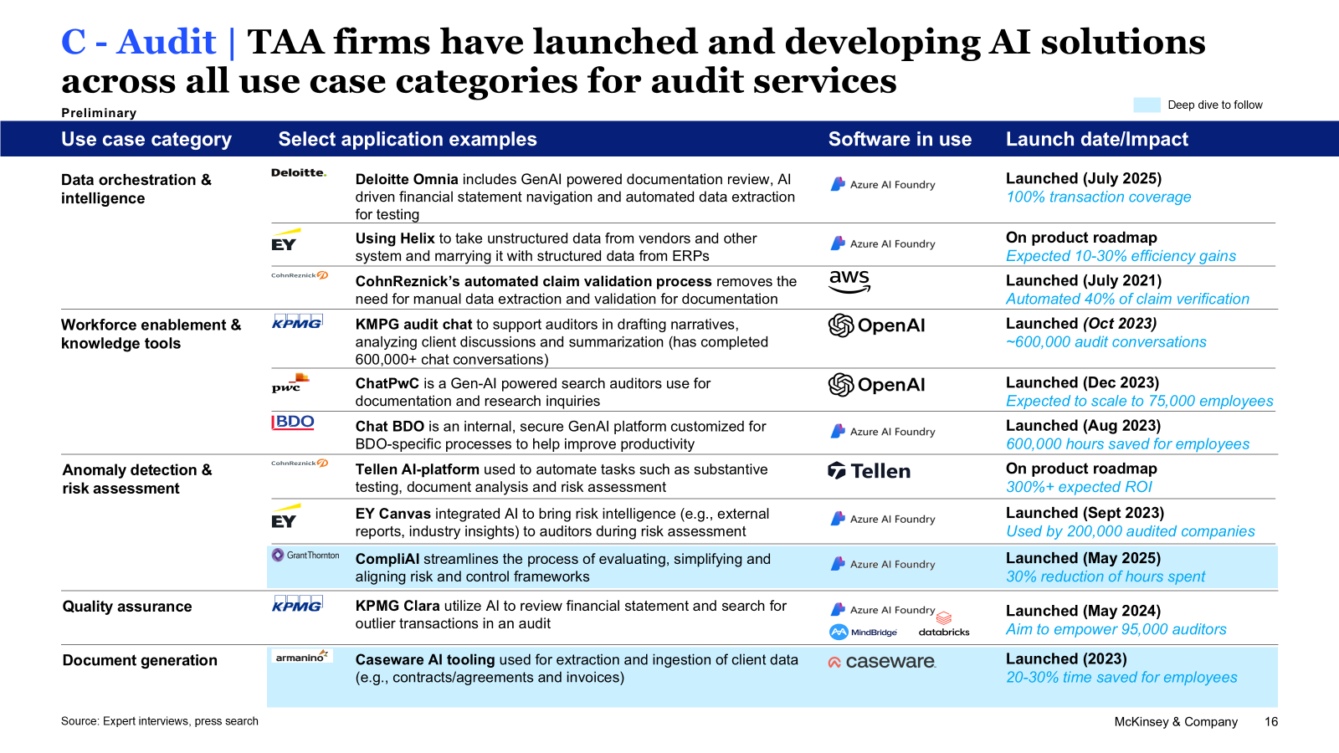
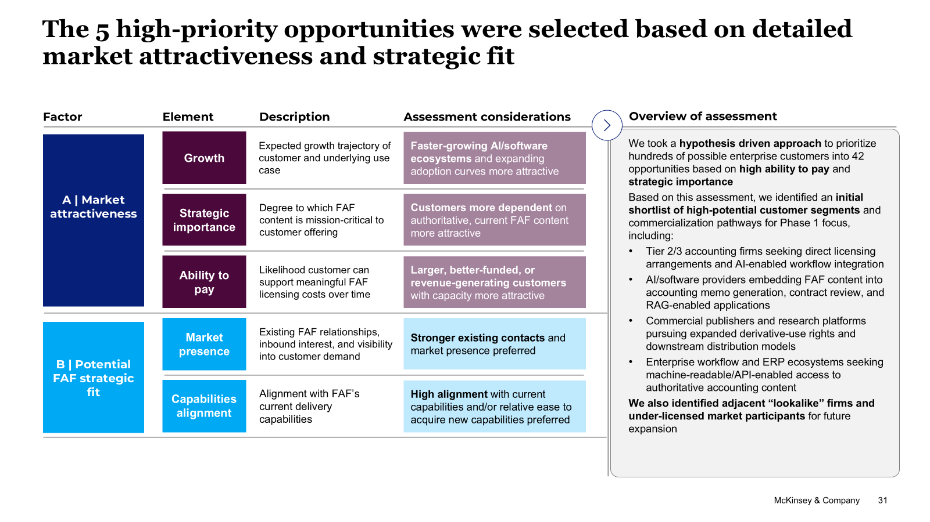
Illustrative outputs for the market analysis workstream
Addressable market map
Define market segments (e.g., from existing customers, inbound requests, interviews)
Size segments (e.g., leveraging expert surveys, proprietary data) to determine TAM and current share
AI-driven market shifts
Assess potential AI use cases of FAF data (e.g., model training, retrieval context)
Determine implications of identified use cases (e.g., headwinds and tailwinds) for FAF market sizes
Prioritization framework
Create framework to evaluate opportunities based off opportunity size and strategic fit (e.g., current market presence)
Leverage framework to identify high-priority opportunities

Slide 6
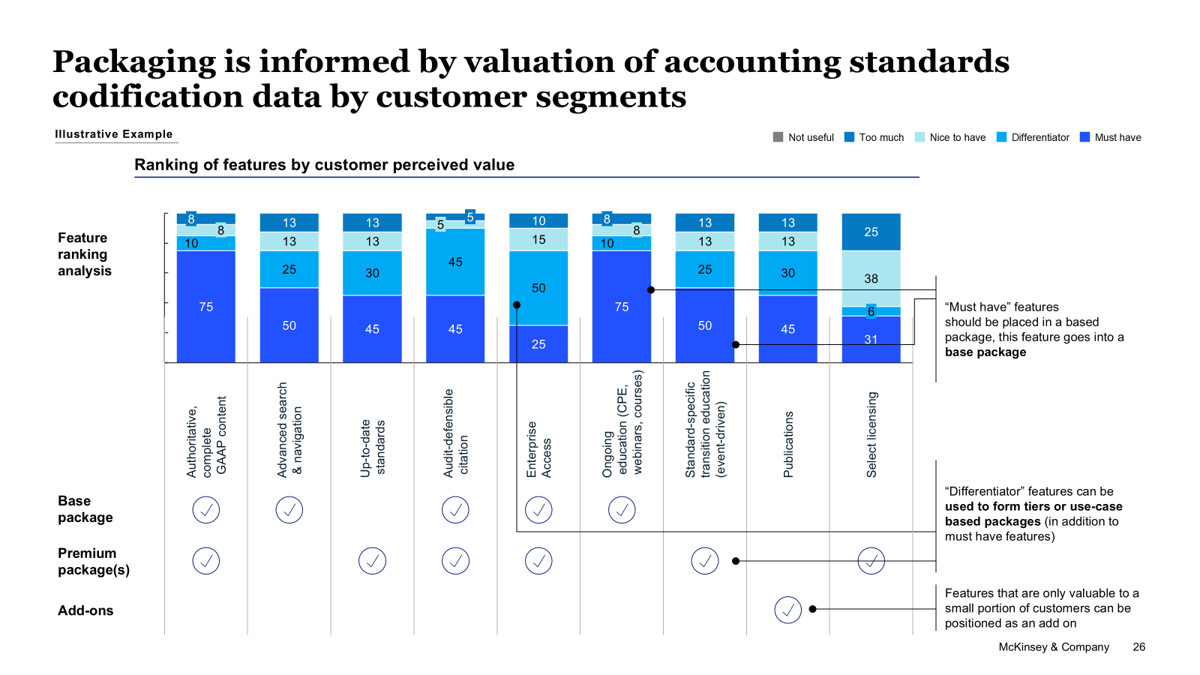
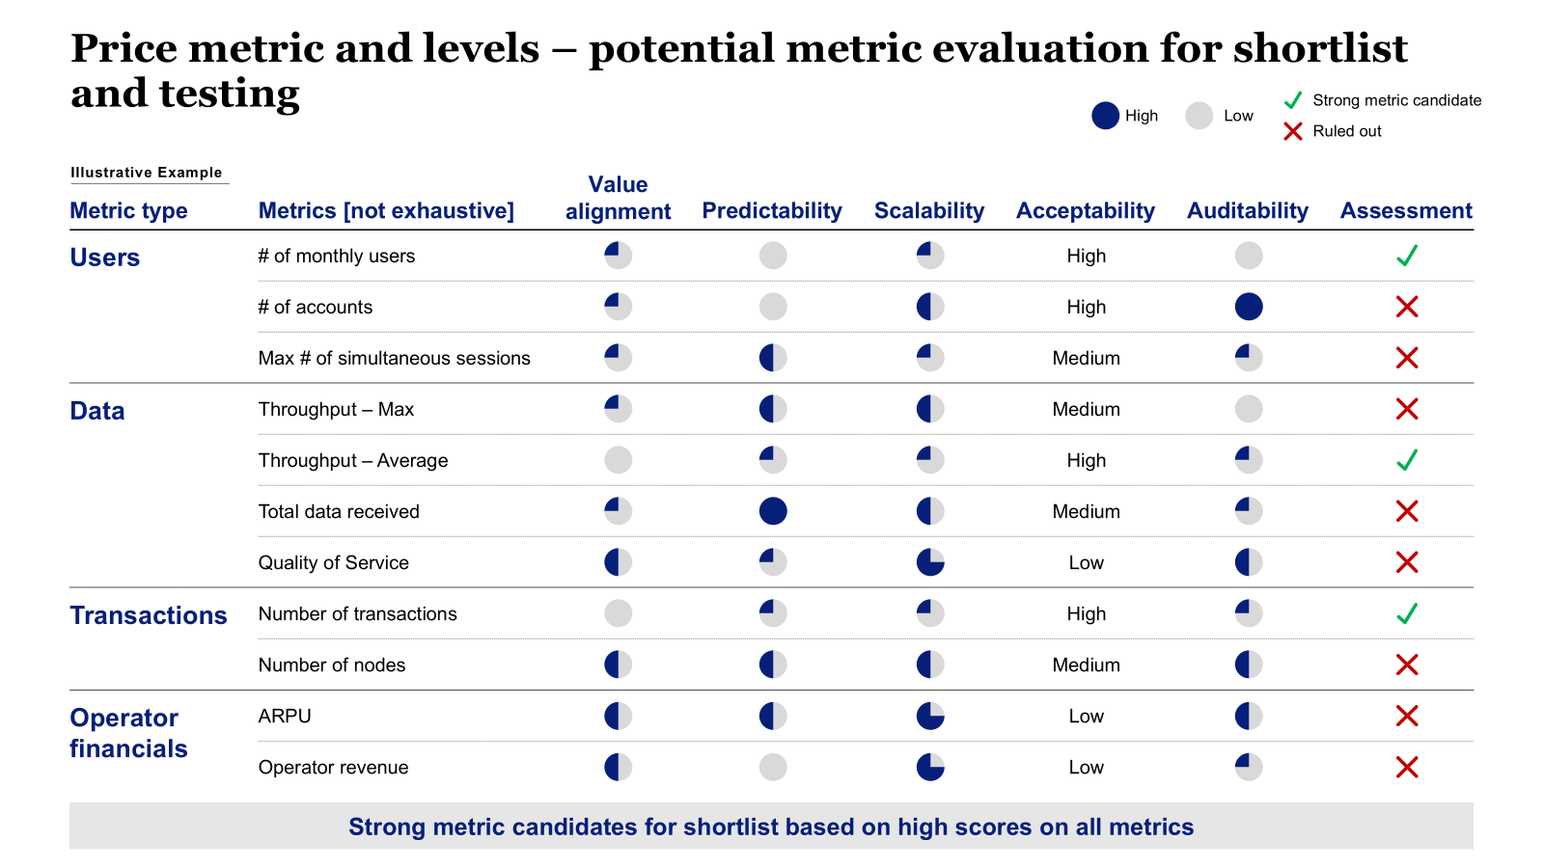
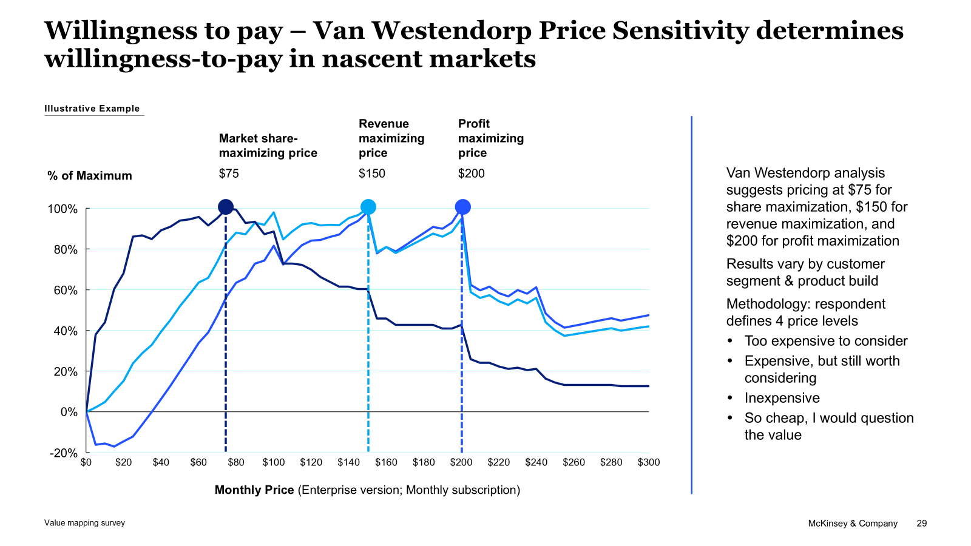
Illustrative outputs for the pricing and packaging workstream
Packaging framework
Develop segment-specific packaging structures tailored to customer use cases (e.g., Big 4 vs. AI startup)
Create tiered packages (e.g., base, premium) informed by customer data and interviews
Pricing models and metrics
Evaluate pricing model and metric options across an industry-tested assessment framework
Develop recommendations, tailored to customer use cases (e.g., model training, licensed wholesalers) and FAF capabilities
Willingness-to-pay analysis
Assess willingness-to-pay through primary research (e.g., customer interviews, benchmarking)
Evaluate price points for individual features to determine package prices

Slide 7
Scope questions we will investigate in Phase 1
Category
Scope question
Selected sources of insight
Customer segmentation & demand landscape
What are the key customer segments (e.g., Big 4, Tier 2/3 firms, software providers, AI-native players)?
How do the ~30 inbound firms map to these segments, and what are their defining characteristics (e.g., size, product type, customer base)?
Client-provided inbound list (~30)
For each segment, what is the current customer footprint (i.e., existing licensed customers)?
Client data
For each segment, what is the whitespace opportunity, and which lookalike firms represent high-probability targets?
Client data
Which segments are most attractive based on monetization potential and scalability of demand?
Research Approach
Informed by 30+ expert interviews of current, past, and prospective customers
Decompose the offering into component features (e.g., raw data, search / navigation, automated updates, citations)
Ask respondents to evaluate each feature (e.g., must-have, differentiator, unnecessary) to create packages
Ask structured pricing questions to model price points
Customer use cases & value drivers
What are the primary use cases for the data across customer segments?
Where does the data sit in the customer value chain, and how would the product or service be impacted without it?
What pain points do customers experience with current data access or usage (e.g., latency, completeness, usability, legal risk)?
Access, consumption & packaging
How are customers accessing and integrating FAF data into their workflows or products (e.g., licensed, scraped, APIs)?
How do customers prefer to consume the data, and what is the value of improved delivery (e.g., APIs, structured data, real-time updates)?
What is the relative importance of ancillary features (e.g., search, navigation, content formats) in driving value?
Value perception & willingness to pay
How important is the data relative to other inputs used by the customer?
How do buyers across segments perceive the suitability of different pricing models (e.g., fixed-fee, seat-based, all-in-one, outcomes-based) in terms of acceptability, predictability, scalability, and linkage to value?
How does the value customers receive from FAF data compare to the price they pay, relative to available alternatives?
What pricing levels have been observed in inbound discussions, and what does transaction data indicate about variability or discount dispersion across similar customers?
Client deal history / inbounds
Monetization opportunities & prioritization
Where is the data being accessed without appropriate licensing (e.g., scraping, redistribution, indirect access)?
Which users are likely non-compliant, and what would trigger them to convert to licensed usage (e.g., pricing, enforcement, ease of access)?
Client data + expert interviews
What is the total revenue opportunity across inbound demand, whitespace segments, and non-compliant users?
Indicative sizing
Which customer segments and accounts should be prioritized based on value and likelihood to convert?
What is the most effective route to market by segment (e.g., direct vs. intermediated)?

Slide 8
We will conduct both qualitative and quantitative research to build our fact base
Qualitative research (interviews)
Quantitative research (survey)
Target N
5-10 interviews is typically sufficient to pressure test initial hypotheses and write an initial survey draft
For B2B clients, N of 200 - 300 enables data to be cut 2-3 times with 25+ responses in each segment
Quotas
Specify min or max quotas for the following respondent attributes:
Competitors: Direct, Substitutes
Customers: by business function, size, and/or industry
Customer status : current customers (discuss perceived value & satisfaction) vs. prospective (discuss market perception)
Specify min or max quotas for key segments, which may be defined by the following respondent attributes:
Business function: data analysts, data scientists, finance, business analysis, sales, marketing, IT, etc.
Company size: SMB/Mid Market/Enterprise, or number of employees, or company revenue
Customer type: TAA, AI/SaaS builders, wholesalers, etc.
Customer status: current customers vs. prospective
Respondent profile
Ensure that respondents are qualified to answer questions:
Employment status: full time, former full time (within last 2 years)
Role in decision making process: decision maker, or significant input (within last 2 years)
Job title: Manager, Director, VP, SVP, C-suite etc.

Slide 9
Case study: Designed new AI platform fee for clinical trials software provider
Disguised client example
Context
Approach
Overall impact
A ~$1B ARR clinical trial software provider with a leading electronic data capture platform was facing challenges monetizing its growing set of AI capabilities. Specifically:
A fragmented portfolio of ~50 AI features that had not been effectively packaged or monetized
A more constrained demand environment, with clinical trial starts flattening
Increasing customer usage and platform activity without a clear mechanism to capture incremental value
Significant data assets without a defined strategy to translate data and insights into revenue
Rationalized and consolidated a disparate set of ~50 AI capabilities into a coherent packaging and monetization framework, defining clear placement of AI features (e.g., automation, analytics, decision support) into a platform fee
Combined outside-in (e.g., market landscape, competitor benchmarking, expert interviews) and inside-out (e.g., customer usage data, sales interviews) perspectives to create a list price table for the AI platform fee that was market-aligned and acceptable to customers
Segmented the customer base into distinct archetypes based on product adoption, usage intensity, customer type (e.g., sponsor, CRO), and scale, to inform differentiated packaging, pricing, and migration pathways
Assessed product cost structure and developed a margin model to support pricing and discount guardrails and target margin profiles across packages
Built and deployed core sales enablement materials (e.g., sales kits, pitch decks, FAQs, pricing and ROI tools) and validated the new packaging approach with a targeted set of customers to ensure adoption feasibility and ARR uplift potential
+$110M projected steady-state ARR uplift from addition of the new “AI platform fee”
50+ AI features consolidated into a coherent set of packages, all monetized through a single platform fee
8+ consumption meters harmonized into a single, fungible AI credit model

Slide 10

What we hope you will take away from today
Unit of measure
You can have confidence in our proven approach to B2B pricing, which we will tailor to your situation, which will benefit from the full extent of understanding of your product as well as the B2B customers you aim to serve
You will get the skills/expertise needed to deliver a high-fidelity answer – we will bring “A Team” of our Pricing, TAA, and information services leaders. Kennedy Research independently reviewed our pricing expertise and gave us top marks for depth and breadth.
You will start discussing an “implementable” answer on the first day itself, our proprietary tools allow for rapid benchmarking and access to defined panels for research, in-fact we have already started building Day 0 hypothesis – to move rapidly to insights and action
We will work hand-in-hand with you your team to ensure co-creation and organization ownership of the answer

