Slide 1
GEORGIA TECH · FINANCE RESEARCH · COMPANION TO ESG_ADAPTIVE_RL
ESG Market-Regime Detection
A 3-State Hidden Markov Model for Regime-Conditional Sustainable Investing
Detects when the ESG universe is Calm · Choppy · Stressed — the signal a reinforcement-learning allocator uses to switch its E/S/G-vs-return reward weights by regime.
Adapted from a production SPY regime model → self-contained on ESG price history (no options data).
Notes:
3-state Gaussian HMM adapted from a production SPY regime model for the ESG universe. The output feeds regime-conditional reward weights in the ESG-Adaptive RL project.

Slide 2
MOTIVATION
Why regime detection for ESG RL
The right trade-off between return and sustainability is not constant — it depends on the market state. A regime label lets the allocator hold a different E/S/G tilt in calm markets than in stressed ones.
In calm markets
Lean into ESG tilts and growth — volatility is low, drawdown risk is contained.
▲
In choppy markets
Trim exposure; the vol-of-vol rises and factor leadership rotates.
◆
In stressed markets
De-risk hard — stress days carry ~2× the volatility with poor risk-adjusted return.
■
Notes:
The RL project's core thesis: reward weights over return and E/S/G should be regime-conditional. This model supplies the regime.

Slide 3
APPROACH
Same HMM engine, ESG-specific features
The ESG adaptation
The engine (unchanged)
SPY model used…
ESG model uses…
3-state Gaussian-emission HMM, diagonal covariance
States pinned by realized-vol → Calm / Choppy / Stress
VIX / VIX9d implied
term structure (SPX-only)
Realized-vol term structure
log(rv₁₀ / rv₆₀) — self-contained
Filtered (forward-only) posteriors — point-in-time, no look-ahead
Variance risk premium
(needs implied vol)
Dropped — no options data
required for any ESG name
Anti-whipsaw hysteresis on regime switches
Trend · realized vol ·
drawdown · Parkinson vol
Kept + 20-day momentum
Deterministic stress guardrail (below 200d trend + vol backwardation)
Notes:
Only the feature set changes. The realized-vol term structure is the key substitute for the SPX-specific VIX term structure, making the model self-contained on any ESG price series.

Slide 4
DATA & UNIVERSES
Three ESG universes — one built from real ESG scores
High-ESG Index
SUSA ETF
DSI ETF
PRIMARY · GENUINELY ESG-DRIVEN
EXTERNAL ROBUSTNESS CHECK
EXTERNAL ROBUSTNESS CHECK
Equal-weight basket of the top-40 US large-caps by real Refinitiv ESG score, from the repo's own Dataset/.
iShares MSCI USA ESG Select — a broad ESG-tilted US equity benchmark.
iShares MSCI KLD 400 Social — a values-screened US equity index.
34
5,085
4,630
names, full history
trading days
trading days
2011–2026
2006–2026
2008–2026
Notes:
The high-ESG index makes the regime model genuinely ESG-driven rather than a generic ETF proxy. SUSA and DSI confirm robustness.

Slide 5
METHODOLOGY
Look-ahead-free by construction
1
2
3
4
5
Lagged z-score
features (t-1 window)
→
Fit 3-state HMM
(8 restarts)
→
Vol-order &
label states
→
Filtered decode
+ hysteresis
→
Stress guardrail
override
Two out-of-sample validation protocols
⏱
Chronological train / test
↻
Walk-forward
Fit the HMM once on dates before 2021-01-01, freeze it, then decode the later test period with filtered posteriors. No test bar is ever seen in training.
Retrain monthly on an expanding window; every single day is labeled by a model trained only on its own past. The honest rolling protocol.
Notes:
Every guard against look-ahead: lagged standardization, forward-only posteriors, and two independent OOS protocols.

Slide 6
RESULT 1 — THE LABELS MEAN SOMETHING
Stress days carry ~2× the volatility of calm days
Out-of-sample next-day realized volatility, grouped by the frozen model's regime label. The separation holds across all three universes — evidence the regimes are economically real, not curve-fit.
2.2×
stress-vs-calm volatility ratio (avg, OOS)
11–20%
of days flagged Stress under the calibrated train/test split
Notes:
The core scientific result: the regime label predicts next-day volatility out of sample, ~2x from calm to stress, on every universe.

Slide 7
RESULT 2 — OUT-OF-SAMPLE BACKTEST
A regime overlay roughly halves risk out-of-sample
Overlay = 100% / 60% / 0% invested in Calm / Choppy / Stress (signal lagged one day, costs charged). Test period 2021–2026, frozen model.
Universe
Strategy
CAGR
Vol
Sharpe
Max DD
Calmar
DSI overlay, out-of-sample
High-ESG
Buy & Hold
14.3%
16.3%
0.78
−22.2%
0.64
0.92 Sharpe vs 0.75 buy & hold
High-ESG
Overlay
6.9%
9.9%
0.52
−14.4%
0.48
SUSA
Buy & Hold
13.8%
17.1%
0.72
−28.2%
0.49
SUSA
Overlay
8.8%
9.9%
0.70
−17.4%
0.50
DSI max drawdown
DSI
Buy & Hold
14.8%
17.7%
0.75
−28.4%
0.52
−7.7% vs −28.4% buy & hold
DSI
Overlay
10.0%
8.5%
0.92
−7.7%
1.29
Green = overlay improves the metric out-of-sample.
Notes:
The overlay is a risk-management demonstration: ~half the volatility and drawdown OOS everywhere, and on DSI it also beats buy & hold on Sharpe and Calmar.

Slide 8
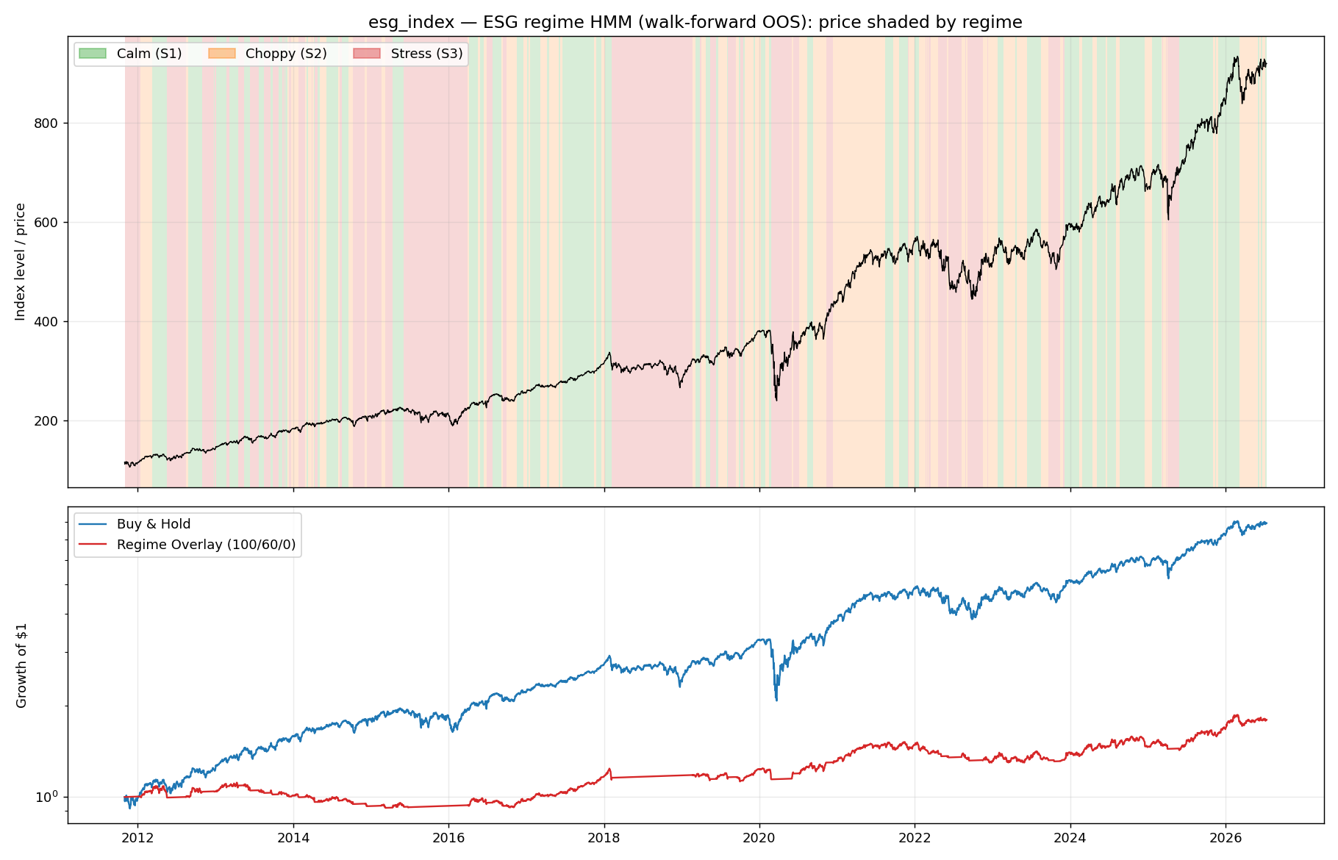
RESULT 3 — REGIME MAP
The model flags every major stress episode
High-ESG index, walk-forward (OOS)
Calm — low vol, trending
Choppy — elevated vol
Stress — high vol / drawdown
Correctly caught
2015–16 selloff
Q4 2018 drawdown
2020 COVID crash
2022 bear market
Notes:
Visual confirmation: the shaded regimes align with the known stress periods, and the overlay equity curve avoids the deep drawdowns.

Slide 9
ROBUSTNESS & HONEST LIMITS
Walk-forward: the same story, plus one caveat
Universe
Strategy
Sharpe
Max Drawdown
!
Where to read it carefully
SUSA
Buy & Hold
0.52
−53.9%
SUSA
Overlay
0.65
−18.2%
Not a return-maximizer.
In strong bull runs the overlay gives up CAGR by sitting out stress days. Its value is proving the labels are tradeable and transfer OOS.
DSI
Buy & Hold
0.56
−49.9%
DSI
Overlay
0.56
−27.9%
Early walk-forward is conservative.
On the shorter high-ESG basket it over-labels Stress (~35%) when training data is thin; the calibrated train/test split puts it at 11–13%.
On the long ETF histories the walk-forward overlay lifts Sharpe and cuts max drawdown by ~half — it even sidesteps the 2008 crash the train/test split can't see.
Price regimes, not ESG-score regimes.
Detected from ESG-universe price dynamics — not yet from ESG scores directly.
Notes:
Intellectual honesty: the overlay trades return for risk in bull markets, and the early walk-forward is conservative. Both are expected and disclosed.

Slide 10
TAKEAWAYS & NEXT STEPS
A regime signal ready to drive the RL allocator
✓
Regimes are real & OOS-valid
Next steps
Stress-day vol ≈ 2× calm across all three universes, out-of-sample — a clean, tradeable signal.
Add ESG-dispersion & ESG-momentum features → regimes reflect ESG-factor stress, not just price stress
✓
Risk cut roughly in half
Overlay ~halves volatility and max drawdown OOS; on DSI it beats buy & hold (Sharpe 0.92 vs 0.75).
Feed regime labels into the RL reward: evolve per-regime E/S/G-vs-return weights
✓
Drops into the repo
Significance tests on the regime-conditional vol separation
regime.py matches esg_adaptive_rl conventions; committed on branch esg-regime-hmm.
ESG-Adaptive RL · Georgia Tech Finance Research · targeting ACM ICAIF 2026
Notes:
The regime detector is validated and integrated. The immediate next step is wiring its labels into the RL reward to realize the project's regime-conditional thesis.

