Slide 1
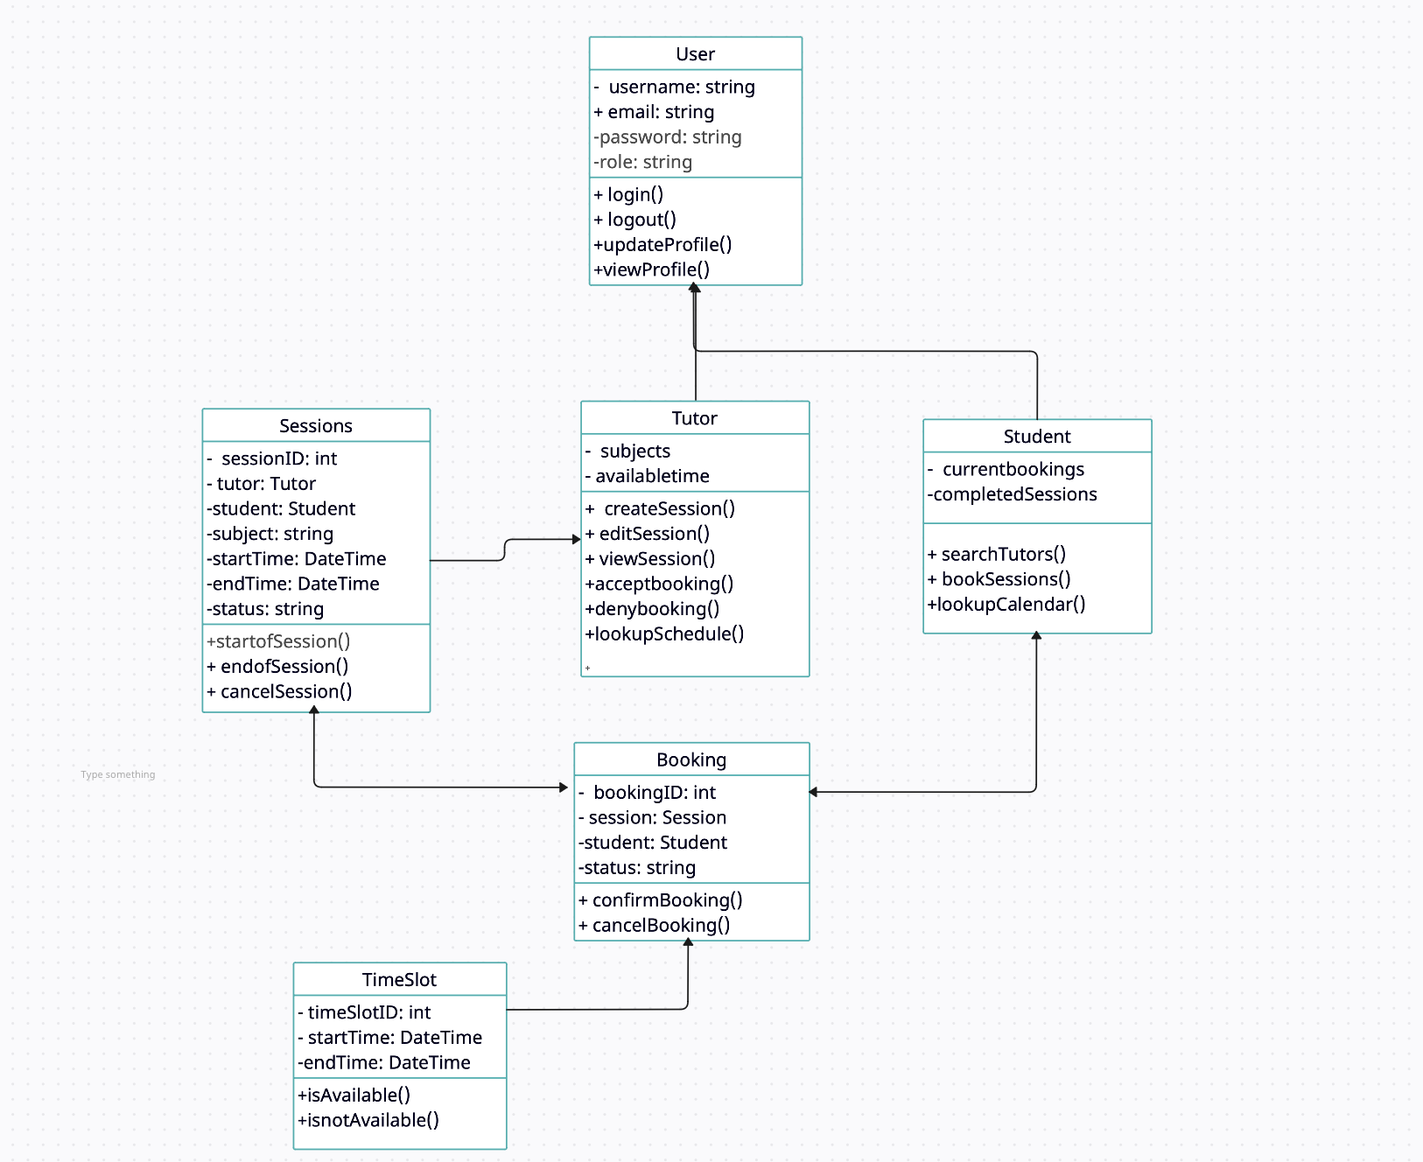
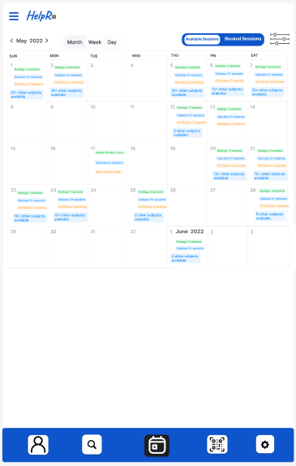
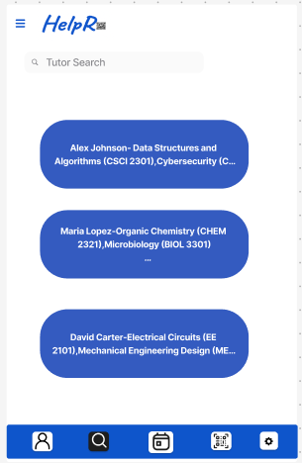
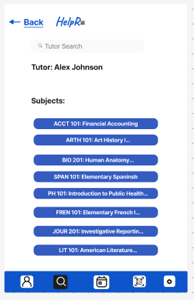
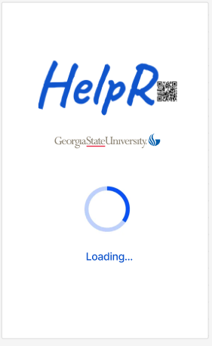
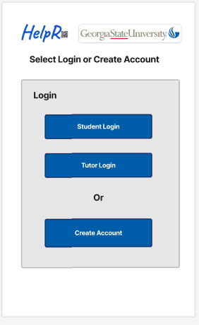
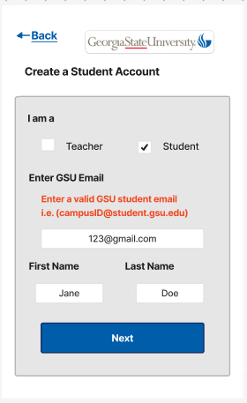
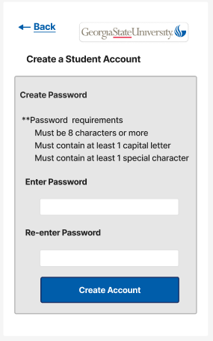
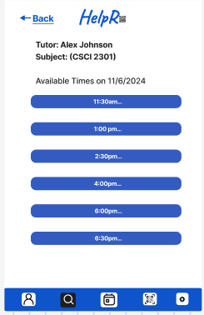
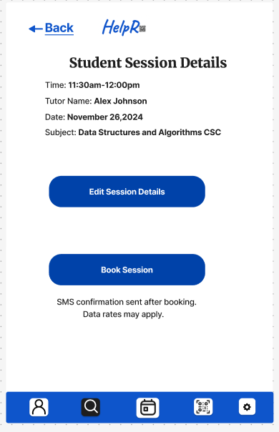
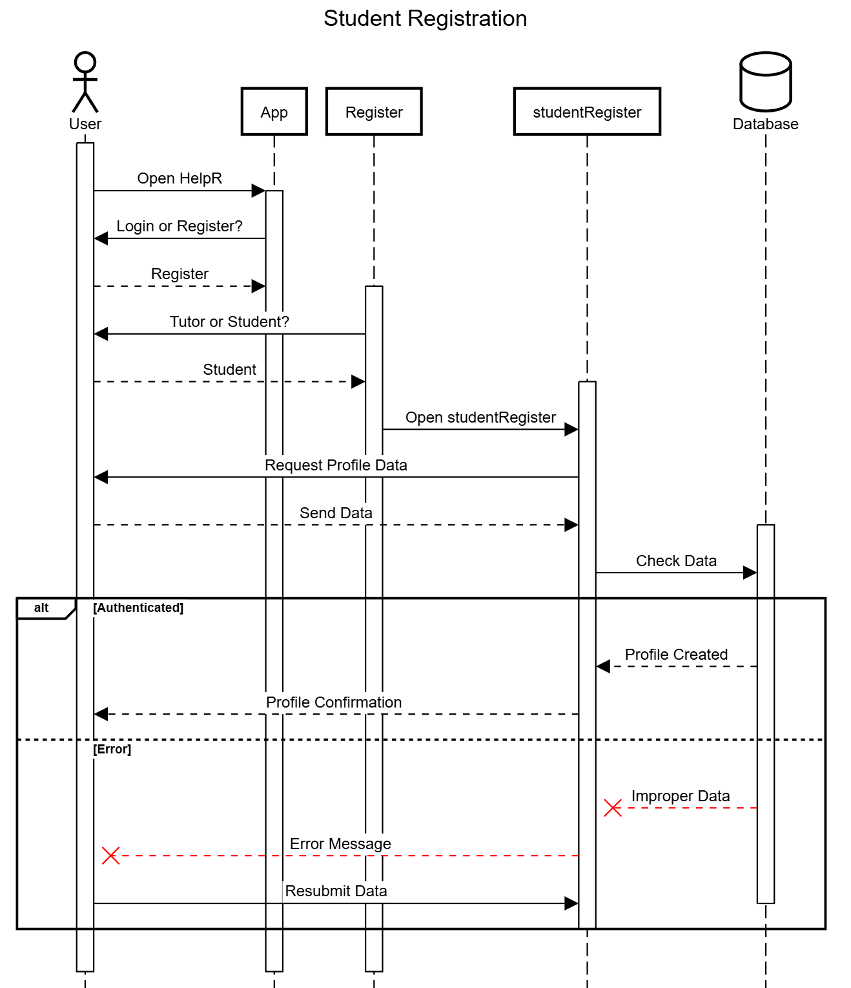
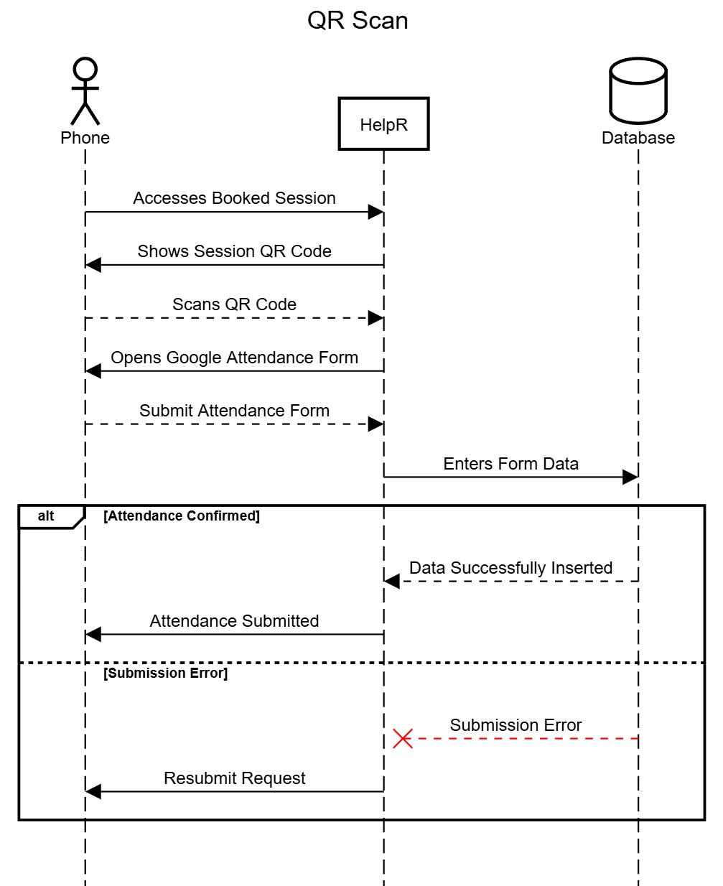
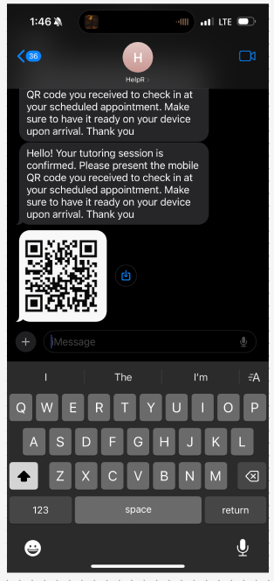
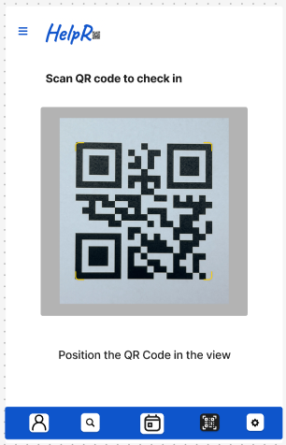
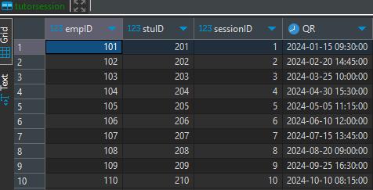
HelpR
Macauley Amobi, Anna Adams, Hayden Gardner, Alanna Ramsoondar
Registration Mockup
High-Level UML
Calendar and Search Mockup
Registration Sequence
QR Scanning Sequence
QR Mockup and Table
Overview
Introduction: This software is a mobile check-in app for tutoring services. Tutors will be able to enter their available tutoring time into a calendar, while students can access the calendar and select tutoring sessions for subjects they are having difficulty with. The app’s purpose is to streamline the connection between tutors and students, allowing for easier access to available tutoring sessions and communication.
Future Research: We will research tools like Flutter to use one programming language and one codebase to build an application for multiple platforms in order to be less cost and time-consuming than native app development. We need to have ways to send confirmation emails through an API using Sendgrid. We need an API to generate QR codes reliably to enable students to start tutor sessions. We will research Springboot controllers for our API endpoints.
References:
Build apps for any screen. Flutter. (n.d.). https://flutter.dev/
QR code generator API - developer Tools. Shareaholic. (n.d.). https://www.shareaholic.com/api/qrcode
SendGrid email API and email marketing campaigns. SendGrid. (n.d.). https://sendgrid.com/en-us

