Slide 1
AI ANALYST · AI ANALYST
Q1 2026 surged +42% but March erased $29K — seasonal trap or new risk?
PERIOD
ORDERS
SEGMENTS
PRODUCTS
PREPARED BY
Jan 2025 – May 2026
488 orders
3 (Enterprise, Mid-Market, SMB)
3 (Platform, Analytics, Support)
AI Analyst

Slide 2
Context | Business Context & Analysis Scope
Q1 2026 rebound masked geographic concentration and a sharp seasonal March trough
Business Context
Analysis Scope
Overall performance Q1 2026 delivered $131,360, the strongest quarter since Q2 2025's peak of $136,809.
Segment growth All three customer segments grew QoQ for the first time in four quarters.
Mid-Market led at +74%
Enterprise added +26%
SMB grew +33%
What the rebound masked
North region alone drove 86% of the QoQ dollar gain, jumping from 23.5% to 40.1% revenue share
Platform accounted for 60.6% of Q1 revenue after a +72% QoQ surge
DATA PERIOD
2025-01-01 to 2026-06-30
RECORDS ANALYZED
500 orders
DIMENSIONS
segment, region, product
METHODS
Descriptive, Diagnostic, Predictive
KEY QUESTION
Q1 2026 rebound masks regional concentration and one deep seasonal trough

Slide 3
Approach | Analysis Framework
Three analytical lenses explain what happened, why it happened, and what comes next
01
02
03
What Happened
Why It Happened
What's Next
Overall performance Q1 2026 revenue reached $131,360, up +41.8% QoQ from Q4 2025's $92,669.
The March trough March hit $25,002, a drop of -54% vs February, the sharpest single-month decline in the dataset.
Segment picture All 3 segments grew QoQ, with North region dominating the dollar gains at +135.5%.
Root cause Enterprise and Platform withdrawal drove 70% of the March drop, within a confirmed seasonal pattern.
Seasonality confirmed March pattern is identical to 2025, confirming structural rather than one-off behavior.
Hypotheses ruled out Discounts and churn tested and rejected as contributing causes. 5 hypotheses, 3 rejected.
Base case Q3 2026 forecast of $155,869, modeled using Holt-Winters at 8.3% holdout MAPE.
Forecast range 95% confidence interval spanning $125K to $179K across three scenarios.
Key risk variables North share and Platform QoQ are the two primary swing factors for Q3 outcome.
→ Descriptive: 17 months, 488 orders
→ 5 hypotheses tested, 3 rejected
→ Q3 2026 forecast, 95% CI: $125K–$179K

Slide 4
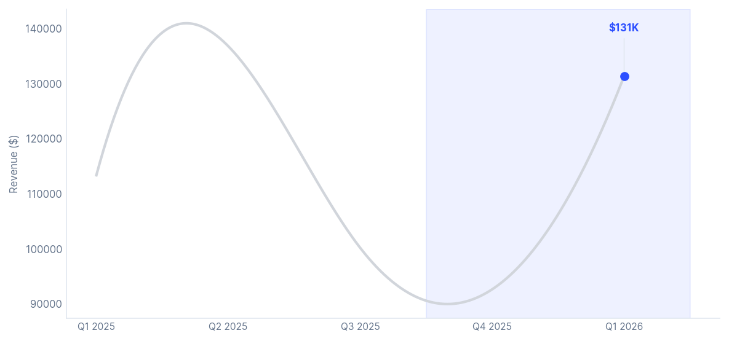
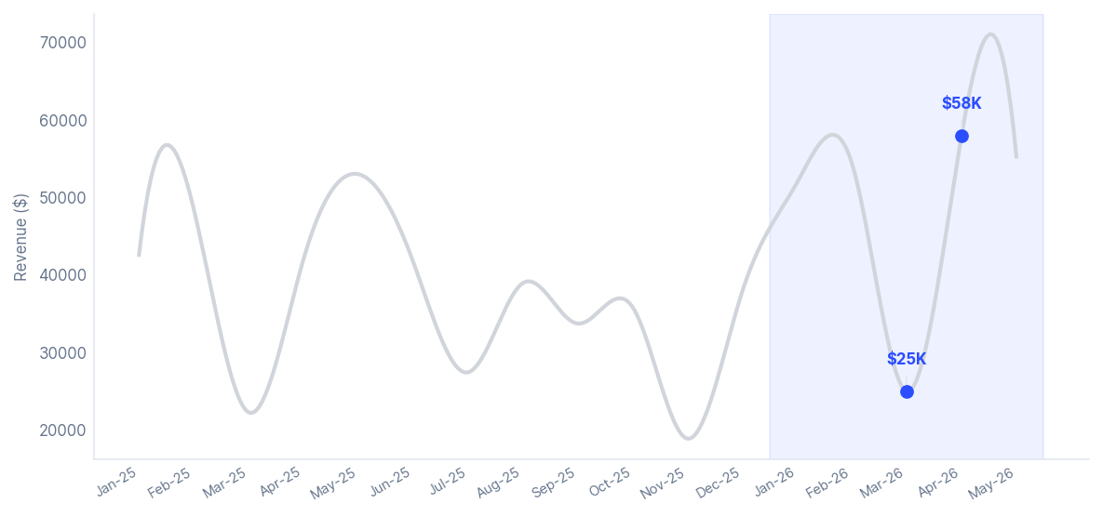
Context | What's Happening
Q1 2026 reversed three consecutive quarters of decline, marking the strongest rebound in 17 months
1
2
Revenue fell three consecutive quarters from the Q2 2025 peak of $136,809 to $92,669 in Q4 2025, a -32% cumulative decline. Q1 2026 reversed course sharply, adding $38,691 (+41.8% QoQ) to reach $131,360, the strongest single-quarter rebound in 17 months.
January ($51,926) and February ($54,432) were the two strongest consecutive months in the dataset. March dropped sharply to $25,002 (-54% MoM), consistent with prior seasonality. April rebounded to a record $58,003 (+132% MoM), confirming a strong V-shaped recovery.
Three-quarter slide reversed in Q1 2026 — revenue recovered to near-peak levels
March 2026: V-shaped trough — April sets all-time monthly record at $58K

Slide 5
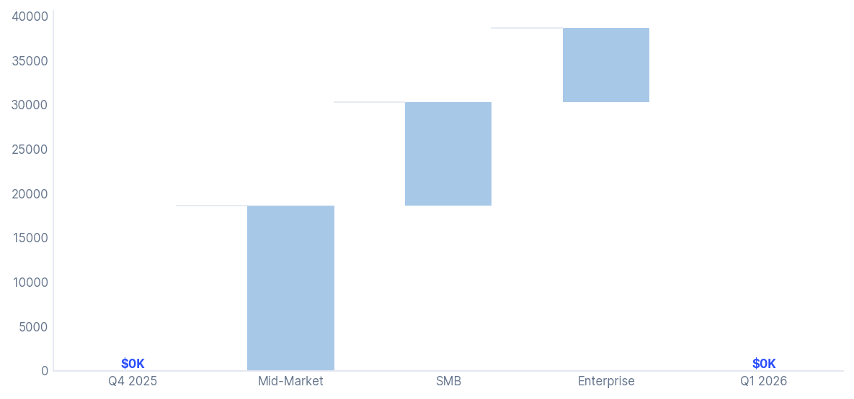
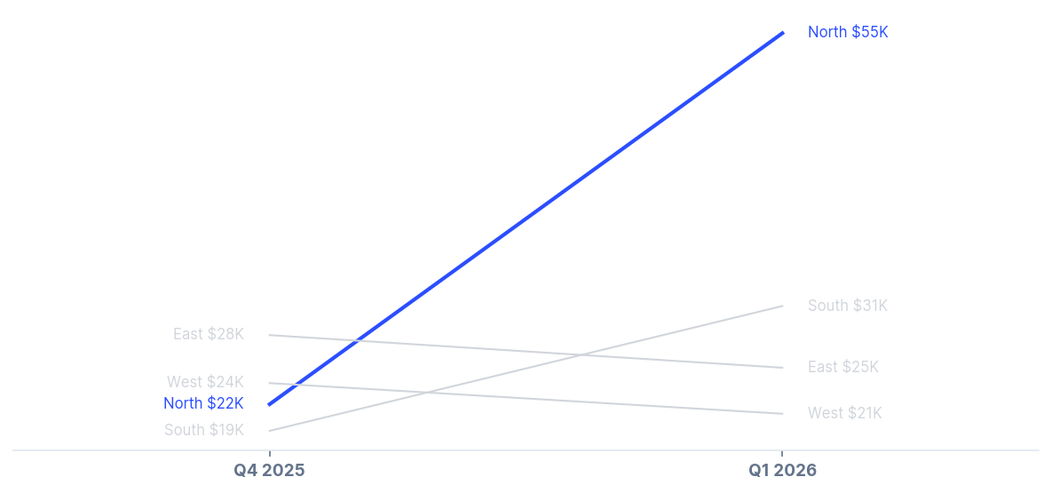
Context | What's Happening
Mid-Market led growth at 74% QoQ, but North drove 86% of the total dollar gain
1
2
All three segments grew QoQ — the first full-segment rebound in four quarters. Mid-Market was fastest at +74.1% QoQ, contributing 48% of the total $38.7K gain. Enterprise (+26%) and SMB (+33%) also expanded, making Q1 the broadest growth quarter in the dataset.
North surged +135.5% QoQ, jumping from 23.5% to 40.1% of total revenue and contributing 86% of the QoQ dollar gain. South grew +57.7%. East (-10.4%) and West (-11.6%) contracted, showing Q1 growth was geographically concentrated despite strong headline numbers.
Mid-Market added $18.6K — nearly half the entire Q4-to-Q1 revenue gain
North jumped from $21.7K to $54.9K — East and West both contracted QoQ

Slide 6
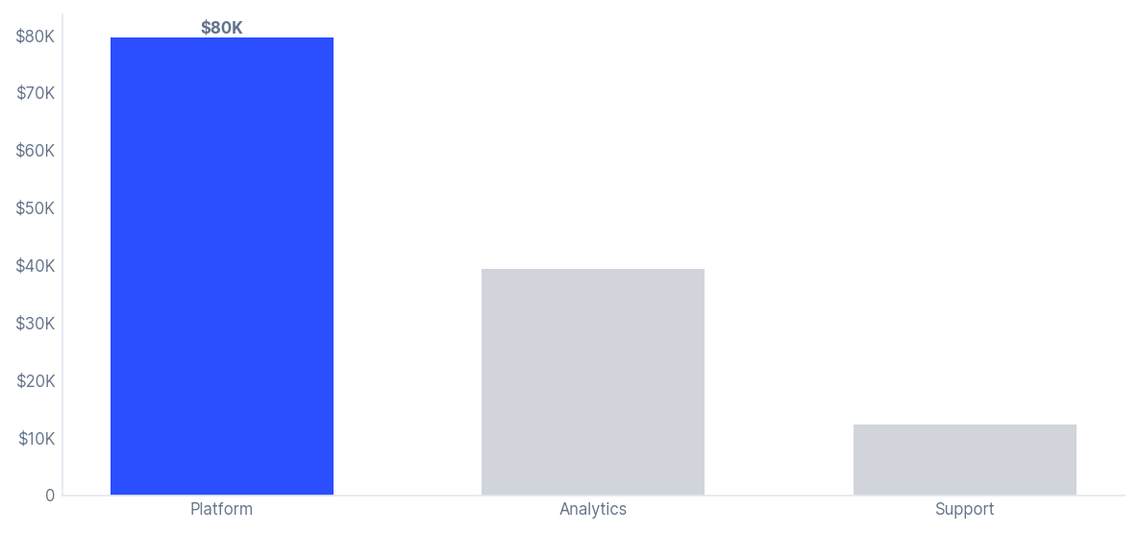
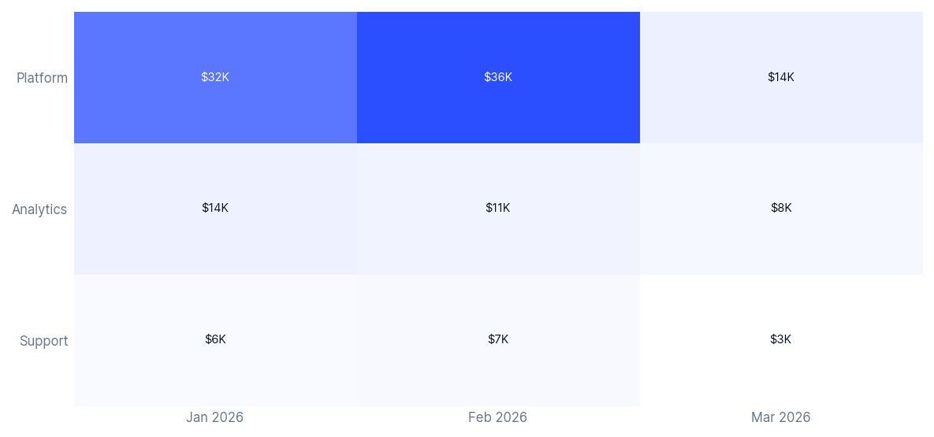
Context | What's Happening
Platform generated 61% of Q1 revenue — primary growth engine and largest concentration risk
1
2
Platform surged +71.8% QoQ to $79,623, contributing 86% of the total QoQ dollar gain and expanding to 60.6% of Q1 revenue. Analytics grew moderately (+36.9%), while Support declined -29.7% as the only contracting product. Platform is now 2.1x larger than Analytics.
With 60.6% of total revenue, Platform has become a major single-product dependency. In March, Platform fell -60.6% and accounted for 73.2% of the monthly revenue drop, amplifying the seasonal trough. Any Platform slowdown in Q3 would disproportionately impact overall performance.
Platform at $79.6K — 2.1x Analytics, 6.5x Support; Support the only product declining
Platform dominates every month of Q1 — March collapse came entirely from Platform drop

Slide 7
Findings | Overview
Three data-backed root causes explain the March decline
01
Seasonal Demand Trough
02
Enterprise Withdrawal
03
Platform Concentration
The pattern March fell -54% in both 2025 and 2026, confirming a structural seasonal trough rather than a one-off event.
The mechanism B2B budget freeze at fiscal year boundary drives Enterprise and Mid-Market buyers to defer purchases.
The recovery signal April recovered V-shaped both years, confirming demand is deferred, not lost.
The scale Enterprise dropped from 9 orders to 4 in March, with revenue falling -86.4%.
The concentration Enterprise and Mid-Market together drove 109% of the total March revenue drop.
The offset SMB grew +21% but only partially masked the severity of the Enterprise decline.
The impact Platform fell -60.6%, losing $21.5K in March alone.
The dominance Platform drove 73.2% of the total revenue drop, the single largest contributing factor.
The paradox AOV compressed from $1,869 to $1,270 per order, while the same product powers Q1 growth.
H1 confirmed: accounts for 100% of drop
H2 confirmed: mechanism within H1
Amplified H2 — same product powers Q1 growth

Slide 8
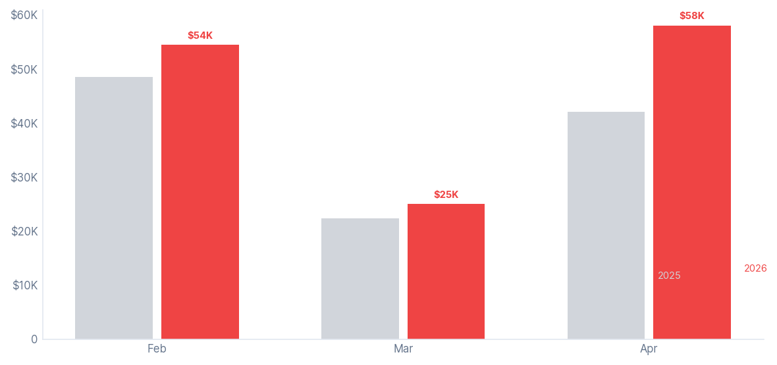
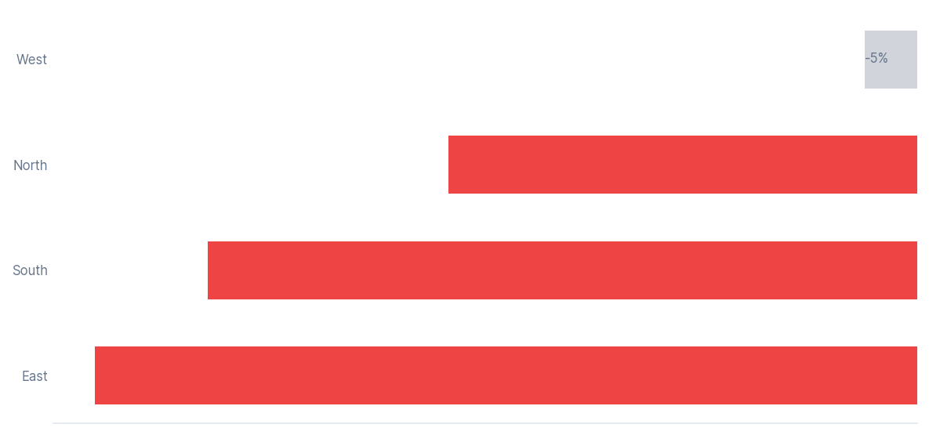
Root Cause #1 | Seasonal Trough
March declined fifty-four percent in both 2025 and 2026, confirming a recurring B2B seasonal pattern
1
2
March declines were nearly identical in both years: -54.0% in 2025 vs -54.1% in 2026, with order counts dropping similarly and April fully rebounding each time. The repeated pattern confirms a structural seasonal effect rather than a one-off event.
The March decline was broad-based across regions: North (-45.7%), East (-80.2%), and South (-69.2%) collectively drove 98.9% of the drop, while West remained relatively stable. The cross-region pattern confirms a structural B2B seasonal pause rather than a company-specific issue.
Feb-Mar-Apr pattern repeats in 2025 and 2026 — magnitude identical, recovery confirmed
North, East, South all fell 46–80% in March — geographic breadth rules out internal cause

Slide 9
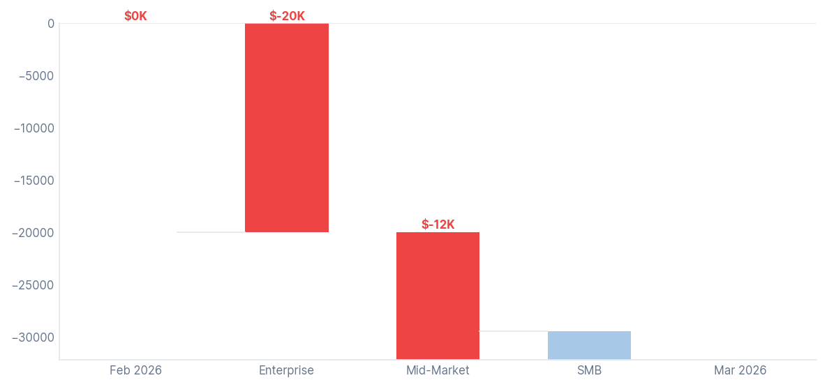
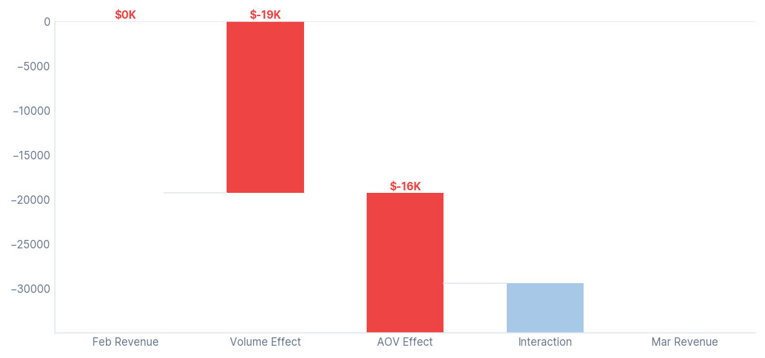
Root Cause #2 | Enterprise Withdrawal
Enterprise fell from 9 to 4 orders in March, driving 68% of the total revenue loss
1
2
The March decline was driven primarily by Enterprise (-86.4%) and Mid-Market (-66.2%), which together contributed over 100% of the total revenue drop. In contrast, SMB grew +21.3%, partially offsetting the decline and masking the severity of the upper-segment slowdown.
The March decline was driven mainly by an order-count shortfall, with 11 fewer orders explaining 66% of the revenue drop. The missing orders were disproportionately high-value Enterprise and Platform deals, while higher discounting had minimal impact.
Enterprise and Mid-Market pulled out $32.2K; SMB added $2.7K back — net drop $29.4K
Volume shortfall (66%) and AOV compression (34%) fully account for the $29.4K March drop

Slide 10
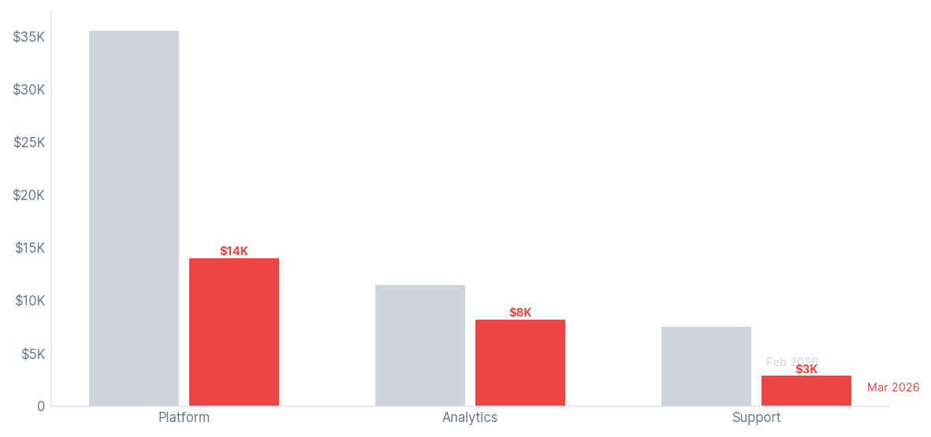
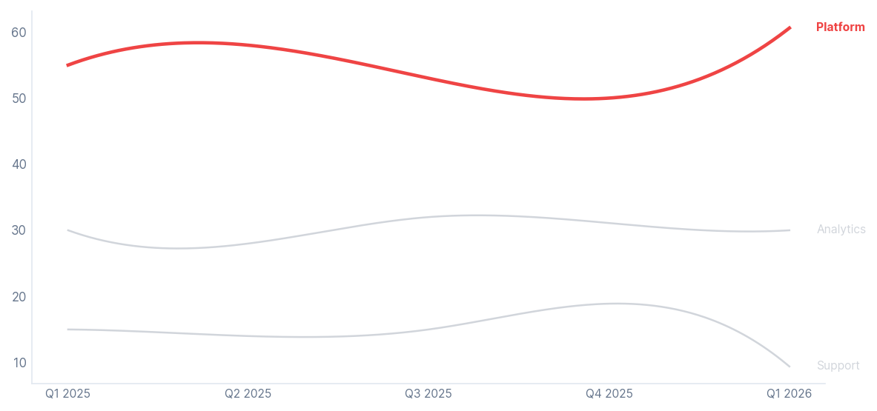
Root Cause #3 | Platform Concentration
Platform drove 73% of March's decline, while the same product powering Q1 also amplified the seasonal trough
1
2
Platform drove 73.2% of the March revenue decline, falling -60.6% as both order volume and AOV weakened. While all product lines declined, the scale of Platform's revenue share amplified the overall seasonal downturn.
Platform concentration is accelerating — rising from 55% of revenue in Q1 2025 to 60.6% in Q1 2026. The same dynamic driving Platform's growth also amplifies downside risk, making it the largest risk factor for Q3 2026 performance.
Platform collapsed from $35.5K to $14.0K in March — drove nearly three-quarters of the drop
Platform share rose from 50% in Q4 2025 to 61% in Q1 2026 — concentration accelerating

Slide 11
Findings | Hypotheses Tested
Three competing explanations were tested and rejected through data-backed evidence
01
02
03
Discounts: Rejected
Churn: Rejected
Discount Pull-Forward: Rejected
The hypothesis Higher discount rates drove the March revenue drop.
The evidence Discount rate rose only +2.3pp, with revenue impact of just -$682, representing 2.3% of the total $29,430 drop.
The verdict The higher discount rate reflects an SMB order mix shift, not price cuts. Negligible as a root cause.
The hypothesis Customer churn drove the reduction in March order volume.
The evidence March 2026 churn rate was 0.200, the second-lowest ever recorded. Q1 2026 average churn improved from 0.381 in Q4 to 0.159.
The verdict Churn affected AOV slightly but had no meaningful impact on order volume.
The hypothesis Q1 growth was manufactured by pulling demand forward through heavy discounting.
The evidence Q4 discount rate was 13.6% vs Q1 at 14.0%, essentially flat. Q1 volume grew by 19 net new orders and AOV rose from $1,404 to $1,545.
The verdict No pull-forward detected. Q1 growth reflects genuine demand, not a pricing artifact.
→ Rejected: explains 2% of drop only
→ Rejected: explains 5% of AOV effect only
→ Rejected: Q1 growth is real, not manufactured

Slide 12
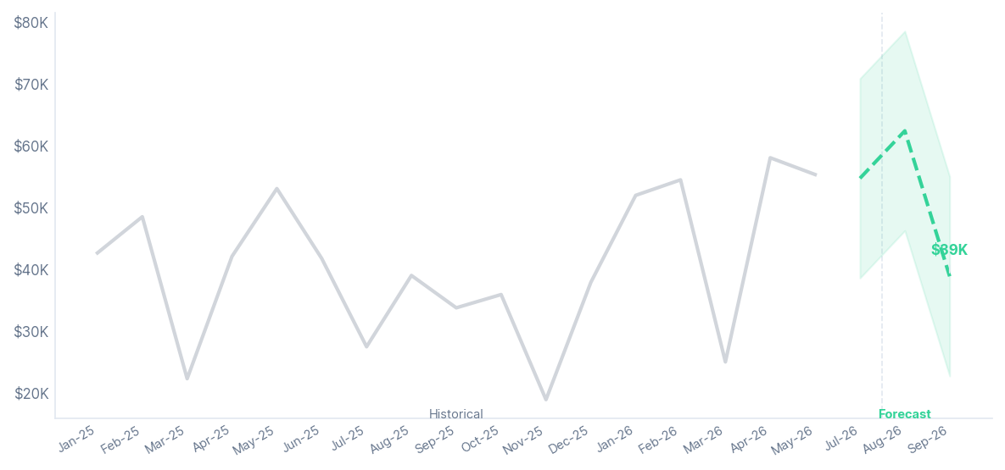
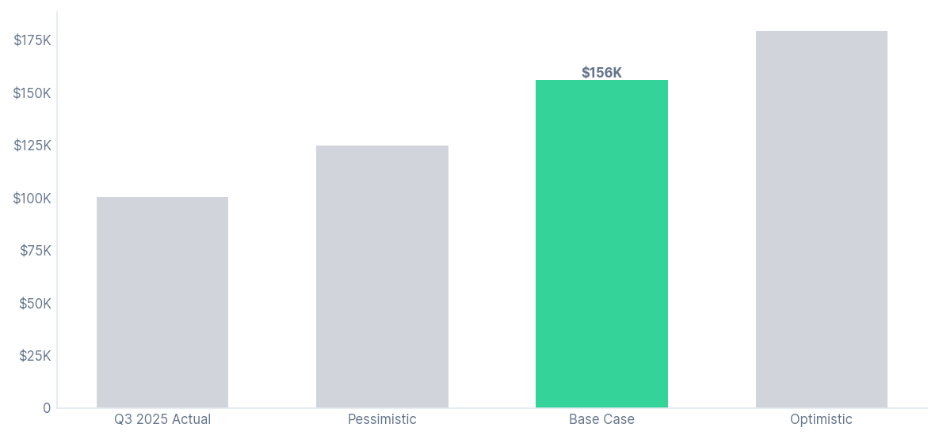
Predict | Q3 2026 Forecast
Q3 2026 base forecast is $155,869, up 56% YoY, with outcomes ranging from $125K to $179K
1
2
The Holt-Winters forecast projects Q3 2026 at $155.9K (+55.6% YoY vs Q3 2025), with August expected to be the peak month before a softer September. The outlook assumes continued North region strength and sustained Platform growth momentum.
The forecast carries meaningful uncertainty, with July 2026's 95% confidence interval ranging from $38.6K to $70.8K. Given the limited 17-month training history, projections should be treated as directional, with downside risk tied to weaker North or Platform performance.
Q3 2026 forecast: $155.9K base — Jul $54.7K, Aug $62.3K, Sep $38.8K
Base $155.9K sits between pessimistic $124.7K and optimistic $179.3K — North/Platform are the swing

Slide 13
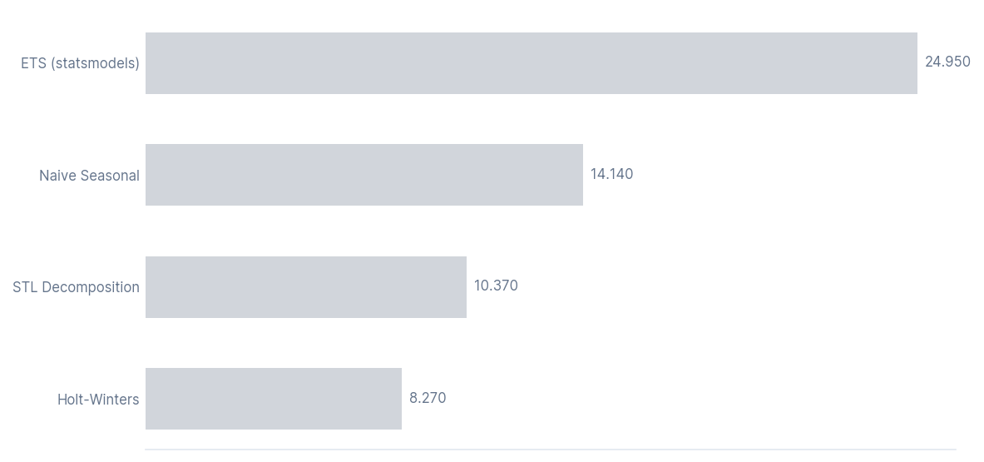
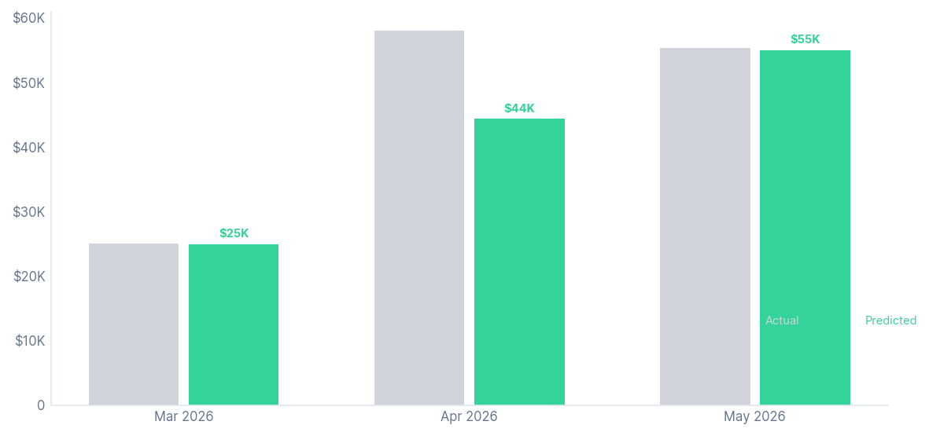
Predict | Model Validation
Holt-Winters outperformed all three competing models, beating the naive seasonal baseline by 42%
1
2
Among four forecasting models tested on the Mar-May 2026 holdout, Holt-Winters performed best with 8.3% MAPE, outperforming STL (10.4%), the seasonal baseline (14.1%), and ETS (24.9%). Its stronger accuracy indicates it captured the B2B seasonal pattern most effectively.
The winning model predicted March 2026 and May 2026 with near-perfect accuracy, but underestimated April's sharp rebound by 24%. The model is most reliable during seasonal troughs and stable periods, while sudden recovery spikes carry higher uncertainty.
Holt-Winters MAPE 8.3% — 42% improvement over naive seasonal, 67% better than ETS
March and May near-exact; April recovery spike harder to call — inherent in V-shape uncertainty

Slide 14
Conclusions | Key Takeouts
Three conclusions: March seasonality is predictable, concentration risk is manageable, and Q3 outlook is strong but conditional
01
March: Plan for It
02
Concentration: Watch It
03
Q3: Base Case Is Strong
The pattern is structural March's -54% decline is confirmed across two consecutive years, making it predictable and plannable.
The action Front-load Enterprise deals into Jan-Feb, where each order averages $2,569 in protected revenue.
The recovery signal April consistently rebounds, indicating March reflects deferred demand rather than lost revenue.
The risk North and Platform drove 86% of Q1 growth, highlighting dangerously concentrated recovery dynamics.
The gap East and West declined, reinforcing the need for stronger regional diversification before Q3.
The warning sign Support fell -30% QoQ, signaling growing product-line risk that needs to be addressed mid-term.
The forecast Q3 2026 base case of $155.9K, representing +56% YoY vs Q3 2025.
The range Forecast spans from $124.7K downside to $179.3K upside, a $54K gap driven by execution.
The swing factors Platform and North remain the two primary variables determining which scenario unfolds.
Act now: Jan-Feb window is the only defense
Mid-term: diversify before concentration bites
Monitor monthly: alert if >30% miss or North < 25%

Slide 15
Action | Three-Phase Roadmap
Three-phase roadmap: stabilize March risk, diversify growth by Q3, and monitor forecasts monthly
01
Defend March (30 days)
02
Diversify Growth (90 days)
03
Monitor Q3 Monthly
The target Front-load $20K+ committed Enterprise in Jan-Feb to buffer against March's structural -54% decline.
The leverage Each Enterprise order averages $2,569, making early deal stacking the strongest revenue cushion available.
The alert If Feb Enterprise pipeline falls below $18K, escalate immediately before the window closes.
The priority accounts Assign AEs to top 5 lapsed accounts in East and West, the fastest near-term recovery opportunity after Q1 declines.
The product play Build an upsell roadmap for Analytics and Support, both currently underweighted relative to their potential.
The concentration target Drive Platform share below 55% by end of Q3 to reduce single-product dependency.
The forecast guard Flag any monthly actuals vs forecast variance exceeding 30%, early detection protects the $155.9K base case.
The North signal Trigger a full review if North share drops below 25%, a key Q3 swing factor alongside Platform.
The recalibration trigger If Platform QoQ turns negative, initiate full forecast recalibration immediately without waiting for quarter-end.
Owner: Sales — Jan-Feb window only
Owner: GTM — reduce single-product risk
Owner: Analytics — monthly review cadence

Slide 16
Action | Recommendations
Five specific actions — two immediate with hard deadlines, two strategic, one ongoing
PRIORITY
ACTION
OWNER
TIMELINE
EXPECTED IMPACT
SUCCESS METRIC
P1-Now
Front-load Enterprise pipeline in Jan-Feb 2027: target $20K+ in committed Enterprise orders by Feb 15 to offset March seasonal withdrawal
Sales VP
By Feb 15, 2027
Reduces March 2027 drop by 20-30%
Feb 2027 Enterprise pipeline > $20K committed
P1-Now
Launch monthly forecast vs actuals review: implement variance tracking and trigger model recalibration if any month misses point estimate by more than 30%
Analytics Lead
Live by June 30, 2026
Early Q3 warning system active before July
Monthly variance report delivered by 10th of each month
P2-Next
Assign dedicated AEs to top 5 lapsed accounts in East and West regions; set Q2 2026 recovery target of more than 10% QoQ growth for each region
Sales/GTM
Q2 2026 (by June 30)
East + West combined share rises toward 40%
East + West combined revenue share > 38% in Q2 2026
P2-Next
Build Analytics and Support upsell roadmap with quarterly revenue targets to reduce Platform concentration from 60.6% toward 55% by Q3 2026
Product/Sales
Q3 2026 (by Sep 30)
Platform share below 55% by Q3 2026
Platform revenue share < 55% in Q3 2026
P3-Watch
Monitor North region revenue share monthly; escalate if share drops below 25% or Platform QoQ growth turns negative for two consecutive months
Analytics Lead
Ongoing from June 2026
Q3 concentration risk flagged 4-6 weeks early
North share > 25% and Platform QoQ > 0% each month

Slide 17
Action | Expected Impact
Execute the playbook and Q3 lands near $179K, ignore it and risk $124K
01
Why Front-Load Enterprise
02
Q3 Scenario Range
The core mechanic: Front-loading Enterprise pipeline in Jan–Feb is the highest-leverage near-term action available.
What each deal is worth:
Each additional Enterprise order in February = ~$2,569 in revenue (Feb 2026 Enterprise AOV)
Shifting just 5 Enterprise deals from March to Jan/Feb recovers an estimated $10–$13K of the typical March shortfall
Equivalent to reducing the March drop from -54% toward -38%
Why January matters most: January is the most efficient month to close Enterprise renewals, before the Q1/Q2 planning freeze sets in.
Base case — $155.9K: Assumes North holds above 35% revenue share and Platform QoQ growth stays positive.
Optimistic case — $179.3K (+15%): Requires Mid-Market and North to maintain Q1 2026 pace through Q3.
Pessimistic case — $124.7K (-20%): Models reversion to Q4 2025 growth rates — a realistic downside if Platform normalizes.
The $54K gap between pessimistic and optimistic is the financial stake of the recommended actions.
Early warning triggers:
Monthly miss > 30% vs forecast
North share below 25%
Platform QoQ turning negative

