Slide 1
Image Morphing

Slide 2
Objective:
You will produce a morph animation of your face into another person's face or any object you prefer.
Requirement:
60 frames of animation
a .avi movie

Slide 3
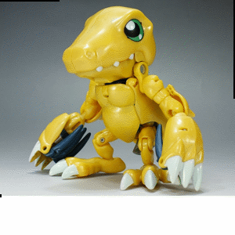
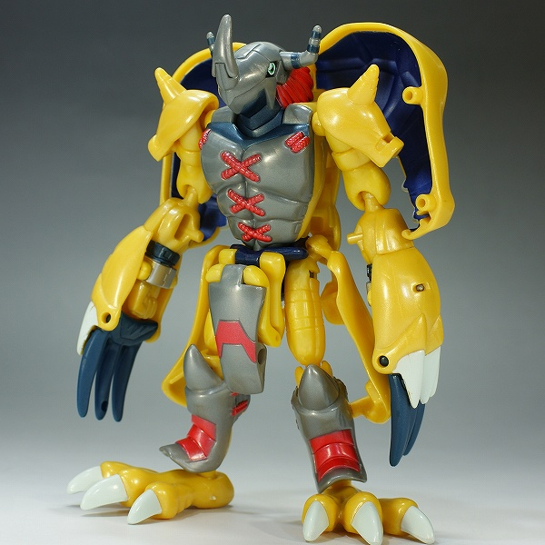
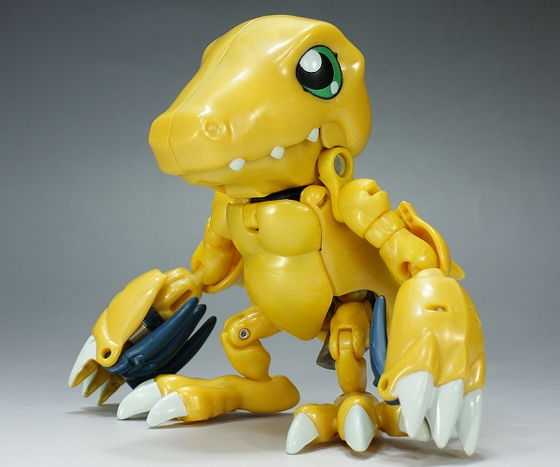
An example….
(you need to morph a face though)

Slide 4
Procedure:
Task 1: get point correspondence
Task 2: morphed_im = morph(im1, im2, im1_pts, im2_pts, tri, warp_frac, dissolve_frac);
Triangulation
Compute intermediate shape for a given warp_frac
Compute the barycentric coordinate for each pixel
Inverse warping
Blending according to dissolve_frac
Task 3: morphed_im = morph_tps_wrapper(im1, im2, im1_pts, im2_pts, warp_frac, dissolve_frac);
1. Compute intermediate control points for a given warp_frac
Compute TPS coefficients
Inverse warping
Blending according to dissolve_frac
Generate video file: use “avifile” in matlab.

Slide 5
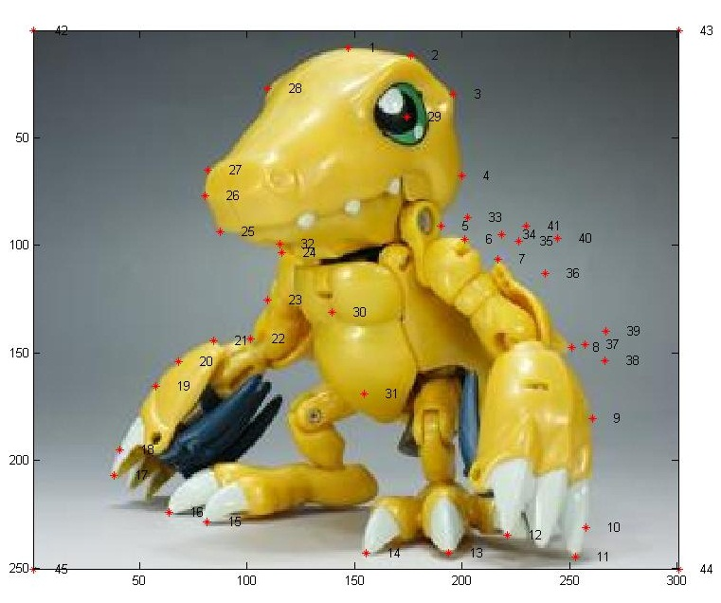
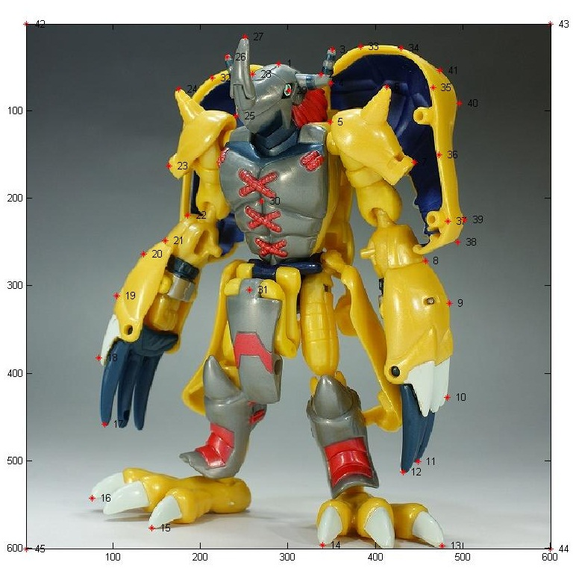
Task 1: get point correspondence
Use “cpselect” tool
Or write your own function with ginput

Slide 6
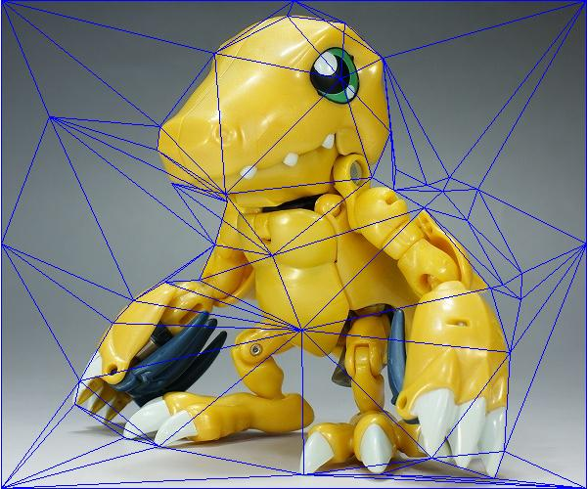
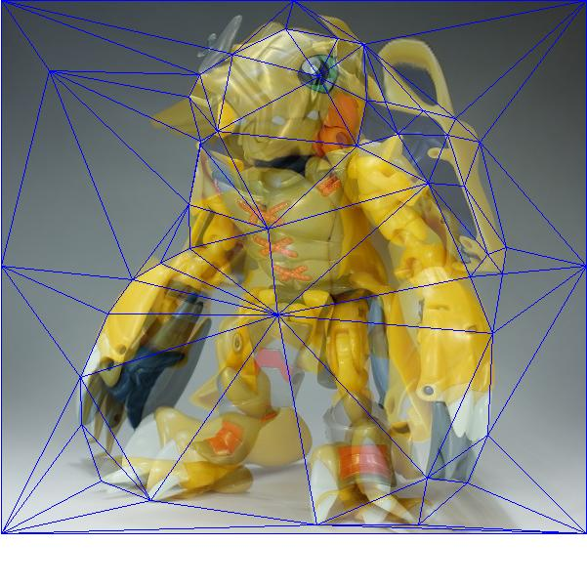
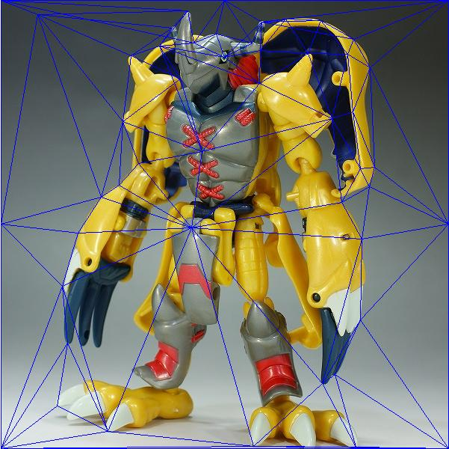
1. triangulation
TRI = delaunay(X,Y);
computing the triangulation at the midway shape (i.e. mean of the two point sets) to lessen the potential triangle deformations

Slide 7
2. Compute intermediate shape for a given warp_frac
impoints = (1-warpFrac)*im1points + warpFrac*im2points;

Slide 8
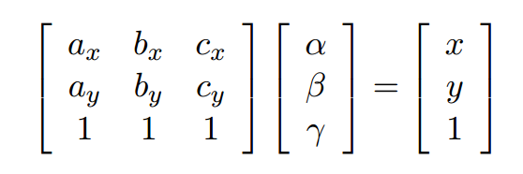
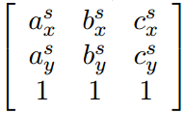



3. Compute the barycentric coordinate for each pixel
Find which traingle a pixel is in:
T = tsearch(X,Y,TRI,XI,YI);
Compute barycentric coordinate:

Slide 9
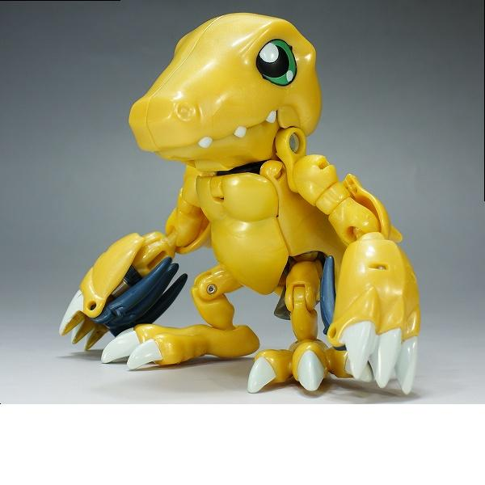
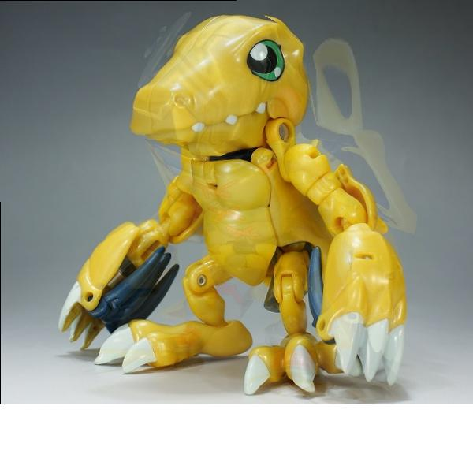
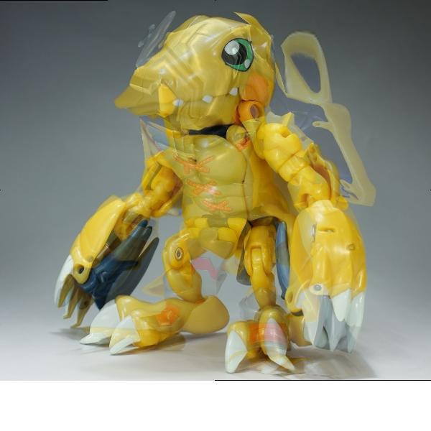

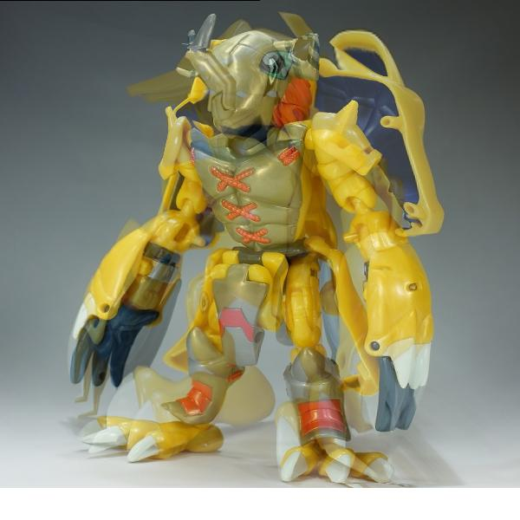
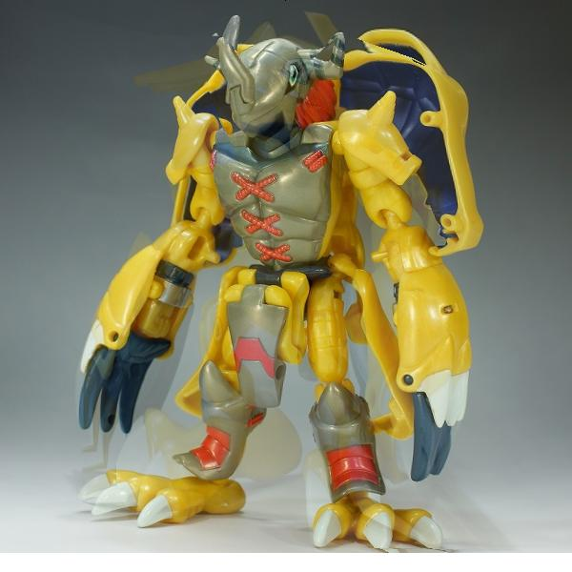
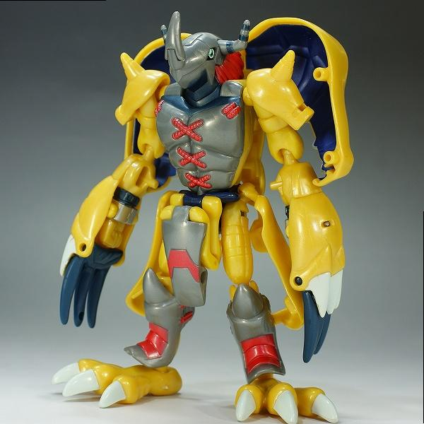
4. Inverse warping
5. Blending according to dissolve_frac
(1-dissolve_frac)*morphed_im1 + dissolve_frac*morphed_im2;

Slide 10
Procedure:
Task 1: get point correspondence
Task 2: morphed_im = morph(im1, im2, im1_pts, im2_pts, tri, warp_frac, dissolve_frac);
Triangulation
Compute intermediate shape for a given warp_frac
Compute the barycentric coordinate for each pixel
Inverse warping
Blending according to dissolve_frac
Task 3: morphed_im = morph_tps_wrapper(im1, im2, im1_pts, im2_pts, warp_frac, dissolve_frac);
1. Compute intermediate control points for a given warp_frac
Compute TPS coefficients
Inverse warping
Blending according to dissolve_frac
Generate video file: use “avifile” in matlab.

Slide 11


Compute TPS coefficients
Compute a set of coefficient for x, and another set for y:
x’ = fx(x,y);
y’ = fy(x,y);

Slide 12
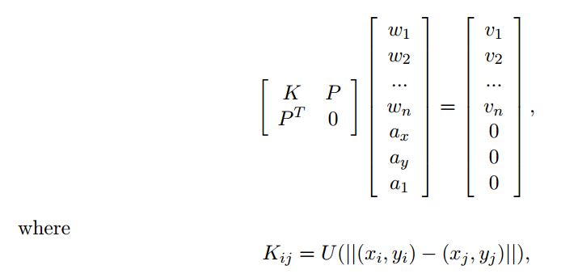
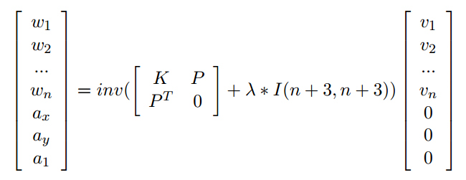
Compute TPS coefficients

