Slide 1

AFA TELECOM COMPANY

Slide 2
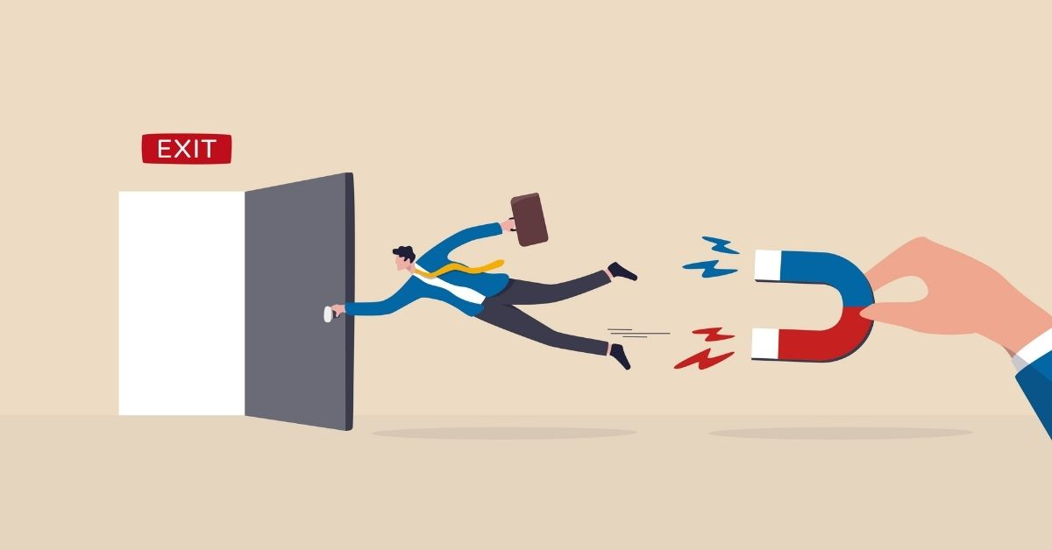
Introduction
Our company needs to improve itself and avoid loss customers, we decided to predict who will leave our company

Slide 3

Our Goal
To find who and why people are churning from our company.

Slide 4
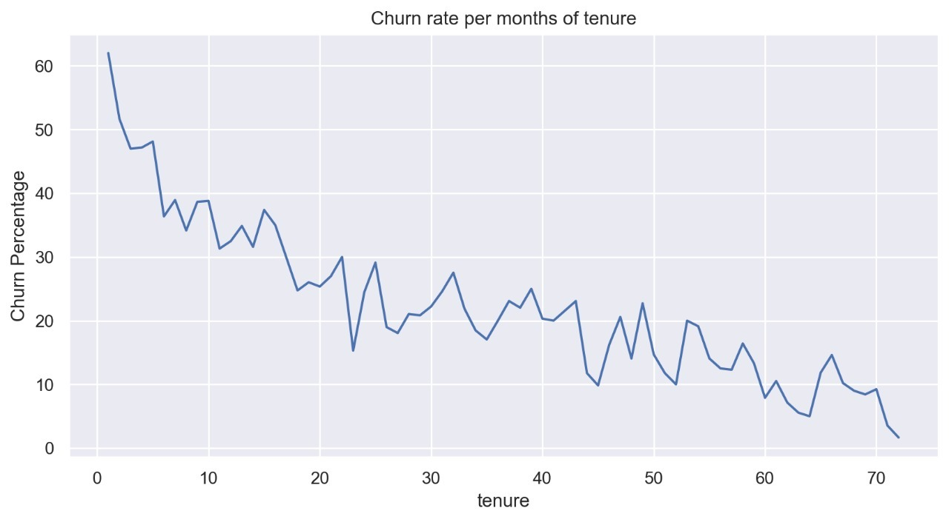
We noticed the most influence for customer churn was contract period
Notes:
As tenure gets longer, customers tends to get stay longer with the service.
We can see a very high Churn Percentage for shot tenure period.

Slide 5

Types of Contract:
Month-to-month
One years
Two year

Slide 6
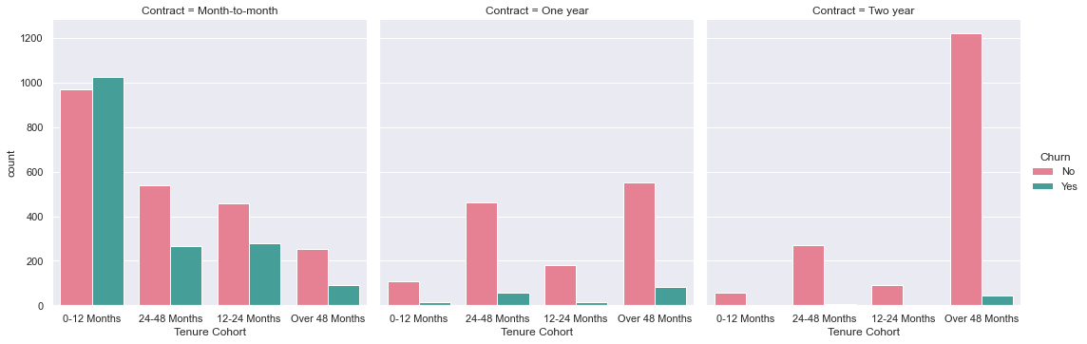
Contract Type And Churn
Notes:
Now we can finally see the seperation of data clearly.
Overall Month-to-Month customers very likely to churn compared to other contract type.
The longer customer stays with the service, the less likely they are churning.
However there are some churning happening for 24-48 Months and Over 48 Months group in Contract One and Two Year. So we need to pay attention for those customers too.

Slide 7
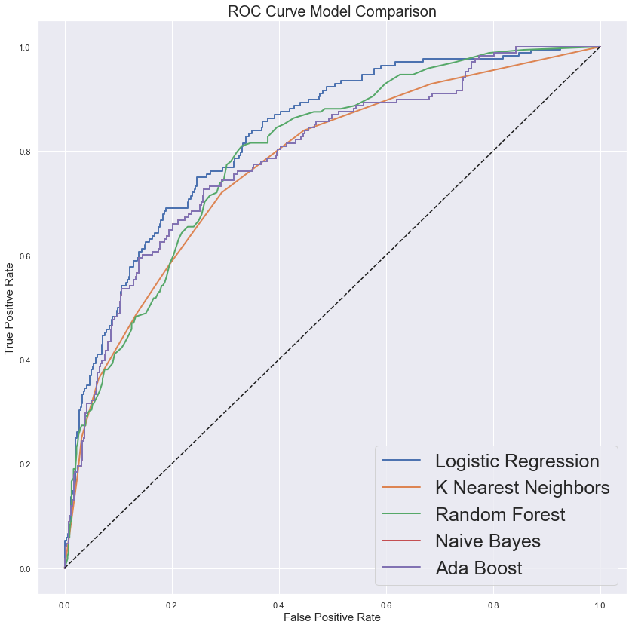

Slide 8
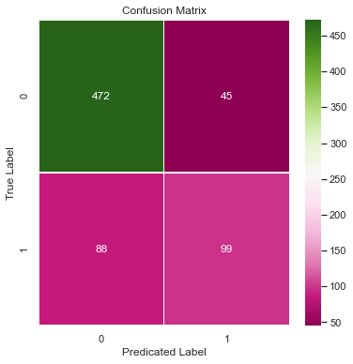
What can we predict?
Accuracy 81%

Slide 9

Conclusion
Attract the customers to stay longer with our company by giving them Promotion and Discount

Slide 10
Thank you!

