Slide 1
AI-POWERED COLLEGE NOTICE ASSISTANT
NOTICE2ACTION
HIGH
Health & Immunization Clearance
From College Notices to
Clear, Personalized Actions.
REQUIRED ACTION
Submit the required documents before the deadline.
An Individual Project by ALAN BAIJU
Working prototype | Python | Streamlit | Groq API
Notes:
SLIDE 1 - COVER (about 20 seconds)
SAY: "Good morning. I'm ALAN BAIJU, and this is Notice2Action: an AI-assisted web app that turns college notices into clear, personalized actions. It is an individual project, and the prototype is already live."
KEY TAKEAWAY: Notice2Action is a working prototype, not just an idea.
TRANSITION: "Before I show the solution, let me show the problem every student already knows."

Slide 2




Notices Arrive From Everywhere
College portals & websites
PDF circulars & official notices
WhatsApp & Telegram groups
Departmental announcements
Scattered notices
Manual reading
Confusion
Deadlines and actions hidden across many sources
Long notices read line by line to check relevance
Missed action opportunities; hard to tell urgent from general
Illustrative everyday scenario. No statistics are claimed.
Notes:
SLIDE 2 - THE EVERYDAY PROBLEM (about 60 seconds)
SAY: "A student gets information from the college portal, PDF circulars, WhatsApp and Telegram groups, and department announcements. The same student then has to read it all, decide what applies to them, and work out what to do. When that goes wrong, it ends in confusion and missed action opportunities."
KEY TAKEAWAY: The problem is relatable. I am not claiming statistics, only describing a familiar everyday scenario.
TRANSITION: "Let me put that into a single problem statement."

Slide 3



The Gap Between Information and Action
THE CORE PROBLEM
WHAT A STUDENT NEEDS TO KNOW
Students receive information, but turning scattered notices into clear, personalized, and actionable tasks requires time and effort.
Does this apply to me?
Relevance to my profile
What must I do?
The challenge is not merely finding notices. It is converting unstructured information into useful decisions and next steps.
Required documents and steps
By when?
Deadlines and priority
Notes:
SLIDE 3 - THE PROBLEM STATEMENT (about 45 seconds)
SAY: "Students do receive information. What they don't receive is clarity. For every notice a student has to ask three questions: does this apply to me, what must I do, and by when? Answering those takes time and effort. So the real challenge is not finding notices, it is converting unstructured information into useful decisions and next steps."
KEY TAKEAWAY: The gap is between receiving information and understanding the required action.
TRANSITION: "Why don't the usual methods close that gap?"

Slide 4


Why Manual Methods Fall Short
Read long PDFs
Find what's relevant
Track deadlines
Work out actions
Lengthy circulars must be read in full to find the key point.
Each notice has to be checked against your own situation.
Dates sit inside paragraphs and are easy to overlook.
Required documents and next steps must be pieced together.
Time goes into interpreting notices, not acting on them.
Notes:
SLIDE 4 - WHY MANUAL METHODS FALL SHORT (about 45 seconds)
SAY: "Doing this by hand means four chores: reading long PDFs, finding what is relevant to you, tracking deadlines buried in paragraphs, and working out the actions. None of these is hard on its own, but together they cost time, and they are repeated for every notice."
KEY TAKEAWAY: The effort is in interpretation, not in access. I am deliberately not criticising any specific existing product.
TRANSITION: "That is exactly the gap Notice2Action is built to close."

Slide 5
Introducing Notice2Action
An AI-assisted web app that turns an uploaded PDF of college notices into structured, student-relevant action cards.
01
02
03
04
Scattered information
Structured understanding
Personalized relevance
Clear next steps
Notices inside a PDF
Titles, deadlines, actions
Matched to the student profile
Priority and required action
Focus: move from information to action.
Current workflow: upload a PDF. WhatsApp, Telegram and portal integrations are future possibilities only.
Notes:
SLIDE 5 - INTRODUCING NOTICE2ACTION (about 45 seconds)
SAY: "Notice2Action takes scattered information and gives the student structured understanding, personalized relevance, and clear next steps. The focus is on moving from information to action."
HONESTY POINT: "To be clear, today's workflow is based on uploading a PDF. It does not read WhatsApp, Telegram or the college portal automatically; those are future possibilities."
TRANSITION: "Here is how it works from the student's point of view."

Slide 6





How It Works
STEP 1
STEP 2
STEP 3
STEP 4
STEP 5
Set profile
Upload PDF
Analyze
Review cards
Take action
Review the student profile used for matching.
Add a PDF containing multiple college notices.
Text is extracted, split and analyzed.
Each notice appears as a structured card.
Know what applies, what to do and when.
Everything starts from one uploaded PDF.
Notes:
SLIDE 6 - HOW IT WORKS (about 45 seconds)
SAY: "Five simple steps. Review the student profile. Upload a PDF with multiple notices. The app analyzes it. The student reviews the notice cards. Then takes action, knowing what applies, what to do and when."
KEY TAKEAWAY: From the student's side it is simple: profile, upload, review.
TRANSITION: "Now let me open the hood and show what happens in the 'Analyze' step."

Slide 7
System Architecture
1
Input
Student uploads a PDF containing college notices
User action
2
PDF text extraction
PyMuPDF extracts readable text from the PDF
PyMuPDF
3
Notice segmentation
Python separates the text into individual notices
Python
4
Extraction & AI analysis
A Groq-hosted language model helps analyze notice content into structured details
Groq LLM + Python
5
Validation & relevance
Python logic checks details, matches the student profile and assigns priority
Python rules
6
Student dashboard
Streamlit shows structured notice cards with required actions
Streamlit
AI-assisted language understanding
Conventional Python processing and rules
A hybrid approach
Notes:
SLIDE 7 - SYSTEM ARCHITECTURE (about 90 seconds)
SAY: "Six stages. 1) The student uploads a PDF. 2) PyMuPDF extracts the readable text. 3) Python splits that text into individual notices. 4) A Groq-hosted large language model helps analyze each notice and produce structured details. 5) Python logic then validates the available details, matches them against the student profile and assigns priority. 6) Streamlit presents the result as notice cards."
KEY POINT: Only one stage is AI-assisted (highlighted in cyan). The rest is conventional Python processing, so the language model does not decide every result.
TECHNICAL NOTES (for questions): It uses a hosted model through the Groq API. There is no custom-trained model, no vector database, no embeddings or RAG pipeline, and no autonomous agents. It is not guaranteed to be perfectly accurate, so details should be verified against the original notice.
TRANSITION: "Let me show how profile matching and priority help the student."

Slide 8
Personalization and Prioritization
Profile-based relevance
Priority indicators
Student profile
Health & immunization clearance
HIGH
Documents are due before a deadline
Each notice compared
Career & internship fair; literary magazine submissions
MEDIUM
Preparation or submission needed
Relevant notices surface
Campus parking notice
LOW
Python logic matches notice details against the student's profile.
Awareness; use the alternative area
Priority levels are shown as displayed in the prototype. The app does not learn student behavior or use advanced personalization models.
Notes:
SLIDE 8 - PERSONALIZATION AND PRIORITIZATION (about 60 seconds)
SAY: "Two ideas make the output useful. First, relevance: the notices are compared against the student's profile so the relevant ones surface. Second, priority: each notice carries a priority level. In the examples, the health and immunization clearance is High because documents are due before a deadline, the career fair and literary magazine submissions are Medium, and the parking notice is Low."
HONESTY POINT: This is profile matching plus priority labels. The app does not learn a student's behavior and does not use advanced personalization models.
BEFORE PRESENTING: Confirm which profile fields your app actually offers and say exactly those out loud.
TRANSITION: "Let me show you what it looks like."

Slide 9

The User Interface
SCREENSHOT PLACEHOLDER
SCREENSHOT PLACEHOLDER
Replace with a real capture from the live app
Replace with a real capture from the live app
Screenshot 1: Profile controls and PDF upload
Screenshot 2: Notice cards with priority and actions
1
Profile controls
2
Upload area
3
Notice cards
4
Priority & required action
Notes:
SLIDE 9 - THE USER INTERFACE (about 45 seconds)
ACTION BEFORE PRESENTING: Replace both placeholders with real screenshots from the deployed app. Then add numbered markers 1-4 on the screenshot for: profile controls, upload area, notice cards, and priority plus required action.
SAY: "The interface is a simple Streamlit page. On the left, the profile controls and the PDF upload area. On the right, the result: notice cards showing priority and required action."
TRANSITION: "Here is what that transformation looks like for real example notices."

Slide 10
From Raw Notice to Clear Action
RAW NOTICE TEXT
RAW NOTICE TEXT
RAW NOTICE TEXT
HIGH
MEDIUM
LOW
Health & Immunization Clearance
Career & Internship Fair
Campus Parking Notice
REQUIRED ACTION
REQUIRED ACTION
REQUIRED ACTION
Submit the required documentation before the deadline.
Pre-register, prepare resumes, and attend appropriately.
Avoid the specified lot after the stated time.
Deadline: as stated in the notice
Event details and preparation shown together
Alternative: use an authorized parking area
Illustrative examples of the kind of information the prototype processes. Not independently verified college announcements, and not performance measurements.
Notes:
SLIDE 10 - REAL EXAMPLES (about 60 seconds)
SAY: "Here are three example notices of the type the prototype handles. A long block of notice text becomes a card with a priority and a required action. The health and immunization clearance is High: submit the documents before the deadline, which is exactly the kind of deadline and consequence worth surfacing. The career fair is Medium: pre-register, prepare resumes, attend. The parking notice is Low: avoid the lot after the stated time and use an authorized alternative."
EXTRA EXAMPLE (if asked): A literary magazine submissions notice, Medium priority, submit content through the stated channel before the deadline.
HONESTY POINT: These are illustrative examples, not verified real announcements, and not proof of measured performance. If your app's cards show a relevant student group or submission channel, add those fields here exactly as the app displays them.
TRANSITION: "Better than slides, you can try it yourself right now."

Slide 11
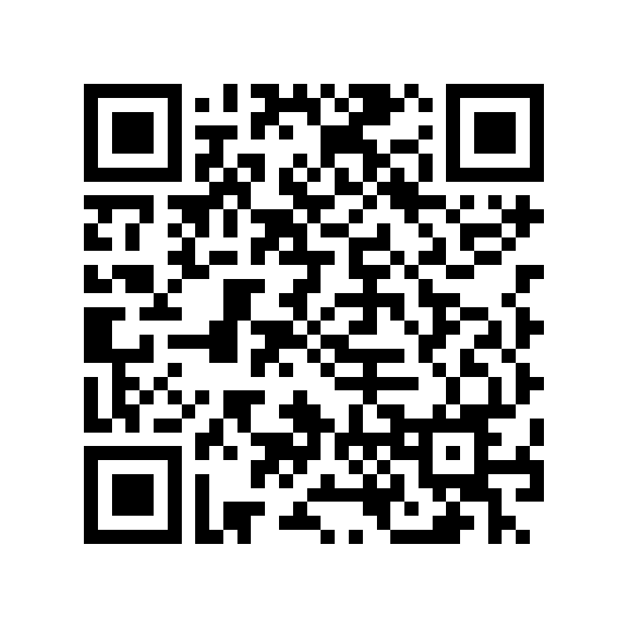
The Prototype Is Live
LIVE WEB APP
https://notice2action-ppdndd9hck3vpiskvwn3oy.streamlit.app/
Hosted on Streamlit. Opens in any browser. Upload a PDF of college notices.
Open the prototype
Scan to open
1
2
3
4
5
6
Open the site
Review the profile
Upload a sample PDF
Let it process
Review the cards
Read priority and actions
Notes:
SLIDE 11 - THE PROTOTYPE IS LIVE (about 90 seconds live demo)
SAY: "This is not a mockup. The prototype is deployed. You can open it from the link or scan the QR code."
LIVE DEMO SCRIPT (60-90 seconds):
1. (0:00) Open the deployed website. Say: "This is the live app."
2. (0:10) Point out the student profile controls. Say: "First, the student profile, which the notices are matched against."
3. (0:20) Upload the prepared sample PDF containing multiple notices. Say: "One PDF, several notices."
4. (0:30) Wait while it processes. Say: "PyMuPDF extracts the text, Python splits it into notices, the language model helps analyze them, and Python rules handle relevance and priority."
5. (0:45) Scroll through the notice cards. Say: "Each notice is now a card."
6. (1:00) Point at one High and one Low card. Say: "Priority, deadline and required action are visible at a glance, with no need to read the whole PDF."
7. (1:15) Close: "Everything here came from a single uploaded PDF."
BACKUP PLAN: Streamlit apps can go to sleep when idle, so open the link a few minutes before presenting. Keep a screen recording or screenshots as a fallback in case the network fails.
TRANSITION: "Now a quick look at the technology behind it."

Slide 12




Technology Stack
Python
Streamlit
PyMuPDF
Groq API
Python rules
Core language for segmentation, matching and priority logic.
Web interface for profile input, PDF upload and notice cards.
Extracts readable text from the uploaded PDF.
Hosted language-model inference that helps analyze notice content.
Conventional checks for relevance and priority.
Hosted LLM through the Groq API. No custom-trained model, no vector database, no RAG pipeline.
Notes:
SLIDE 12 - TECHNOLOGY STACK (about 45 seconds)
SAY: "Python is the core: segmentation, matching and priority logic. Streamlit provides the web interface. PyMuPDF extracts text from the PDF. The Groq API provides hosted language-model inference to help analyze notice content. And Python rules handle relevance and priority."
KEY POINT: A hosted model is used. No custom-trained model, no vector database, no RAG pipeline.
IF ASKED 'Why Groq?': Hosted inference keeps the app lightweight and responsive for a prototype. Confirm your own reason before presenting.
TRANSITION: "Let me be transparent about what works today and what does not."

Slide 13


Capabilities and Limitations
Implemented today
Current limitations
Accepts an uploaded PDF of college notices
Needs a PDF upload; no automatic WhatsApp, Telegram or portal reading
Extracts text and splits it into individual notices
Extracted and AI-generated details should be verified against the original notice
Uses AI to help extract structured details
Results depend on readable text in the PDF
Matches notices against the student profile
No formal accuracy evaluation yet
Assigns priority levels
A working prototype, not production-ready
Shows structured cards with required actions
Notes:
SLIDE 13 - CAPABILITIES AND LIMITATIONS (about 60 seconds)
SAY: "Here is what is implemented: PDF upload, text extraction, splitting into notices, AI-assisted extraction of details, profile matching, priority levels, and structured cards. And here is what is not: it needs a PDF, it does not read WhatsApp, Telegram or portals automatically, extracted and AI-generated details should be verified against the original notice, results depend on readable text in the PDF, there is no formal accuracy evaluation yet, and it is a prototype, not a production system."
KEY TAKEAWAY: Being upfront about limits makes the project more credible.
TRANSITION: "So where could it go next?"

Slide 14





Future Scope
POSSIBLE FUTURE DIRECTIONS, NOT CURRENT FEATURES
Automated ingestion
Calendar & reminders
More formats
Better validation
Easier profiles
Pull notices from approved college sources.
Add deadlines to a calendar with reminders.
Support document types beyond PDF.
Stronger extraction checks and formal evaluation.
More convenient student-profile management.
Each item is a possibility for later versions. None is implemented in the current prototype.
Notes:
SLIDE 14 - FUTURE SCOPE (about 45 seconds)
SAY: "These are possibilities, not features: automated notice ingestion from approved college sources, calendar integration with deadline reminders, more document formats, stronger extraction validation and formal evaluation, and more convenient profile management."
KEY POINT: The dashed outlines signal that none of these exists yet.
TRANSITION: "To close..."

Slide 15
Less time interpreting notices. More clarity about what to do next.
NOTICE2ACTION
Developed by ALAN BAIJU
LIVE PROTOTYPE
https://notice2action-ppdndd9hck3vpiskvwn3oy.streamlit.app/
Scan to try it
Notes:
SLIDE 15 - CLOSING (about 20 seconds)
SAY: "College notices should not stop at delivering information. Students need to understand what applies to them, what action is required, and when they must act. Notice2Action is a working step in that direction: less time interpreting notices, more clarity about what to do next. The prototype is live, so please try it. Thank you. I'm happy to take questions."
LIKELY QUESTIONS:
- How accurate is it? "There is no formal evaluation yet, so I recommend verifying details against the original notice."
- Does it use a custom model? "No. It uses a hosted model through the Groq API combined with Python logic."
- Does it read WhatsApp or the portal? "Not today. Currently it works from an uploaded PDF. Automatic ingestion is future scope."

